Slide 1
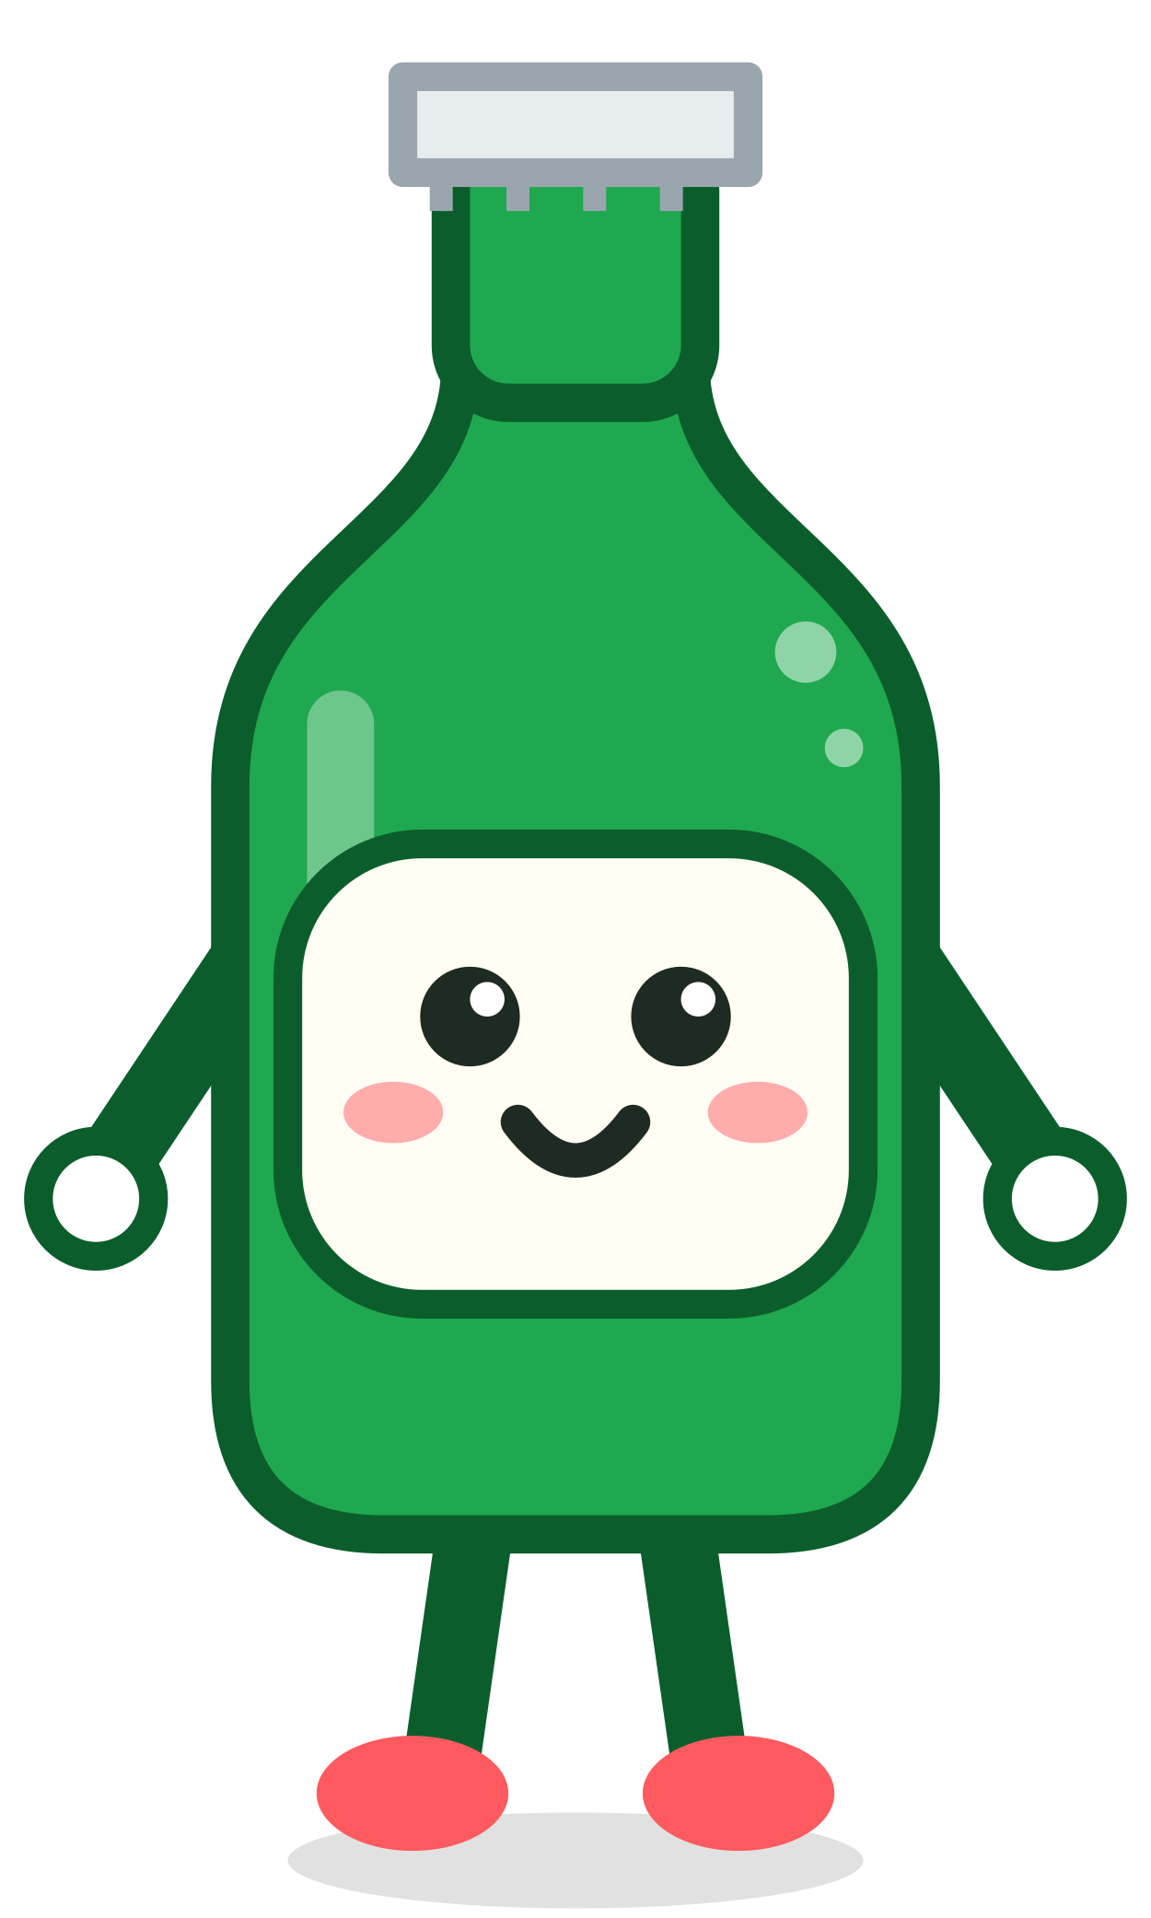
Retention Copilot: Hoppy plans the visits that save accounts
Four questions: why the rep’s trip · what the data really says · how each visit is planned · which data makes it smarter next.
Meet Hoppy, the rep’s co-pilot
Notes:
Reps manage hundreds of accounts and notice churn too late. Hoppy turns the order data into a planned, approved, well-briefed visit. Four questions in four slides.

Slide 2
1 · We focus on the rep’s trip, where saves happen
Keeping accounts is the core of the problem, and rep time is its scarcest input
1
2
3
1 rep : hundreds of outlets
The visit is the moment of truth
So we equip the whole trip
A rep sees each account only a few times a year. Time, not data, is the bottleneck.
Saves are decided face to face. A late or unprepared visit is a lost account.
Who to visit, in which order, with which approved offer and what to say — ready 3 days before.
Built to be used on the road. Drive mode shows only the next destination and the task; voice briefings and one-tap navigation keep eyes on the road. Accounts that don’t need the car get a Hoppy call or a care note.
Notes:
Why this scenario: the brief says the action layer matters most. And we built for real use on the road: drive mode shows one destination and one task, with voice briefing and navigation, so the rep never has to read while driving. Rep visits are the scarcest and most decisive resource, so we design around the trip: plan, brief, visit, log.

Slide 3
2 · Watch the order rhythm, not the complaints
Churn = an active account (≥5 orders) places no order in the next 90 days · back-test on 5,088 accounts
We assumed: Unhappy reviewers are the ones who leave.
Data says: Complainers who keep ordering churn less than average (23.7% vs 28.5%). Silent decliners are the danger (37.1%).
We assumed: A low month means risk.
Data says: Only a break from the account’s own rhythm matters: ≥2× its usual gap → 39% churn.
Tested on months it never saw
Trained to Feb 2018, predicted Jun–Aug: AUC 0.72; top 10% → 57% really churned.
The 90-day definition fits today’s data. With more data we will map the full paths accounts take to churn, and re-weight monthly.
Notes:
Two surprises. First, complaints are not a churn signal on their own: busy accounts simply have more orders to complain about. Second, a bad month is not risk; breaking your own rhythm is. The score is validated on unseen months and re-weighted every month.

Slide 4
3 · Who gets a visit, and when Hoppy plans it
Priority = P(churn) × last-12-month spend · only while saveable (last order ≤ 120 days)
Channel | Priority | Rule | # | Action
🚗 Rep visit | P1 · visit now | Top 40 by priority | 40 | Visit + offer
 | P2 · this week | Next 80 | 80 | Visit if on route
🤖 Hoppy, remote | P3 · win-back call | Silent > 120 days | 101 | AI call + offer
 | P4 · care note | Complained, stable orders | 197 | Note + small gift
 | P5 · monitor | Everything else | 682 | Re-score weekly
Planned 3 days ahead so approvals arrive in time
T-3
Hoppy proposes visits + best offer per account
T-2
Rep confirms; GM-level offers submitted
T-1
Manager / GM approvals land
🗺️ Route: P1 always before P2; inside each group nearest-first + 2-opt. Demo day: 42.5 km vs 57.0 km in risk order (−26%).
Visit
Route, 30-sec audio briefing, talk track, log
P4 is the small, inclusive gesture: complainers whose orders are stable get a personal note — not the rep’s time.
Approval time: Rep instant · Manager 1 day · GM 2 days
Levels and permissions are simulated in the demo.
Notes:
Route: we never let geography override priority, every P1 comes before any P2. Inside each group Hoppy orders stops nearest-first and then improves the order with 2-opt; on the demo day that is 42.5 km instead of 57 km in plain risk order, and a brute-force check confirms it is the shortest order for those six stops. Next step: opening hours and live traffic. One numbering, two channels: P1 and P2 are worth the car, P3 to P5 Hoppy handles remotely. Because manager and GM approvals take one to two days, Hoppy prepares the plan three days before the visit.

Slide 5
3 · Which offer: each option scored alone, best one wins
Expected profit = Revenue at risk × Save-lift × Margin (35%) − Offer cost
Example A01216: spend R$ 2,541/yr × churn risk 62% = R$ 1,575 revenue at risk (same for every option)
Option (pick one) | Offer | ① Save-lift | ② Revenue kept 1,575 × ① | ③ Profit kept ② × 35% | ④ Cost | Expected ③ − ④
Tier 1 · Rep | Service fix + trial case + POS kit | 15% | R$ 236 | R$ 83 | − R$ 25 | R$ 58
Tier 2 · Manager | Bundle or pizza-partner combo; 5% off the next order | 30% | R$ 473 | R$ 166 | − R$ 102 | R$ 63
Tier 3 · GM ⭐ | Co-branded event, cooler, loyalty reward | 60% | R$ 945 | R$ 331 | − R$ 203 | R$ 128
Three alternatives, not a sum
Hoppy compares the rows and recommends one. The rep brings only that offer.
No straight price cuts
Every incentive is tied to the next order, a bundle, a partner brand or brand support.
A model to test, not a promise
Lift, cost and approvals are simulated; we check the model against real results before rollout.
Notes:
Approval levels are simulated; the profit model is a testable estimate that we will check against real results before rollout. Incentives are never straight price cuts: they are tied to the next order, a bundle such as a pizza-partner combo, or brand support. Read one row: of R$1,575 at risk the offer keeps 15%, R$236 of sales; at 35% margin that is R$83 profit; minus R$25 cost gives R$58. Tier 3 wins here because the lapse is deep (4.4× usual gap, +15 points lift). Each tier is its own scenario; we compare, never add.

Slide 6
4 · From saving accounts to building loyalty
Input | Today | Data to add | What improves
P(churn) | Order rhythm, frequency, value | Visit logs, outlet type, competitor activity | Fewer false alarms
Gross margin | Assumed 35% flat | Real SKU margins, cost to serve | Profit, not revenue
Save-lift | Assumed 15 / 30 / 45% | Offer history, A/B tests, visit outcomes | Uplift per account × offer
Offer cost | Assumed % of spend | Actual redemption & promo cost | Exact ROI
Lead time | Assumed 0 / 1 / 2 days | Real approval timestamps | Smarter planning window
Saving accounts is one step. Every outcome flows back so we fix the root cause:
Saved & lost accounts
→
Why did they drift?
→
Fix product, quality, service
→
Brand loyalty
v2 · 0–3 mo · Pilot
2 territories vs control; monthly back-test & re-weighting
v3 · 3–6 mo · Learn
Map churn paths; A/B test offers; uplift model
v4 · 6–12 mo · Scale
Plug into AIDDA; loyalty programme; multi-market
Notes:
Every number we assumed today becomes measured in the pilot: each logged visit outcome is training data. Retention is not the end goal: the reasons saved and lost accounts drifted away flow back to product, quality and service teams, so fewer accounts drift in the first place. The goal is brand loyalty. Success metrics: lower churn in P1/P2 vs control, more saves per visit, every at-risk account gets an action, zero unapproved deals.

