Slide 1
Data Science Jobs and Salaries Analysis
Skills Takeaway: Python coding, Data Pre-processing, Visualization Domain: Recruitment Industry, Job portal, Job Posting
By: Juliet
OESON Learning

Slide 2
Problem Statement
We are presented with a dataset extracted from a renowned job portal, detailing the job status of various data-related positions posted during the year 2023. Our task is to extract meaningful insights from this data to elucidate the actual remuneration each job title offers across the globe. This analysis will aid recruiters in understanding job requirements better, particularly in terms of salaries across different levels of work experience, enabling them to procure proficient profiles for any data-related requirement.

Slide 3
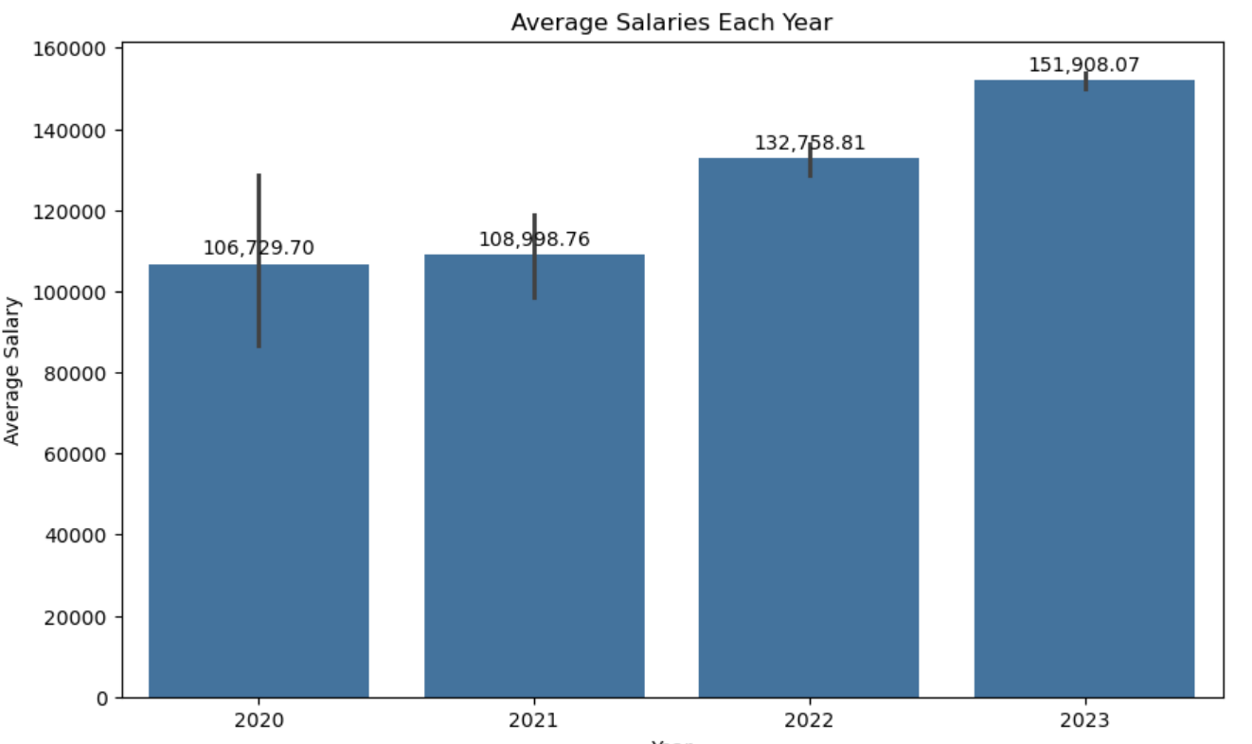
Average Salaries for Each Year
The average salaries showed an upward trend each year, with 2023 recording the highest average salary.

Slide 4
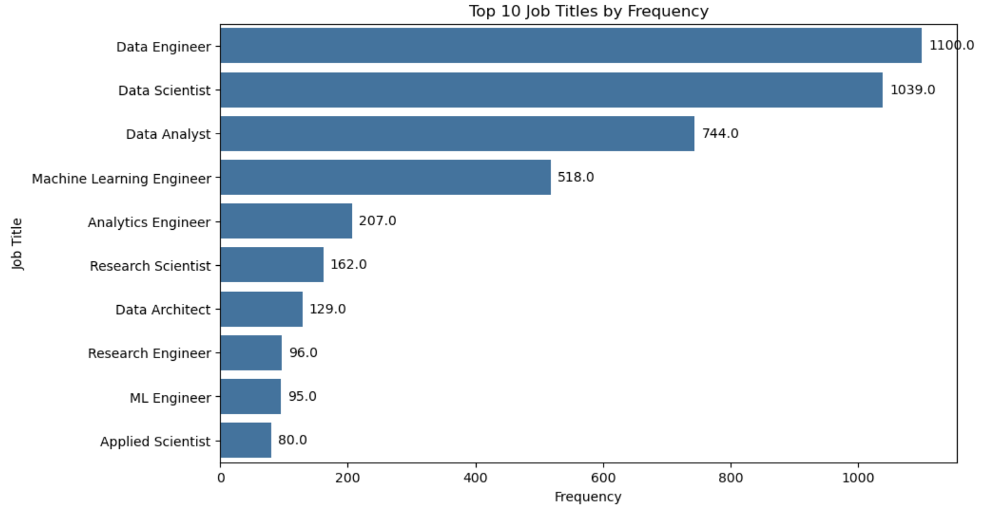
Frequency of Job Titles
The frequency analysis of job titles reveals that "Data Engineer" stands out as the most popular job title, followed closely by "Data Scientist", "Data Analyst", "Machine Learning Engineer", and others in descending order of popularity.

Slide 5
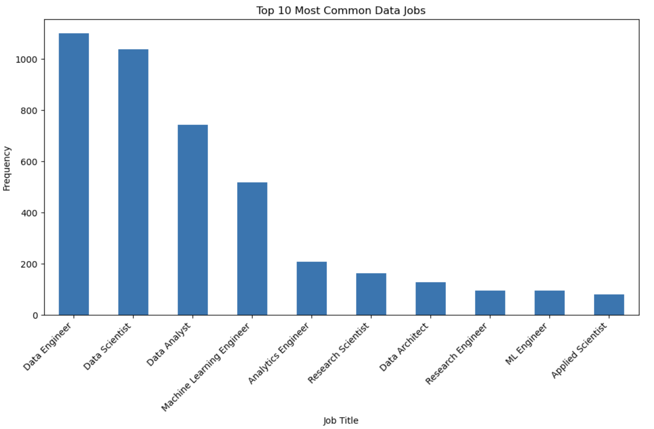
Top 10 Most Common Data Jobs
The plots depict the top 10 most common data-related job titles.

Slide 6
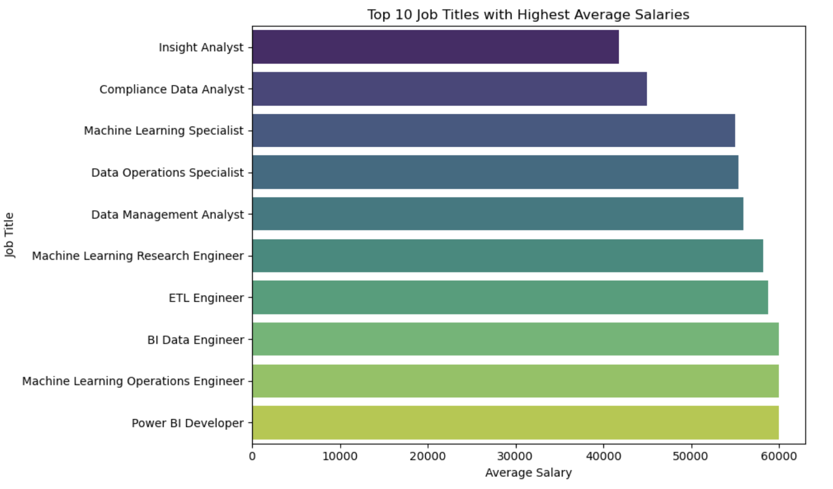
Average salaries by job titles

Slide 7
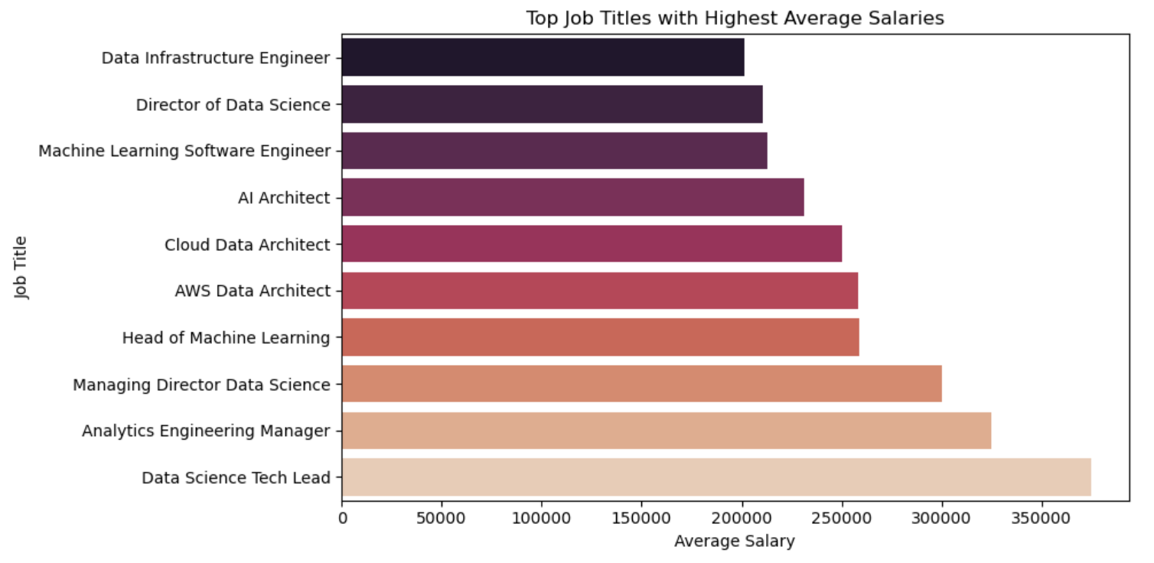
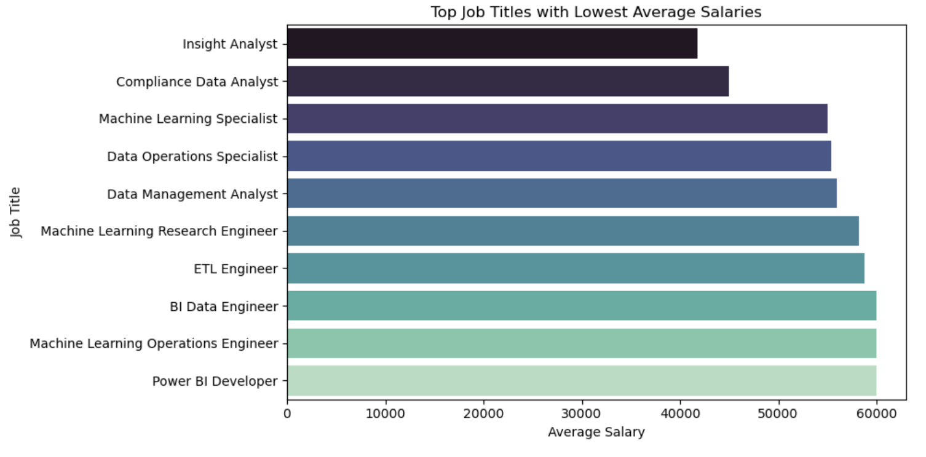
The top job titles with highest average salaries and least average salaries

Slide 8
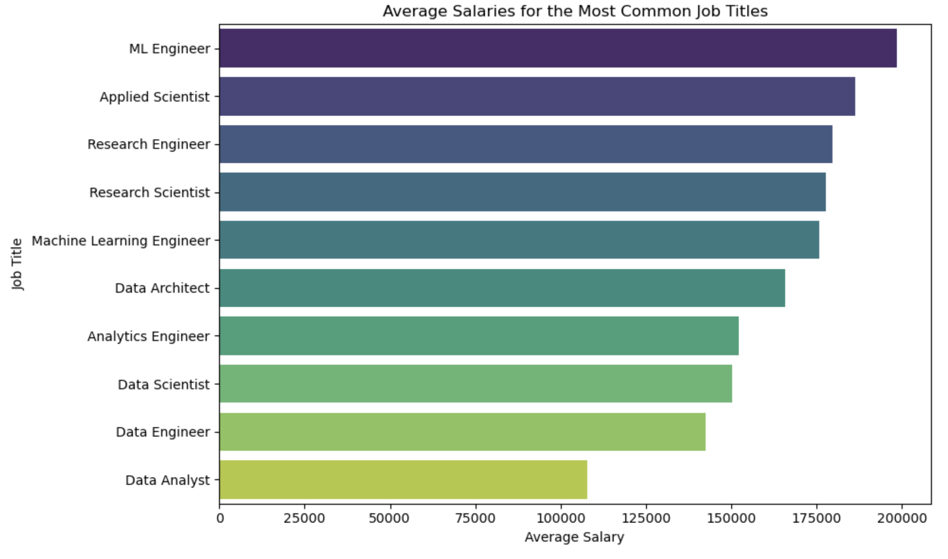
Average Salaries for the most common job titles

Slide 9
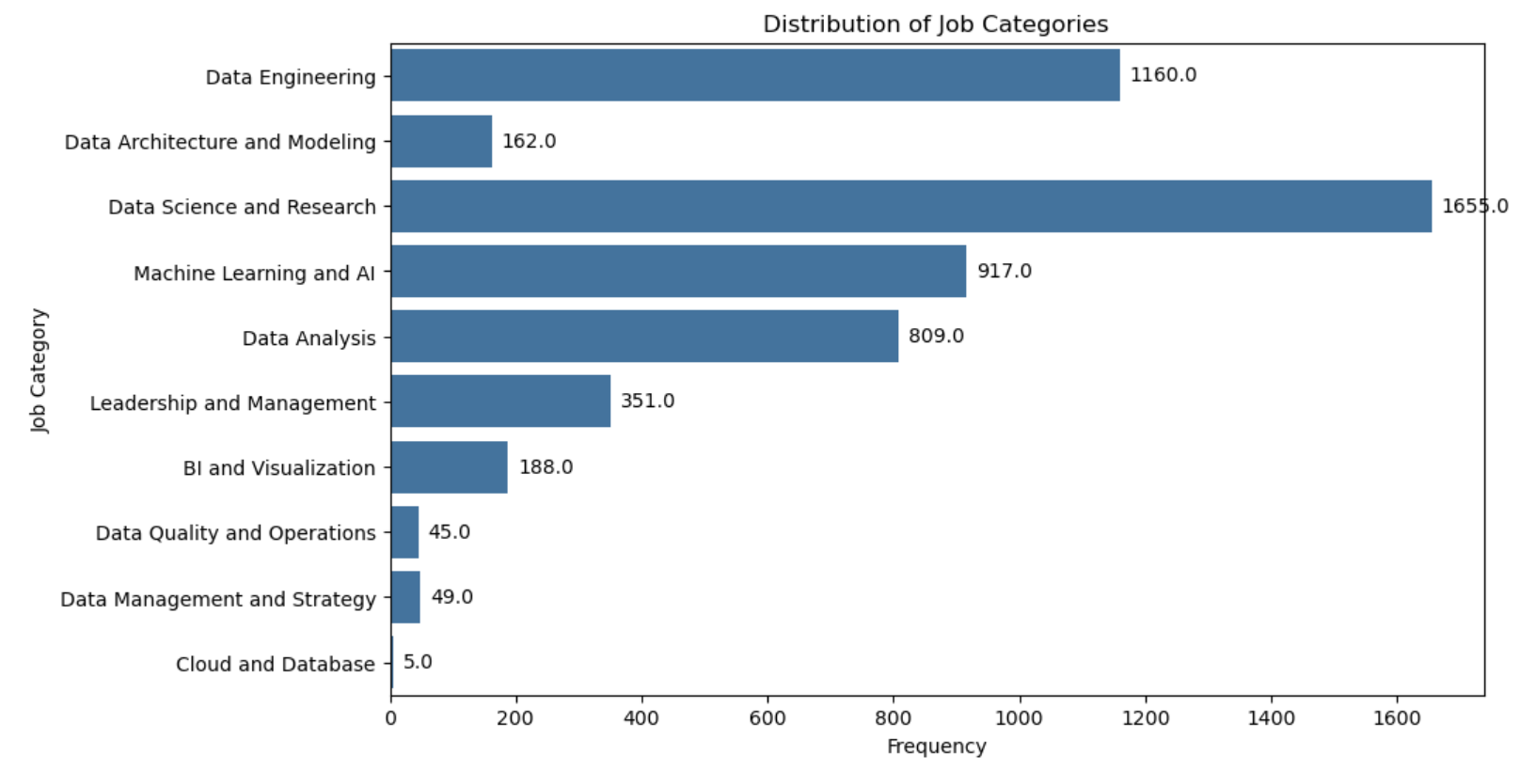
Distribution of Job Categories

Slide 10
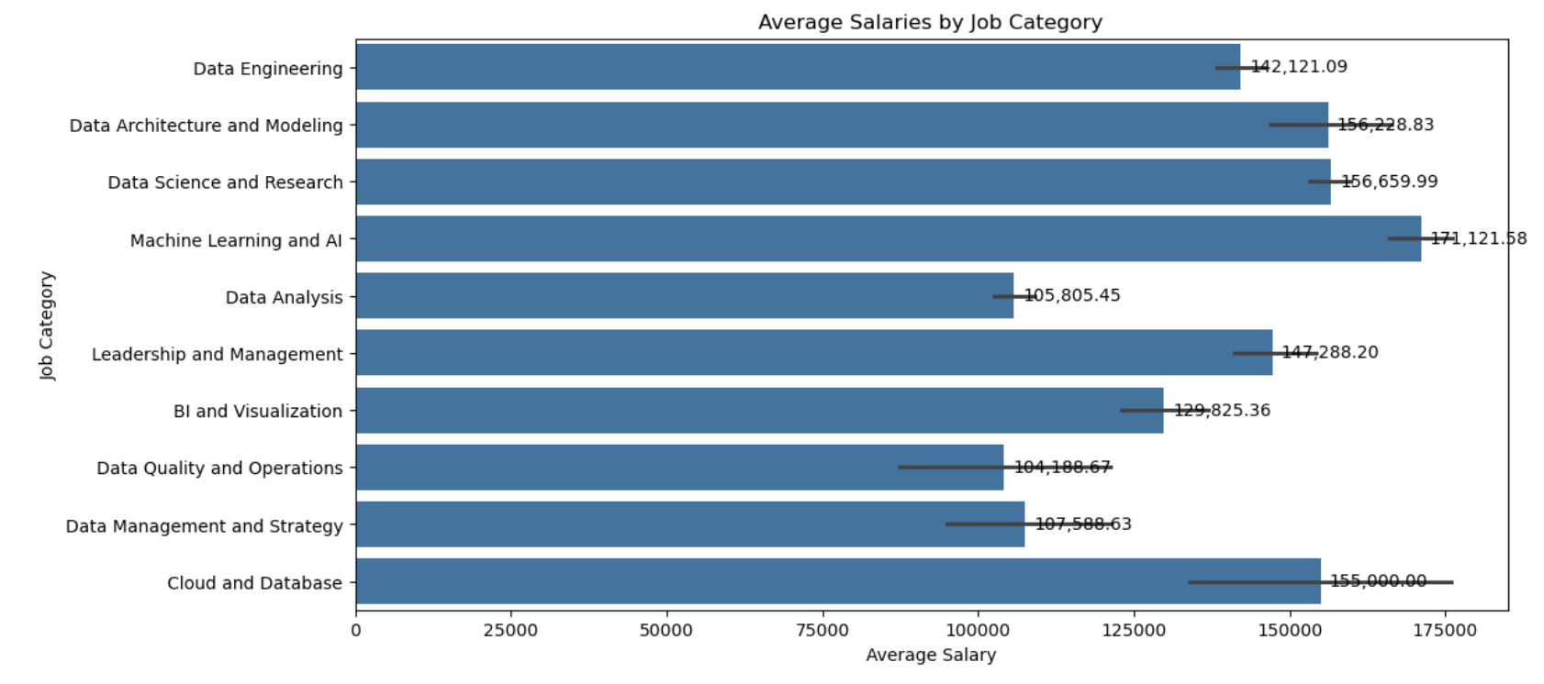
Average Salaries by Job Category

Slide 11
Average Salaries by Job Category

Slide 12
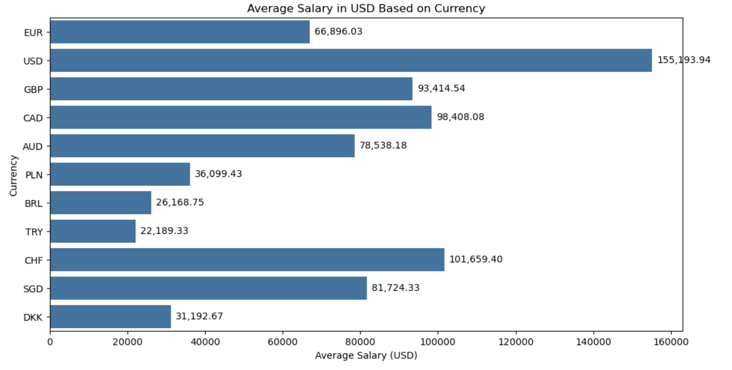
Average Salary in USD Based on Currency

Slide 13
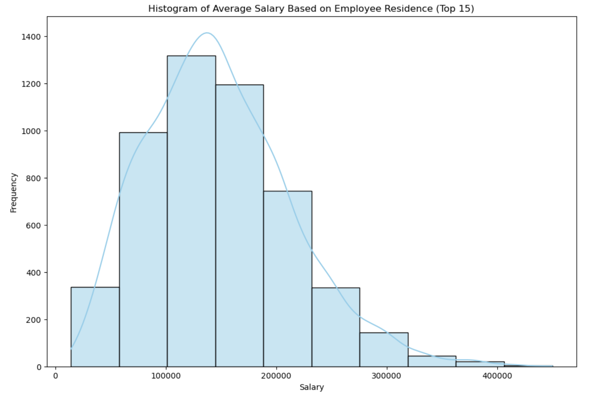
Average Salary Based on Employee Residence and Company Location
The following analysis focuses on visualizing the average salary based on employee residence and company location. Firstly, we aimed to identify the top 15 employee residence locations. Subsequently, we filtered the DataFrame to extract data pertaining only to these top 15 locations. Finally, we created a histogram to represent the salary distribution across these selected locations.

Slide 14
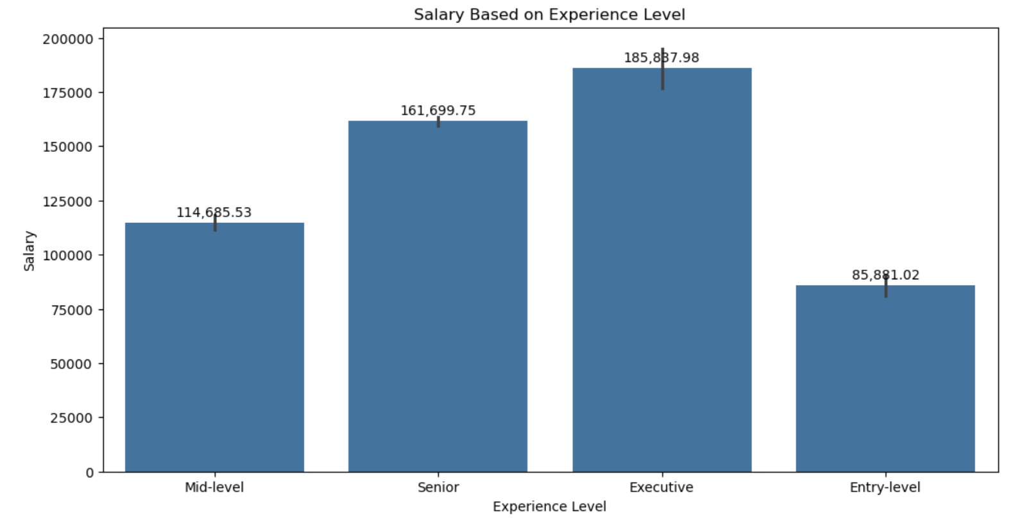
Salary Based on Experience Level
The plots illustrate that salaries increase with experience level. Specifically, entry-level positions typically offer the lowest salaries, followed by mid-level roles, senior positions, and finally, executive-level positions, which command the highest salaries.

Slide 15
THANKS!

