Slide 1

Investigating the relationships between spatial skills, programming and attitudes towards computing in a middle school age group
Juliet Wallace and Quintin Cutts, University of Glasgow
2760588w@student.gla.ac.uk and quintin.cutts@glasgow.ac.uk

Slide 2
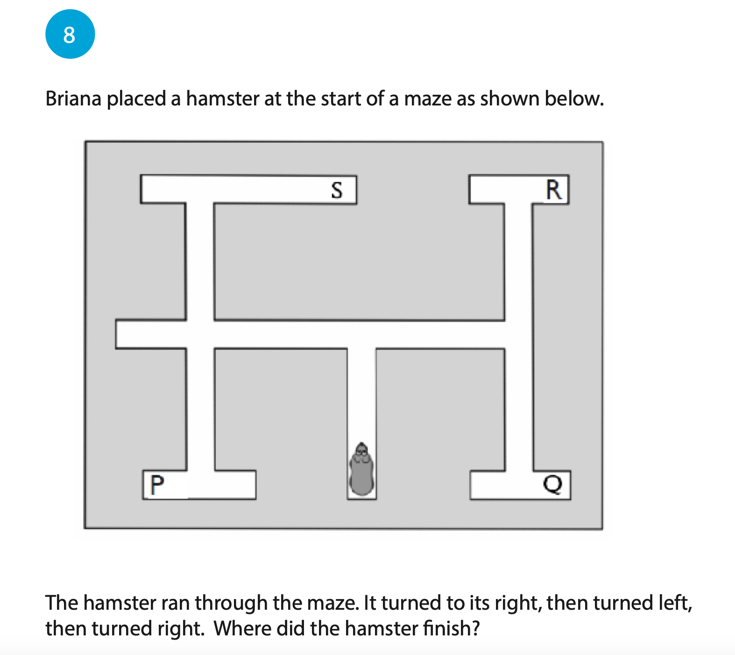
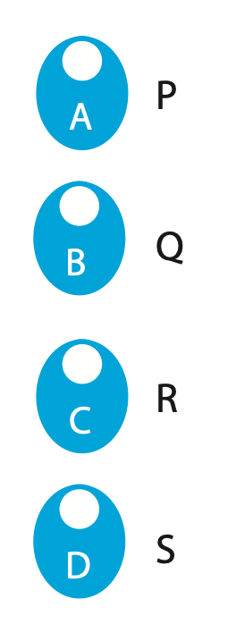
Another spatial reasoning quiz…
Taken from the Spatial Reasoning Instrument (Ramful et. al., 2018)
Notes:
Spatial reasoning skills: the ability to visualize space and mentally manipulate objects in 2D/3D space. Including being able to rotate an object in your head and visualize navigating a space.

Slide 3

Another spatial reasoning quiz…
Taken from the Spatial Reasoning Instrument (Ramful et. al., 2018)

Slide 4
Background
Significant prior research connecting spatial skills to computing science
For more information, checkout:
Code navigation (Jones and Burnett, 2007)
Proposed model connecting reading/writing code to spatial skills (Parkinson and Cutts, 2019)
Spatial Encoding Strategy (Margulieux, 2020)

Slide 5
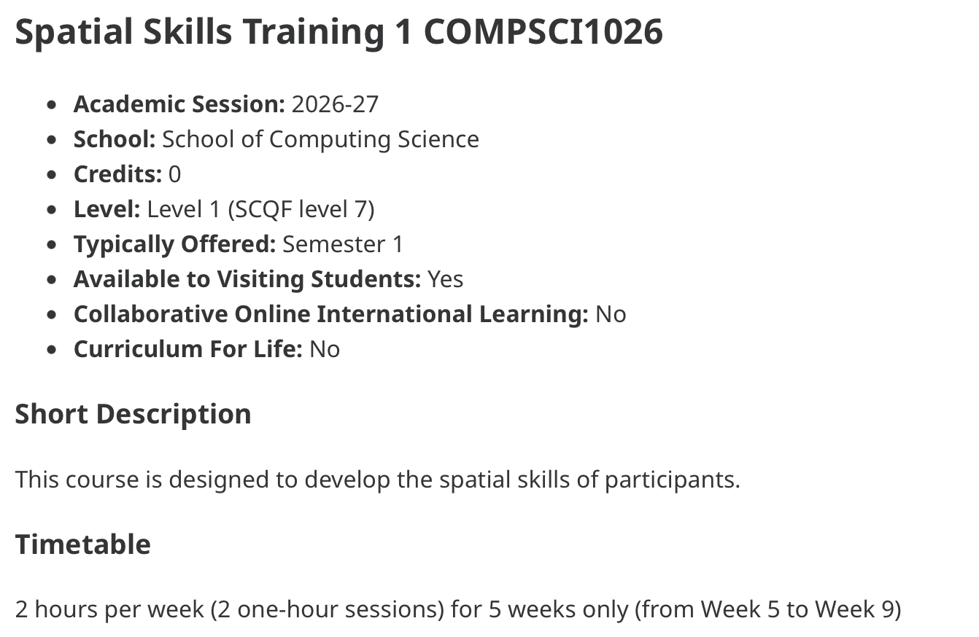
Motivation - Research Gap
Introduction of spatial skills training modules in undergraduate CS courses
References: Parkinson and Cutts (2020), Bockmon et al. (2020), Parkinson et al. (2023)

Slide 6
Motivation - Research Gap
Introduction of spatial skills training modules in undergraduate CS courses
-> Improved CS grades for students who took spatial skills module
-> Bidirectional CS <-> spatial skills relationship
References: Parkinson and Cutts (2020), Bockmon et al. (2020), Parkinson et al. (2023)

Slide 7
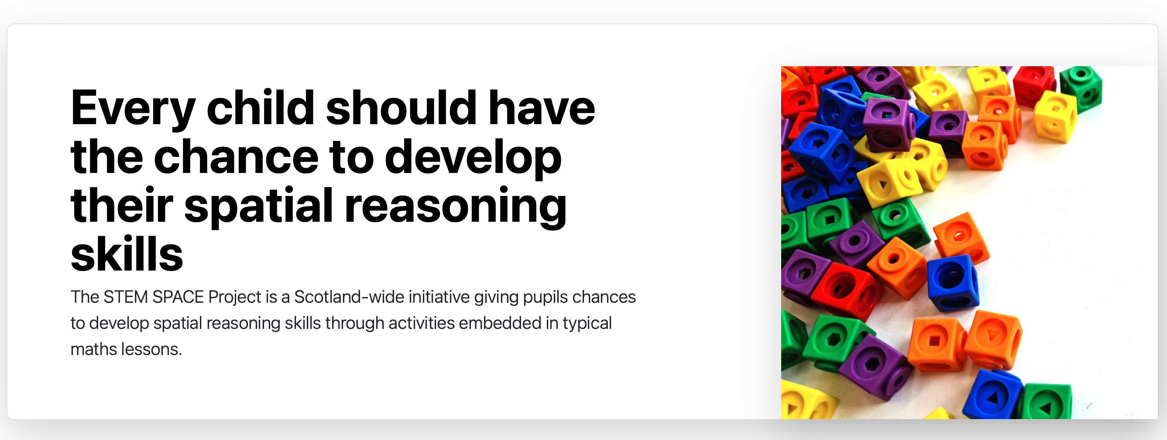
Motivation - Research Gap
Integrated maths/spatial skills programmes for primary school pupils in Scotland, Canada + Australia
References: Lowrie and Logan (2023), Hawes et. al. (2022), Parkinson and Cutts (2025)

Slide 8
Motivation - Research Gap
Integrated maths/spatial skills programmes for primary school pupils in Scotland, Canada + Australia
-> More effective in training spatial skills than an ‘isolated’ spatial skill programmes (Australia)
References: Lowrie and Logan (2023), Hawes et. al. (2022), Parkinson and Cutts (2025)

Slide 9
Motivation - Research Gap
Bidirectional CS <-> spatial skills relationship at undergraduate level
Integrated spatial/mathematics programmes for primary school pupils
Integrated spatial/computing science programmes for primary school pupils?

Slide 10
Motivation - Research Gap
Would integrated spatial/computing lessons be an effective teaching strategy for primary school pupils?
Bidirectional CS <-> spatial skills relationship at undergraduate level
Integrated spatial/mathematics programmes for primary school pupils
Integrated spatial/computing science programmes for primary school pupils?

Slide 11
Motivation - Background
I am a primary school classroom assistant in Scotland
Working with P7 (Y6) class (> 30 pupils)

Slide 12
Motivation - Background
I am a primary school classroom assistant in Scotland
Working with P7 (Y6) class (> 30 pupils)
Two components:

Slide 13
Motivation - Background
I am a primary school classroom assistant in Scotland
Working with P7 (Y6) class (> 30 pupils)
Two components:
Establish whether the connection between computing science (both performance and attitudes) and spatial skills exists in this age group

Slide 14
Motivation - Background
I am a primary school classroom assistant in Scotland
Working with P7 (Y6) class (> 30 pupils)
Two components:
Establish whether the connection between computing science (both performance and attitudes) and spatial skills exists in this age group
Explore pupils’ responses to a programme of integrated spatial/computing lessons

Slide 15
Approach
6 x 90 minute Python lessons with pre- and post-assessments
Spatial skills integrated into lessons – more details later
Pre-assessments: spatial reasoning test (SRI) + attitudes questionnaire
Post-assessments: repeat of spatial reasoning test (SRI) + attitudes questionnaire + Python assessment
Other data collected: exit passes, focus group sessions

Slide 16

Language Choice
Previous Scratch experience – following instructions rather than learning concepts

Slide 17
Language Choice
Previous Scratch experience – following instructions rather than learning concepts
Chose Python to encourage a different mode of thinking about programming

Slide 18

Overview of Lessons
Materials available on GitHub ->
Lesson | Content
1 | Scratch pen tool
2 | Python print and input
3 | Python variables
4 | Python if/else statements
5 | Python more variables and turtle introduction
6 | Python turtle group project

Slide 19
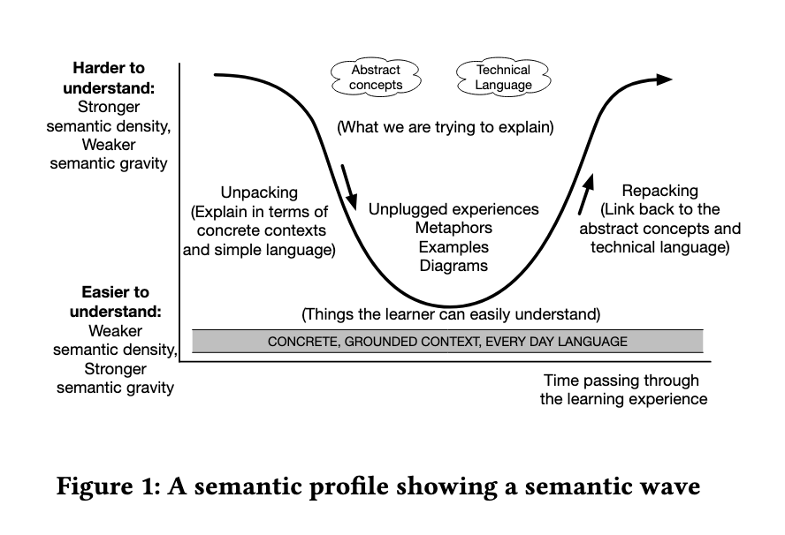
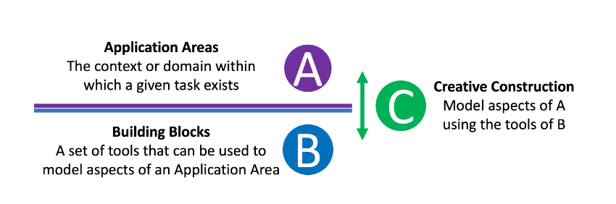
Lesson Structure – Semantic Waves + ABC
Lesson structured using the semantic waves teaching pattern (Curzon et. al. (2020))
ABC framework (Cutts (2024)) used to approach programming problems
Image credit: Curzon et. al. (2020)
Image credit: Cutts (2024)

Slide 20
Lesson 2 Example
= Application Area
= Building Block
1. Pose question to pupils: “Can you have a conversation with a computer?”
= Creative Construction
Abstract Concepts Technical Language
5. Class discussion evaluating programs as a model of human conversation
6. Search engines as an example of input/output
3. Introduction to print and input in Python (as a whole class)
Harder to understand
4. Creating conversation from 2 in Python using print and input
2. Simple “human” conversation with partner
Concrete Representation Everyday Language
Time

Slide 21
Spatial Focus in Lesson Structure
Semantic waves – different representations (concrete to abstract) of (approximately) the same problem
Hi how are you?
|

Slide 22
Spatial Focus in Lesson Structure
ABC – different representations of a programming problem
Have a back and forth “conversation” with your laptop
Write and interact with Python input/output program
Python print and input functions
Notes:
Both semantic waves and ABC encourage pupils to build different non-verbal mental representations of the same problem. By Margulieux’s SpES this encourages spatial reasoning.

Slide 23
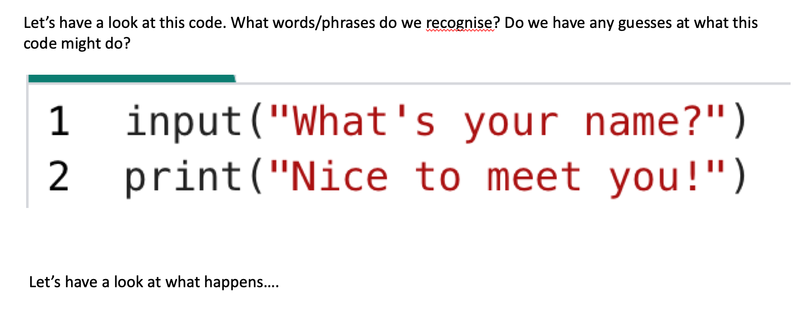
Spatial Focus in Lesson Structure
VPC (Visualise-Predict-Check) (Patahuddin et. al. (2020))
Reading code…
Reading code…

Slide 24
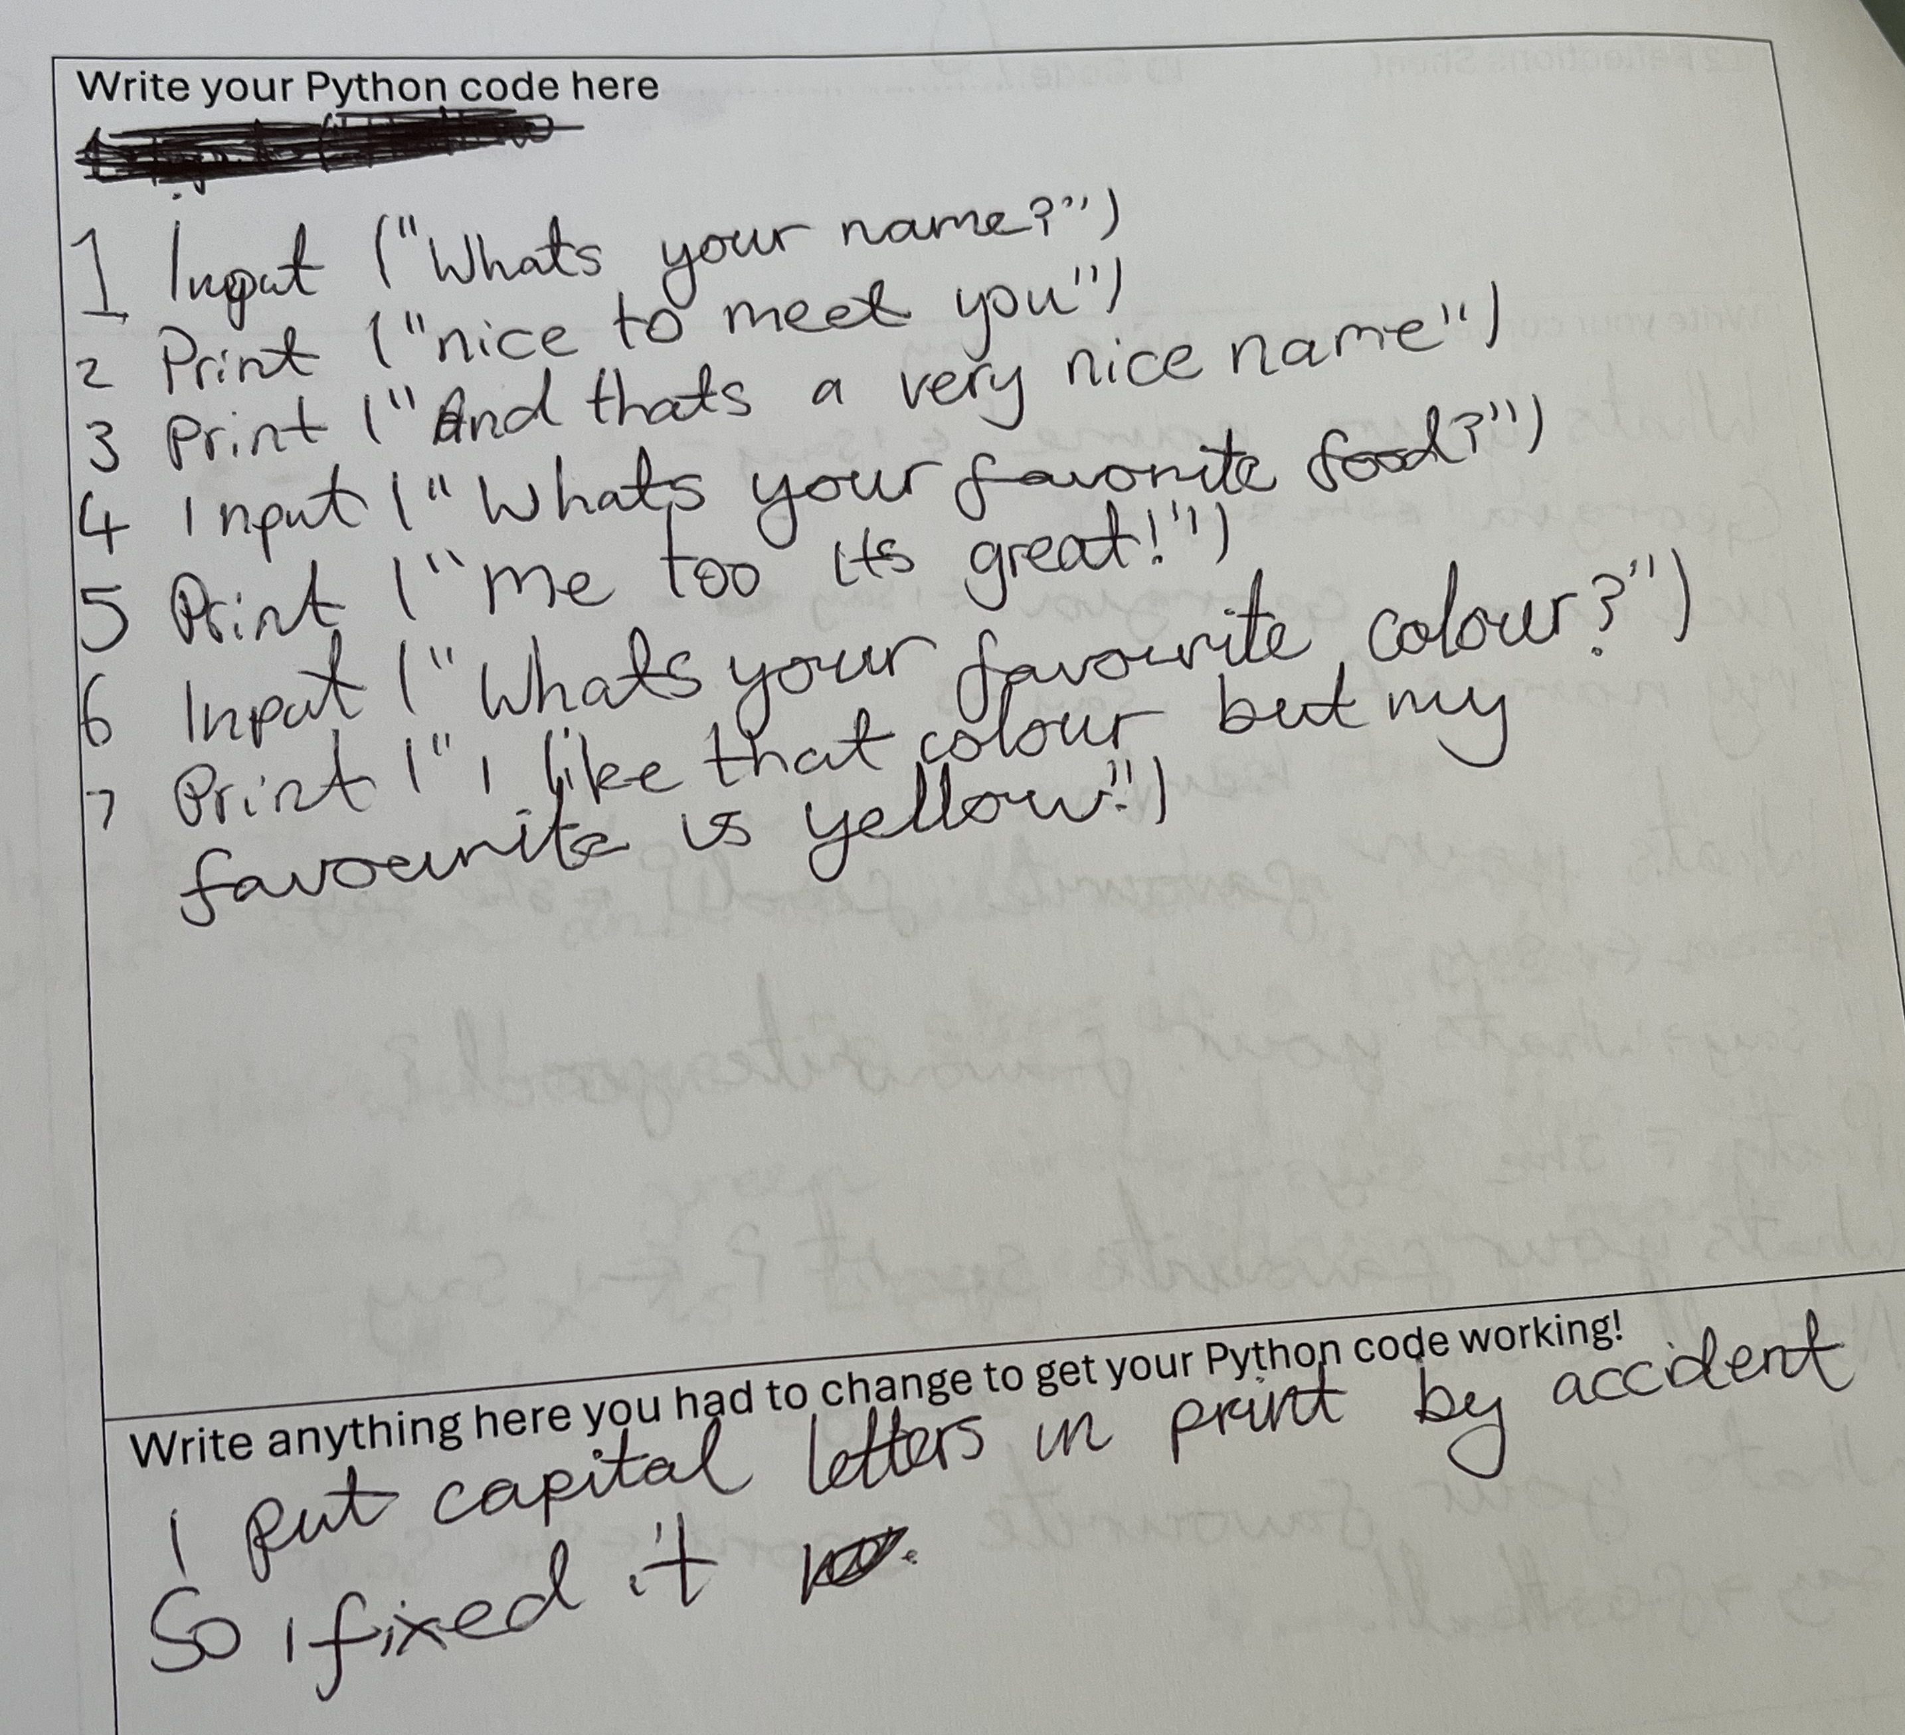
Spatial Focus in Lesson Structure
… and writing code

Slide 25
Results RQ1: spatial skills and programming ability
Correlation | Pearson’s r/Spearman’s rho and p-value
Pre-assessment SRI and Python programming | rho = 0.71, p < 0.001
Post-assessment SRI and Python programming | rho = 0.69, p < 0.001
Pre-assessment SRI and exit passes | r = 0.45, p < 0.05
Post-assessment SRI and exit passes | r = 0.43, p < 0.05

Slide 26
Results RQ1: spatial skills and programming ability
Correlation | Pearson’s r/Spearman’s rho and p-value
Pre-assessment SRI and Python programming | rho = 0.71, p < 0.001
Post-assessment SRI and Python programming | rho = 0.69, p < 0.001
Pre-assessment SRI and exit passes | r = 0.45, p < 0.05
Post-assessment SRI and exit passes | r = 0.43, p < 0.05
Pupils with stronger spatial skills performed better on both measures of programming ability (exit passes + Python assessment)

Slide 27
RQ2: spatial skills and attitudes towards computing
Group | Characteristics
1 (n= 4) | Low spatial skills and did not improve; struggled to learn Python; positive attitude and showed interest in learning.
2 (n= 6) | Low spatial skills and did not improve; struggled to learn Python; not interested in learning Python; evidence some pupils had low self-confidence with respect to programming.
3 (n= 3) | Initially middle spatial skills and showed improvement at post-test; showed some ability in learning Python; mix of interest levels.
4A (n= 5) | All girls; strong spatial and programming skills; low interest in programming.
4B (n= 4) | All boys; strong spatial and programming skills; strong interest in programming.

Slide 28
RQ2: spatial skills and attitudes towards computing
Group | Characteristics
1 (n= 4) | Low spatial skills and did not improve; struggled to learn Python; positive attitude and showed interest in learning.
2 (n= 6) | Low spatial skills and did not improve; struggled to learn Python; not interested in learning Python; evidence some pupils had low self-confidence with respect to programming.
3 (n= 3) | Initially middle spatial skills and showed improvement at post-test; showed some ability in learning Python; mix of interest levels.
4A (n= 5) | All girls; strong spatial and programming skills; low interest in programming.
4B (n= 4) | All boys; strong spatial and programming skills; strong interest in programming.
Data came from: pre- and post-assessment questionnaire, focus group sessions, exit pass responses, direct observations of pupils

Slide 29
RQ2: spatial skills and attitudes towards computing
Group | Characteristics
1 (n= 4) | Low spatial skills and did not improve; struggled to learn Python; positive attitude and showed interest in learning.
2 (n= 6) | Low spatial skills and did not improve; struggled to learn Python; not interested in learning Python; evidence some pupils had low self-confidence with respect to programming.
3 (n= 3) | Initially middle spatial skills and showed improvement at post-test; showed some ability in learning Python; mix of interest levels.
4A (n= 5) | All girls; strong spatial and programming skills; low interest in programming.
4B (n= 4) | All boys; strong spatial and programming skills; strong interest in programming.
Finding programming challenging /= lack of interest
Lack of engagement indicating low self-efficacy

Slide 30
RQ2: spatial skills and attitudes towards computing
Group | Characteristics
1 (n= 4) | Low spatial skills and did not improve; struggled to learn Python; positive attitude and showed interest in learning.
2 (n= 6) | Low spatial skills and did not improve; struggled to learn Python; not interested in learning Python; evidence some pupils had low self-confidence with respect to programming.
3 (n= 3) | Initially middle spatial skills and showed improvement at post-test; showed some ability in learning Python; mix of interest levels.
4A (n= 5) | All girls; strong spatial and programming skills; low interest in programming.
4B (n= 4) | All boys; strong spatial and programming skills; strong interest in programming.
Hit Zone of Proximal Development for Group 3

Slide 31
RQ2: spatial skills and attitudes towards computing
Group | Characteristics
1 (n= 4) | Low spatial skills and did not improve; struggled to learn Python; positive attitude and showed interest in learning.
2 (n= 6) | Low spatial skills and did not improve; struggled to learn Python; not interested in learning Python; evidence some pupils had low self-confidence with respect to programming.
3 (n= 3) | Initially middle spatial skills and showed improvement at post-test; showed some ability in learning Python; mix of interest levels.
4A (n= 5) | All girls; strong spatial and programming skills; low interest in programming.
4B (n= 4) | All boys; strong spatial and programming skills; strong interest in programming.
Gendered difference in attitudes to computing in high-performing pupils in programming and spatial skills
For boys ONLY: correlation between spatial skills and enjoyment of computing.

Slide 32
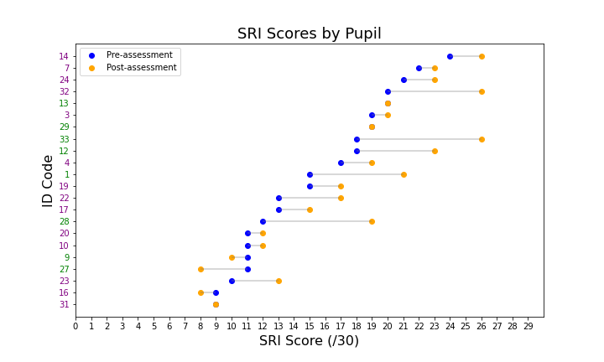
RQ3: change in spatial reasoning scores

Slide 33
RQ3: change in spatial reasoning scores
Overall improvement from pre- to post-assessment scores (p < 0.01) – unreliable without control!

Slide 34
RQ3: change in spatial reasoning scores
Overall improvement from pre- to post-assessment scores (p < 0.01) – unreliable without control!
Greatest improvements for pupils with initially middling scores. Fewer improvements for pupils at extremes.

Slide 35
Main findings and future work
Evidence that spatial skills can predict outcomes in learning programming even at primary school age.
Gendered difference in attitudes towards programming for pupils with strong spatial skills.
Improvement in spatial skills appears to depend on initial spatial skills.

Slide 36
Main findings and future work
Evidence that spatial skills can predict outcomes in learning programming even at primary school age.
Gendered difference in attitudes towards programming for pupils with strong spatial skills.
Improvement in spatial skills appears to depend on initial spatial skills.
In future work, I want to explore spatial skills in different modes of primary CS teaching (unplugged, physical, coding) and the relative significance of spatial skills in determining attitudes towards programming.

Slide 37
References
Bockmon, R. et al. (2020) ‘A CS1 Spatial Skills Intervention and the Impact on Introductory Programming Abilities’, Proceedings of the 51st ACM Technical Symposium on Computer Science Education. New York, NY, USA: Association for Computing Machinery (SIGCSE ’20), pp. 766–772. Available at: https://doi.org/10.1145/3328778.3366829.
Cutts, Q. (2024) ‘Orienting learners and teachers in introductory programming classes: the ABC Framework’, Proceedings of the 8th Conference on Computing Education Practice. CEP ’24: Computing Education Practice, Durham United Kingdom: ACM, pp. 1–4. Available at: https://doi.org/10.1145/3633053.3633063.
Curzon, P. et al. (2020) ‘Using semantic waves to analyse the effectiveness of unplugged computing activities’, Proceedings of the 15th Workshop on Primary and Secondary Computing Education. WiPSCE ’20: Workshop in Primary and Secondary Computing Education, Virtual Event Germany: ACM, pp. 1–10. Available at: https://doi.org/10.1145/3421590.3421606.
Hawes, Z. et al. (2017) ‘Enhancing Children’s Spatial and Numerical Skills through a Dynamic Spatial Approach to Early Geometry Instruction: Effects of a 32-Week Intervention’, Cognition and Instruction, 35(3), pp. 236–264. Available at: https://doi.org/10.1080/07370008.2017.1323902.
Lowrie, T. and Logan, T. (2023) ‘Spatial Visualization Supports Students’ Math: Mechanisms for Spatial Transfer’, Journal of Intelligence, 11(6), p. 127. Available at: https://doi.org/10.3390/jintelligence11060127.
Messer, D. et al. (2018) ‘Evaluating the effectiveness of an educational programming intervention on children’s mathematics skills, spatial awareness and working memory.’, Education and Information Technologies, 23(6), pp. 2879–2889. Available at: https://doi.org/10.1007/s10639-018-9747-x.
Parkinson, J. and Cutts, Q. (2025) ‘Improving Primary School Pupils’ Spatial Skills Leads to Computational Thinking Gains’, Proceedings of the 30th ACM Conference on Innovation and Technology in Computer Science Education V. 1. New York, NY, USA: Association for Computing Machinery (ITiCSE 2025), pp. 646–652. Available at: https://doi.org/10.1145/3724363.3729075.
Parkinson, J. and Cutts, Q. (2020) ‘The Effect of a Spatial Skills Training Course in Introductory Computing’, Proceedings of the 2020 ACM Conference on Innovation and Technology in Computer Science Education. New York, NY, USA: Association for Computing Machinery (ITiCSE ’20), pp. 439–445. Available at: https://doi.org/10.1145/3341525.3387413.
Patahuddin, S.M., Rokhmah, S. and Ramful, A. (2020) ‘What does teaching of spatial visualisation skills incur: an exploration through the visualise-predict-check heuristic’, Mathematics Education Research Journal, 32(2), pp. 307–329. Available at: https://doi.org/10.1007/s13394-020-00321-2.

