Slide 1
Thesis results
May 3rd, 2024
Julieta Medawar Dumandzic

Slide 2
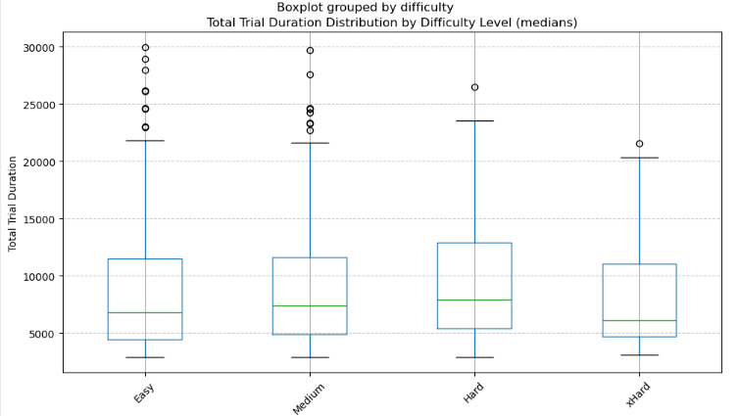
Hypothesis 1: As task complexity increases (higher difficulty), children may extend their exploration periods, fixate on images longer and more frequently, and exhibit heightened image-switching behavior.
When modelling the relationship between difficulty and children’s information-seeking patterns, I found a significant relationship for the following variables:
- Total trial (duration): positive relationship, which is higher if we leave out the xHard level.
- Exploration period duration: positive correlation, which is higher if we leave out the xHard level.
- Decision period duration: positive relationship, only significant when leaving out the xHard level.
- Look duration (considering fixations and gazes) of bottom cards during exploration: positive correlation, only significant when leaving out the xHard level
- Total number of fixations: positive correlation
For the models, I applied mixed effects hierarchical models accounting for non-linear trend, random slope, random intercept, and the distribution of the dependent variable (although I have many questions about this point).
This pattern is followed by a number of variables: total trial duration, exploration period and decision period duration, fixation duration and number of fixations of bottom cards during exploration period.
Session by session, there is much variation.

Slide 3
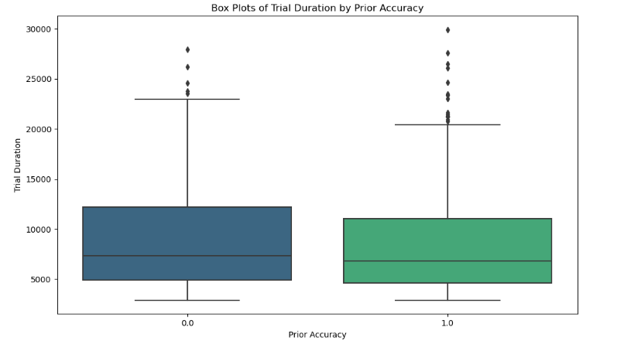
Hypothesis 2: Following successful trials, infants may shorten their exploration durations. In response to errors, they may exhibit prolonged gaze durations on the images. After experiencing errors, they may demonstrate heightened eye-switching behaviour as they attempt to optimize their performance.
In general, the differences between the means and medians of each variable depending on prior accuracy are small and non significant. In addition, when analyzing session by session, there is much variability.
Maybe this is why, when modelling the relationship between prior accuracy and children’s information-seeking patterns, I found no significant correlations (it could also have to do with how I modelled the relationships).
I also investigated if sessions tended to change for each variable (difference between the value of a feature between a trial and the next one – if the difference is negative, then they improved from one trial to the next). When the prior trial was incorrect, in general children did worse than before. When the prior trial was correct, children tended to improve or at least to stay the same.
This trend is followed by: accuracy, total trial duration, duration of exploration and decision periods, fixation duration, fixation number and number of switches of bottom cards during exploration period, total number of fixations and of switches.

Slide 4
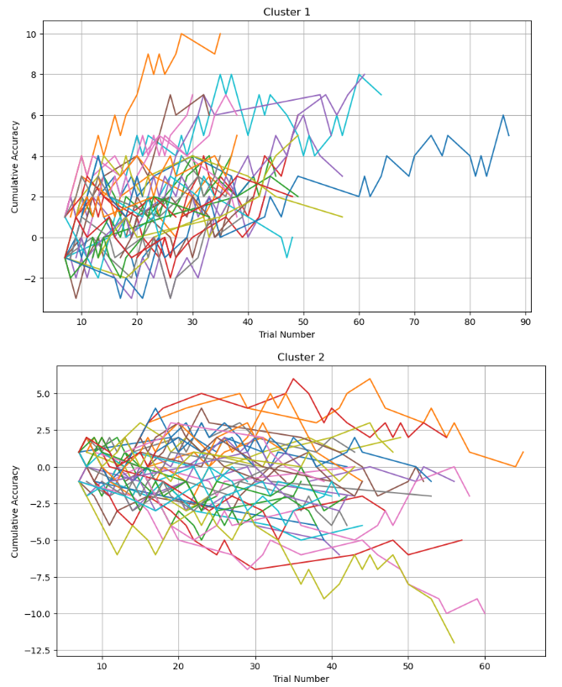
Hypothesis 3: As children gain experience with the task, they may become more efficient in their information-seeking strategies, which may lead to fewer mistakes
Cumulative accuracy: two clusters
When modelling the relationship between trial number (progression) and children’s information-seeking patterns, I found a significant relationship for the following variables:
- Cumulative Accuracy: only significant when considering the clusters (positive correlation for cluster 1 and negative for cluster 2).
- Fixation duration and number of fixations of bottom cards during exploration: positive relationship
However, the coefficients are extremely small.

