Slide 1
City Similarity Test

Slide 2
Why cluster cities
Help making better decisions for business expansion into different cities
Similar cities >> consider similar business operation mode
Cities with unique features >> consider localized and customized business methods
Informed decisions on which cities to expand and how to operate business

Slide 3
Data Acquisition & Clustering
https://en.wikipedia.org/wiki/List_of_cities_by_GDP
There are 3 data features used for the model
Venue-Category data:
FourSquare API requests
City GDP data:
Table on the Wikipedia Page – A list of GDP values for cities
https://en.wikipedia.org/wiki/List_of_cities_by_GDP
City Temperature data:
Table on the Wikipedia Page – A list of temperatures for cities
https://en.wikipedia.org/wiki/List_of_cities_by_average_temperature

Slide 4
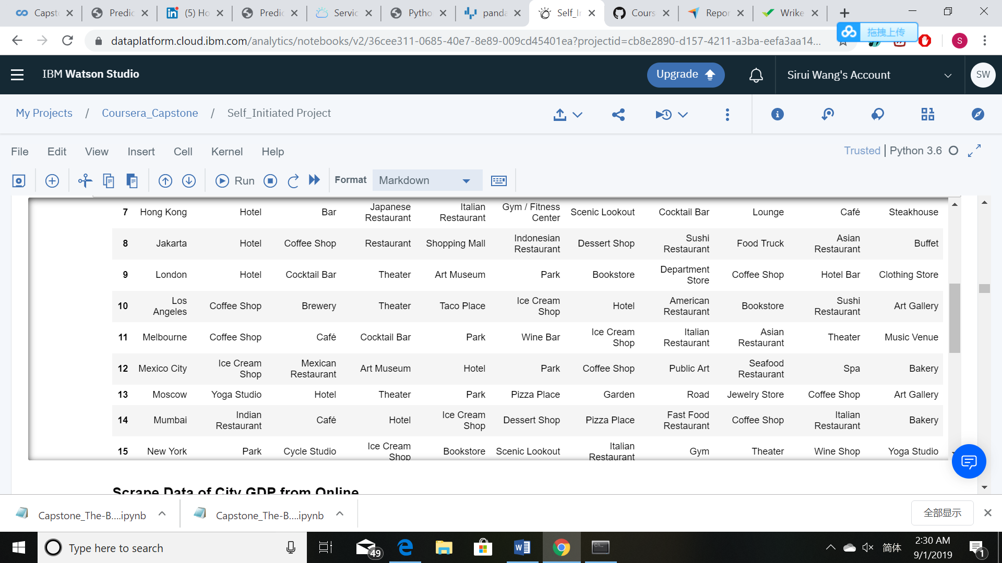
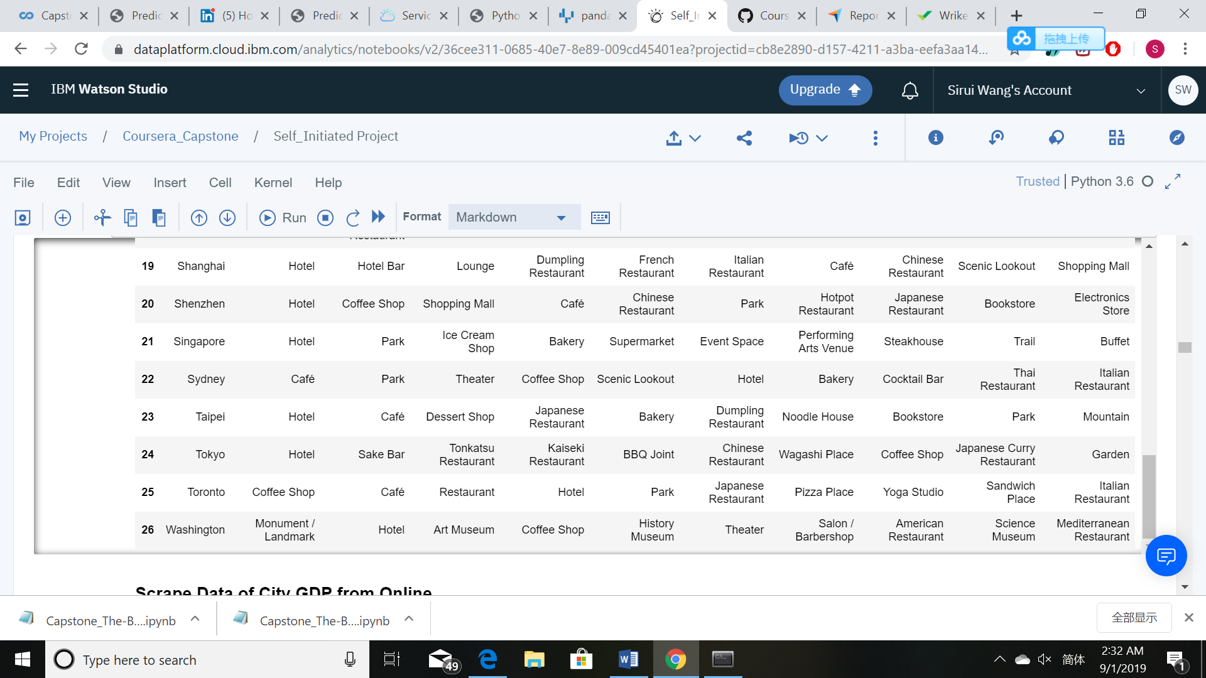
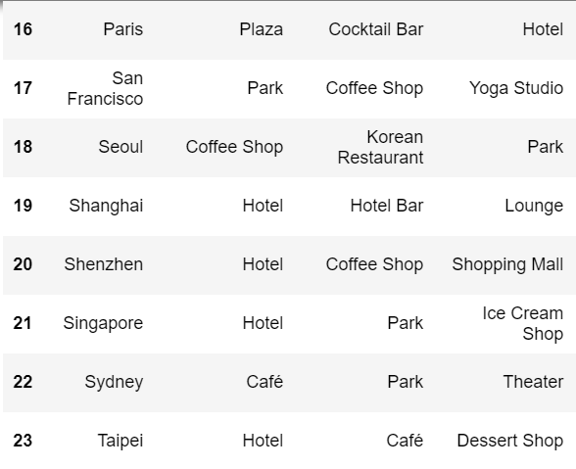
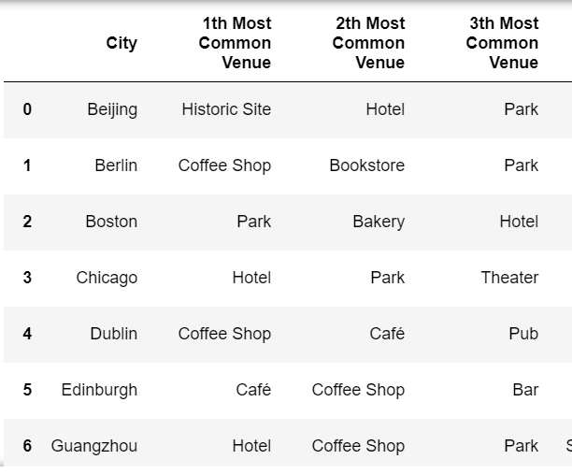
Cities with Top Venues

Slide 5
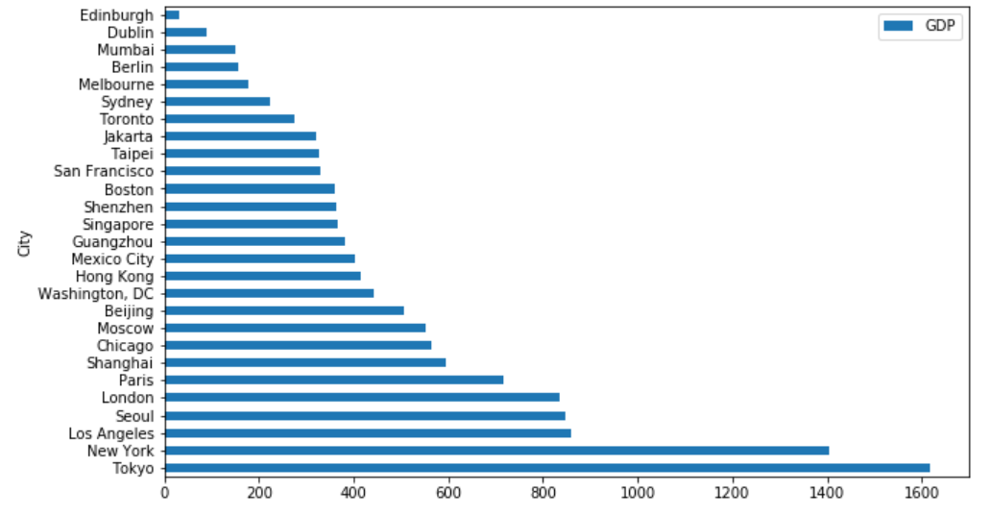
City Rankings in gdp

Slide 6
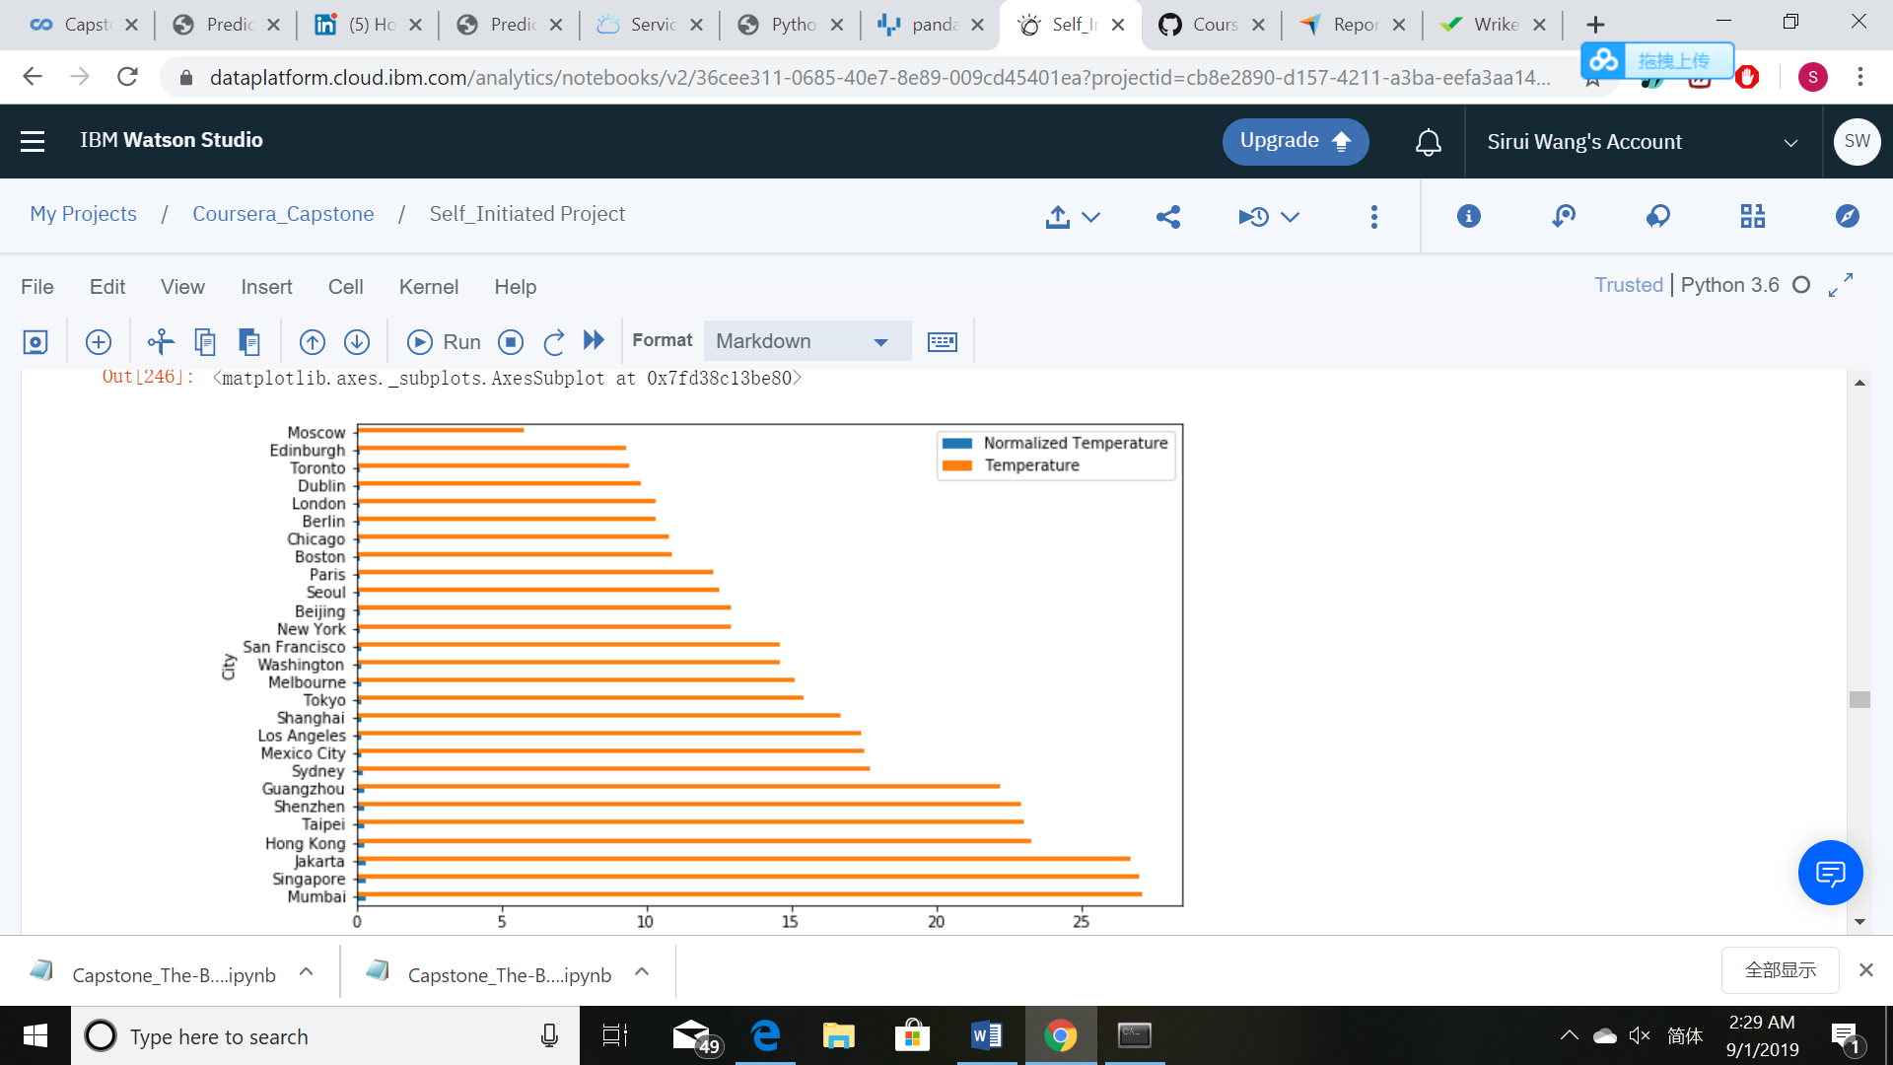
City Rankings in temperature

Slide 7
City Rankings in TEMPerature
6 Groups are Clustered Out
>> Singapore, HK Guangzhou, Shenzhen, Mumbai, Taipei, Jakarta
>>London, LA, Chicago Shanghai, Moscow, Paris
>>Boston, SF, Washington Mexico City
>>NY, Tokyo
>>Edinburgh, Toronto, Sydney, Melbourne Dublin Berlin
>>Beijing

Slide 8
CONCLUSION
In this assignment we have built up a clustering model to segment the major big cities into different groups.
The result could be a valuable reference to the Board of Directors when they are making decisions on their business expansions into these cities.
This result is straight-forward and takes different factors into account.
However, there is also room for improvement
as there are a lot of features that influence the similarity between two cities and more variables could be included for higher accuracy of the clustering results.

