Slide 1
Softwareproject
Introduction to Python Programming
Notes:
Welcome to my presentation about my software project. My name is Julian Hoffmann and I created the game sudoku in python using numpy and curses. Unfortunately my partner quit our project and I had to do the whole project myself.

Slide 2
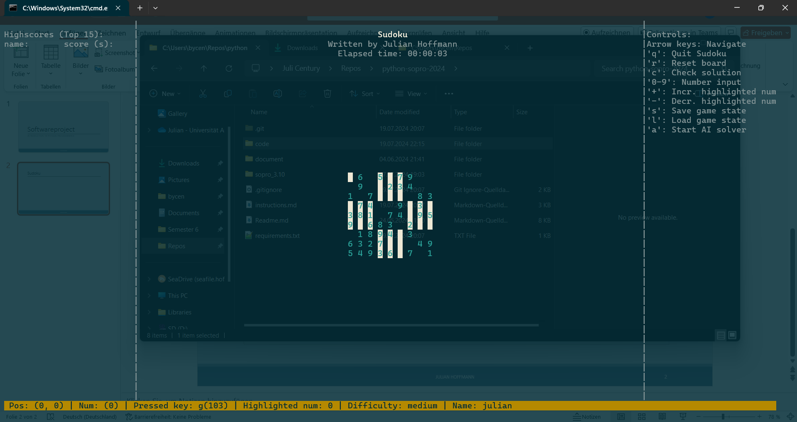
Sudoku: Start
Notes:
After launching the game, entering your name and starting it you will see this screen. This is the main screen of my sudoku implementation. On the left you will see the different highscores, if there are any saved. On the right you are seeing the different controls with which you can interact with. In the center you are seeing the main thing, the sudoku board. Depending on the chosen difficulty the board will be harder or easier to solve. You can move your cusor with your arrow keys and enter numbers with the number keys on your keyboard.

Slide 3
Sudoku: AiPlayer
Notes:
If you don‘t want to play the game yourself or the current generated board is too hard for you, you can choose to let an AI solve it for you. For that you have to press the “A” key, after that the user input will be disabled and the AI takes control over the controls. Calculating the next best move to make and number to choose. As you can see on this slide, this would be how the AI would play the game and try to solve the board for you.

Slide 4
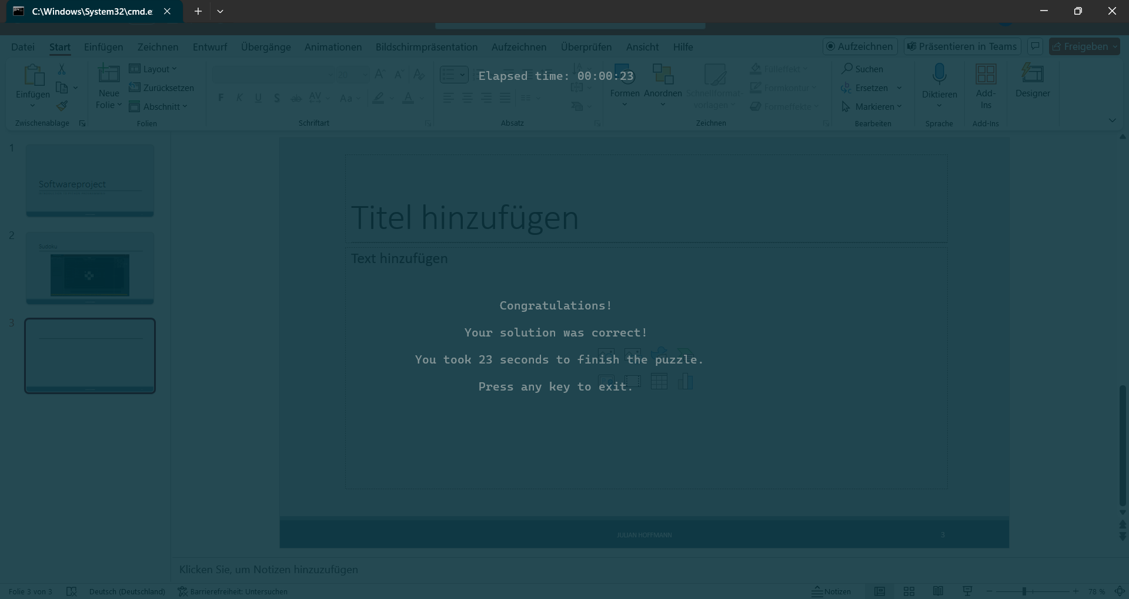
Sudoku: Game won
Notes:
After completing the board the AI will trigger the Sudoku checker, which will make sure if the current board is a valid solution. If the solution is correct, you will be greeted with this window and you high score will be saved inside a file. If you solved the board yourself without the AI, you will have to press the “C” key, to get your current board checked for correctness.

Slide 5
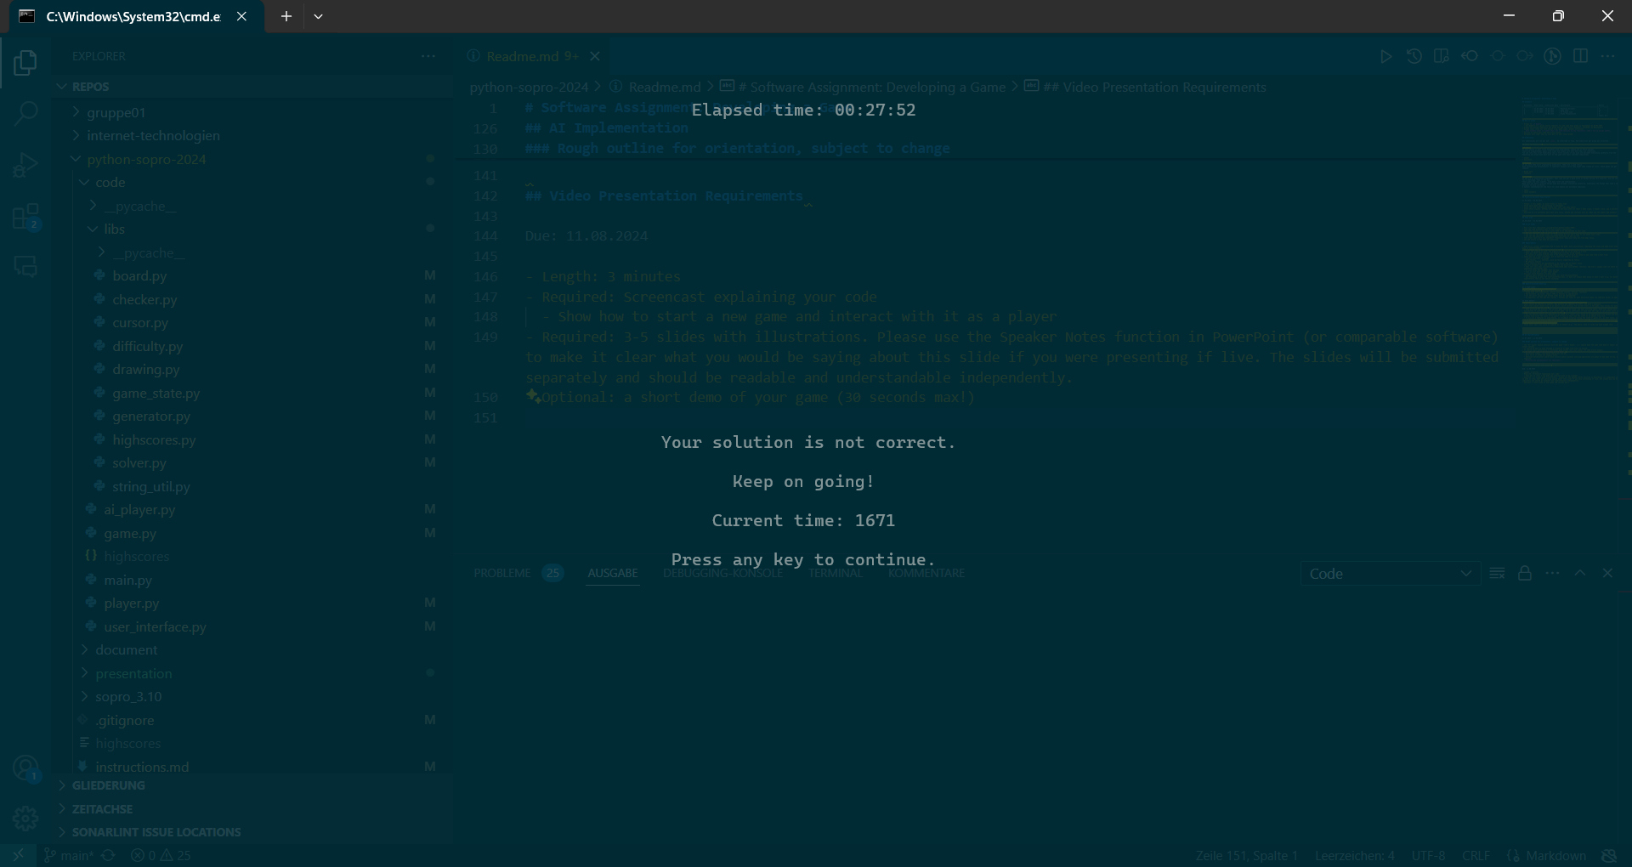
Sudoku: Game not (yet) won
Notes:
If your board is not a valid solution you will see this screen and will be asked to retry or keep going. During that the timer is also stopped and will resume once you dismiss this screen.

Slide 6
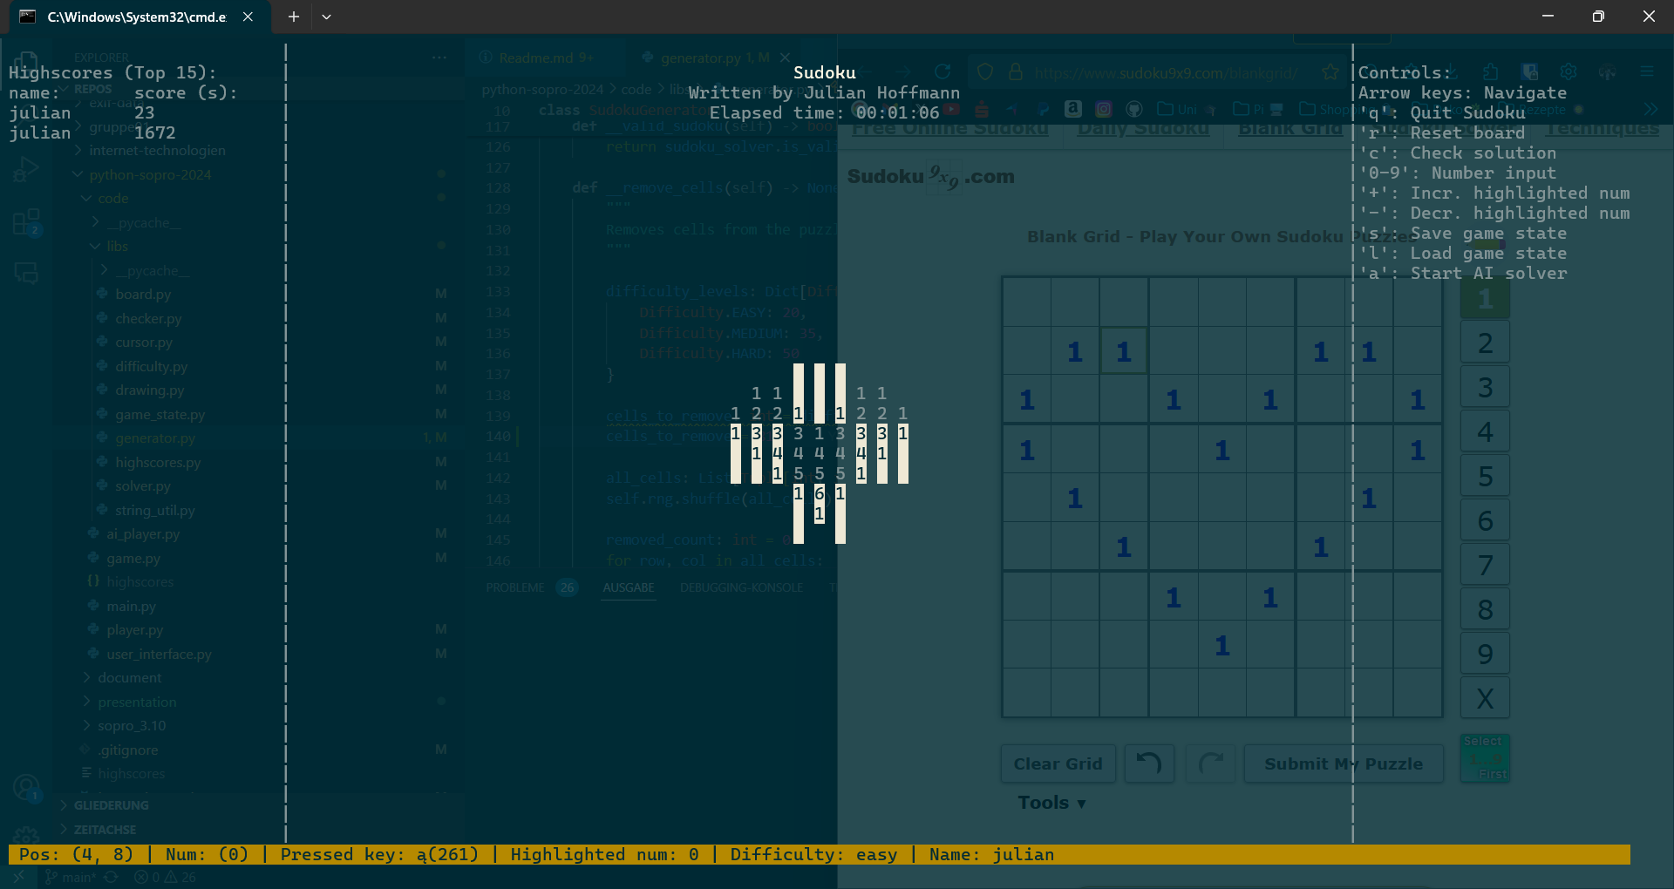
Thanks for your attention!
Notes:
This was my presentation about implementation of sudoku! Thanks for your attention.

