Slide 1


Practical Work – GGOSSS 2025
Group 3 – Ocean Modeling
Summer School GGOSSS-2025
Theme : Correlate the Upwelling Intensity with wind variations over the length of the simulations ?
Atelier animé par: Dr. Audrey, Dr. Franck Ghomsi et Dr. Assene
Membres : Julio, Roy, Lyne, Willy & Bikop
Project

Slide 2
Context
Upwelling is a key oceanographic process that brings nutrient-rich waters to the surface, strongly influencing primary productivity and ecosystem dynamics. Understanding how wind forcing drives upwelling intensity is crucial for quantifying variability in ocean circulation and its ecological impacts.
Project

Slide 3
Scientific Objective
The main objective of this work is to correlate the upwelling intensity with wind variations over the length of the simulation. This involves quantifying how changes in wind speed and direction modulate the strength and spatial distribution of upwelling
Project

Slide 4
Specific Objecive
Research Questions
How does wind variability (speed and direction) influence upwelling intensity over time?
Is there a spatial correlation between regions of stronger wind stress and stronger upwelling?
What is the timescale of the response of upwelling intensity to wind forcing?
Can we identify seasonal or event-based patterns that amplify upwelling?
Project

Slide 5
Methodology
Extract wind data (speed, direction, wind stress) from the simulation outputs.
Compute upwelling indices from vertical velocity fields or temperature gradients.
Apply statistical methods (e.g., correlation, regression, time-lag analysis) to quantify relationships.
Visualize results using **xarray**, **xgcm**, **matplotlib**, and **cartopy** for spatio-temporal analysis.
Project

Slide 6
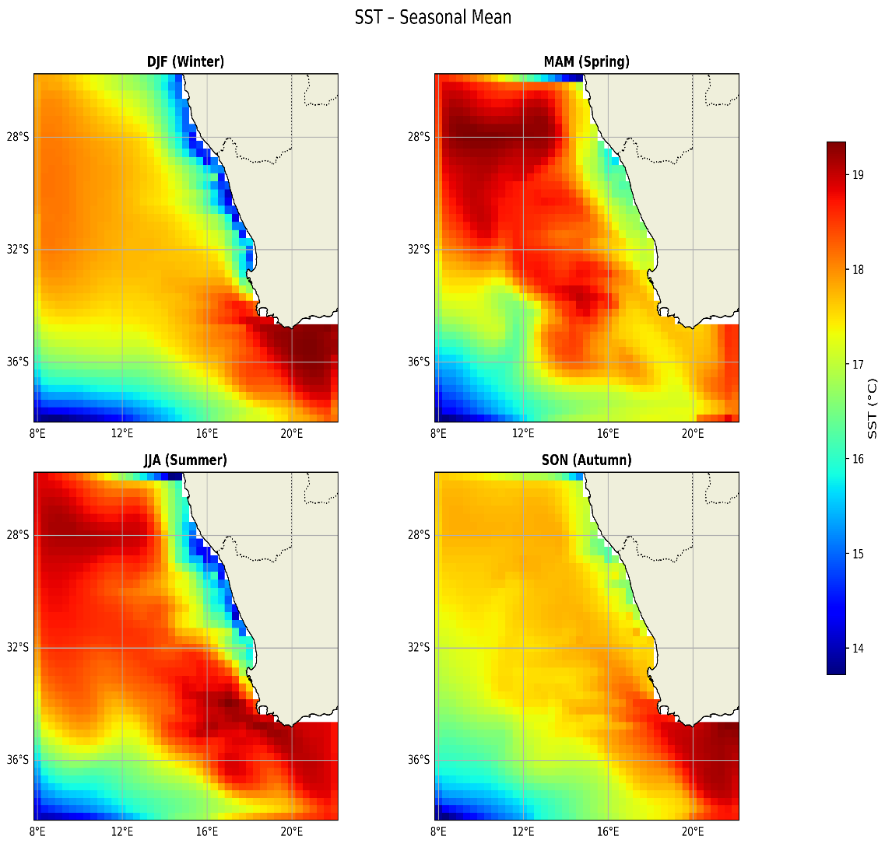
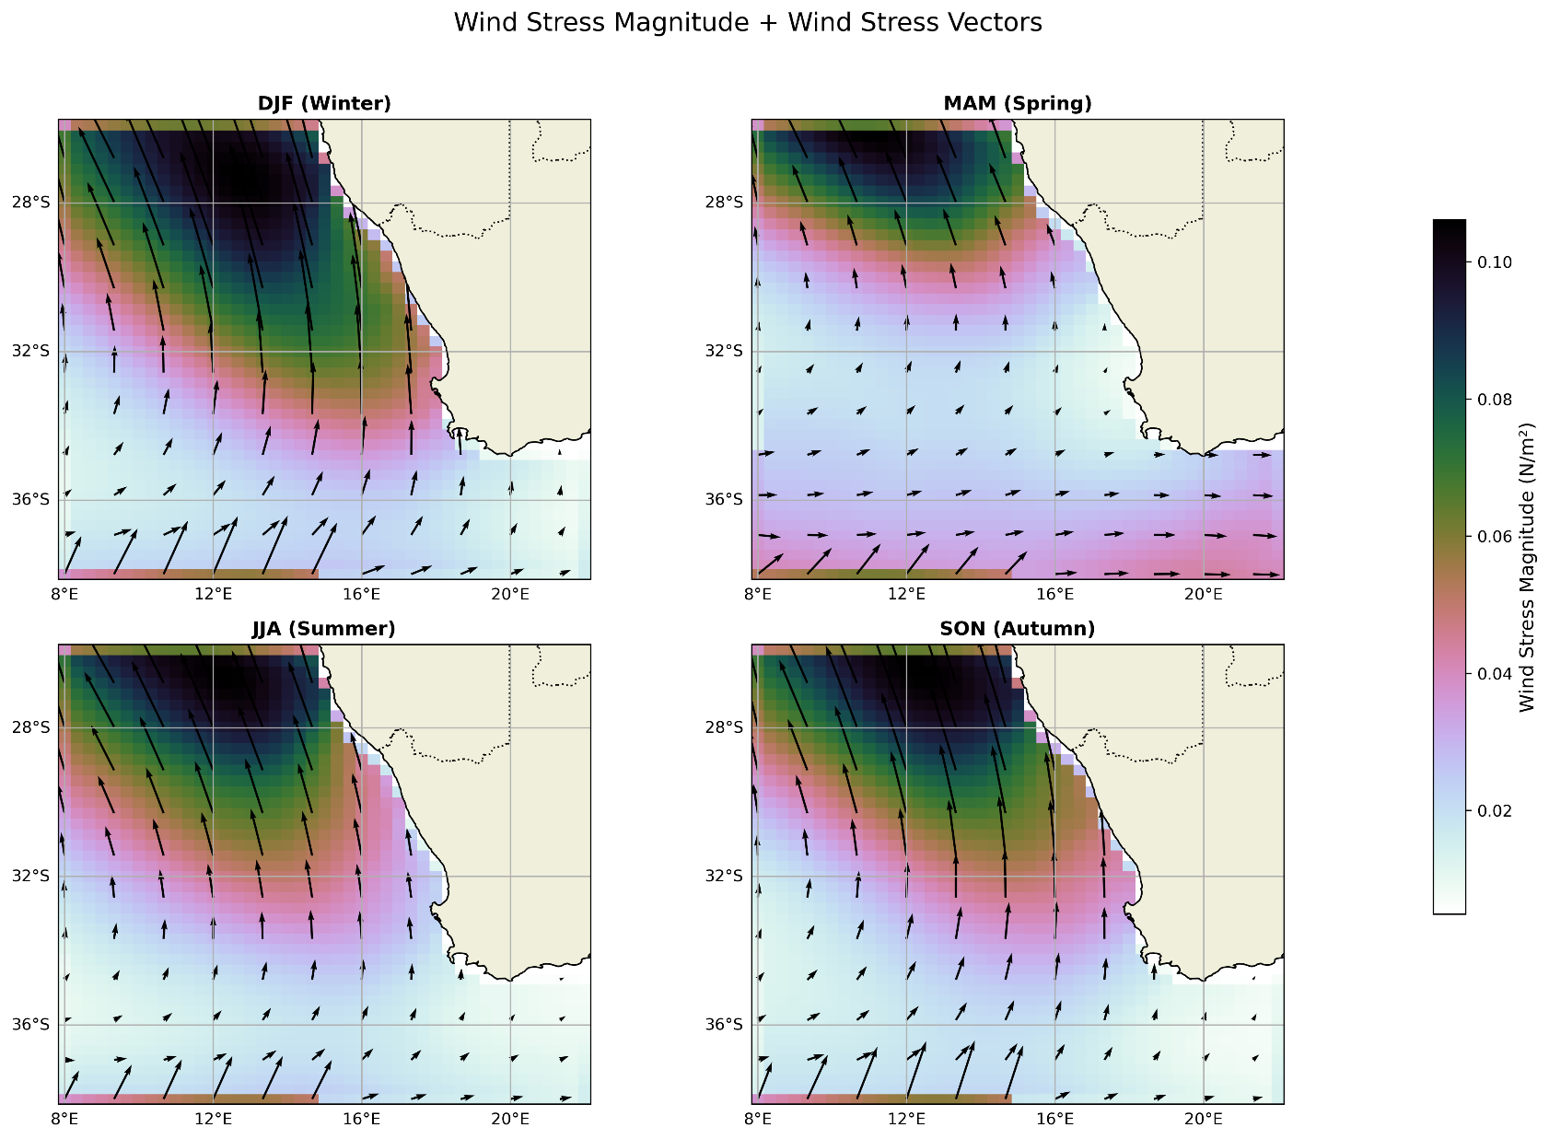
Seasonal Patterns of wind stress and SST
Project

Slide 7
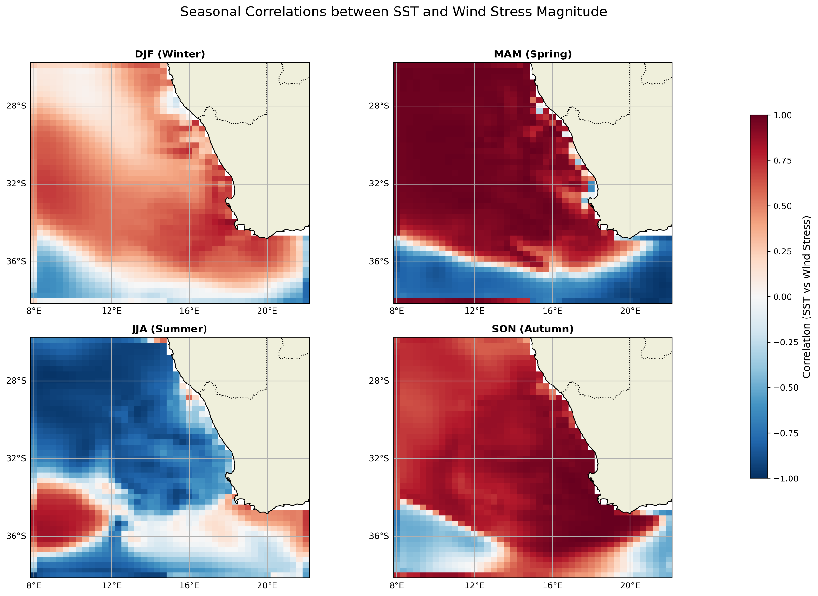

Seasonal Patterns of wind stress and SST
Seasonal Patterns of wind Conclusions
Continuity equation
2. Yes
3. Immediate, or with a delay of three days or more
4. Le c
. SST
Project

Slide 8
THANK YOU FOR YOUR KIND ATTENTION!!!!!!!
MERCI
Project
777

