Slide 1


BUSINESS MODEL CANVAS

Slide 2
ABOUT BUSINESS
(Value-driven) premium value proposition – the best home automation devices over wireless usage and a big portfolio of high level quality products. Also, our services are reliable and take advantage on the easiest way to set up and use;
(Value-driven) premium value proposition – awesome quality delivery in projects (on demand);
However, costs should be minimized in every business model. Thus:
Low fixed cost – outsourcing of hardware production, software production, server service, accounting, HR, logistics, etc. It makes our fixed costs as lower as possible;
Best forecast of variable cost – because of above sentence (outsourcing of production and services), we can forecast variable costs changes and make it more reliable.

Slide 3
CANVAS
KEY PARTNERSHIPS | KEY ACTIVITIES | VALUE PROPOSITION |  | CUSTOMER RELATIONSHIPS | CUSTOMER SEGMENTS
• (Optimization / economy of scale / uncertainty) hardware manufacturers • (Optimization / economy of scale / uncertainty) Server service outsourcing • (Optimization) software factory partnership • (Acquisition of particular activities) products delivery/shipment outsourcing • (Acquisition of particular activities) HR/personnel department/accounting outsourcing | • (Production) development for production • (Problem solving) problem solving on demand • (Platform/network) service provisioning | • Wireless communication to control and/or monitor • No building adaptation • Wherever a smartphone is • No extra wiring (and cost either) • No broken walls or dirt • Easily configured (plug and play) • Big portfolio of devices • The cheapest way • We master our technologies |  | • Self-service (web site / web store / business phone) • Automated service (web site / web store / web chat / URA) • Personal assistance (or a dedicated personal assistance in case of big accounts) • Transactional web services | • Final consumer (A/B/C classes) • Electrical/electronic stores (B2B) • Regional representatives (B2B) • Home appliance industry (B2B) • Marketplace
 | KEY RESOURCES |  |  | CUSTOMER CHANNELS
 | • (Physical) a product warehouse • (Physical) IT infrastructure • (Intellectual Property) patents and brand • (Intellectual Property) customer database • (Human) human resource • (Financial/Physical) sales system |  |  | • Web site • Web chat • Web services • Publicizing
COST STRUCTURE |  |  | REVENUE STREAMS
• Hardware production outsourcing • Software development outsourcing • Server outsourcing • Sales fee • Logistics fee • Import duty • Workers |  |  | • Consumer products sales • Specific projects sales • Home appliances integration to Dragonfly IoT System • Subscription to Dragonfly server usage • Mailing and clients’ data information (*** assess this risk) • Website advertising • Customized switch plates

Slide 4
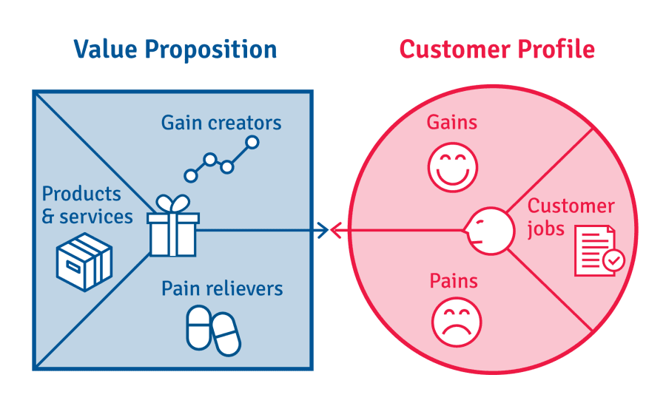
VALUE PROPOSITION

Slide 5
VALUE PROPOSITION
Wireless communication to control and/or monitor ⇒ usage of wireless communication to connect smartphones/tablets to everything that can be controlled or monitored;
No building adaptation ⇒ commercial facilities and older buildings can also be controlled/monitored through the same Dragonfly system without adaptation;
No extra wiring (and cost either) ⇒ no extra wiring (and cost either) to connect the central hub to devices because of wireless communication;
No broken walls or dirt ⇒ with wiring automation systems, only new buildings can have this wiring systems without broken walls and dirt. We don’t have this problem;
Wherever a smartphone is ⇒ we can be wherever a smartphone is;
Easily configured (plug and play) ⇒ just supply power to devices and start using them;
Big portfolio of devices ⇒ portfolio of devices bigger than our competitors;
The best cost/benefit ⇒ just try it out;
We master technologies we use ⇒ we really know .

Slide 6
CUSTOMER SEGMENTS
Final consumer (A/B/C classes) = Upper Class – Elite / Upper Middle Class / Lower Middle Class ⇒ web store;
Electrical/electronic stores (B2B) ⇒ in person / web store;
Regional representatives (B2B) ⇒ in person / web store;
Home appliance industry (B2B) ⇒ in person / web store;
Marketplace ⇒ web services.

Slide 7
CUSTOMER CHANNELS
Web site;
Web services;
Publicizing
Backoffice (messaging through app);
Email;
Web chat;
Commercial phone (only selling and adm);
In person;

Slide 8
CUSTOMER RELATIONSHIPS
Final consumer ⇒ self-service (web site / web store) / automated service (web site / web store) / messaging through the app (backoffice) or email;
Electrical/electronic stores (B2B) ⇒ self-service (web site / web store) / automated service (web site / web store) / personal assistance (email / web chat / business phone / a dedicated personal assistance in case of big accounts);
Regional representatives (B2B) ⇒ self-service (web site / web store) / automated service (web site / web store) / personal assistance (email / web chat / business phone / a dedicated personal assistance in case of big accounts);
Home appliance industry (B2B) ⇒ personal assistance (email / business phone / a dedicated personal assistance in case of big accounts);
Marketplace ⇒ messaging through the app (backoffice) or email.

Slide 9
REVENUE STREAMS
Consumer products sales ⇒ sale of Dragonfly home automation products (e.g. hubs, switches, irrigation, curtain motors, blind motors, digital thermometers, etc.);
On demand projects sales ⇒ sale of Dragonfly specific projects (e.g. home appliance, industry automation, farm irrigation, etc.);
Subscription to Dragonfly server usage ⇒ a monthly fee of USD 1.00/Hub for server usage, that is, if a client wants to use an external access of home automation. First year is for free. If clients just want to use their local Wi-Fi network, they do not pay for this fee. However, they only can reactivate their external usage (through carriage network or external internet) if the usage fee (starting on 2nd year) is payed before;
Mailing and clients data information (*** assess this risk) ⇒ selling of clients data for interested companies;
Website advertising ⇒ advertising a particular product, service, or brand.

Slide 10
KEY RESOURCES
(Physical) office administration + a product warehouse ⇒ a reasonable stock needs to be available for shipment as soon as products are sold – products have a very small size and it needs to be considered;
(Physical) IT infrastructure ⇒ sales are performed by the Dragonfly web store, whereas external accesses of home automation usage are performed by an web server and a database. Besides, software subscriptions (e.g. Labcenter Proteus) are needed to keep on developing new projects;
(Intellectual Property) patents and brand ⇒ needed to offer substantial values;
(Intellectual Property) customer database ⇒ needed to offer extra revenues;
(Human) human resource ⇒ creative projects need creative and skilled people;
(Financial/Physical) sales system ⇒ almost all sales are performed through credit/debit cards, bank transfers, etc. Thus, it’s extremely needed that the sale system is on and reliable.

Slide 11
KEY ACTIVITIES
(Production) projects development for production ⇒ development, production (through third party companies) and hardware/software programming are our core business;
(Problem solving) problem solving on demand ⇒ problems as company room climate, ambient lightning of event companies, whole farm irrigation, etc.;
(Platform/network) service provisioning ⇒ database and Dragonfly server for home automation usage need to be always on and reliable.

Slide 12
KEY PARTNERSHIPS
(Optimization / economy of scale / uncertainty) hardware manufacturers ⇒ hardware production outsourcing optimizes the production process so that we can speed up the assembly line dramatically by delivering economy of scale and allows costs advantage from business expansion (by reducing costs). Besides, we turn our human resources to focus on our core business, that is, project development and innovation. Also, we can reduce production as much as we need in case of market uncertainty;
(Optimization / economy of scale / uncertainty) Server service outsourcing ⇒ the same thinking about hardware manufacture outsourcing;
(Optimization) software factory partnership ⇒ new projects may have different technologies and many solutions. As there are too many software factories all over the world, we can purchase specific software development to integrate to our existing systems and turn our human resources to software project management;
(Acquisition of particular activities) products delivery/shipment outsourcing ⇒ there are too many logistics specialized companies. So we rely on them and pay for their service to deliver or ship our products. That’s when we can keep our human resource on our core business;
(Acquisition of particular activities) HR / personnel department / accounting outsourcing / web chat ⇒ there are too many specialized companies. So we rely on them and pay for their service to select skilled candidates and manage our company accounting. That’s when we can keep our human resource on our core business.

Slide 13
COST STRUCTURE
Hardware production outsourcing ⇒ PCB and assembly;
Software development outsourcing ⇒ specific programming on demand;
Server outsourcing ⇒ external server service (service on demand);
Sales fee ⇒ Paypal, Sipag, marketplace, PagSeguro, etc;
Logistics fee ⇒ Fedex, DHL, etc;
Import duty ⇒ any country to any country;
Workers ⇒ development, administrative, logistics (warehouse, receiving, expedition).

