Slide 1
Mineros Financial Reports Pipeline
Overview of Tasks 1–3 and Architecture
Julian Andres Vallejo Londoño
August 3, 2025

Slide 2
Approach for Each Task
Task 1 – Bronze Ingestion
Selenium + Requests to download PDFs
Store in bronze-zone and log metadata
Task 2 – Silver Transformation
PDF parsing (pdfplumber) & normalization
Store tables in silver Parquet
Task 3 – Gold Layer Design
Rule-based normalization
Prepare JSONL & ML-ready tables

Slide 3
Tools and Libraries
Selenium, Requests
pdfplumber
pandas, pyarrow
Azure Data Factory
Azure Databricks
Azure Key Vault
Azure Blob Storage / ADLS Gen2

Slide 4
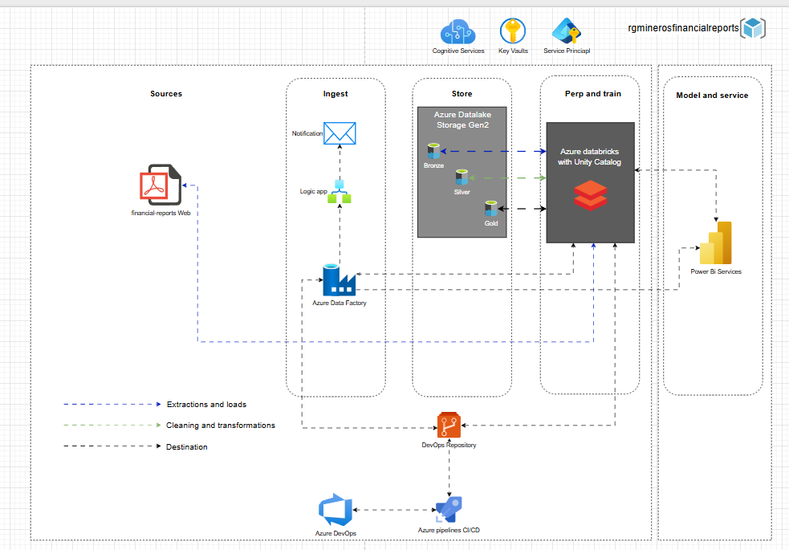
Solution architecture diagram

Slide 5
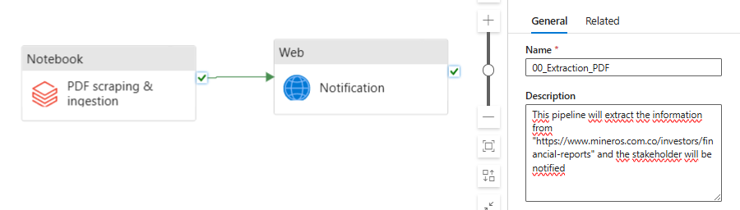
Pipeline architecture diagram - 00_Extraction_PDF

Slide 6
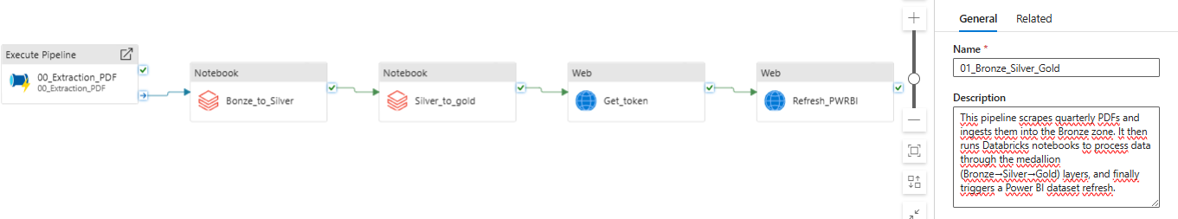
Pipeline architecture diagram - 01_Bronze_Silver_Gold

Slide 7
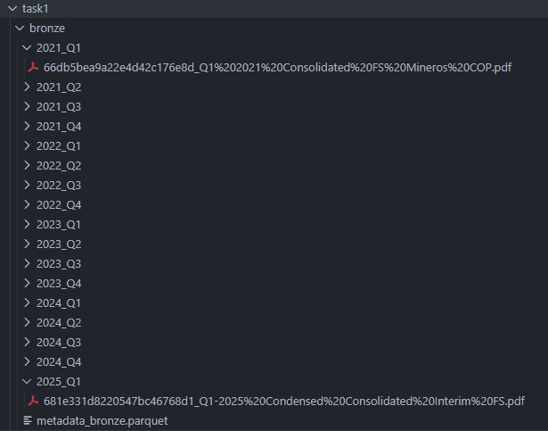
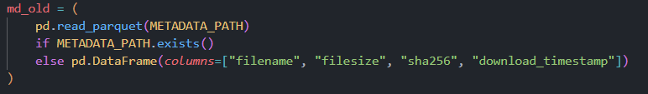
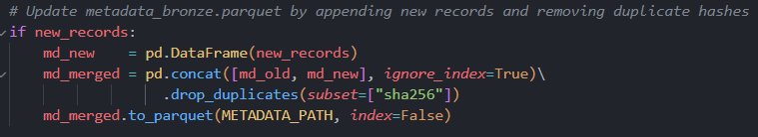
Validation Results
Bronze: 17 PDFs downloaded, all SHA256 verified

Slide 8
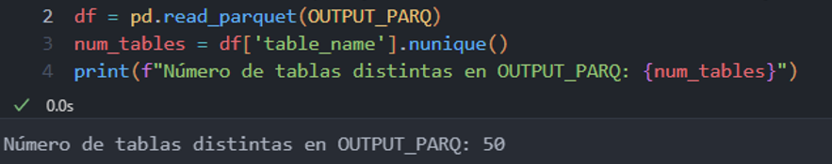
Validation Results
Silver: 50 tables extracted from Q1 2025

Slide 9
Improvement Ideas
Use Azure Cognitive OCR for scanned tables
Incorporate LLM for merged-cell parsing
Automate CI/CD via Azure DevOps pipelines
Implement data quality checks with DLT
Add multi-language support for captions
Use unity catalog from databricks

