Slide 1
Neo4j: The Database for Graph
NLP model applying on Semantic Analysis
Chuanyuan Chen

Slide 2
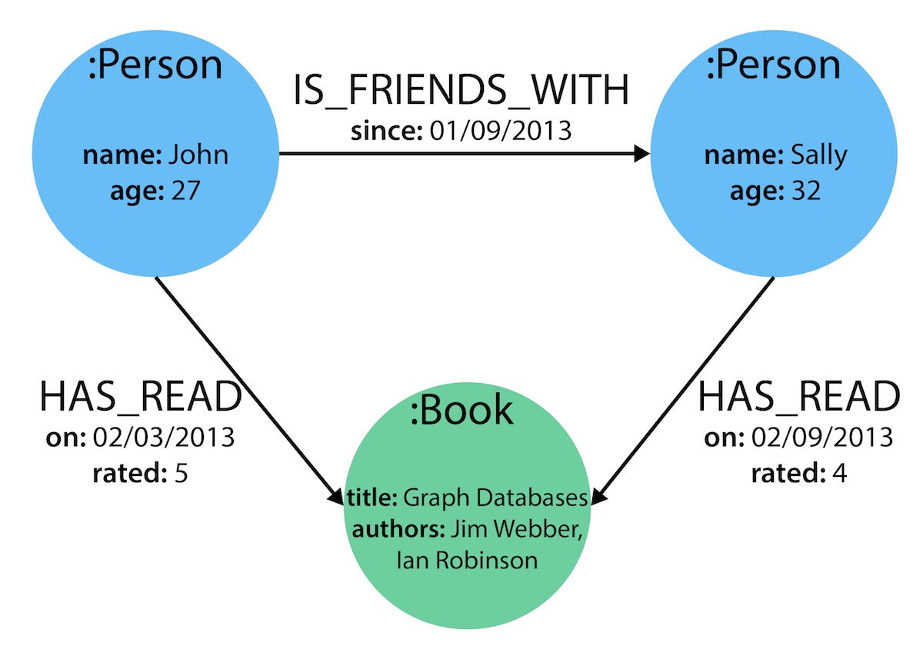
1. Introduction
Graph-based NoSQL system.
Node, Relationship, Property.

Slide 3
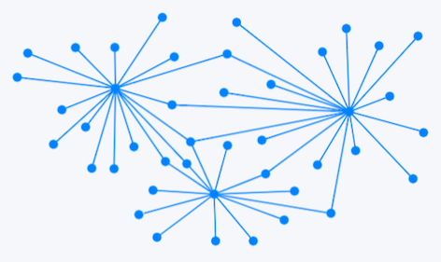
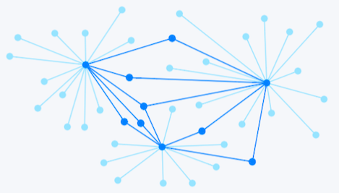
2. Motivation
Store graphs as graphs
No more complex joins
Many-to-many relationships
Find patterns & hidden connections

Slide 4
3. Characteristics
Fast Query
Scalable (huge data)
ACID Compliance (guarantee integrity)
Handful Libraries (faster development)

Slide 5
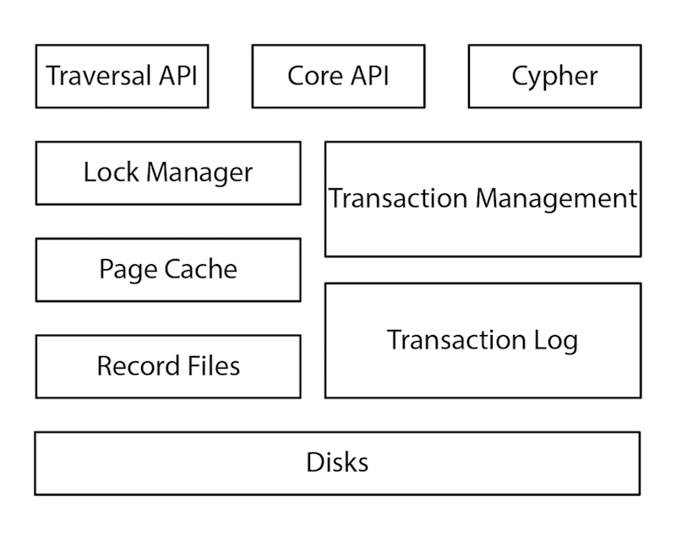
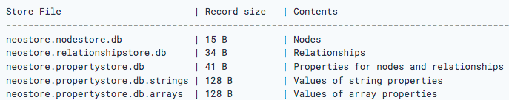
4. Architecture
Cypher: Graph Query Language
Disk: Nodes, Relationship, Properties.

Slide 6
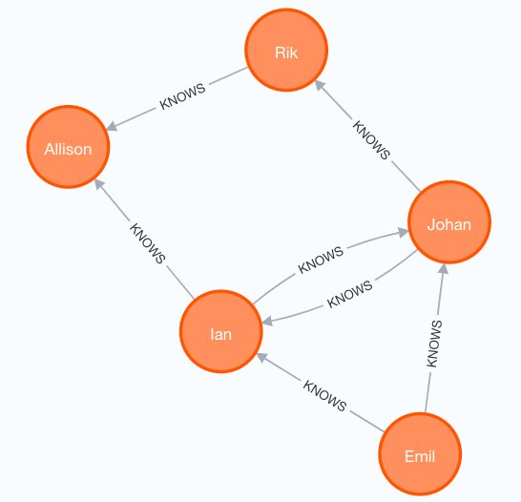
5. Example
CREATE (ee:Person {name: 'Emil'})
CREATE (jj:Person {name: 'Johan'})
MATCH (ee:Person) WHERE ee.name = 'Emil'
MATCH (jj:Person) WHERE jj.name = 'Johan'
CREATE (ee)-[:KNOWS]->(jj)
MATCH (ee:Person)-[:KNOWS]-(friends) WHERE ee.name = 'Emil' RETURN friends

Slide 7
Thank You!
NLP model applying on Semantic Analysis
Reference
[1] Neo4j Documentation from https://neo4j.com/.
[2] Graph Databases by Ian Robinson, Jim Webber, and Emil Eifrem.

