Slide 1
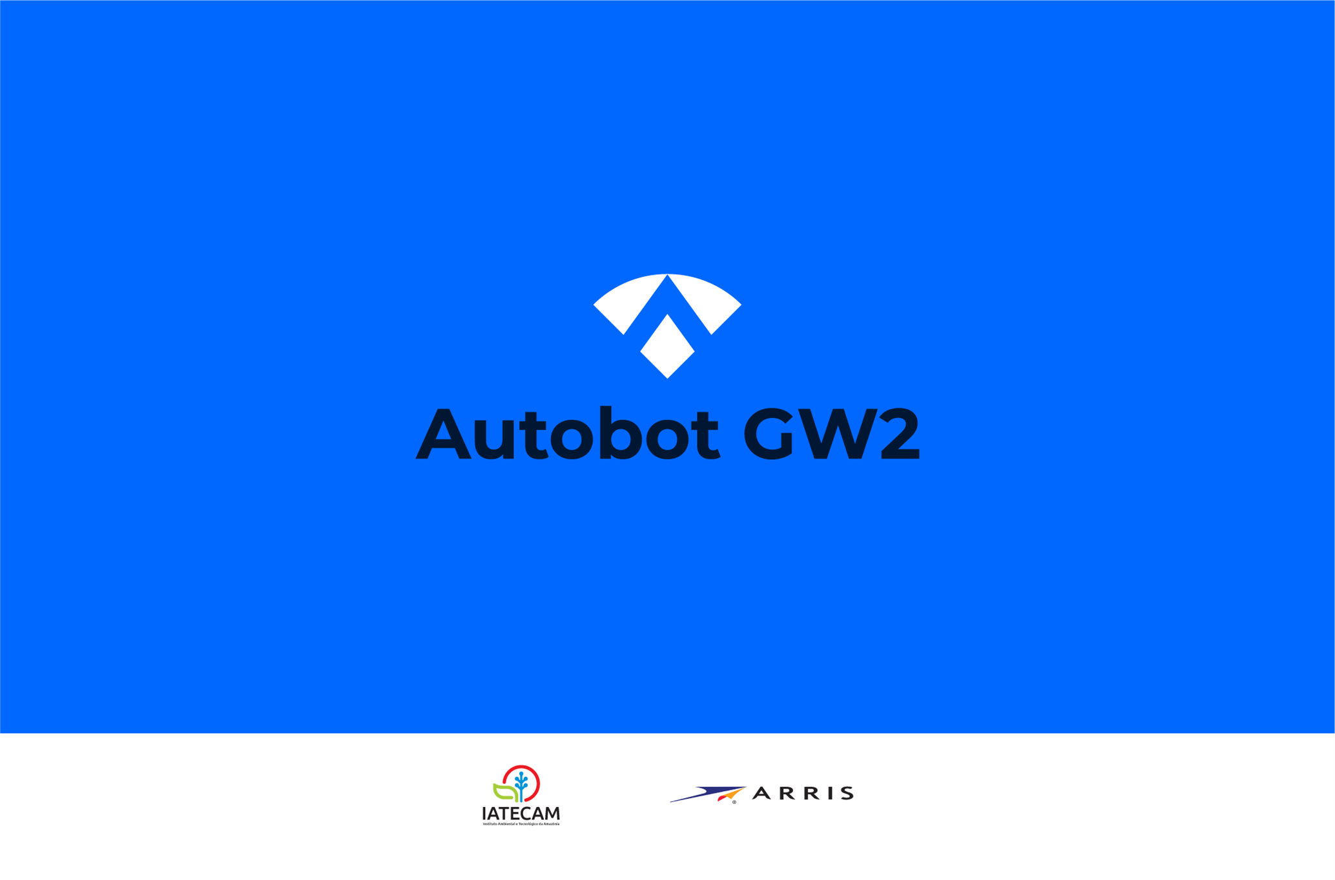
K I C K – O F F
October 2018

Slide 2
Outline
R&D Project
Team
Project Schedule
Way of Working
Expected Results

Slide 3
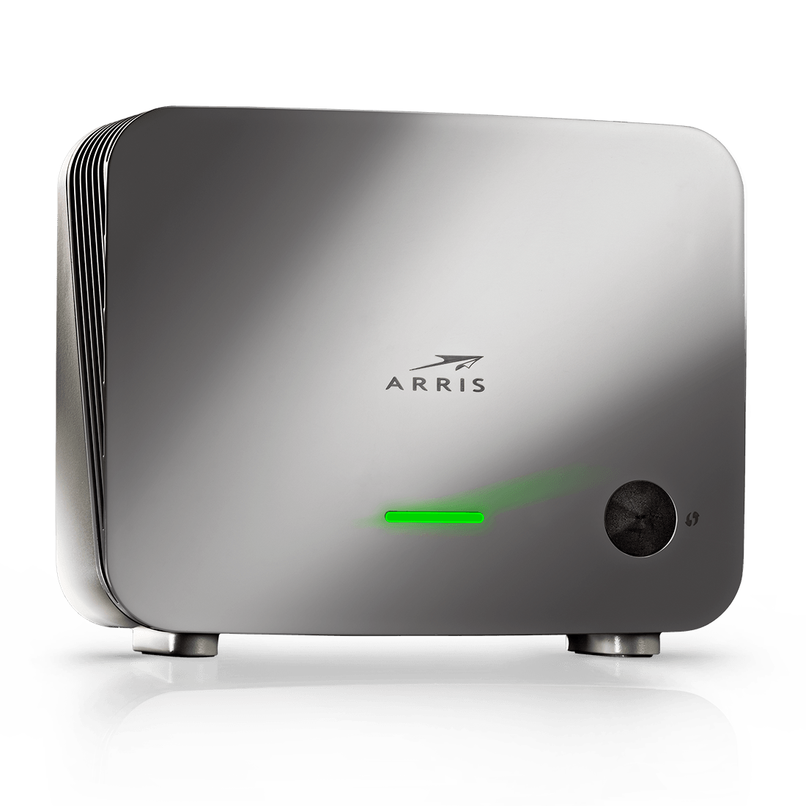
Autobot GW2 – R&D Project
Autobot Gateway 2 is an R&D Project sponsored by Arris to be developed by IATECAM
Motivation
Autobot GW2 is the second phase of Autobot Gateway Project. In the first phase, the Autobot Test Automation Tool was built to automate test cases of NET 3P Gateway equipment. Based on the achivied results, Arris Q&A team decided to expand Autobot functionalities to automate test cases of other product, VAP4641.
GW2 Goals
Expand Autobot tool to automate VAP4641 test cases;
Expand Autobot tool to run tests on remote devices, developing a client-server application architecture
VAP4641

Slide 4
GW2 Team
Stakeholders
Name | Role | Company
Michelle Silva | R&D Coordinator | Arris
Thatiane Almeida | Product Owner | Arris
Manas Acharya | Specialist | Arris
Diego Mathias | Support | Arris
Diego Alegria | Support | Arris
Development Team
Name | Role | Company
Karla Okada | Project Manager | IATECAM
Renato Lima | Software Developer (Team Leader) | IATECAM
Júlio Magnani | Software Developer | IATECAM
Janderson Lira | Software Developer | IATECAM
Pedro Pinto | UX Designer | IATECAM

Slide 5
Project Schedule
October
November
December
January
February
March
April
May
June
Analysis
Cliente-server
Development of 2.4GHz, 5.0GHz Test Cases
Development of Customer, BTM and HNE Test Cases
Validation
Project Duration: 8 Months
Start Date: Oct 15th 2018
Finish Date: Jun 24th 2019

Slide 6
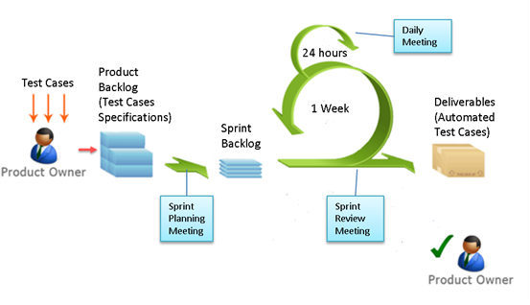
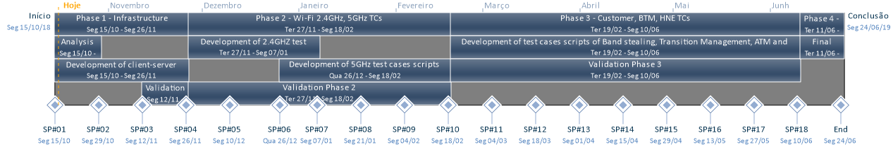
Way of Working
SCRUM Practices
Product Backlog
2-Weeks Sprint
Sprint Planning
Sprint Review
Daily Meeting (Dev Team)
2 Weeks
Weekly Sync up meetings with PO on Mondays
18 Sprints

Slide 7
Expected Results
Add VAP automated test cases to Autobot
Wi-Fi 2.4GHz
Wi-Fi 5.0GHz
User Scenario Testing…
Implemented Test Cases Documentation
Autobot as a Client-Server Application to make possible running tests on remote devices

Slide 8

GW2
Thank you!

