Slide 1
Fullwave, user’s guide
DAY ONE
simulation of a radiating dipole in vacuum
(no output files)

Slide 2
Step 1: Open a new project

Slide 3
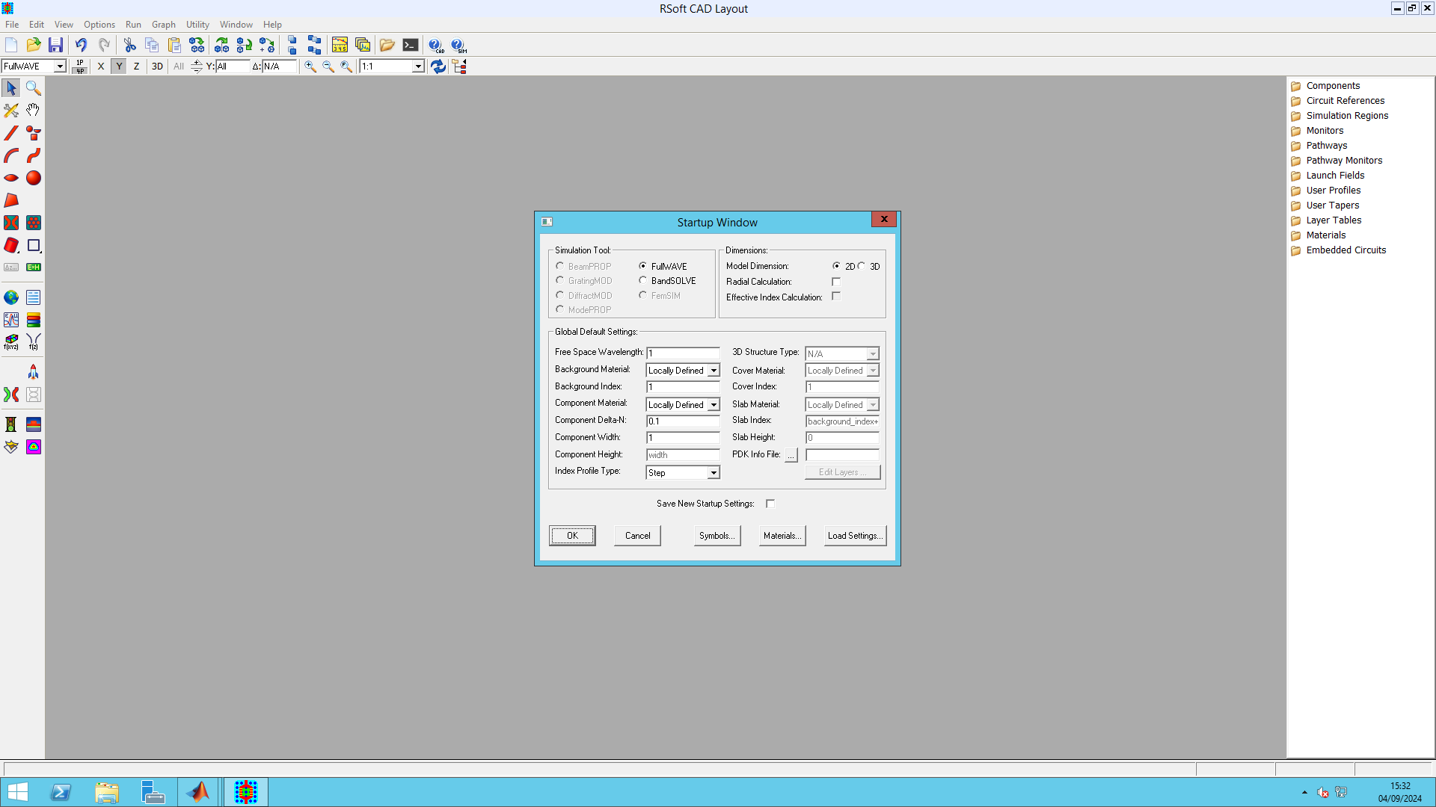
To open a new project
Save the program
Choose 3D
Choose Fullwave
Emission lambda
0.8

Slide 4
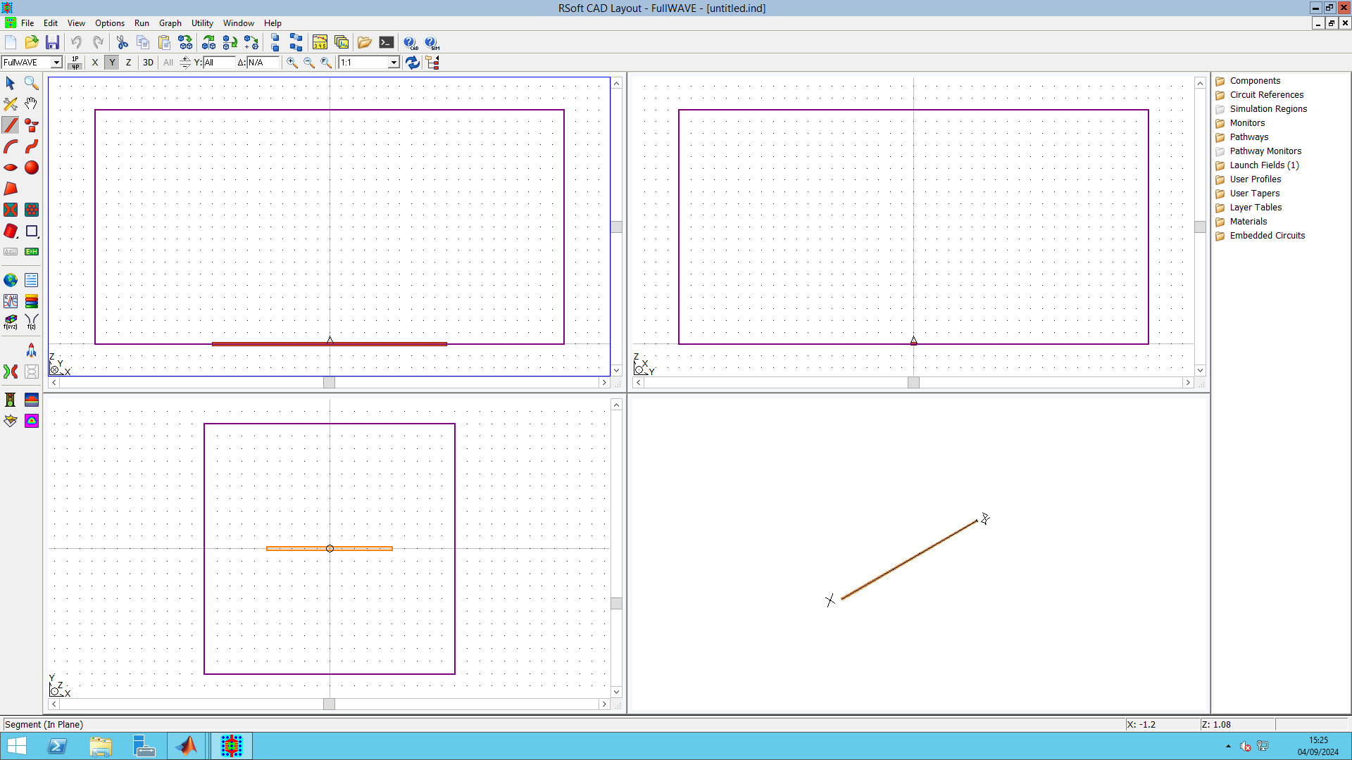

FDTD, commercial software « Fullwave »

Slide 5
Step 2: Define the computation settings volume/window, meshgrid, PML, dispersion, duration, etc.

Slide 6
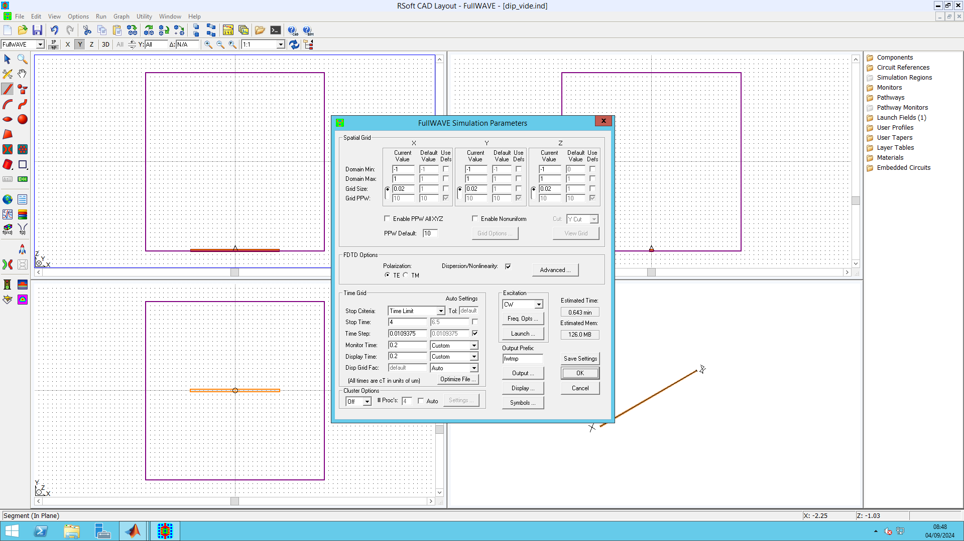
Save
Volume and gridding
Grid size: 20 nm, Domain at +/- 1 µm along X, Y and Z.
ALL LENGTHS ARE IN MICRONS
Just a convention
➔ dipoles along (0x)
Save parameters
(do not forget)
Comput.
limit
Name (the root) of the OUTPUT FILES

Slide 7
Step 3: Define the dipole

Slide 8
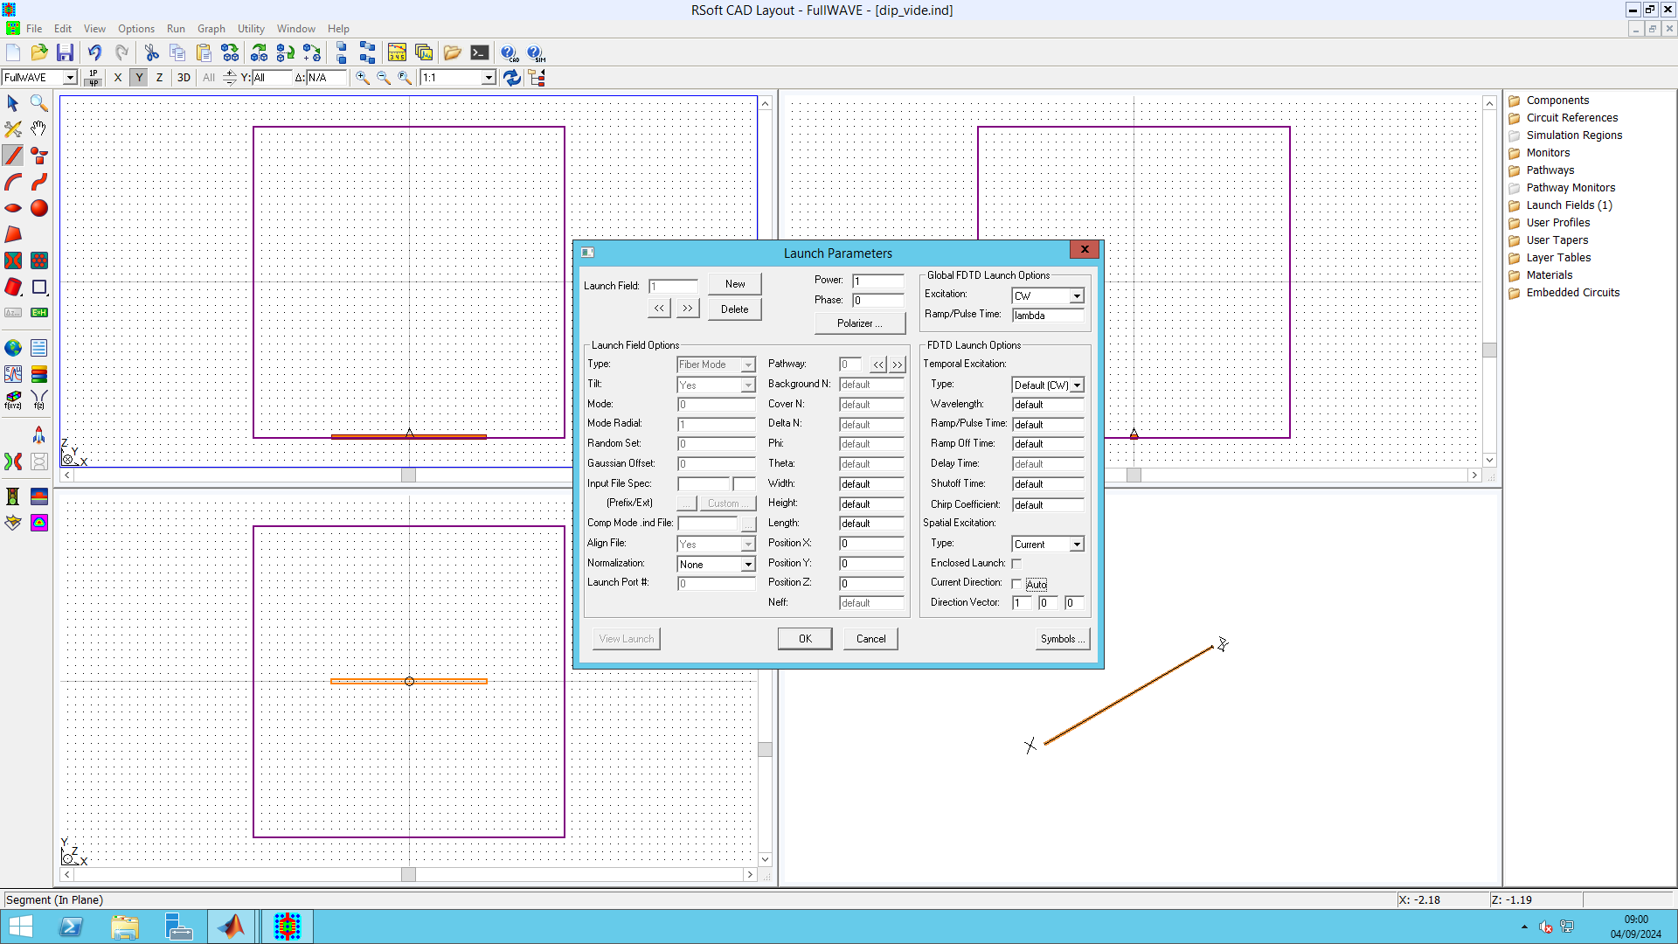
Let it at lambda
Switch from « field » to « current »
x y z
x=y=z=0
Dipole orientation

Slide 9
Step 4: Include an object

Slide 10
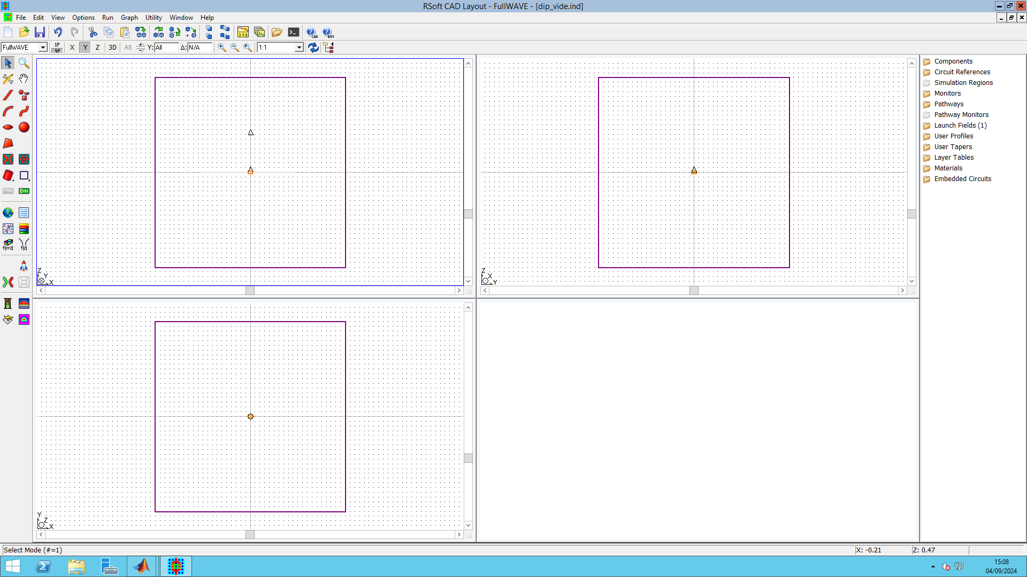
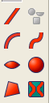
layer
Sphere

Slide 11

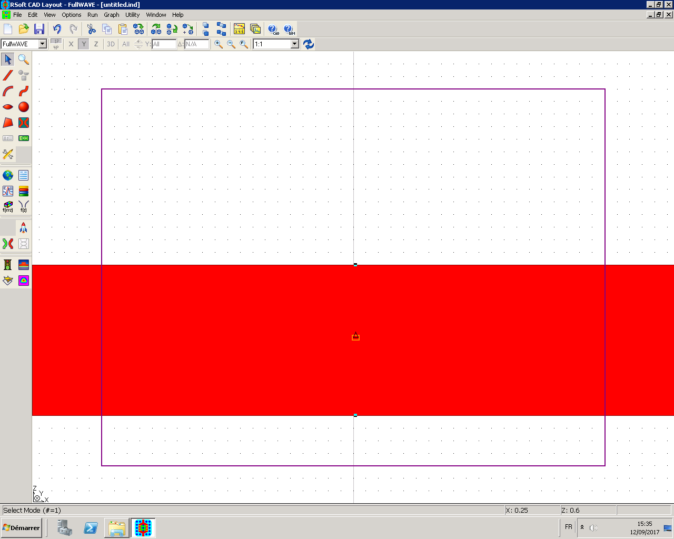
Inclure une couche
1
The object can extend outside of the computation volume (it can cross boundaries)
Then, « pull up » the cross and click
➔ You position the upper interface
3
Result
2
Position the cross and click (with the mouse)
➔ You position the downer interface of the layer

Slide 12
Right click on the object to define its size and position. A dialog window of the object appears when right-clicking

Slide 13
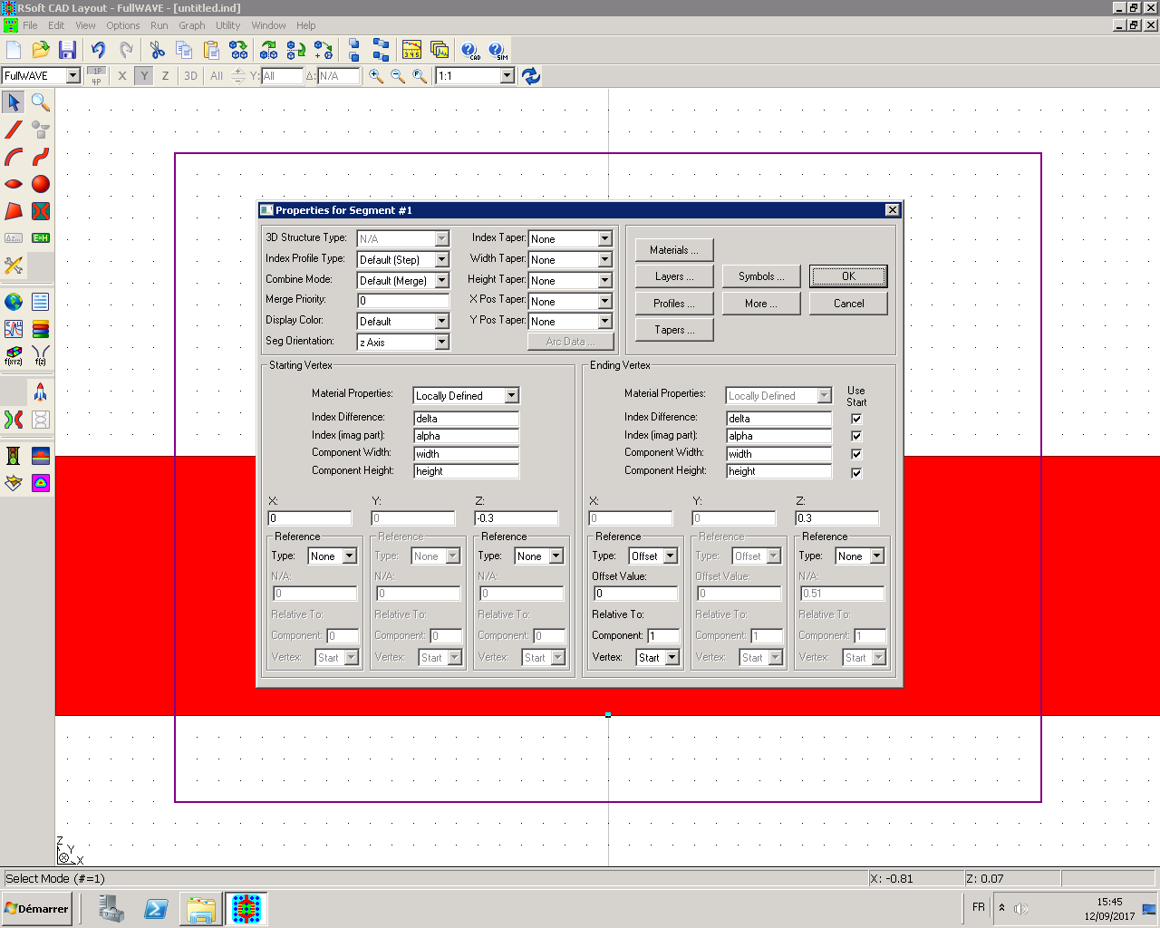
Call me
Define upper interface
Define downer interface
VALUES IN MICRONS

Slide 14
Step 5: Export data
Output fields

Slide 15
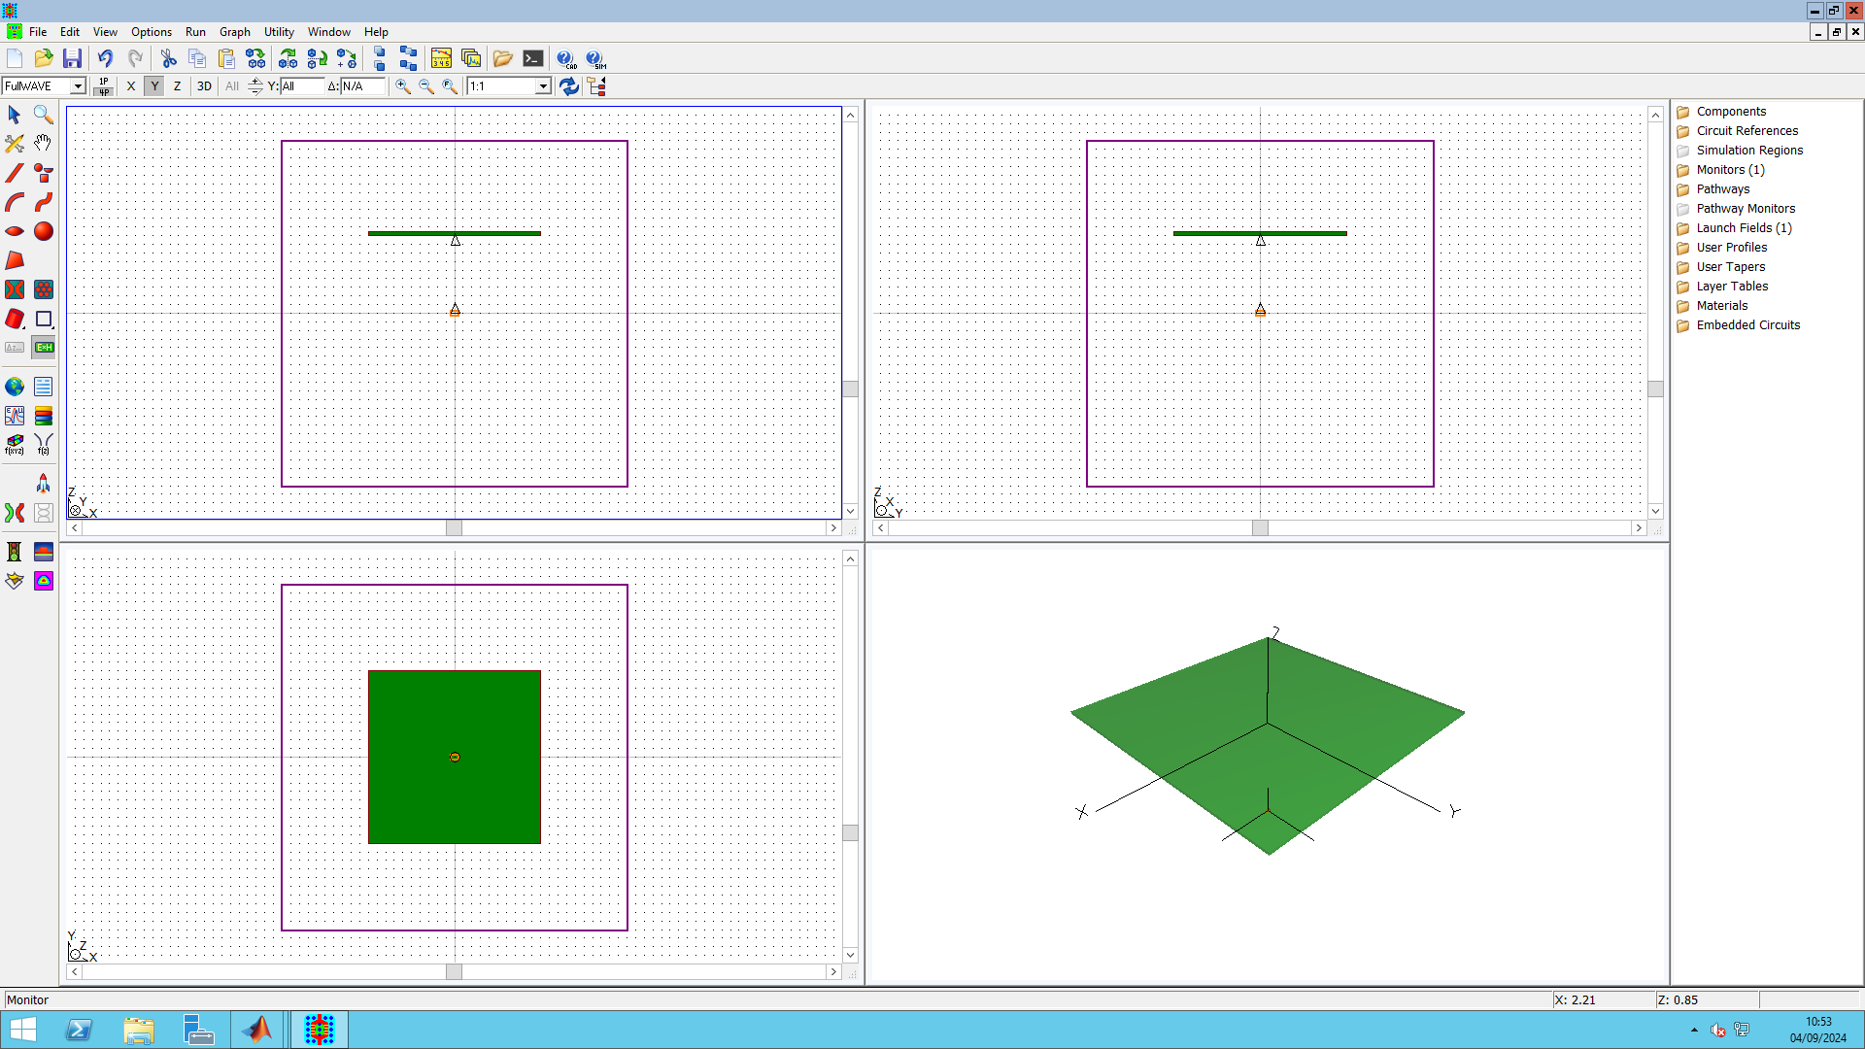
Center of the monitor,
Position reference
Left-clic in the window to make it appear
The monitor positionning and size are defined in the monitor window (right click on the monitor)

Slide 16
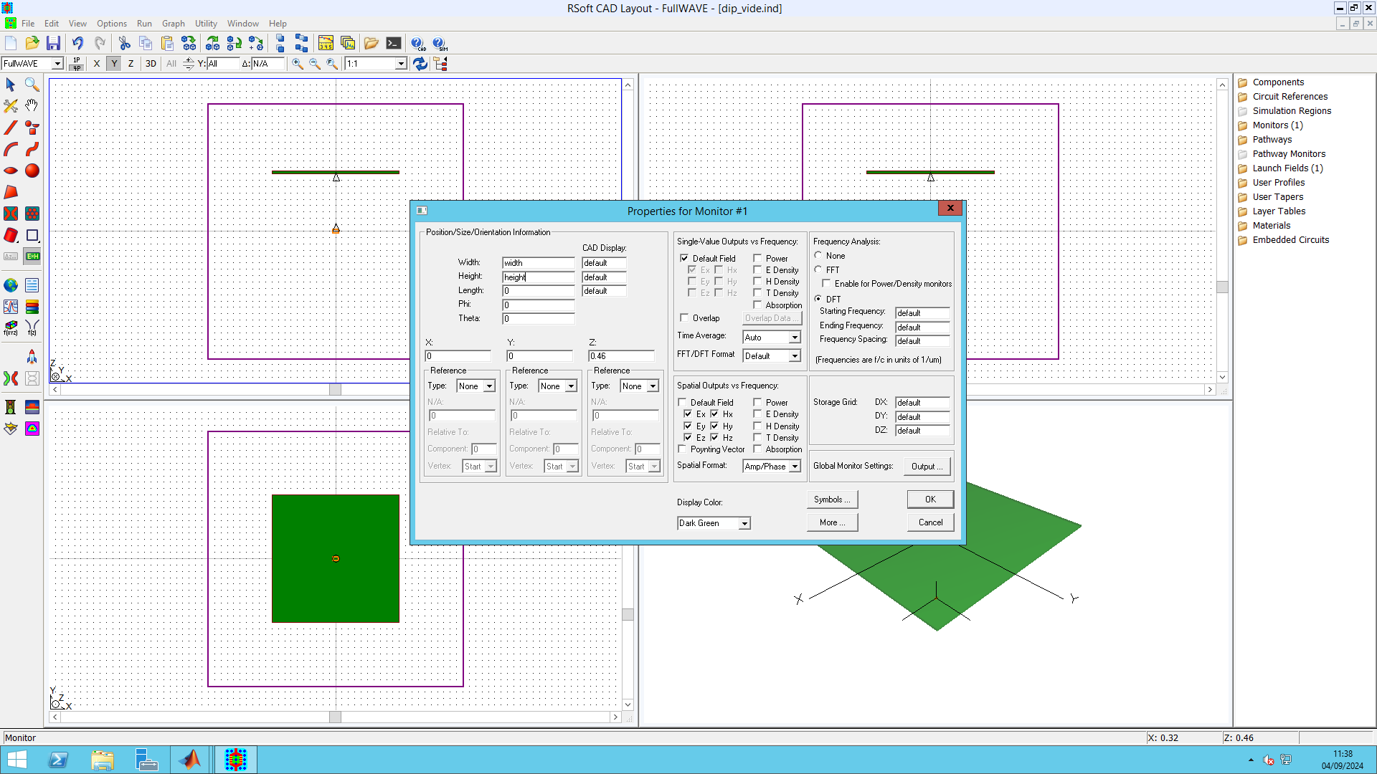
Right clic on the monitor to open the window
Monitor size (IN MICRONS)
Position of the monitor center
Record the field in complexe notation (Amplitude/phase)
Save E and H fields (6 vector components) within the monitor
➔ Will be use for power calculation with Matlab or Python

Slide 17
Step 6: Launch the simulation

Slide 18
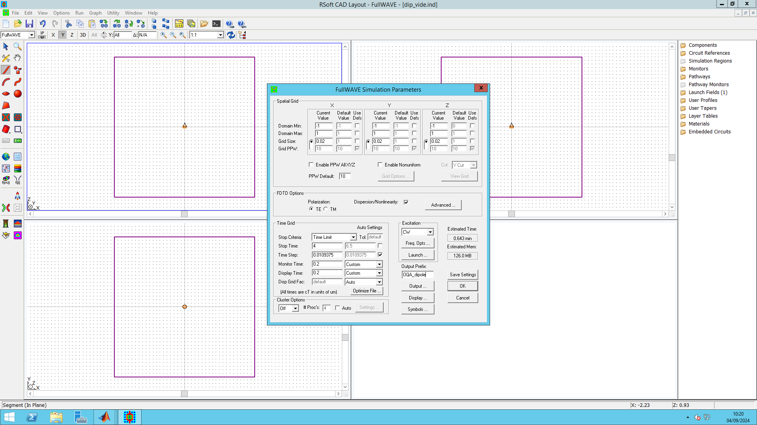
Prefix of the ouput folders
Verify
The name of the output folders and of the program can be different
Launch
Temps : c*t (en microns)

Slide 19
