Slide 1
Context analysis of taxi data using the Powerwall
Group 3 – Julia Klein, Julius Rauscher
12.11.2019

Slide 2

Data set
Taxi rides in New York from 2009 to 2019
Pick-up & drop-off times
Pick-up & drop-off locations
Trip distances
Extra data: passenger count, itemized fare, rate type, payment type
https://www1.nyc.gov/site/tlc/about/tlc-trip-record-data.page
Taxi Driver movie cover, IMDB
(https://www.imdb.com/title/tt0075314/)

Slide 3
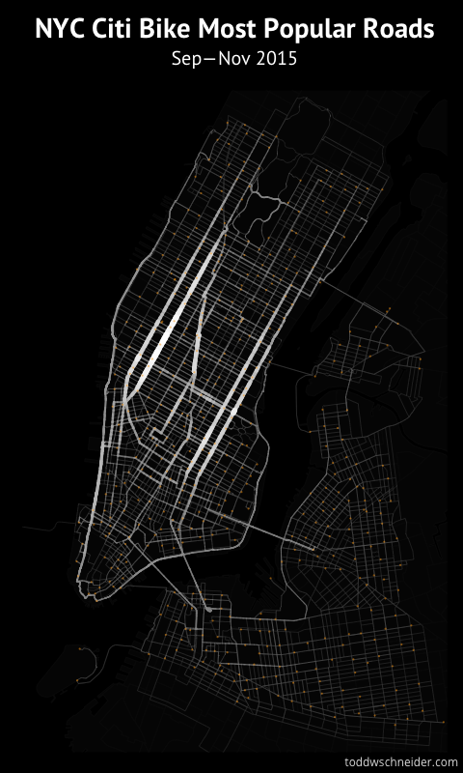
Motivation
Use geographic context information for analysis to show interesting facts on the Powerwall!
Hotspots in NYC
Event deviations (e.g. UN General Assembly, New Years Eve)
Analyze temporal influence
Morning vs Nighttime
Weekdays vs. Weekends
Summer vs. Winter
Use semantic zoom to present different levels of detail
Most popular roads, thickness & brightness based on number of Citi Bikes that traveled there (https://toddwschneider.com/page/3/)

Slide 4
Challenges
Very large dataset (~600MB per month)
use only one year of data
Find interesting patterns in the data that are not obvious
Dependent on external factors
Develop a visualization technique to show results
Occlusion problems
Display the analysis simple, clear and understandable on the Powerwall
Semantic zoom

