Slide 1
Context Analysis of Taxi Data Using the Powerwall
Group 3 – Julia Klein, Julius Rauscher
04.02.2020

Slide 2
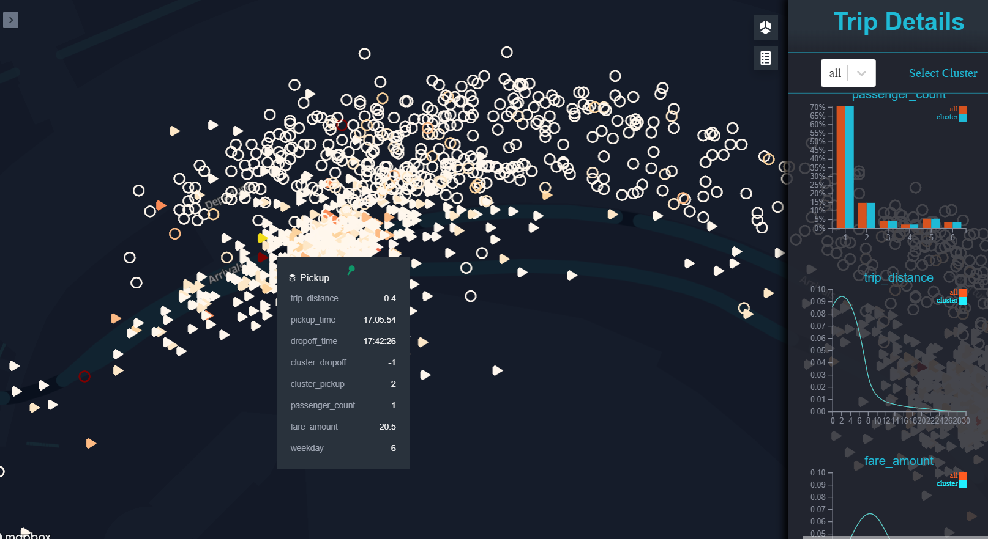
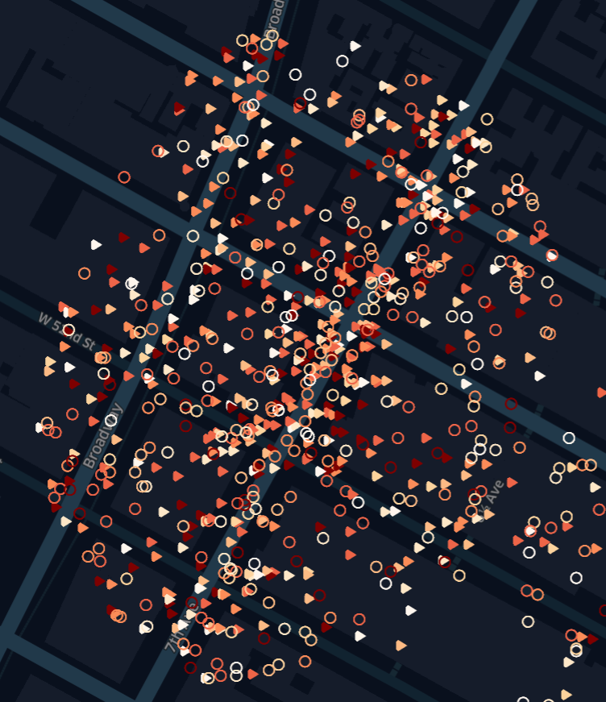
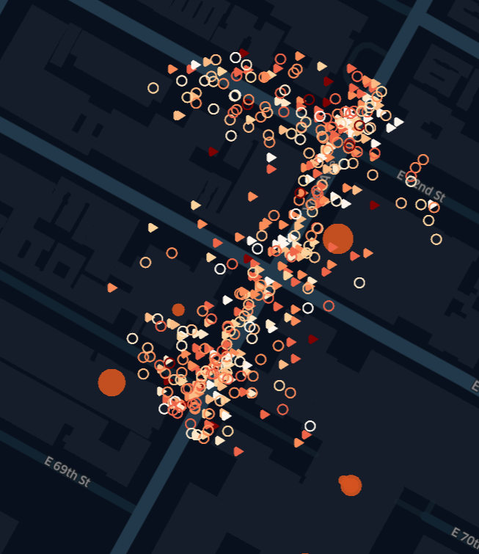
Current status
Points of Interest from Google
→ Better results
Icon color depends on relationship between trip duration and trip distance
Identify outliers
Differences between clusters

Slide 3
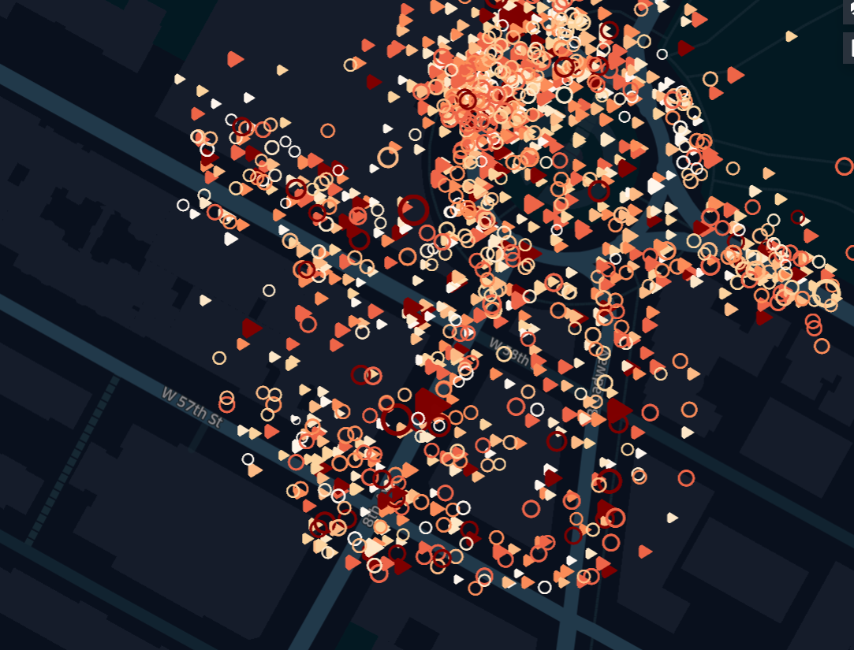
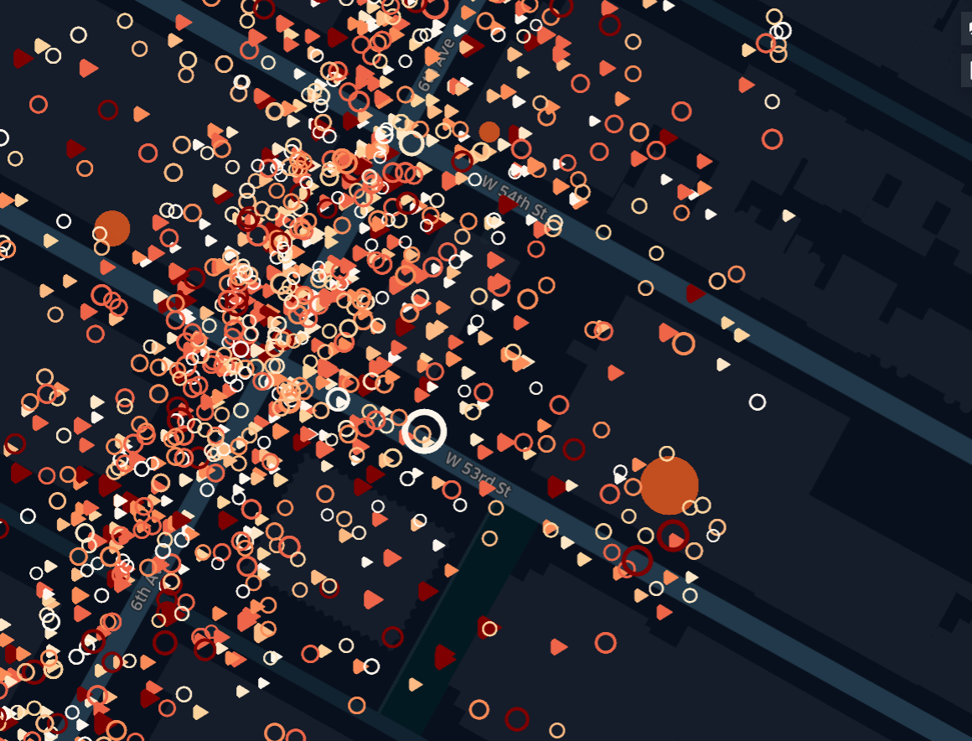
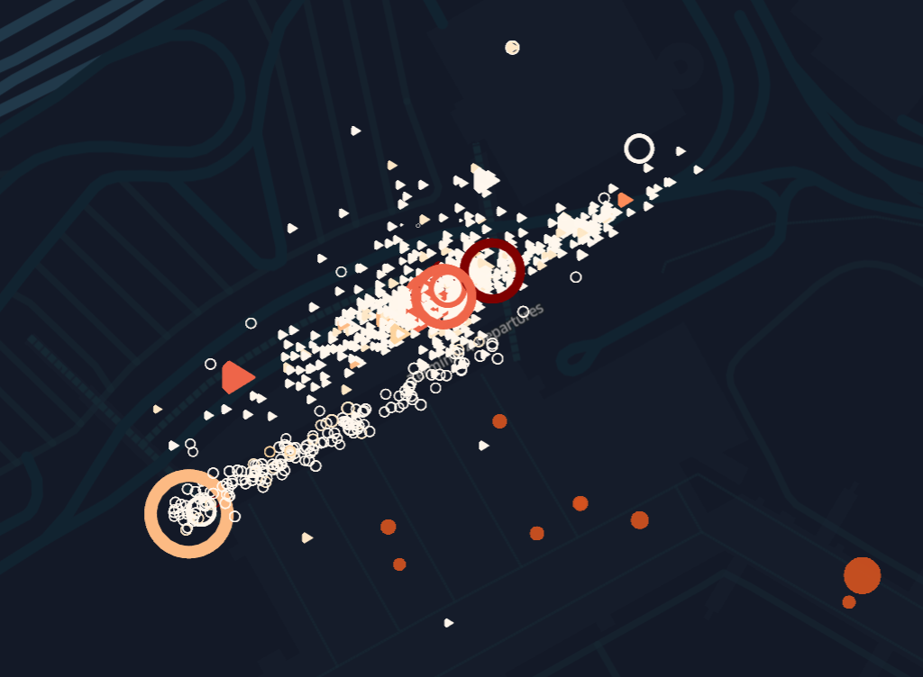
Current status
Icon size depends on relationship between fare amount and trip distance
Consistent with distance & duration?
Distance: 0.1m
Duration: 06:38
Fare: 5.5$
Distance: 0.05m
Duration: 00:03
Fare: 2.5$
Distance: 18.06m
Duration: 01:05:29
Fare: 52.0$

