Slide 1
Context Analysis of Taxi Data Using the Powerwall
Group 3 – Julia Klein, Julius Rauscher
26.11.2019

Slide 2
Data Management
  SQLite Database with Tables for different Data Sources
  2016 Taxi Trip Data
    Longitude / Latitude included
    Preprocessing steps (date format, relevant columns, …)
  131.165.043 trips in total
    Uploaded 500.000 by now

Slide 3
Additional Data
  Weather Data from NOAA National Centers for Environmental Information
  Daily values for
    Temperature
    Precipitation
    Snowfall
    …
(https://www.ncdc.noaa.gov/)

Slide 4
Additional Data
  Google Maps Places API
    Query for Points of Interest on hotspot locations
    Nearby Search Request
      Input: location, radius (rankby, keyword, opennow, type)
    Challenges
      Finding most relevant point of interest
(https://developers.google.com/places/web-service/search/)

Slide 5
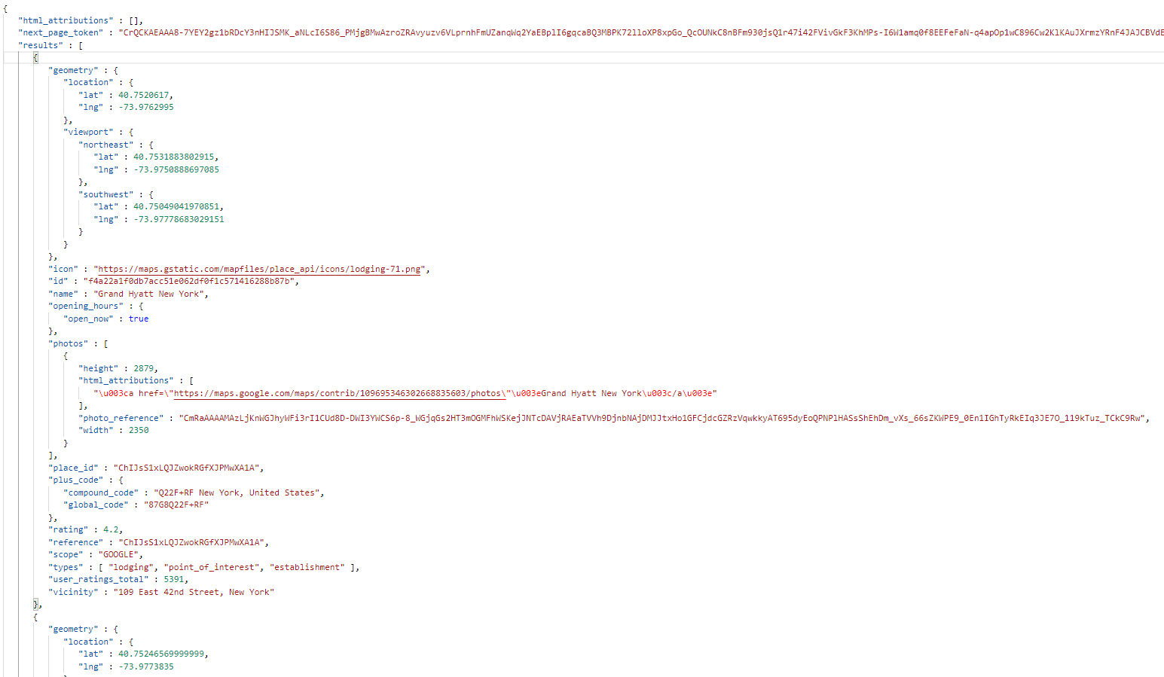
Query output

