Slide 1
Context Analysis of Taxi Data Using the Powerwall
Group 3 – Julia Klein, Julius Rauscher
03.12.2019

Slide 2
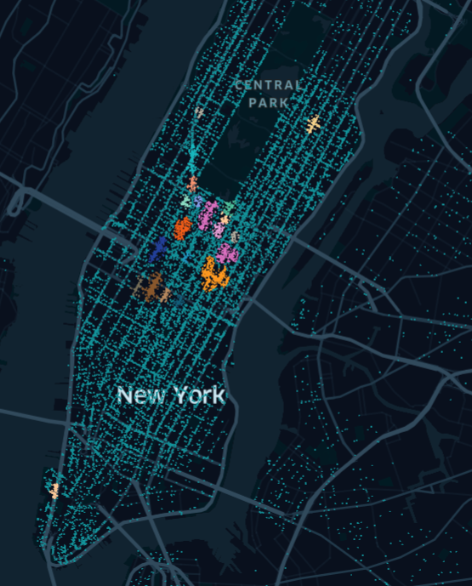
Hotspot detection
Mining the most-frequented places from the taxi data
Remove zero rows
Cluster data by location -> DBSCAN
Future Challenges
Try other clustering algorithms
Separate clusters by daytime (& weekday/weekend)
Morning, afternoon, evening & night

Slide 3
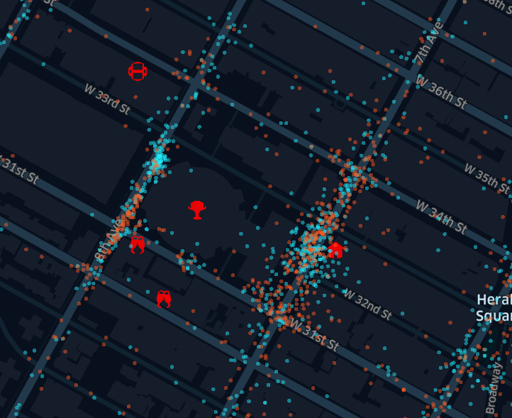
Location Scan
“Why are so many drop-offs at this location?”
Investigate using external data
Google Maps, Foursquare
Yelp
Subway stations
Future Challenges
Identify the correct reason for drop-off
Interactivity
Query limits

