Slide 1
Context Analysis of Taxi Data Using the Powerwall
Group 3 – Julia Klein, Julius Rauscher
10.12.2019

Slide 2
Current status
NYC Subway Stations added to map
Implemented Sidebar
Plots with additional information
Passenger_count
trip_distance
Applicable to entire dataset & individual clusters

Slide 3
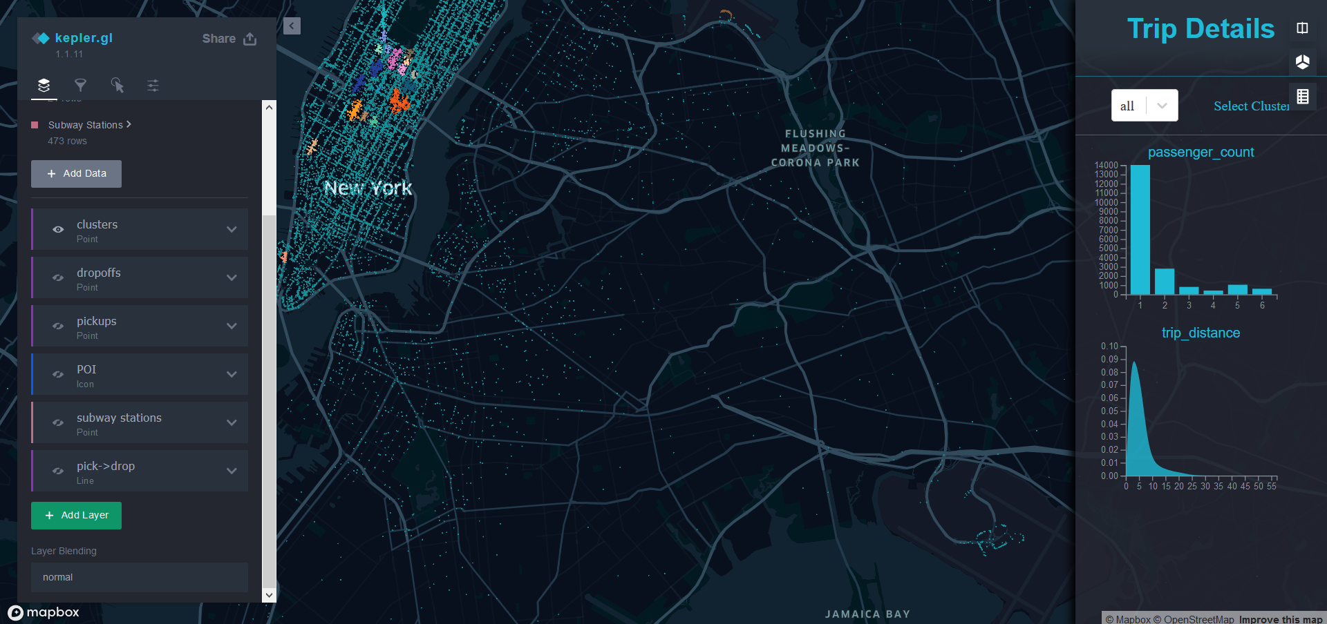
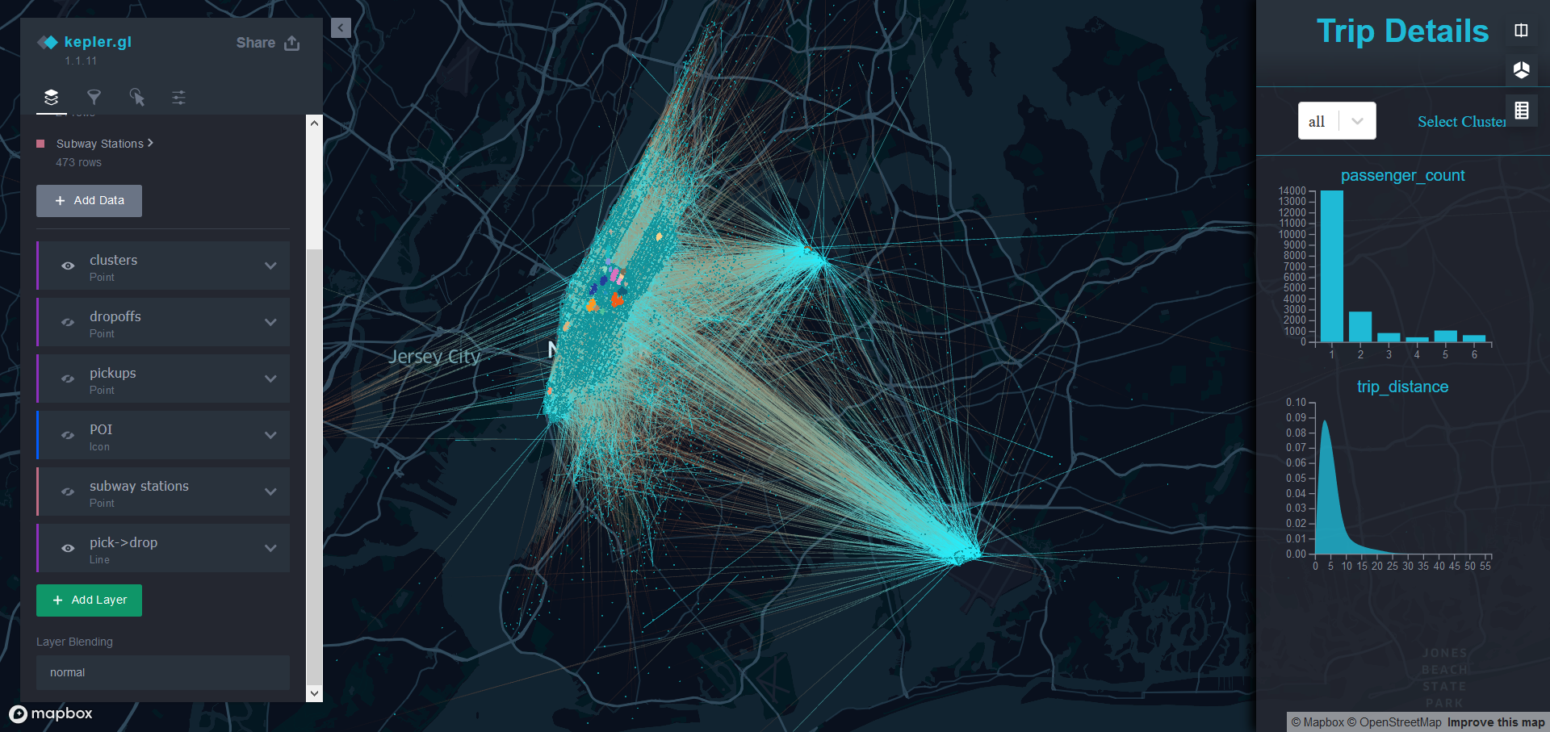
Challenges
No perfect clustering with DBSCAN
Airport not considered
→ Difficult to find good hyperparameters
No preloading of very large dataset possible
Limit to ~20000 datapoints

Slide 4
Next steps
Different visualization for outliers
Trip Details for clusters
Include List of Points of Interest
Show results for cluster in comparison to entire dataset
Plots for time of day, weekday, month
Compare pickups and dropoffs
Semantic Zoom

Slide 5
Next steps
Make use of tool easier
Buttons to show subway stations and Points of Interest
Improve hovering & tooltips
Add Points of Interest for each cluster

