Slide 1
Context Analysis of Taxi Data Using the Powerwall
Group 3 – Julia Klein, Julius Rauscher
07.01.2020

Slide 2
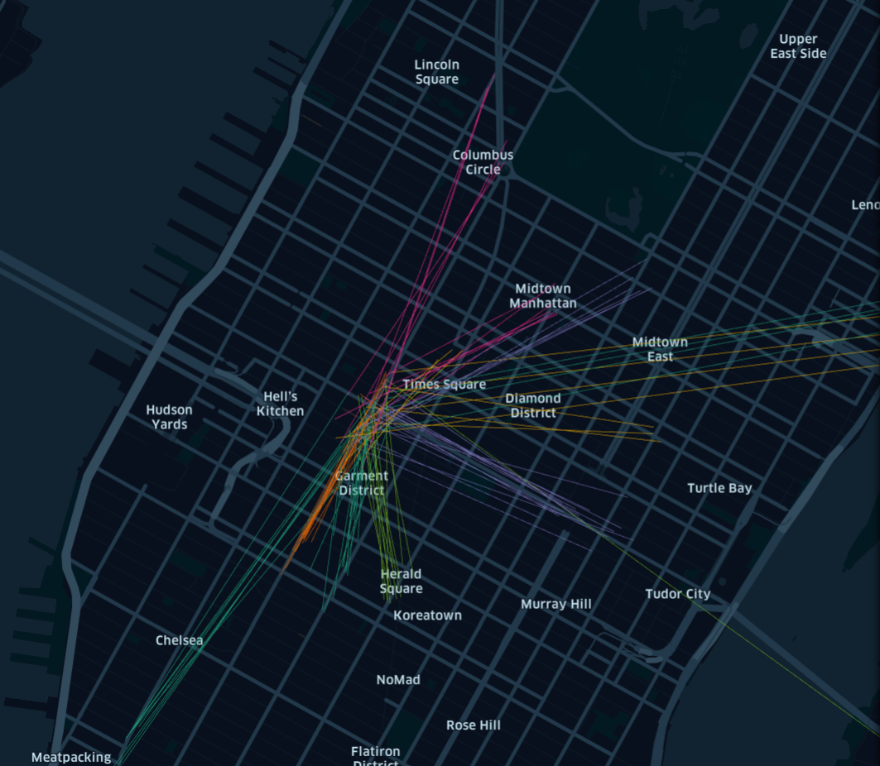
Current status
Improved cluster highlighting
show colored lines from pickup to dropoff
unclustered points have smaller radius
Joined pickups and dropoffs for cluster analysis
Previously: only dropoffs analyzed
Now: separate analysis of pickups and dropoffs
See differences, for example more dropoffs than pickups in afternoon at airport

Slide 3
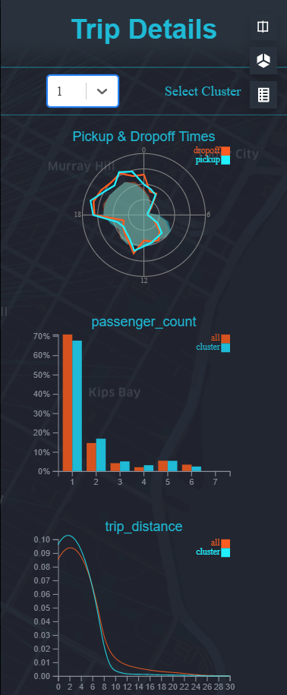
Current status
Increased size of dataset (20.000 – 50.000)
Export clustered data as string
Bounding box for NYC to filter outliers
Added plot to compare pickup vs. dropoff
Clustered data comparable against entire dataset

Slide 4
Next Steps
Add points of Interest for each cluster
Overview of time of day
Semantic zoom
Change radius/opacity of points & lines depending on zoom level

