Slide 1
Context Analysis of Taxi Data Using the Powerwall
Group 3 – Julia Klein, Julius Rauscher
14.01.2020

Slide 2
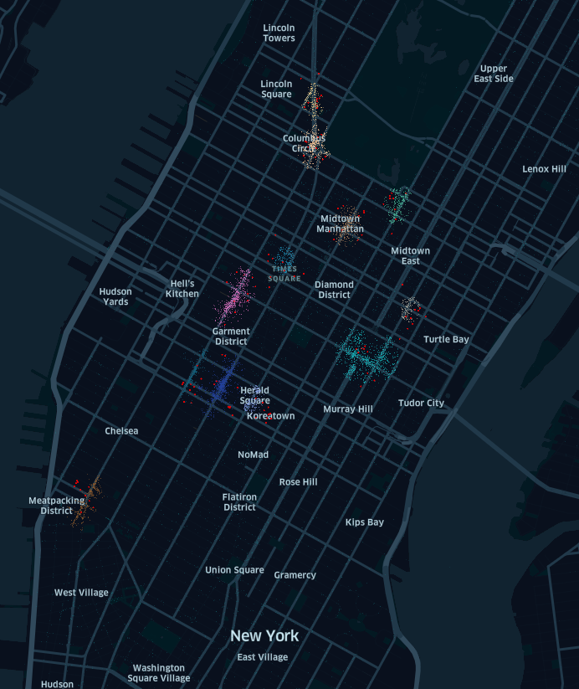
Current status
Points of Interest available for every cluster
Detect Hotspots
Confirm clusters

Slide 3
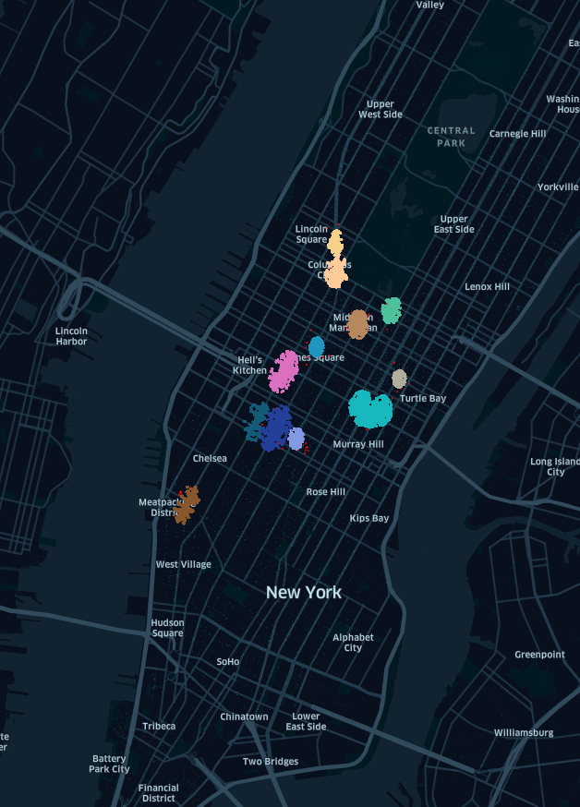
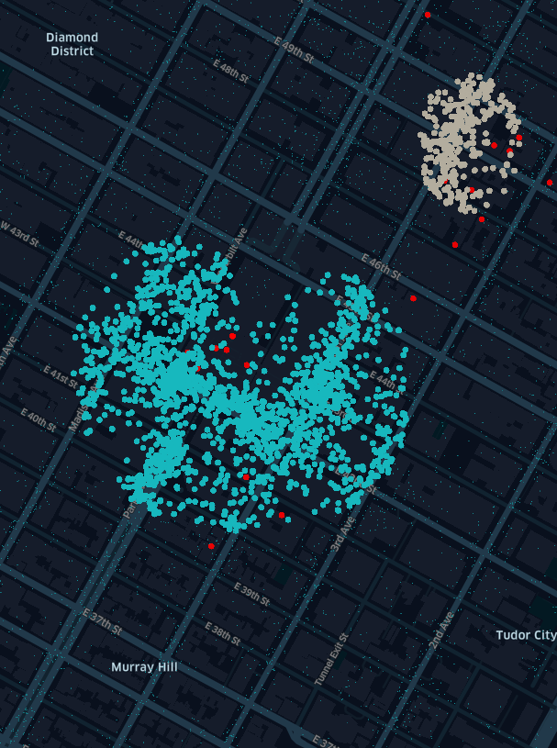
Current status
Semantic zoom
Change size of points according to zoom level
Perceive different levels of detail
Only for overview, not for specific clusters

Slide 4
Next Steps
Semantic zoom improvements
Clustering of points
Finer scaling
For all views, not just overview
Try on Powerwall what is working
Improve trip details
Cluster by daytime

