Slide 1
Context Analysis of Taxi Data Using the Powerwall
Group 3 – Julia Klein, Julius Rauscher
21.01.2020

Slide 2
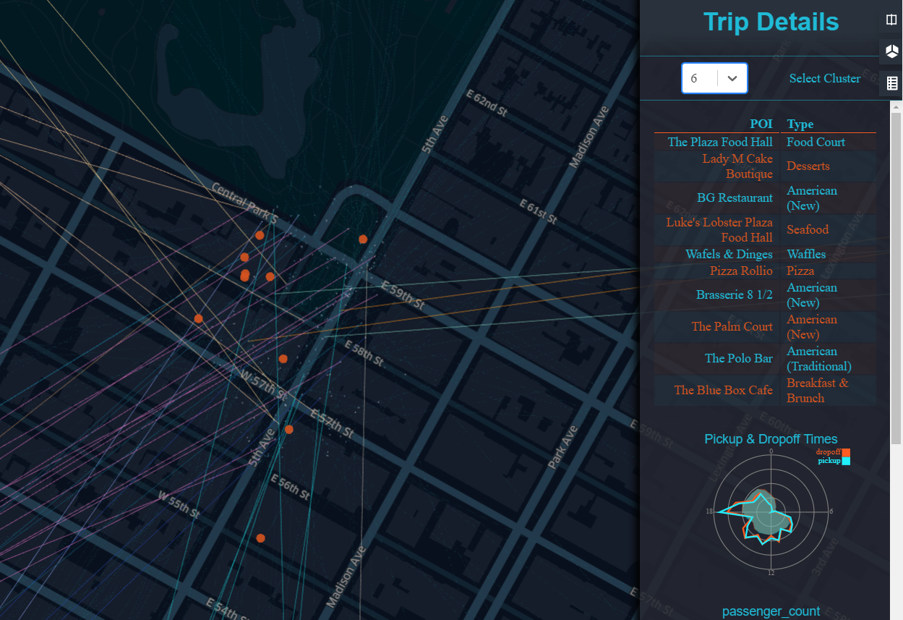
Current status
Points of Interest added to side view
Shows name & category
Sorted by best match
Points of interest are restaurant biased

Slide 3
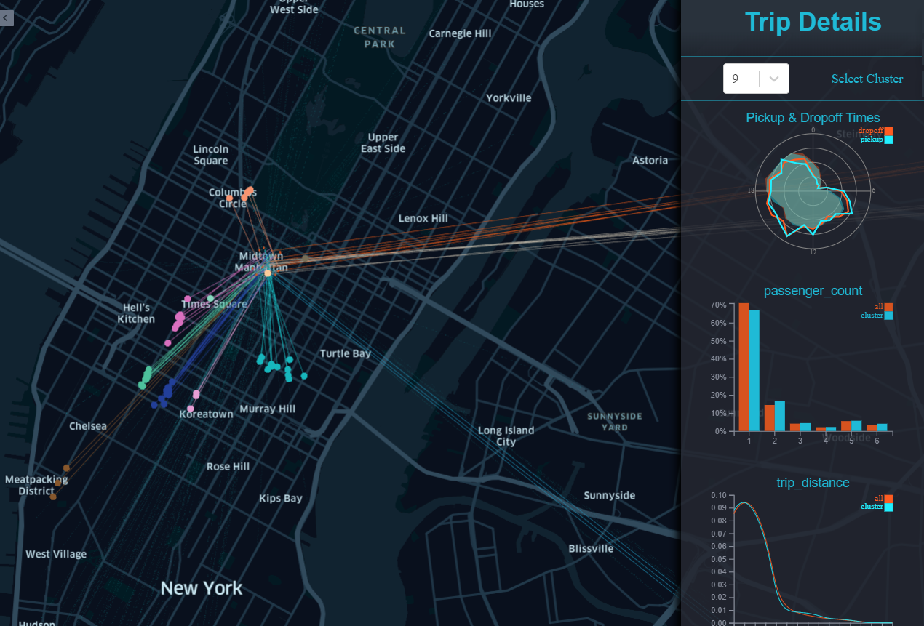
Current status
Minor refinements
Line colors match pickup clusters
→ detect where people come from
Zooming & position errors fixed
Zooming parameters adapted to Powerwall

Slide 4
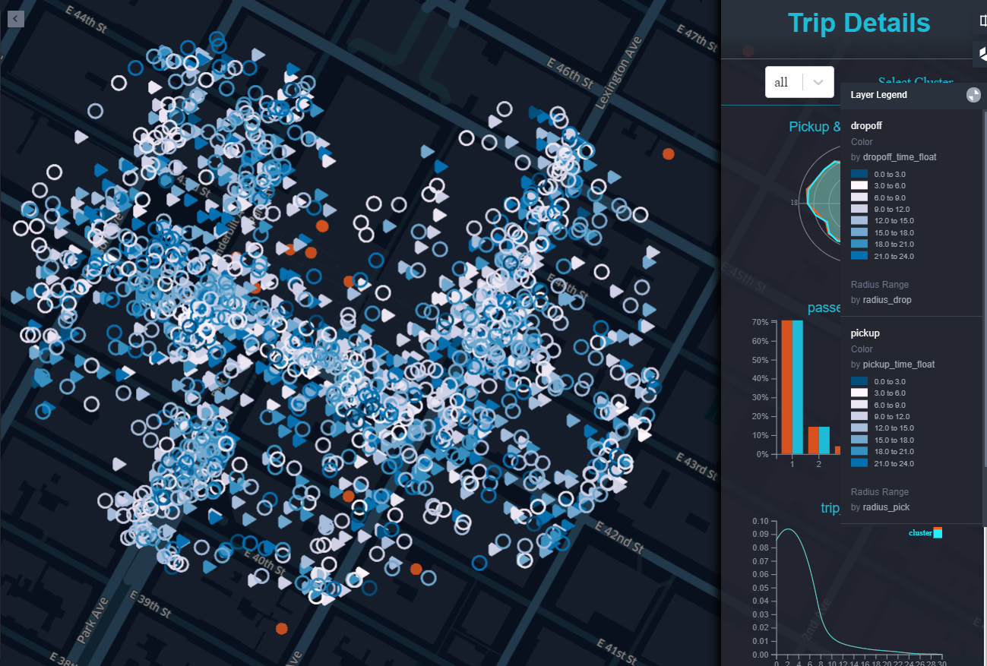
Current status
Semantic zoom
Change points when a specific zoom level is reached
Shape = pickup / dropoff
Color = daytime

Slide 5
Problems / Next steps
Semantic zoom
Further modify data points (Kepler properties)
Clutter
Pickup / dropoff clustering
Filter works only for one type of data points
Points of Interest
Highlighting
Process categories of Points of Interests in cluster
E.g.: Only bars indicate a drinking area
gain more information about cluster

