Slide 1
Context Analysis of Taxi Data Using the Powerwall
Group 3 – Julia Klein, Julius Rauscher
28.01.2020

Slide 2
Current status
Added weekday column
Selection of individual weekdays possible
Different clusters for different weekdays
Differences in pickup/dropoff times
Minor bugfixing
Show/hide lines
Include legend

Slide 3
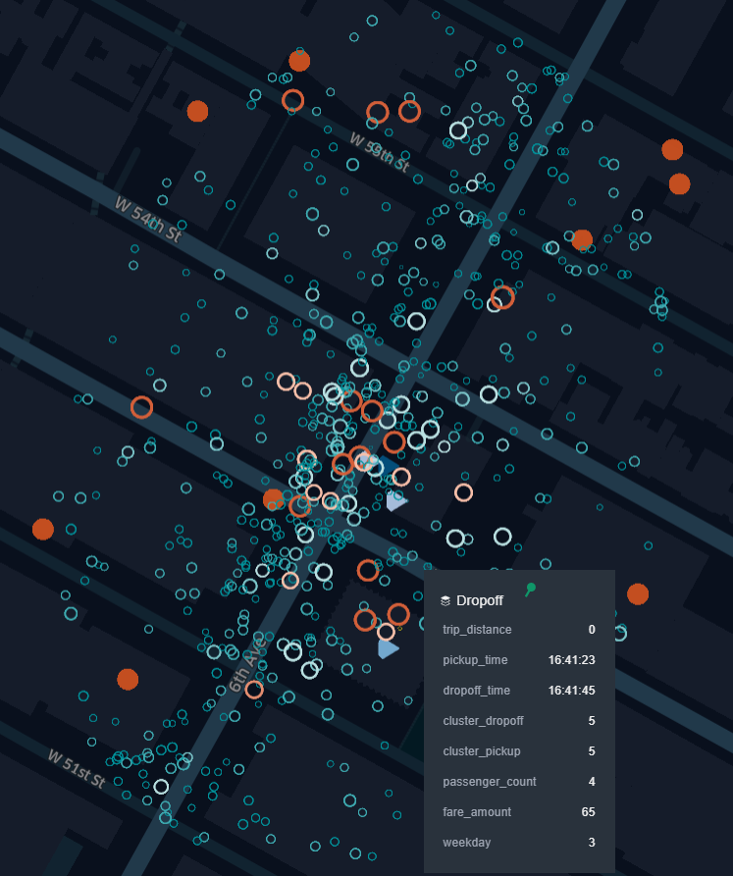
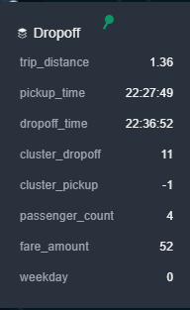
Next Steps
Coding attributes to visual variables
visualize interesting patterns
color
Size
Refine Point of Interest results
More categories than restaurants

