Slide 1
KELOMPOK 2
Book Store
Dessy Putri Alvini
Julius Danes

Slide 2
System Analysis
The book store is a shop that sells books. The book sold is of the donations in the donors by the book donors and fund donors, and then in process through the staff.

Slide 3
Project Detail
Tables
Quaries
Form
Report
Book
Book Donors
Customer
Fund Donors
Staff
Transaction
Transaction Detail
Fund Donors Query
Book Donors Query
Customer Query
Transaction Query
Staff Query
Book
Book Donors
Customer
Fund Donors
Main Menu
Staff
Transaction
Book Report
Book Donors Report
Fund Donors Report
Customer Report
Staff Report
Transaction Report

Slide 4
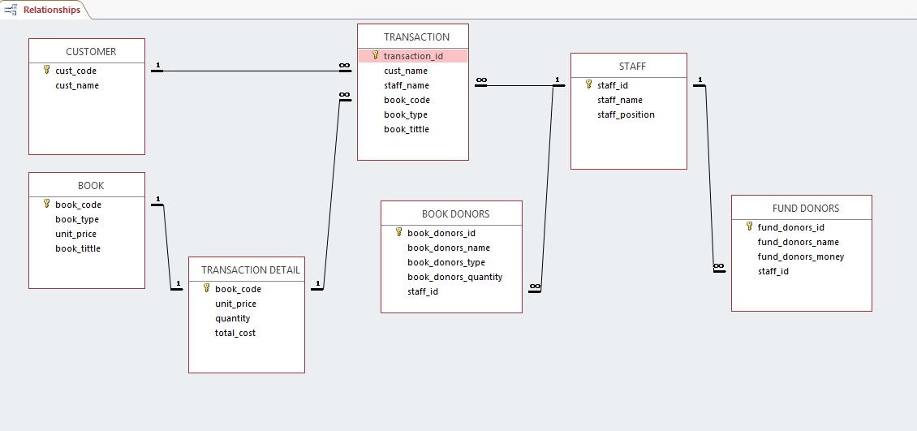
Relationship Between Final Tables

Slide 5
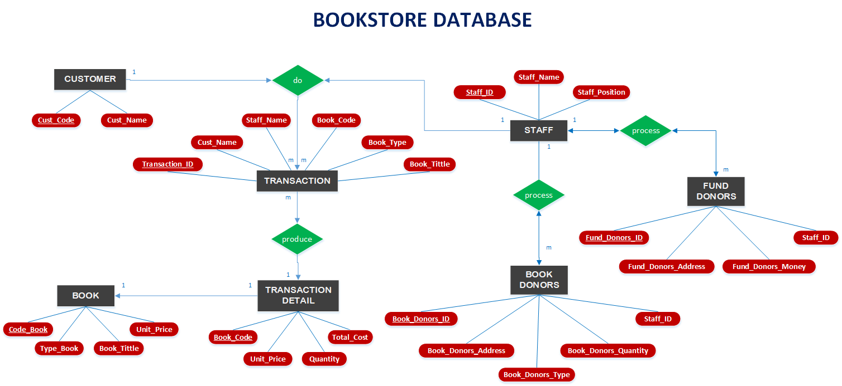
ER Diagram

Slide 6
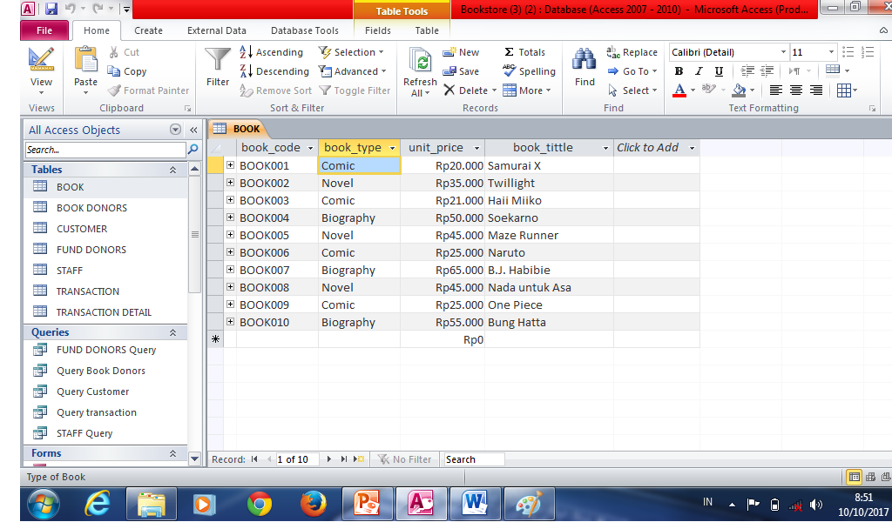

Slide 7
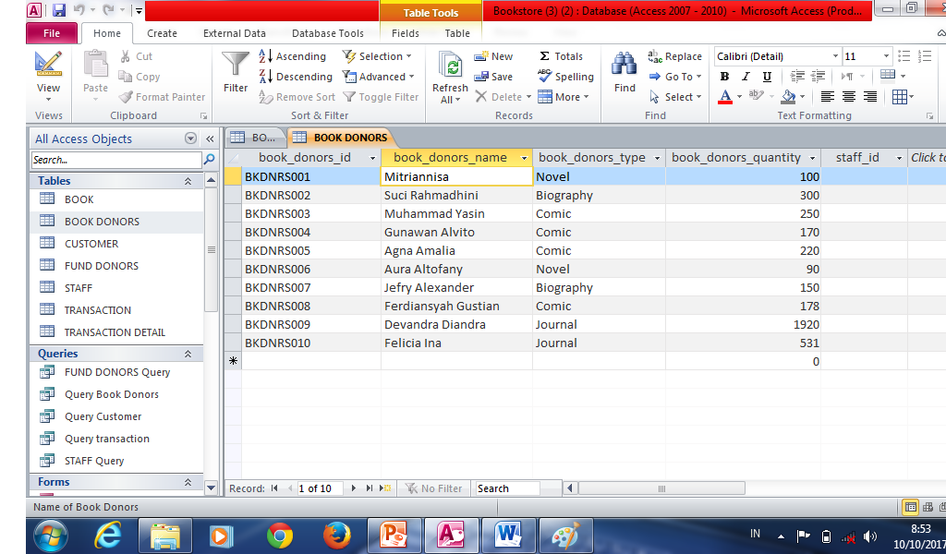

Slide 8
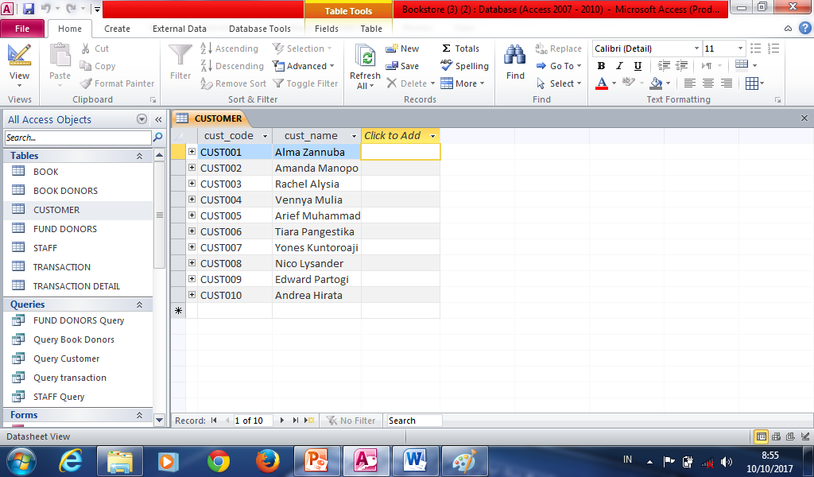

Slide 9
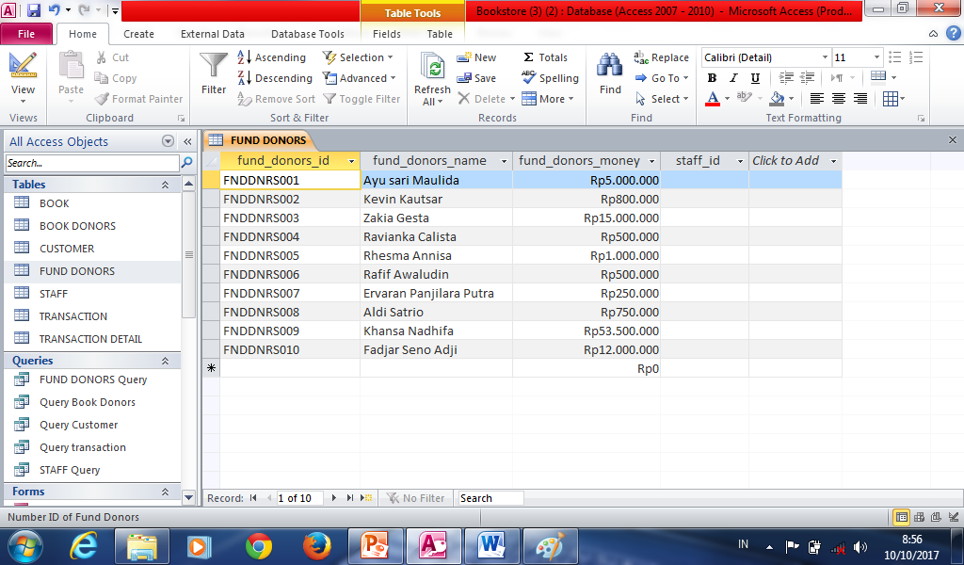

Slide 10
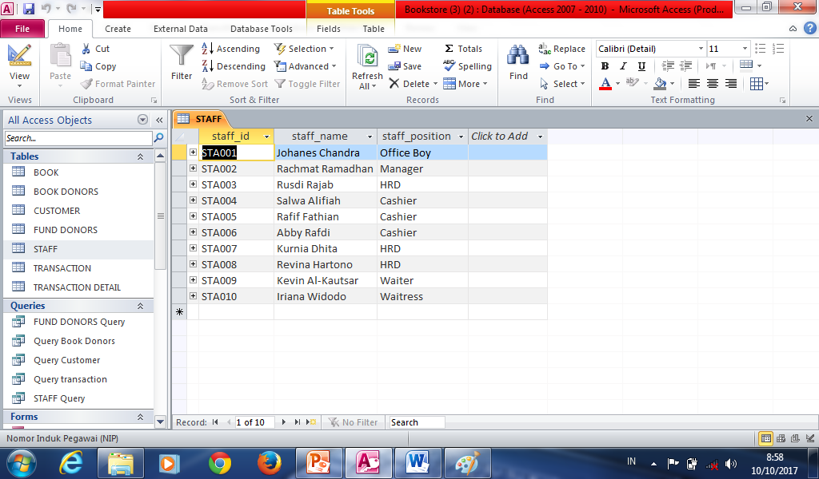

Slide 11
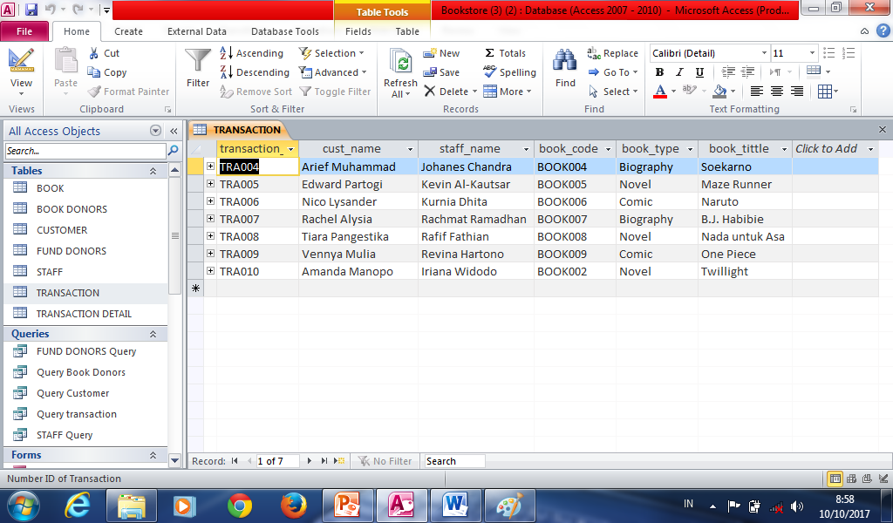

Slide 12
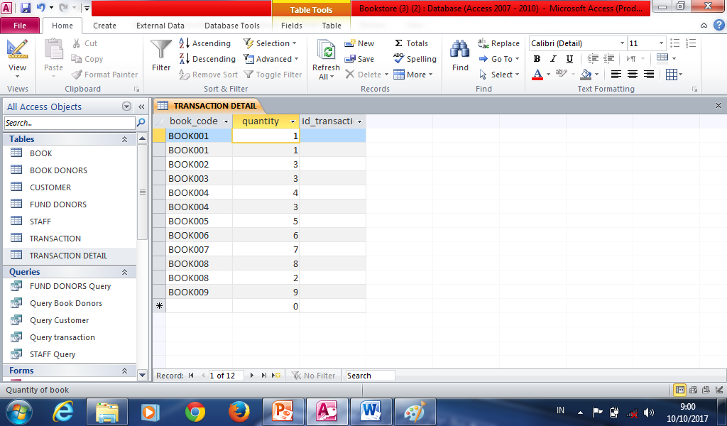

Slide 13

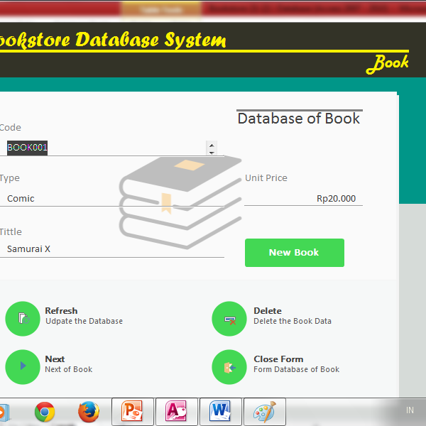
Form Book

Slide 14
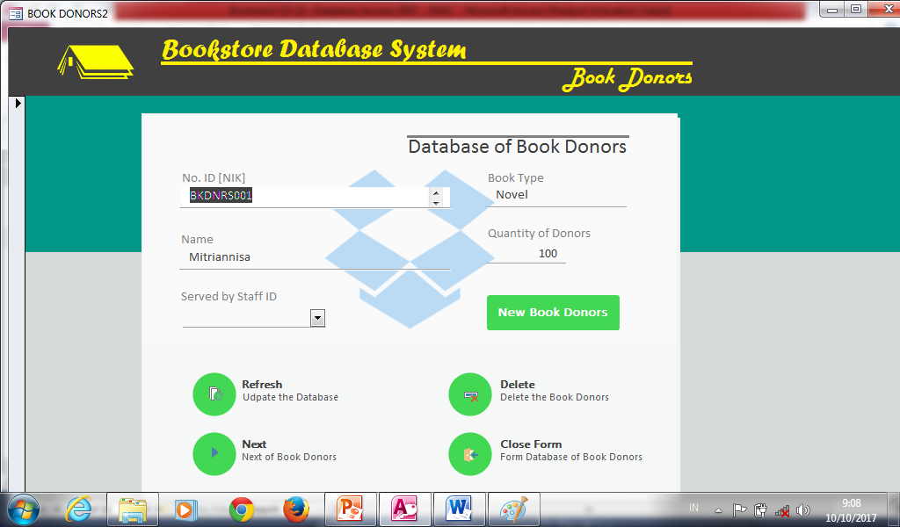
Form Book Donors

Slide 15
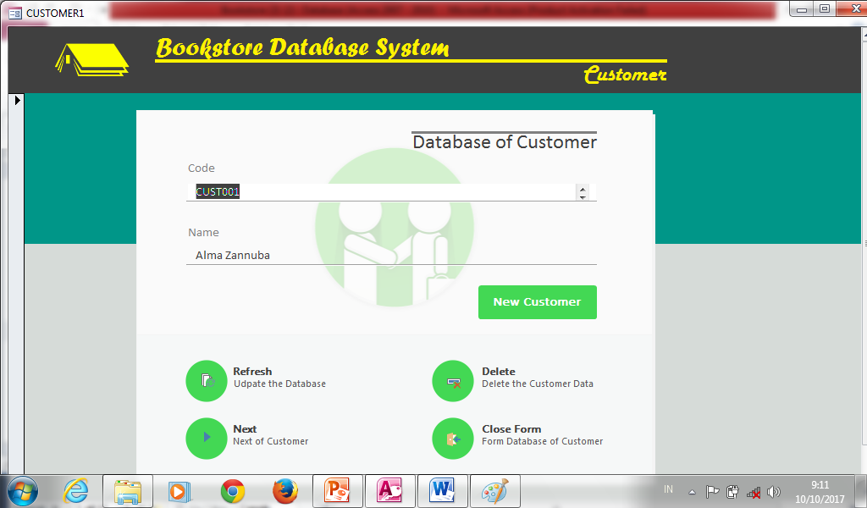
Form Customer

Slide 16
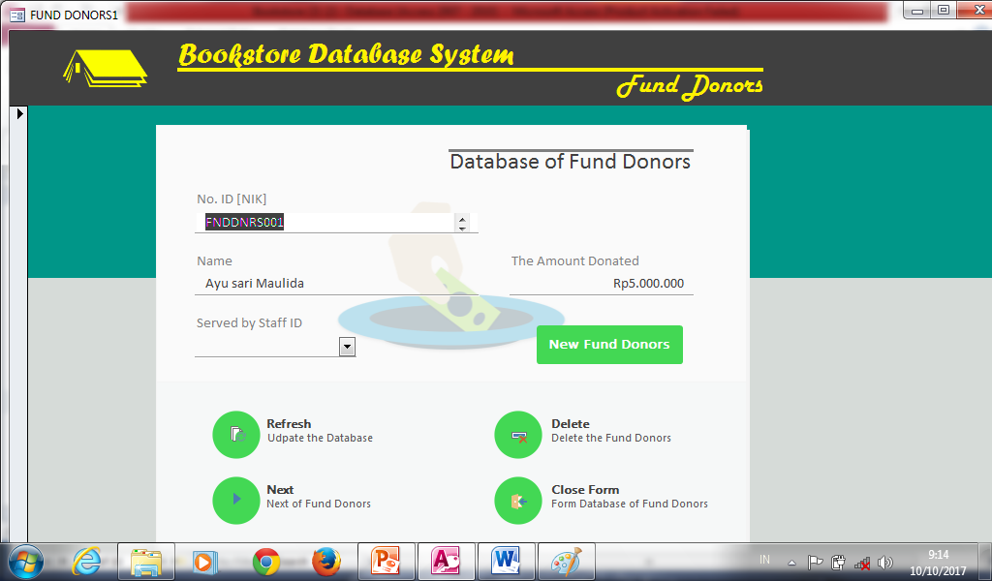
Form Fund Donors

Slide 17
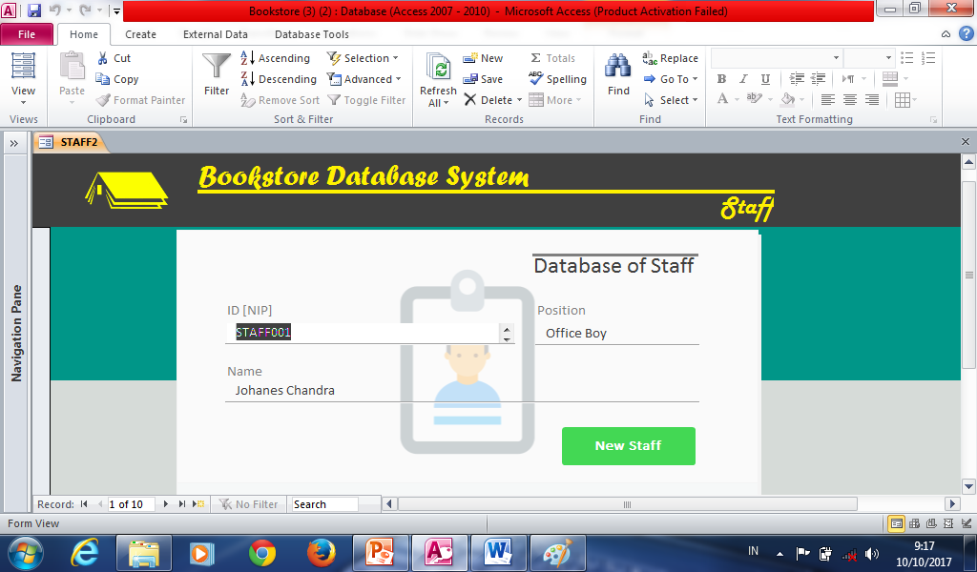
FORM STAFF

Slide 18
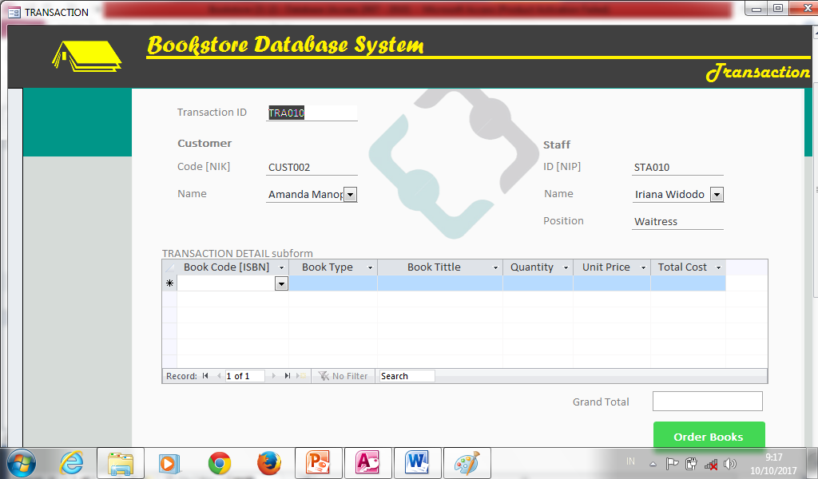
FORM TRANSACTION

Slide 19
Thank You

