Slide 1
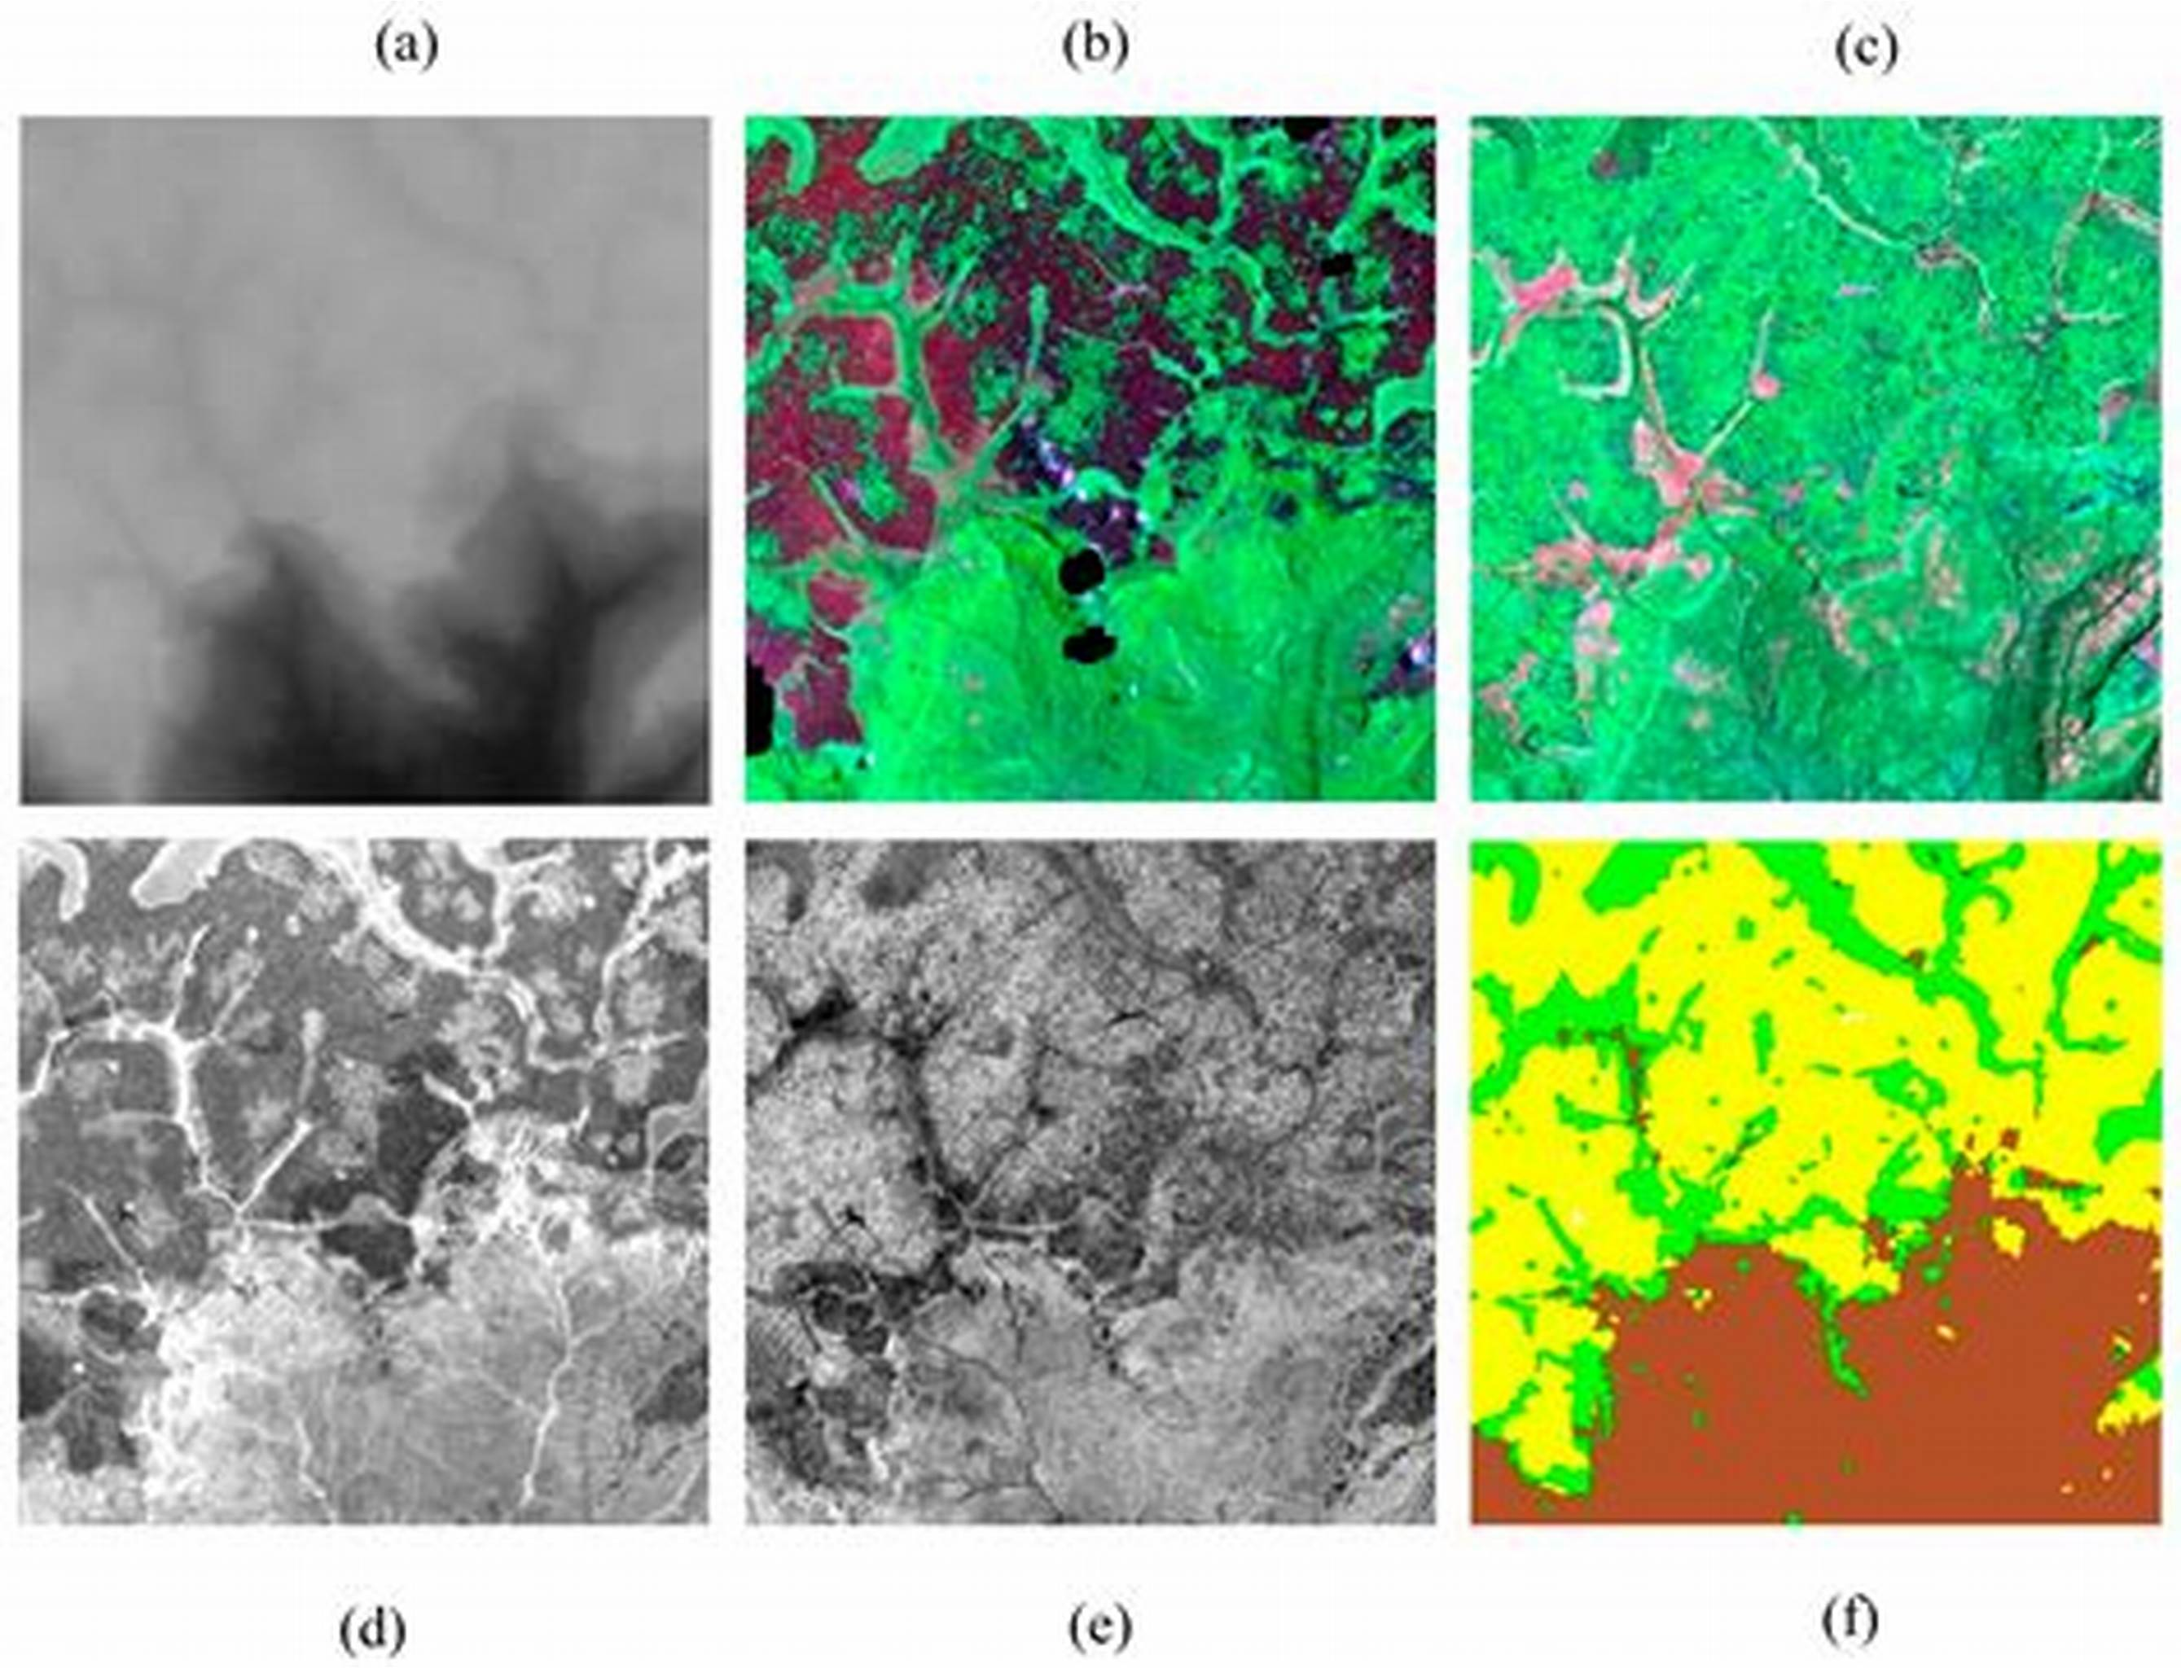
GeoAI Challenge Estimating Soil Parameters from Hyperspectral Images by ITU
JULIUS M. MAINA
- Graduate Student-MSC (Data Analytics)
- Work: Financial Markets (Research)
- Interests: Time Series/ Earth Observation
- Currently Ranked 5/70000+ on Zindi

Slide 2
Agenda
Introduction
Data Analysis
Proposed
Solution
Results
Conclusion
&
Improvements
Presentation Title

Slide 3
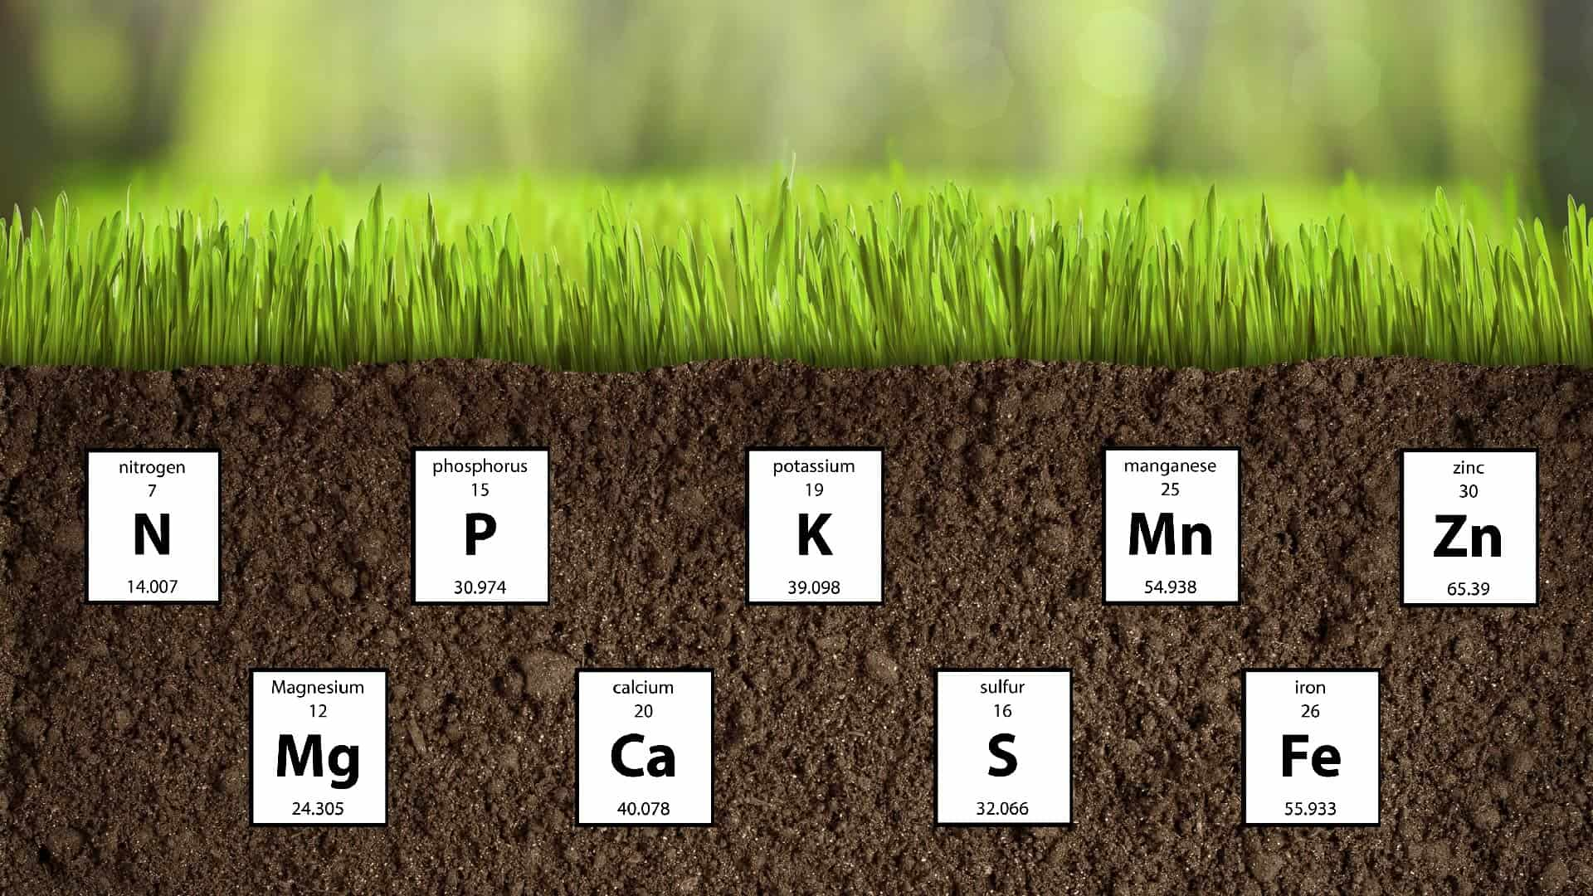
Introduction
Project Overview:
This collaborative project between ESA Φ-lab, KP Labs, and QZ Solutions pioneers a transformative farming revolution by combining Earth observation and AI technologies.
The project leverages cutting-edge hyperspectral imaging from satellites and advances in AI for in-orbit processing, targeting the automatic estimation of crucial soil parameters.
Concerns:
The traditional in-situ soil analysis methods are laborious and inefficient, limiting scalability and hindering timely access to crucial soil data for optimal fertilization.
Project Focus:
Addresses the need for a more efficient and scalable solution by harnessing the potential of advanced hyperspectral imaging from satellites and in-orbit AI processing to revolutionize soil parameter retrieval for sustainable agriculture.

Slide 4
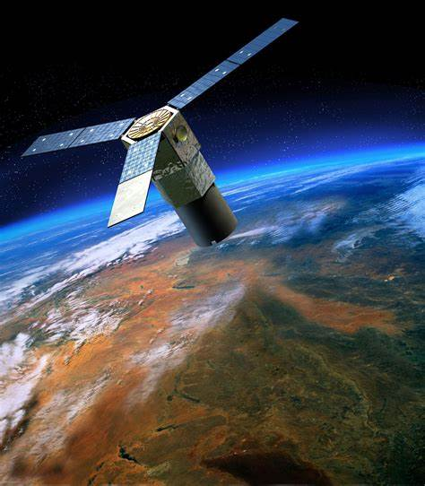
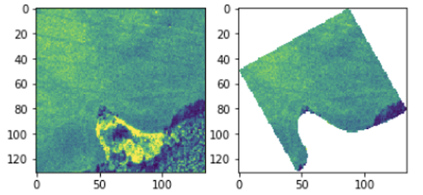
Train Dataset
The training dataset consists of 1732 hyperspectral image patches while the test had 1154,
Each image corresponded to an individual agricultural field.
These patches, varying in size and averaging around 60x60 pixels, encoded crucial information with 150 contiguous hyperspectral bands (462-942 nm) for soil property prediction.
Ground truth labels, representing soil parameters such as phosphorus (P), potassium (K), magnesium(Mg), and soil acidity (pH), were provided for these training examples
Data analysis
Fig. 1: The masked hyperspectral image patches corresponding to the fields of interest (one masked patch is a single field), and should estimate the four soil parameters based on the available image data.

Slide 5

THE APPROACH
Customized the training set with data augmentation—random cropping and noise addition for larger agricultural fields when loading the datasets.
After data loading the following features were added:
Singular Value Decomposition (SVD) captured spatial relationships,
wavelet transforms provided insights into local variations,
gradient calculations captured data changes, and
Fast Fourier Transform (FFT) revealed frequency domain characteristics.
Features were then concatenated, and spectral curve filtering created compact representations.
Data reshaping, including melting and merging, ensured compatibility for subsequent machine learning tasks.
Data analysis

Slide 6
Results –LGBM and HistGradientBoosting
RMSE was used to track performance
Only default parameters were used for each of the models
There was no hyperparameter tuning -the dataset had many features that may have taken a lot of train time.
Final submission is average of the two models predictions with an RMSE of 0.269867471 on the leaderboard
A 5 kfold splitting is used for cross validation
Soil Parameter | LGBM CV | HistGradient CV
phosphorus (P) | 16.1953 | 16.5703
Potassium (K) | 35.4535 | 35.4981
magnesium (Mg) | 20.1607 | 20.1952
pH | 0.135913 | 0.143455

Slide 7
Results –Zindi Leaderboard
In order to normalize the values, Zindi divided the reference file by the starter code submission file.
To scale my submission file correctly, I divided it by the starter code submission file too. Specifically, ph-6.782719399538106, Mg-159.28123556581986, K-227.9885103926097 and P-70.3026558891455
These were the outcomes
 | Public Leaderboard | Private Leaderboard
LGBM | 0.265251639 | 0.272199595
HistGradient | 0.268166685 | 0.273011599
Ensemble | 0.262584911 | 0.269867471

Slide 8
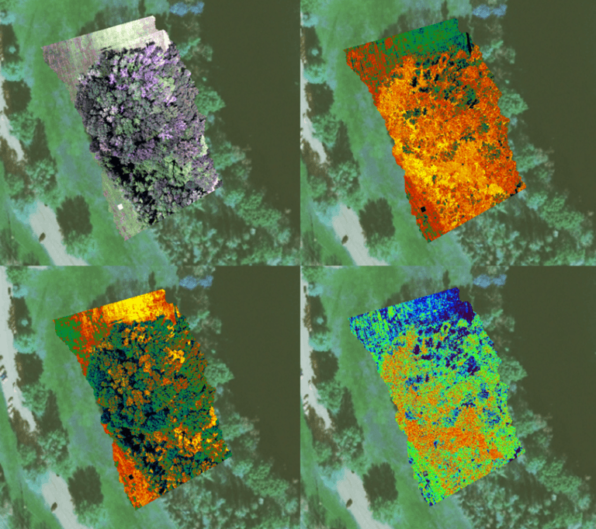
Conclusion
Additional Features from around 0.30 on the leaderboard to around 0.26
Higher compute power could help do more augmentations and create more interesting features for further improvement. I only applied free Kaggle GPU for the task
Histgradient benefited from selecting most important features and ignoring less important features
Use of deep learning could improve the results further

Slide 9
Thank you
Julius Maina
Contact: julmngii@gmail.com

