Slide 1

🎙️SemaAfya
A telemedicine and a health records’ management Enabler
JULIUS M. MAINA
-Student KCA University (Kenya)

Slide 2
AGENDA -Introduction -Problem Statement -Proposed Solution -App Prototype -Limitations and Conclusion
Introduction
Problem Statement
Proposed Solution
APP
Prototype
Limitations & Conclusion
Presentation Title

Slide 3

Introduction to "SemaAfya" Telemedicine Platform
Revolutionizing Healthcare: SemaAfya is a cutting-edge telemedicine platform designed to transform healthcare accessibility.
Key Features
Voice-Enabled Consultations: Leverages Automatic Speech Recognition (ASR) for Swahili, allowing users to describe symptoms using voice.
Record Management: The system then converts spoken words into text for accurate diagnosis by healthcare professionals.
Beyond Consultations
Automated Health Insights: SemaAfya provides health tips and reminders for a holistic approach to well-being.
Personalized Recommendations: Users receive tailored suggestions for a healthier lifestyle.

Slide 4
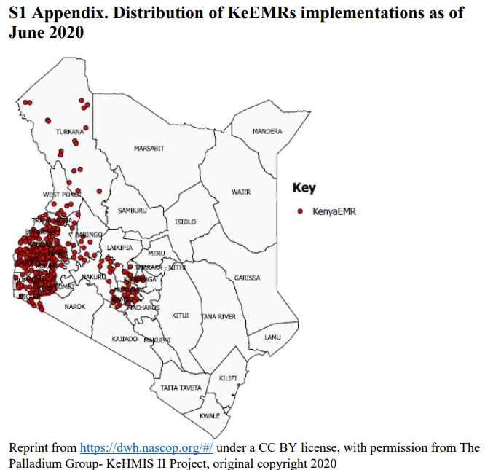

BACKGROUND
Manual Records
Lost manual records could impact medical prescription, diagnostic tests, and the overall loss of critical patient historical health information (Orwa, 2022).
Could lead to more health risks to patients in especially those in critical conditions -due to delays in recording and retrieval
Electronic Records
Health facilities in developing countries are increasingly adopting Electronic Health Records systems (EHRs) for example KeHMIS in Kenya to support healthcare processes (Ngugi et al., 2021)
EHRs enhance service delivery, communication among health professionals, and ensure efficient and effective healthcare services (Orwa, 2022).
Problem
statement

Slide 5
BACKGROUND..
Electronic Records…
However EHRs still have their challenges. In 2010 and 2012 studies showed inpatient resident physicians spend between 40 and 49% of their time using a computer, and 70% of this time is spent in documentation and order entry (Block et al., 2013) & (Oxentenko et al., 2012)
Could lead to more health risks to patients in especially those in critical conditions -due to delays in recording and retrieval
Automatic Speech Recognition
Analysis of documentation speed using web-based medical speech recognition technology has already shown promising results
The overall increase in documentation speed through web-based ASR assistance has been shown to increase clinical documentation speed by 26% (Vogel et al., 2015)
PROPOSED
SOLUTION

Slide 6
BACKGROUND..
Access to Health Services
Common Attractors to health services: Lower cost, proximity, positive provider manner, effective medicines, and timely services attract patients-Kizito, J. etal (2012).
ASR therefore becomes a big boost to access to health services and information which improves time and proximity to services
Problem
statement

Slide 7

🎙️SemaAfya
The Technology: SemaAfya addresses healthcare accessibility challenges by offering a groundbreaking telemedicine platform integrating new technologies such as LLMS & ASR Models with existing EHRs .
Barrier Reduction: It aims to overcome barriers to timely medical advice, particularly in regions with limited healthcare access or to people with language barrier issues. This promotes inclusivity & convenience.
Prompt Consultation: SemaAfya tackles the issue of delayed diagnoses and treatments by leveraging Automatic Speech Recognition (ASR) technology for fast data capture and response to users.
Voice-Based Communication: Patients can describe symptoms using voice, enhancing communication and providing immediate medical guidance, regardless of literacy levels.
Competitiveness: SemaAfya transforms patient interactions with the healthcare system, offering a reliable and accessible solution for swift consultations and overall well-being. This is attracts more patients to the health institution.
PROPOSED
SOLUTION

Slide 8
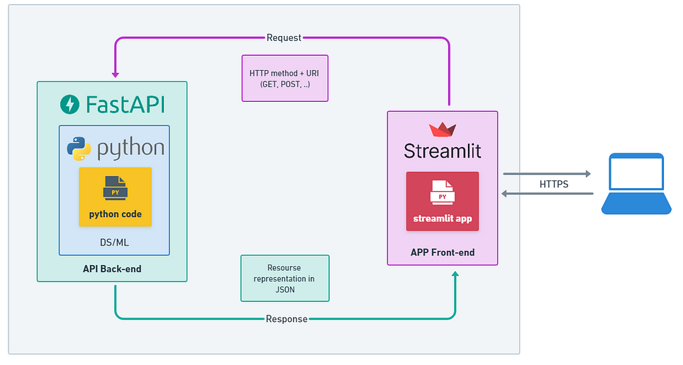
APP ARCHITECTURE

Slide 9
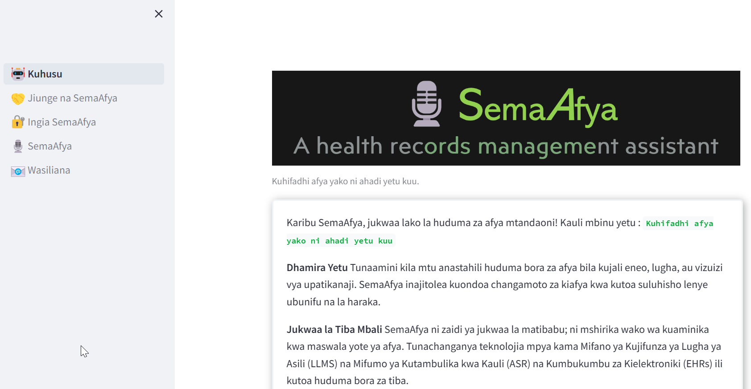
Welcome Page

Slide 10
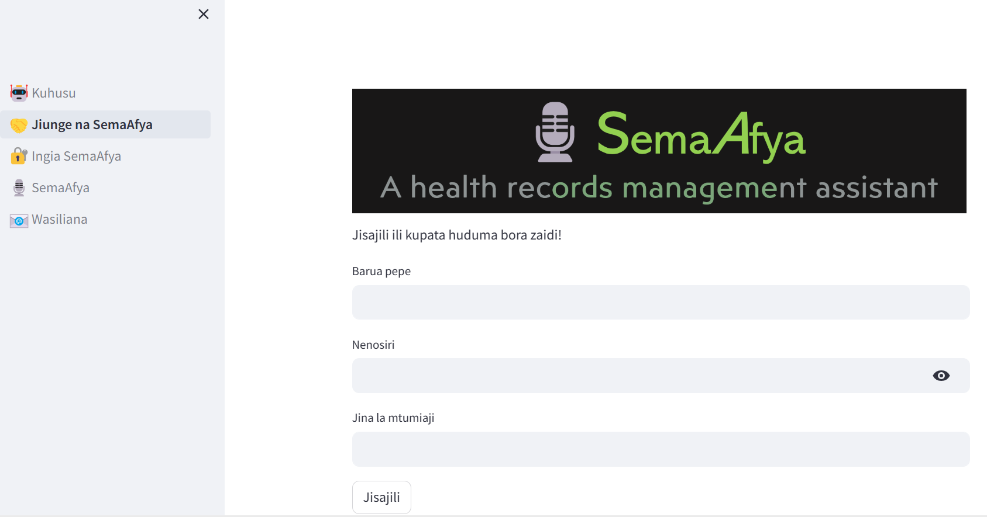
Registration Page

Slide 11
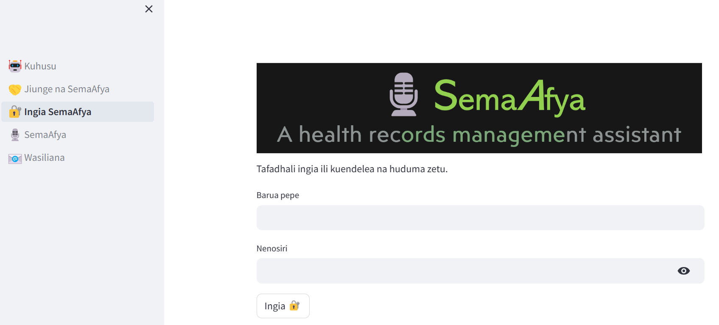
Login Page

Slide 12
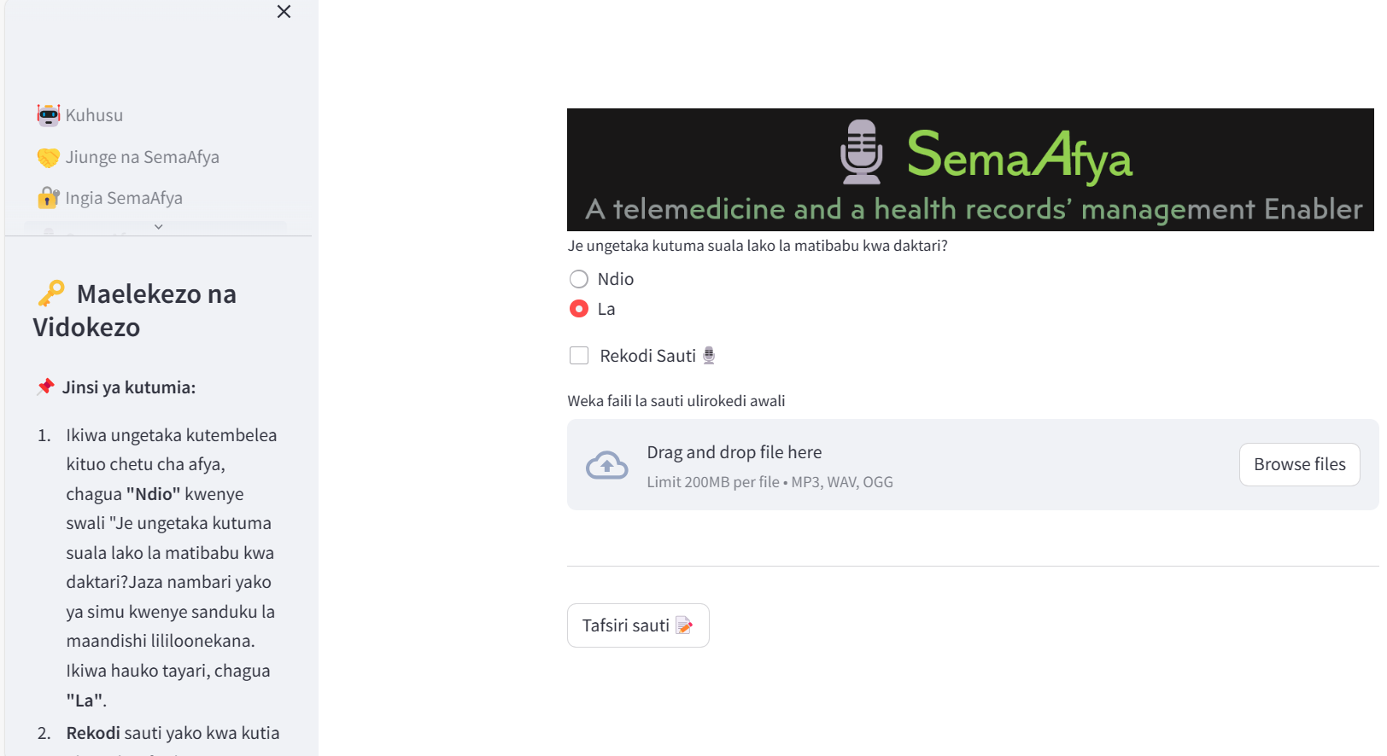
Main App

Slide 13
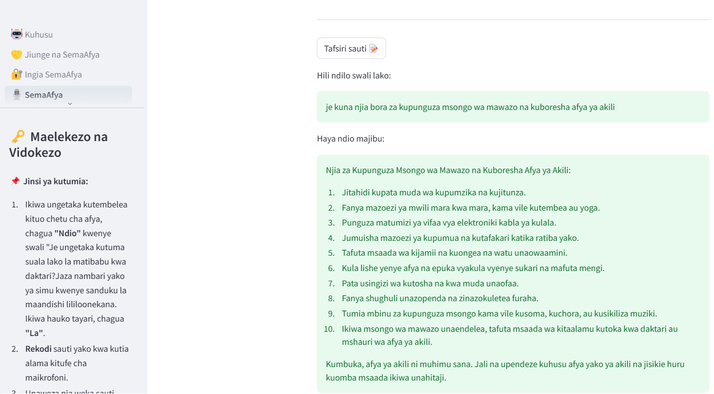
Main App..

Slide 14
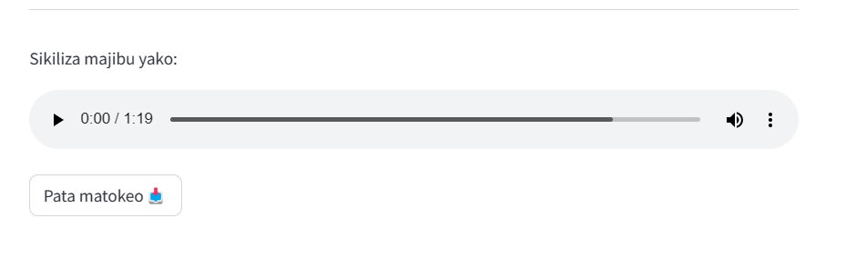
Main App..

Slide 15
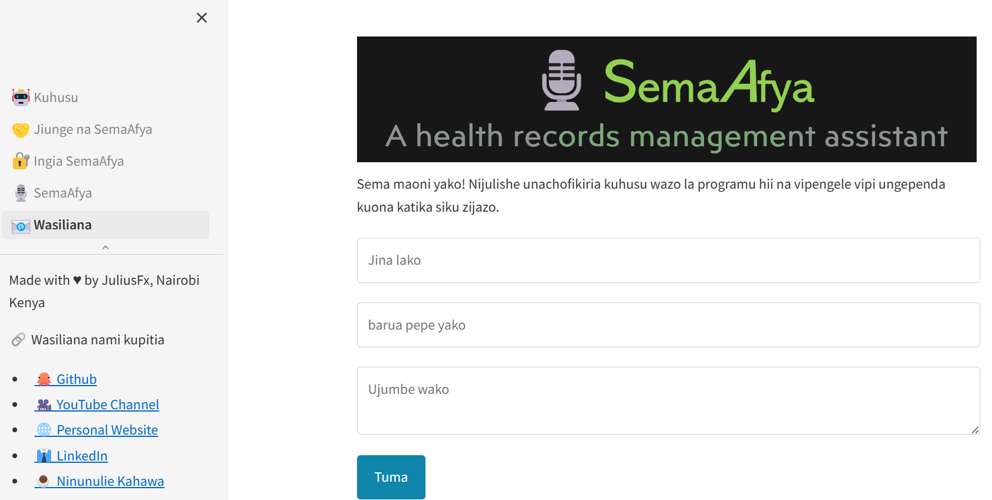
Contacts Page

Slide 16

LIMITATION
Unauthorized access or data breaches may occur. Implement robust encryption, strict access controls, and clearly communicate the app's privacy policies.
ASR models may exhibit biases based on accent, language proficiency, or cultural nuances, leading to inaccurate interpretations. Regularly retrain with diverse datasets could help.
Might lead to misinterpretation of symptoms, potentially resulting in inaccurate medical advice. There is need to emphasize the importance of combining voice-based input with other diagnostic methods to health professionals.

Slide 17
REFERENCES
REFERENCES
Orwa, B. (n.d.). Management of medical records for better healthcare service delivery: a case study of narok county referral hospital, kenya
Ngugi, P., Babic, A., & Were, M. (2021). A multivariate statistical evaluation of actual use of electronic health record systems implementations in Kenya.
L. Block, R. Habicht, A.W. Wu, S.V. Desai, K. Wang, K.N. Silva, T. Niessen, N. Oliver, L. Feldman, In the wake of the 2003 and 2011 duty hours regulations, how do internal medicine interns spend their time?
A.S. Oxentenko, C.U. Manohar, C.P. McCoy, W.K. Bighorse, F.S. McDonald, J.C. Kolars, J.A. Levine, Internal medicine residents' computer use in the inpatient setting
Vogel M, Kaisers W, Wassmuth R, Mayatepek E. Analysis of Documentation Speed Using Web-Based Medical Speech Recognition Technology: Randomized Controlled Trial
Kizito, J., Kayendeke, M., Nabirye, C. et al. Improving access to health care for malaria in Africa: a review of literature on what attracts patients

Slide 18

Thank you
Julius Maina
Contact: julmngii@gmail.com

