Slide 1
Emotion Recognition in Conversation: A Comparative Study of Representation and Context Modeling
Julius Maliwat 864520

Slide 2


Task: Emotion Recognition in Conversation
Goal: Classifying the emotional state expressed in each utterance of a multi-turn dialogue, considering both content and context.
Domain: Conversational AI (e.g. chatbots, customer service agents) , Mental Health Support (emotion-aware assistants), Human-Computer Interaction (adaptive dialogue systems)
A: How's the bride-to-be? → [neutral]
B: Tired and stressed. This wedding is giving me a headache. → [sadness]
A: Just relax. With me as your maid of honor, everything will be fine! → [happiness]
B: I'm worried that everything will be chaotic! → [fear]
A: Hey! I'm the tour guide. I'll take care of the Taiwanese guests. → [neutral]
B: You're going to have to tell them what to do in church, what everything means... → [neutral]
A: I will. Don't worry! → [happiness]

Slide 3


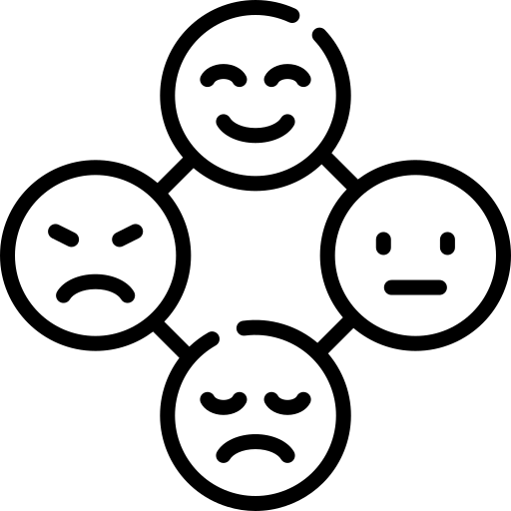


Dataset overview: DailyDialog
Research Questions
Representation
Context Modeling
Label | Freq. (%)
Neutral | 83.10
Happiness | 12.51
Surprise | 1.77
Sadness | 1.12
Anger | 0.99
Disgust | 0.34
Fear | 0.17
13,118 multi-turn dialogues, all manually annotated
Each dialogue involves 2 speakers and has ~7.9 turns on average
Annotated at utterance-level with 7 emotions:
Neutral, Happiness, Sadness, Anger, Fear, Disgust, Surprise
Utterances average 14.6 tokens, dialogues average 114.7 tokens
Does task-specific fine-tuning of sentence embeddings improve ERC performance?
Does dialogue-level context help disambiguate emotional utterances?

Slide 4


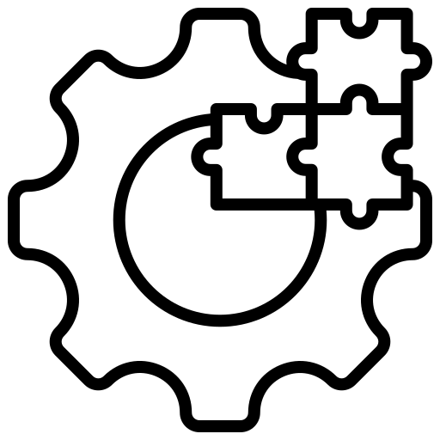



Experimental Design
We evaluate two modeling approaches for ERC:
(A) a task-adaptive end-to-end model, and
(B) a modular pipeline with 9 configurations combining 3 utterance representations and 3 modeling architectures
(A) End-to-end Model
(B) Modular Pipeline
→ 9 configurations from 3 embeddings × 3 models
RoBERTa + Classification Head
Partial fine-tuning (last 2 encoder layers)
Utterance-level ERC (no context)
Task-adapted embeddings reused (frozen) in modular pipeline
Two-stage architecture:
1. Utterance Representation
• SBERT (frozen)
• RoBERTa (frozen)
• RoBERTa fine-tuned on ERC (then frozen)
2. Modeling
• MLP (utterance level, no context)
• GRU+ MLP (dialogue-level, context-aware)
• Transformer encoder + MLP (dialogue-level, context-aware)

Slide 5

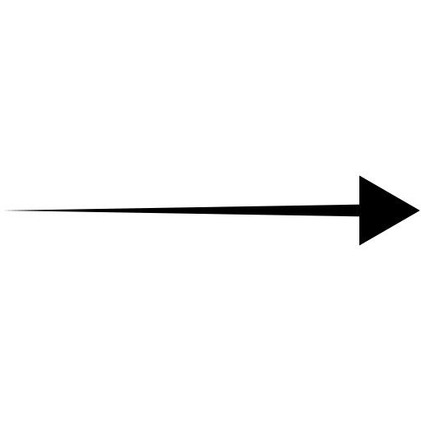
Validation Results
R: Utterance representations from frozen RoBERTa (not fine-tuned)
R-FT: Utterance representations from frozen RoBERTa + CLF (joint), fine-tuned on ERC
SBERT: Utterance representations from frozen Sentence-BERT (not fine-tuned)
Utt. Repr. | Model | Macro F1 | Micro F1
-- | RoBERTa + CLF (joint) | 33.80 | 56.55
R | MLP | 31.26 | 52.75
R-FT | MLP | 28.98 | 55.42
SBERT | MLP | 29.94 | 53.95
R | GRU + MLP | 26.24 | 53.27
R-FT | GRU + MLP | 32.32 | 55.56
SBERT | GRU + MLP | 27.10 | 51.38
R | Transformer E. + MLP | 31.59 | 54.37
R-FT | Transformer E. + MLP | 38.09 | 55.60
SBERT | Transformer E. + MLP | 29.95 | 53.34
Macro-F1 and Micro-F1 are computed excluding the neutral class
Best Macro-F1: 38.09
(Modular pipeline: R-FT → Transformer E. + MLP)
Best Micro-F1: 56.55
(End-to-end: RoBERTa + CLF (joint))
selected for final test evaluation

Slide 6
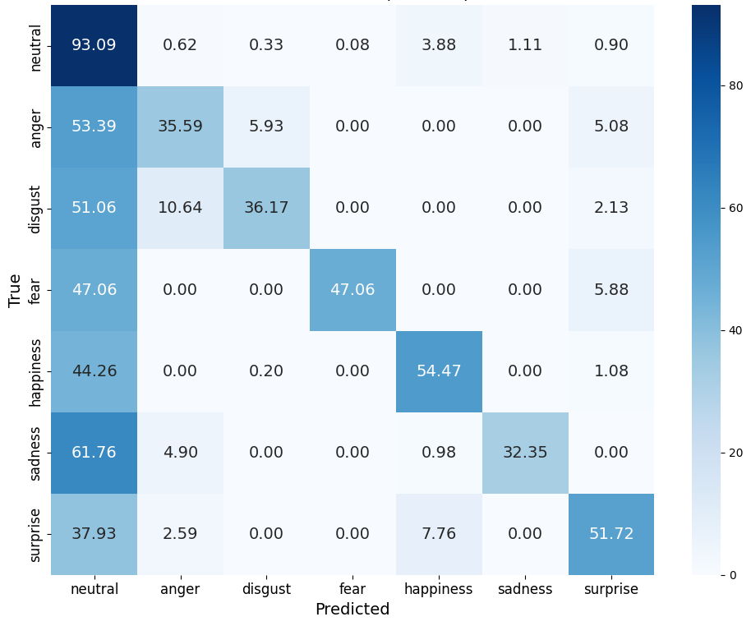

Test Results
(Modular pipeline: R-FT → Transformer E. + MLP)
Macro F1 | Micro F1
44.94 | 54.54
Macro-F1 and Micro-F1 are computed excluding the neutral class
Label | F1 | Support
Happiness | 60.69 | 1019
Fear | 53.33 | 17
Surprise | 47.62 | 116
Anger | 39.62 | 118
Disgust | 36.17 | 47
Sadness | 32.20 | 102
Confusion matrix normalized over true labels (test set, all classes included)

Slide 7
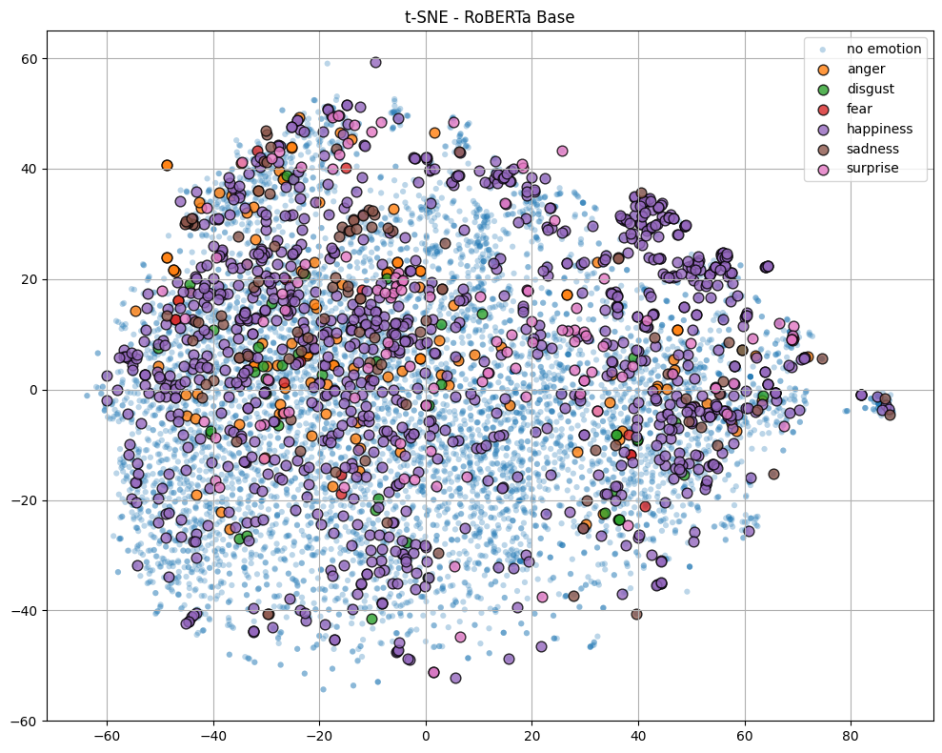
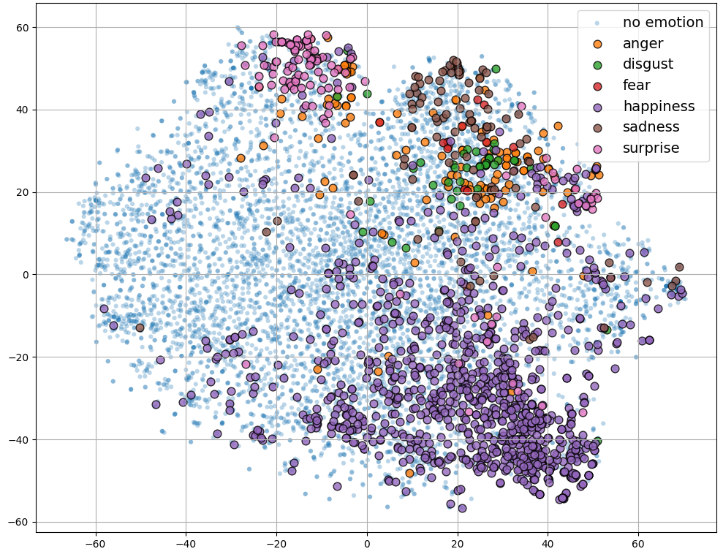
Utterance Representation Space
t-SNE projection of utterance representations on the test set, colored by true emotion labels
R: frozen RoBERTa (not fine-tuned)
R-FT: frozen RoBERTa + CLF (joint), fine-tuned on ERC

Slide 8
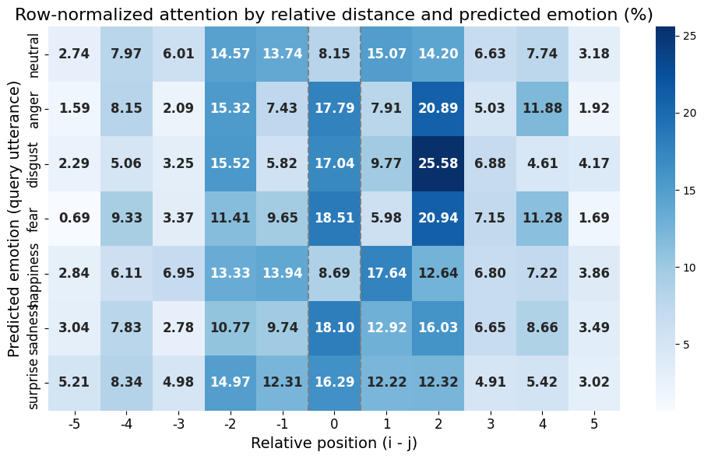






Dialog-level attention analysis
Anger, Disgust, Fear
Happiness
Sadness, Surprise
attention peaks at self and ±2, suggesting intra-speaker consistency
low attention on self, more evenly spread on ±1/±2, suggesting context dependence
balanced attention on self and other speaker, reflecting both intra- and inter-speaker signals
Average attention by relative position between query and context turns (i – j), grouped by predicted emotion. Aggregated over all layers and heads (test set).

Slide 9
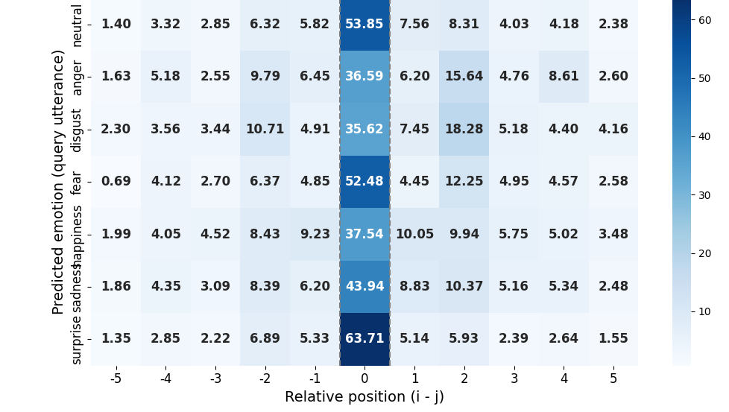
Integrated Gradients-based context attribution
Surprise, Fear
Anger, Disgust
Happiness, Sadness
Strong self-attribution, minimal context use
Self-attribution with secondary peaks at ±2, relying on intra-speaker context
Self-attribution with more spread over ±1/±2, involving both speakers
Attribution by relative position between query and context turns (i–j), grouped by predicted emotion. Normalized IG scores reflect each context utterance’s influence on the prediction (test set).

Slide 10


Example 1 - Context-dependent misclassification
Do you really have all of these drugs? Where do you get them from? → [true: neutral, pred: neutral] — Attn: 1.80 | IG: 2.10
I got my connections! Just tell me what you want and I’ll even give you one ounce for free. → [true: neutral, pred: neutral] — Attn: 6.35 | IG: 5.45
Sounds good! Let’s see, I want… → [true: neutral, pred: neutral] — Attn: 6.82 | IG: 4.60
Yeah? → [true: fear, pred: surprise] — Attn: 1.70 | IG: 64.78
I want you to put your hands behind your head! You are under arrest! → [true: neutral, pred: neutral] — Attn: 62.46 | IG: 12.95

Slide 11
Example 2 - Fear correctly predicted
How's the bride-to-be? → [true: neutral, pred: neutral] — Attn: 6.19 | IG: 3.56
Tired and stressed. This wedding is giving me a headache. → [true: sadness, pred: neutral] — Attn: 35.41 | IG: 15.29
Just relax. With me as your maid of honor, everything will be fine! → [true: happiness, pred: neutral] — Attn: 3.47 | IG: 3.10
I'm worried that everything will be chaotic! → [true: fear, pred: fear] — Attn: 28.55 | IG: 58.73
Hey! I'm the tour guide. I'll take care of the Taiwanese guests. → [true: neutral, pred: neutral] — Attn: 4.32 | IG: 5.22
You're going to have to tell them what to do in church, what everything means... → [true: neutral, pred: neutral] — Attn: 11.70 | IG: 8.43
I will. Don't worry! → [true: happiness, pred: neutral] — Attn: 10.35 | IG: 5.66

Slide 12


Conclusions and Future Work
Key Takeaways
Future Work
Incorporate Dialog Acts Use dialog act labels as auxiliary input to disambiguate emotions with overlapping surface cues (e.g. anger vs. surprise).
Joint Encoder Fine-Tuning Explore end-to-end training of RoBERTa + Transformer encoder, with full or partial encoder updates to better align utterance- and dialog-level signals.
Transformer Enables Effective Context Modeling Modeling dialog-level context with a Transformer encoder leads to the best performance overall, confirming the value of context-aware architectures for ERC.
Joint Training Still Competitive The RoBERTa +Classification Head model, with partial fine-tuning of the encoder, surpasses all modular approaches except the Transformer—highlighting the effectiveness of limited task-adaptive training.

Slide 13
Thanks!
Do you have any questions?

