Slide 1

..
Synthetic Image Detection
Rahul Yadav,211020434,DSAI
Devajit Patar,211020417,DSAI
Mohit Kulhari,211020427,DSAI
Supervisor name: Dr. Anurag Singh
Date:
Dr. Shyama Prasad Mukherjee International Institute of Information Technology, Naya Raipur
International Institute of Information Technology, Naya Raipur

Slide 2
Introduction
Synthetic images, in the form of computer-generated or artificially created visuals, have become an integral part of our digital landscape.
The advancement of technology, particularly in deep learning and image processing, has made it easier for individuals to create highly convincing synthetic images.
International Institute of Information Technology, Naya Raipur
<number>

Slide 3
Motivation
Synthetic image detection can be crucial for security applications.
It helps in identifying fake identification documents, counterfeit currency, or forged signatures, which are often created using image manipulation techniques.
Social media platforms and websites rely on synthetic image detection to identify and remove inappropriate or harmful content, such as explicit or violent imagery.
Synthetic image detection can be used for user authentication. Ensuring that users are uploading real photos of themselves is important in various online platforms and applications.
International Institute of Information Technology, Naya Raipur
<number>

Slide 4
Literature Review
Paper | Methodology
U. A. Ciftci, I. Demir and L. Yin, "FakeCatcher: Detection of Synthetic Portrait Videos using Biological Signals," in IEEE Transactions on Pattern Analysis and Machine Intelligence, doi: 10.1109/TPAMI.2020.3009287. | CNN based classification of images
C. Han et al., "GAN-based synthetic brain MR image generation," 2022 IEEE 15th International Symposium on Biomedical Imaging (ISBI 2022), Washington, DC, USA, 2022, pp. 734-738, doi: 10.1109/ISBI.2022.8363678. | GAN for Brain MR Classification
09/10/23
International Institute of Information Technology, Naya Raipur
<number>

Slide 5
Problem Definition/Problem statement
The spread of misinformation through manipulated images is a growing concern.
As viral content can quickly spread across social media, it's important to have a system that can verify the authenticity of such content to prevent the propagation of synthetic images.
09/10/23
International Institute of Information Technology, Naya Raipur
<number>

Slide 6
Research Gap
Instead of sending training data to a central server, federated learning allows GANs to be trained on data that is distributed across multiple devices, such as smartphones, laptops, and IoT devices. This keeps user data private and secure, as it never leaves the device.
Federated learning can be used to train GANs on sensitive data, such as medical images or financial data, that cannot be shared publicly. By keeping the data on-device, federated learning eliminates the risk of data breaches or leaks.
International Institute of Information Technology, Naya Raipur
<number>

Slide 7
Objective (s) of the Project
Our primary goal in this project is to develop a robust system for the accurate detection of synthetic images.
Developing a robust synthetic image detection system can help combat the dissemination of false information in the digital realm.
Federated learning is a decentralized machine learning approach that allows multiple devices to train a shared model without sharing their data. This makes it ideal for training GANs on private and sensitive data, such as medical images or financial data.
International Institute of Information Technology, Naya Raipur
<number>

Slide 8
GANs (Generative Adversarial Networks)
Our primary goal in this project is to develop a robust system for the accurate detection of synthetic images.
Developing a robust synthetic image detection system can help combat the dissemination of false information in the digital realm.
Federated learning is a decentralized machine learning approach that allows multiple devices to train a shared model without sharing their data. This makes it ideal for training GANs on private and sensitive data, such as medical images or financial data.

Slide 9
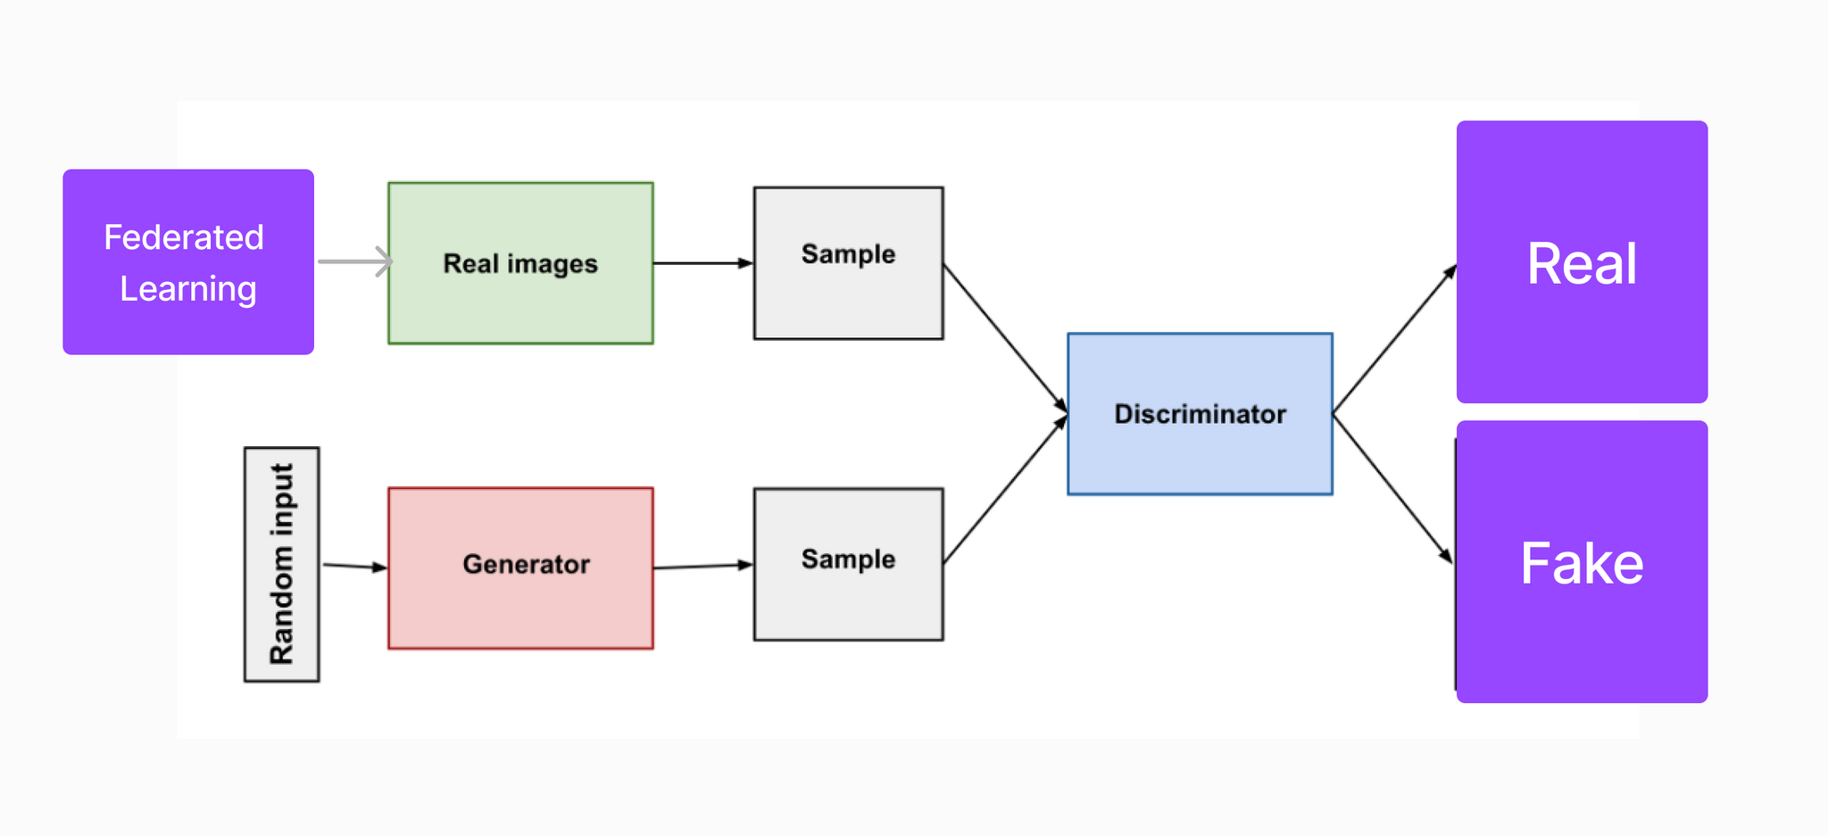
Proposed Framework/Methodology
09/10/23
International Institute of Information Technology, Naya Raipur
<number>

Slide 10
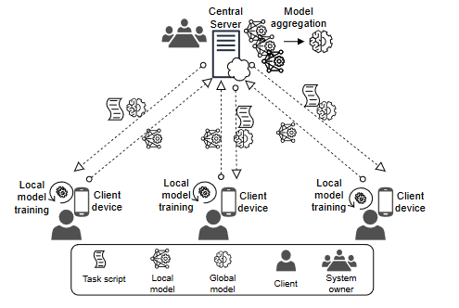
Proposed Framework/Methodology
09/10/23
International Institute of Information Technology, Naya Raipur
<number>

Slide 11
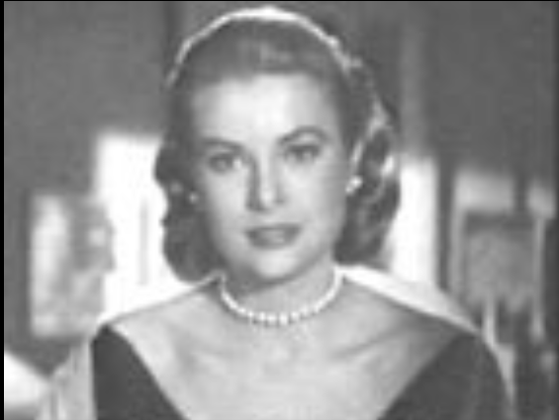
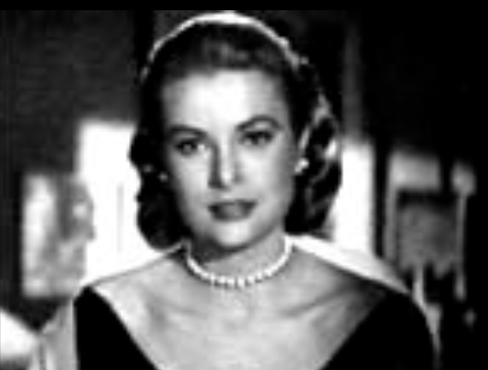
Image Pre-Processing
Contrast streching

Slide 12
Experimental Results and Discussion
Team Name | Test
Sherlock | 87.70
FAU Erlangen-Nürnberg | 87.14
Megatron | 96.05
Our | 90.27
09/10/23
International Institute of Information Technology, Naya Raipur
<number>

Slide 13
..
Thank You
Dr. Shyama Prasad Mukherjee International Institute of Information Technology, Naya Raipur
09/10/23
International Institute of Information Technology, Naya Raipur
<number>

