Slide 1
0,26345511 0,092292015 0,008668652 0,930514317 0,690193606 0,809881135
0,694520294 0,191824943 0,843726573 0,397571025 0,88542996 0,895276224
0,076633595 0,258720111 0,547534792 0,282283781 0,27890791 0,232620594
0,577995093 0,045616941 0,04903375 0,940889749 0,153318421 0,668360752
0,054555716 0,791513927 0,587116733 0,466957774 0,975446368 0,048053341
0,966026984 0,196283834 0,711044406 0,338944328 0,719445195 0,438488392
0,98417512 0,507944361 0,1180168 0,796692478 0,175376468 0,488659533
0,98839607 0,155737146 0,800206213 0,633481382 0,752698206 0,852943441
… … … … … …
{
"SamplingFrequency": 60,
"SamplingFrequencyEffective": 60.00197437,
"TaskName": "BIDS Motion fictive example",
"TrackingSystemName": "imu1",
"TaskDescription": "walking and talking",
"MotionChannelCount": 18,
"RecordingDuration": 4667.641106,
"RotationRule": "right-hand",
"RotationOrder": "ZXY",
"SpatialAxes": "FRU",
"SubjectArtefactDescription": "n/a",
"TrackedPointsCount" : 2,
"ACCELChannelCount": 6,
"ANGVELChannelCount": 6,
"MAGNChannelCount": 6,
"Manufacturer": "BWSensing",
"ManufacturersModelName": "BW-imu600",
}
Example1/
└─sub-001/[ses-01/]
├─eeg/
...
└─motion/
sub-001[_ses-01]_task-<label>_tracksys-<label>_motion.tsv
sub-001[_ses-01]_task-<label>_tracksys-<label>_motion.json
sub-001[_ses-01]_task-<label>_tracksys-<label>_channels.tsv
sub-001[_ses-01]_task-<label>_tracksys-<label>_events.tsv
sub-001[_ses-01]_task-<label>_tracksys-<label>_events.json
name type units srate tracked_point component placement
imu1_lf_acc_x ACCEL m/s^2 222 lf x left_foot
imu1_lf_acc_y ACCEL m/s^2 222 lf y left_foot
imu1_lf_acc_z ACCEL m/s^2 222 lf z left_foot
imu1_lf_gyro_x GYRO rad/s 222 lf x left_foot
imu1_lf_gyro_y GYRO rad/s 222 lf y left_foot
imu1_lf_gyro_z GYRO rad/s 222 lf z left_foot

Slide 2

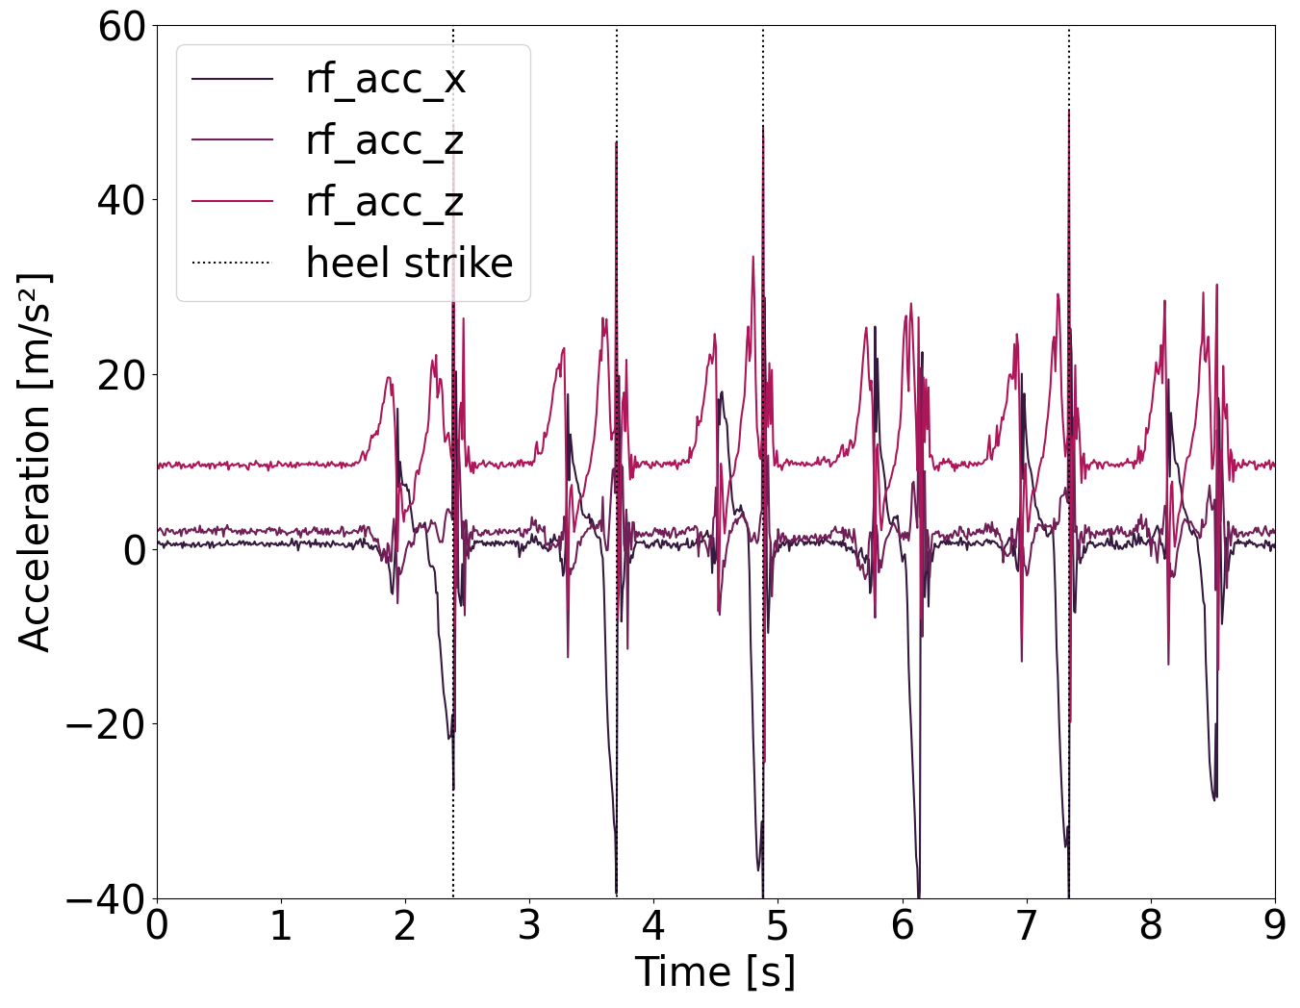
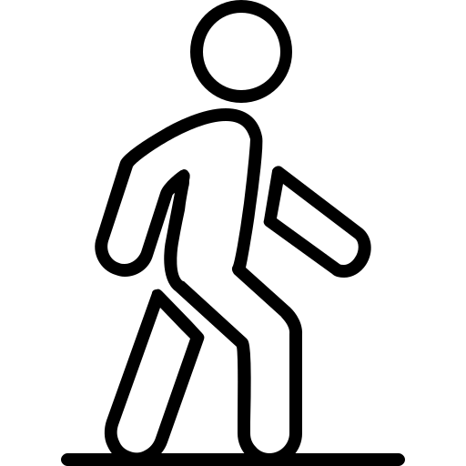
0,26345511 0,092292015 0,008668652 0,930514317 0,690193606 0,809881135
0,694520294 0,191824943 0,843726573 0,397571025 0,88542996 0,895276224
0,076633595 0,258720111 0,547534792 0,282283781 0,27890791 0,232620594
0,577995093 0,045616941 0,04903375 0,940889749 0,153318421 0,668360752
0,054555716 0,791513927 0,587116733 0,466957774 0,975446368 0,048053341
0,966026984 0,196283834 0,711044406 0,338944328 0,719445195 0,438488392
0,98417512 0,507944361 0,1180168 0,796692478 0,175376468 0,488659533
0,98839607 0,155737146 0,800206213 0,633481382 0,752698206 0,852943441
… … … … … …
README
{
"SamplingFrequency": 60,
"SamplingFrequencyEffective": 60.19,
"TaskName": "BIDS Motion fictive example",
"TrackingSystemName": "imu1",
"TaskDescription": "walking and talking",
"MotionChannelCount": 6,
"RecordingDuration": 10.05,
"RotationRule": "right-hand",
"RotationOrder": "ZXY",
"SubjectArtefactDescription": "n/a",
"TrackedPointsCount" : 2,
"ACCELChannelCount": 3,
„GYROChannelCount": 3,
"Manufacturer": "BWSensing",
"ManufacturersModelName": "BW-imu600",
}
dataset_description.json
participants.tsv
participants.json
sub-001
motion
sub-001[_ses-01]_task-<label>_tracksys-<label>_motion.tsv
sub-001[_ses-01]_task-<label>_tracksys-<label>_motion.json
sub-001[_ses-01]_task-<label>_tracksys-<label>_events.tsv
sub-001[_ses-01]_task-<label>_tracksys-<label>_events.json
sub-001[_ses-01]_task-<label>_tracksys-<label>_channels.tsv
sub-002
onset duration trial_type
2.45 0.1 heel_strike 3.81 0.1 heel_strike
4.95 0.1 heel_strike
6.11 0.1 heel_strike
7.24 0.1 heel_strike
motion
sub-002[_ses-01]_task-<label>_tracksys-<label>_motion.tsv
…
name type units srate tracked_point component placement
imu1_rf_acc_x ACCEL m/s^2 222 rf x right_foot
imu1_rf_acc_y ACCEL m/s^2 222 rf y right _foot
imu1_rf_acc_z ACCEL m/s^2 222 rf z right _foot
imu1_rf_gyro_x GYRO rad/s 222 rf x right _foot
imu1_rf_gyro_y GYRO rad/s 222 rf y right _foot
imu1_rf_gyro_z GYRO rad/s 222 rf z right _foot

