Slide 1


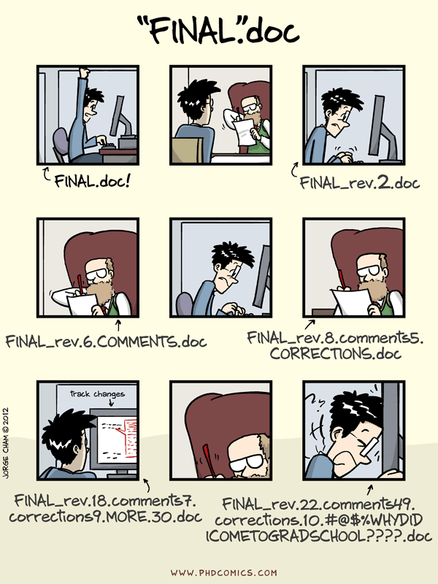


Introduction to Git
Version control for scientists using Atom IDE

Slide 2
What to expect
Overview of Git
GitHub and Atom
Practical example using coffee data

Slide 3
Overview
How do you manage different file versions?
How do you work with collaborators on the same files?
Version control system
manage different versions of files
collaborate with yourself
collaborate with other people
“Always remember your first collaborator is your future self, and
your past self doesn’t answer emails”

Slide 4

Git vs. GitHub vs. atom
Git
Version control system
GitHub
Cloud based hosting service
ATOM/
GitHub Desktop
Tracks changes
Run locally
Manages Git repositories
Editor to connect to GitHub and manages repositories

Slide 5
Why Git?
Version control – manage different versions of your files
Collaborate – working on files as a team (n ≥ 1)
Local
Remote
working directory
staging area
local repo
remote repo
add
commit
push
fetch
merge

Slide 6
Tour of GitHub
Init/ Clone
Commit
Push/ Pull
Branches/ merge
Local
Remote
working directory
staging area
local repo
remote repo
add
commit
push
fetch
merge

Slide 7
1. init/ clone
Create your project by cloning an existing one or creating a new one
Local
Remote
init
working directory
staging area
remote repo
clone
add
README (.md)
.gitignore

Slide 8
2. commit
Be committed, save your interim results and provide a description
Local
working directory
staging area
local repo
add
Data
Scripts
Literature
Paperwork
commit
“ Init project folder and add first README”

Slide 9
3. push/pull
Push changes/ commits to remote repo and pull to see if anything changed on remote repo
Local
Remote
working directory
staging area
local repo
remote repo
add
commit
“Data added”
“Current version of ethics”
…
push
fetch

Slide 10
4. branches
experiment
Multiple versions of the same project
default
Local
Remote
working directory
staging area
local repo
remote repo
fetch
merge

Slide 11
GitHub and Atom
Local
Remote
working directory
staging area
local repo
remote repo
add
commit
push
fetch
merge

Slide 12
GitHub and Atom
Local
Editor
&
Communicator
to GitHub
Remote
Hosting
Service
working directory
staging area
local repo
remote repo
add
commit
push
fetch
merge

Slide 13

Practical example using coffee data
Init project
Add README
Add .gitignore
Add script and commit changes
Push to remote
Pull remote changes

