Slide 1
Feedback Tremor
Third results
24.09.2021
Julius Welzel

Slide 2


Paradigm
Task
6s “hit & hold” target with thumb & index finger
Archer: 30s “hit & hold” target with whole hand
Manipulations
Visual gain (viewing angle)
Uniformly distributed between 12.9° & 1.3°
Archer: 2 conditions – 0.039° & 6.9°
Max force (MVC)
15, 20 & 25 % of a 3 trial average of 3 seconds
Archer: only 15%
Feedback
Visual, auditory & combined
Archer: only visual
~12.9°
~1.3°

Slide 3
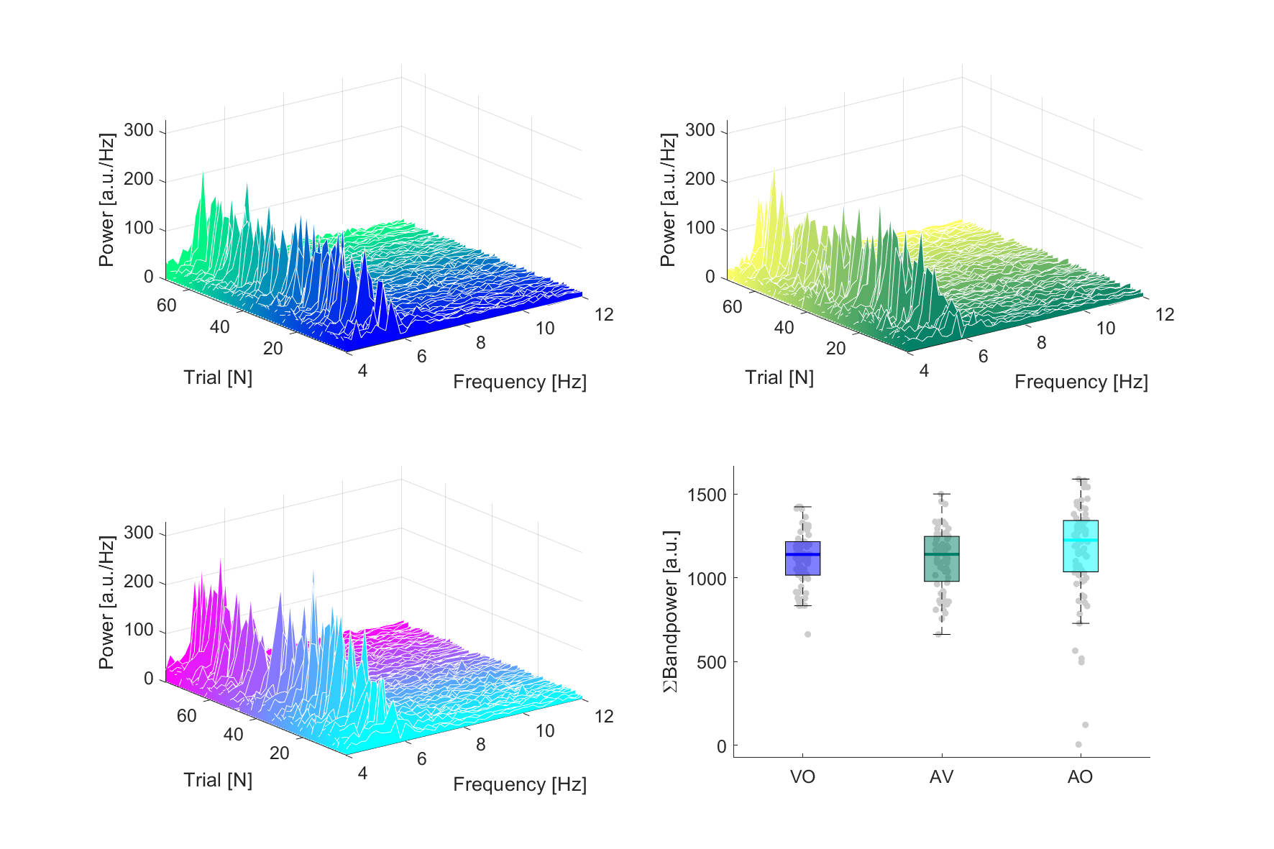
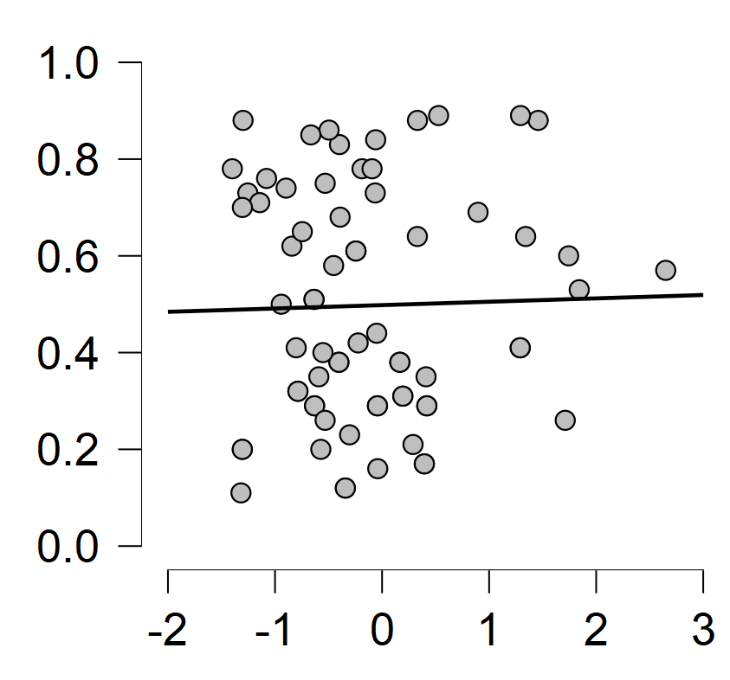
Tremor example data
Constant tremor in all trials over all feedback conditions
Higher variance in auditory feedback condition
No correlation (r = .025, p = 0.837) between visual feedback scaling and tremor power
Sclae (Visual Gain)
Z-scored Power_{4-12 Hz}

Slide 4
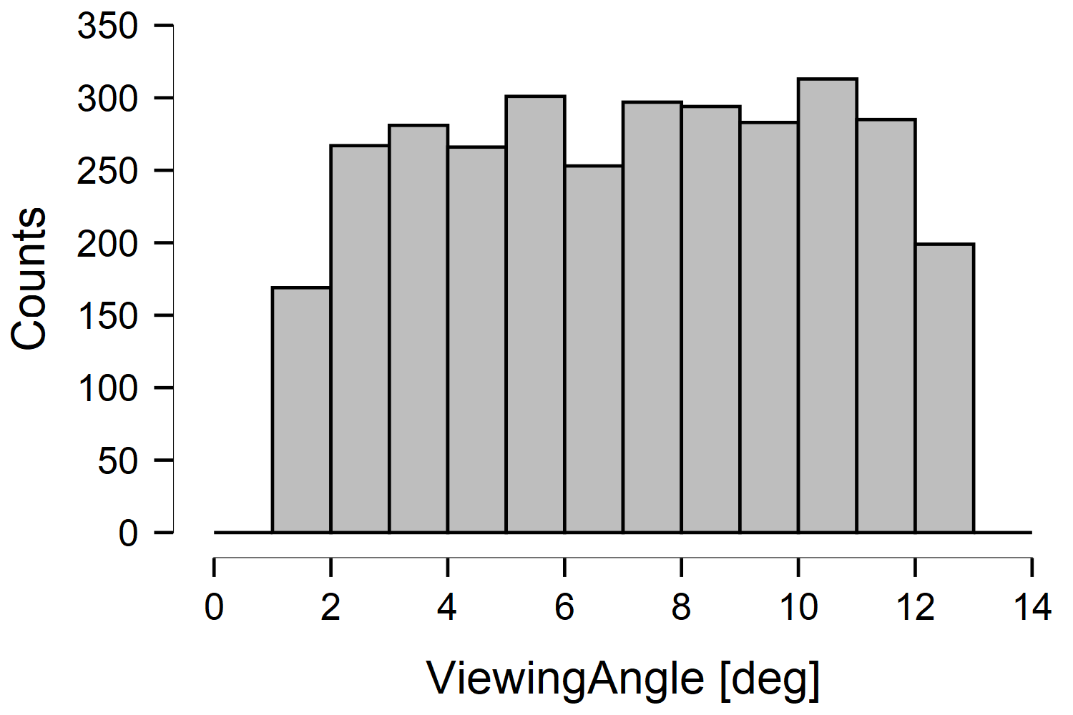
Archer
“[…] We chose visual gain levels below (0.039°) and above (6.9°) 0.5° […]”
0.074 cm & 13.31 cm
0.039°
6.9°

Slide 5
New datasets
August 2021

Slide 6
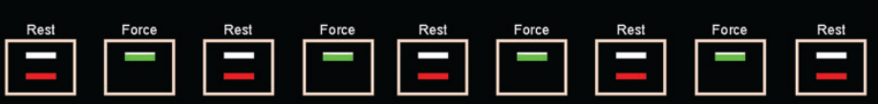
Improved paradigm
270 s total
5 rest periods (30s)
4 force periods (30s)
3 times for each feedback condition
15% of max force as target force
x3

Slide 7
Hypotheses
The viewing angles in first recordings is to similar to show tremor power differences in regression (t-test)
Auditory feedback shows higher RMSE compared to the other two (1-way ANOVA)
Pupil size is influenced differently in all three feedback conditions between scaling conditions (2x3 ANOVA)

Slide 8
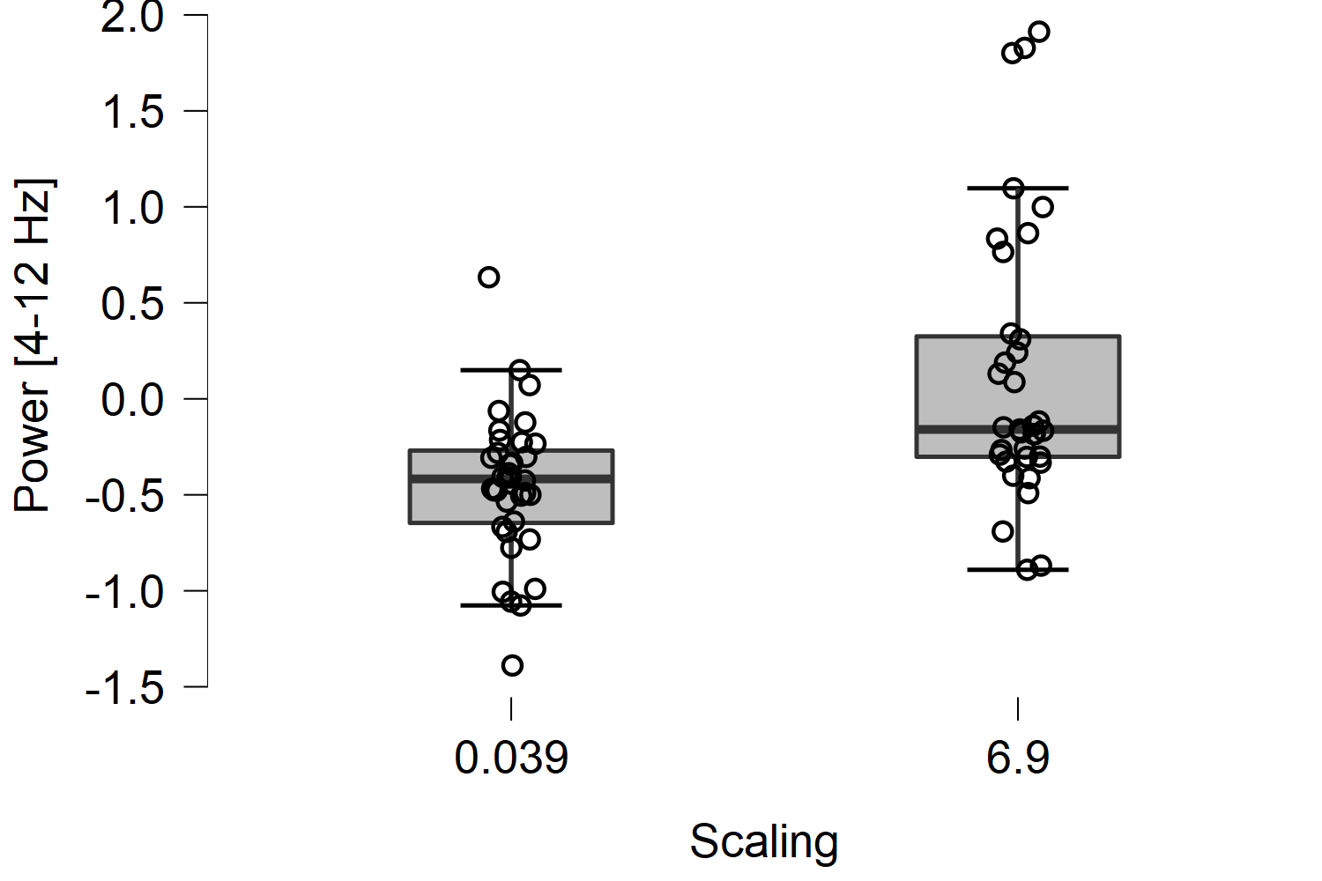
Tremor power [4-12 Hz] – vo,av,ao
Independent Samples T-Test
 | t | df | p
RMSE | -0.224 | 69 | 0.823
Power [0-3 Hz] | -0.923 | 69 | 0.359
Power [4-12 Hz] | -4.217 | 69 | < .001 | ᵃ
Pupilsize | -2.270 | 42 | 0.028 | ᵃ
Note. Student's t-test.
ᵃ Levene's test is significant (p < .05), suggesting a violation of the equal variance assumption

Slide 9
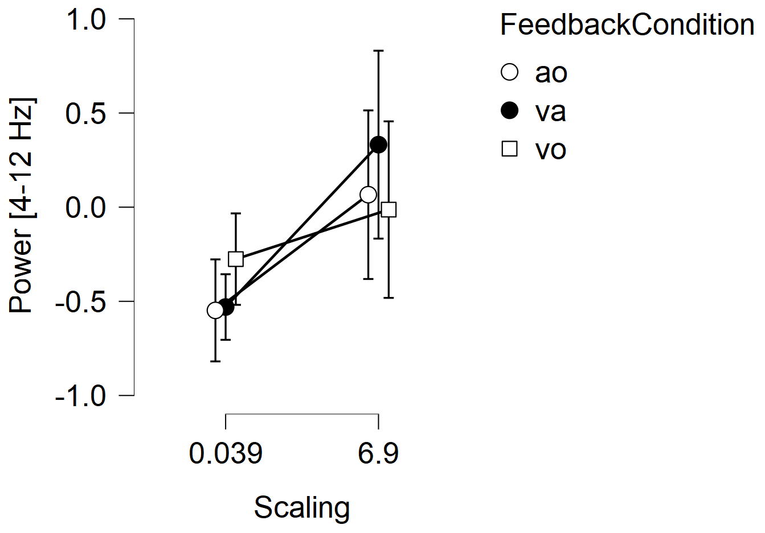
All conditions
ANOVA - Power [4-12 Hz]
Cases | Sum of Squares | df | Mean Square | F | p
Feedback Condition | 0.248 | 2 | 0.124 | 0.376 | 0.688
Scaling | 5.961 | 1 | 5.961 | 18.114 | < .001
FeedbackCondition ✻ Scaling | 1.067 | 2 | 0.534 | 1.621 | 0.206
Residuals | 21.392 | 65 | 0.329
Note. Type III Sum of Squares

Slide 10
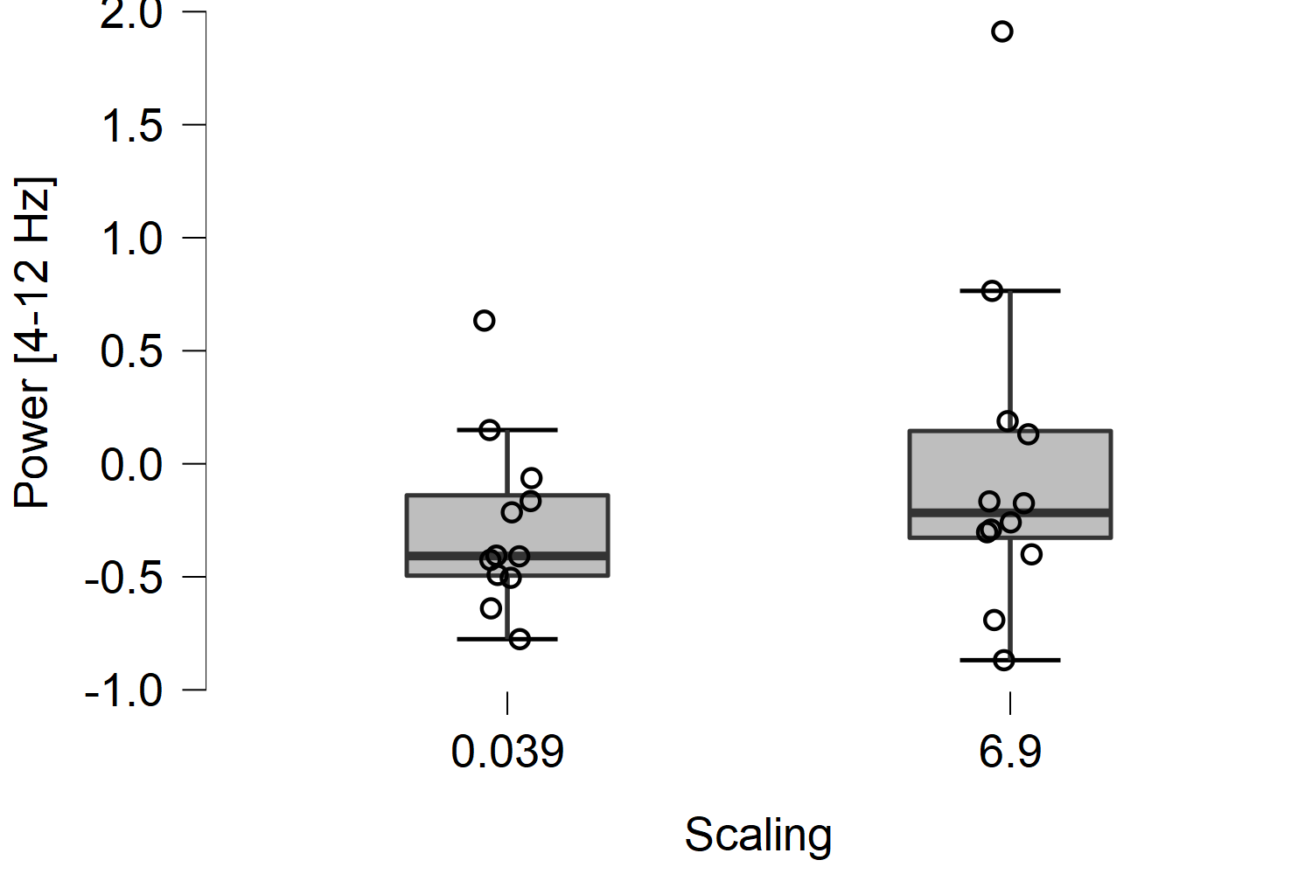
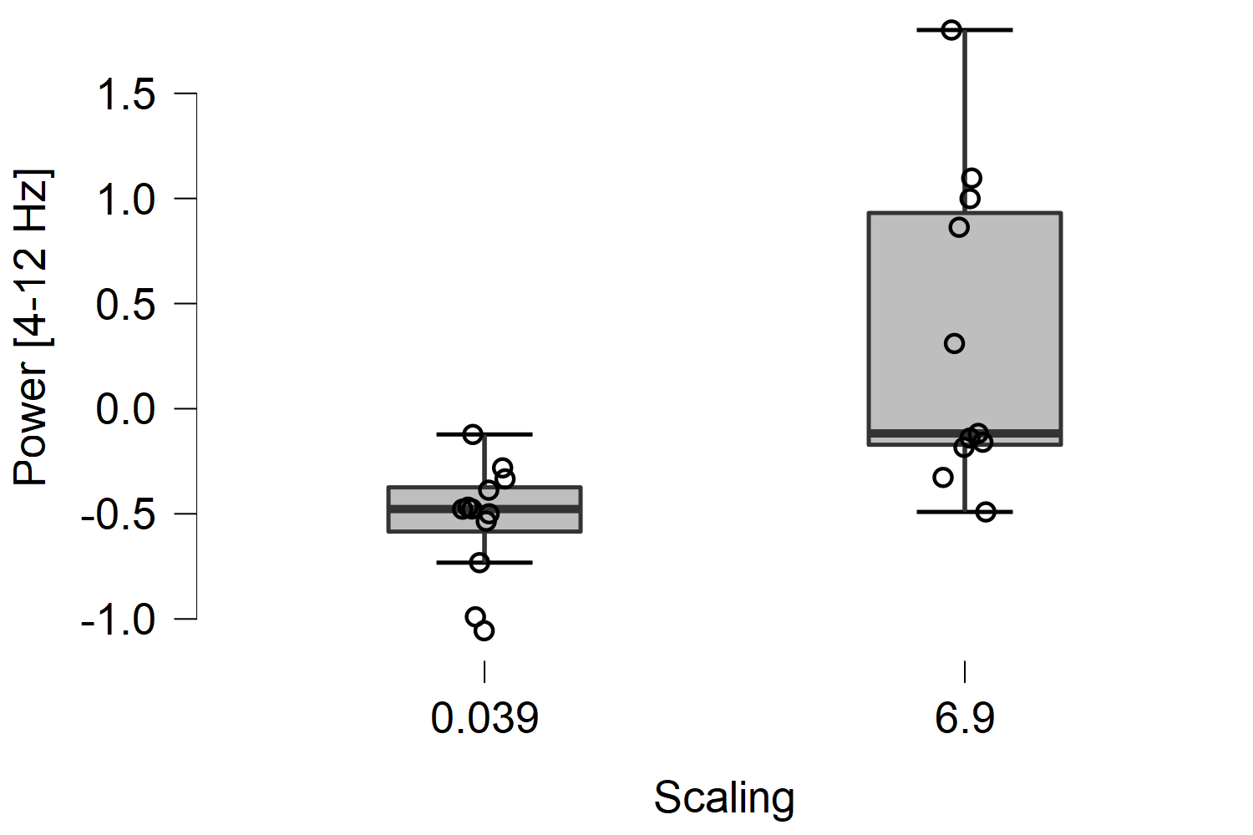
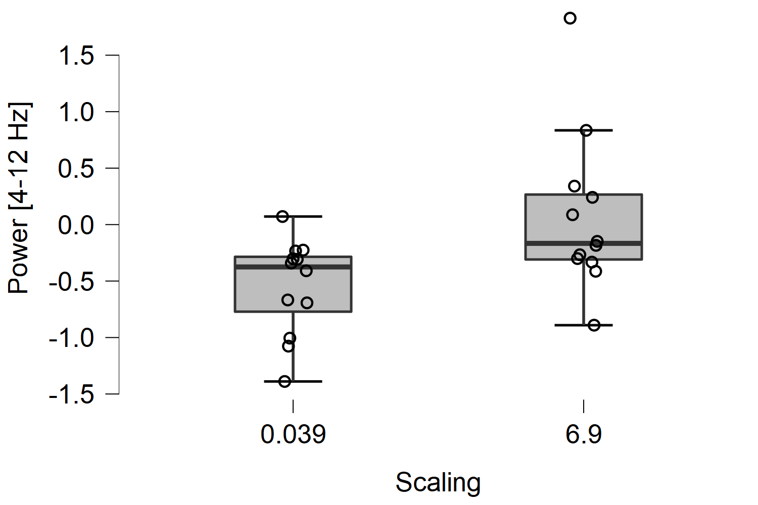
Per condition
Vo; p = 0.285 (n = 11*) – av; p = 0.001 – ao; p = 0.017

Slide 11
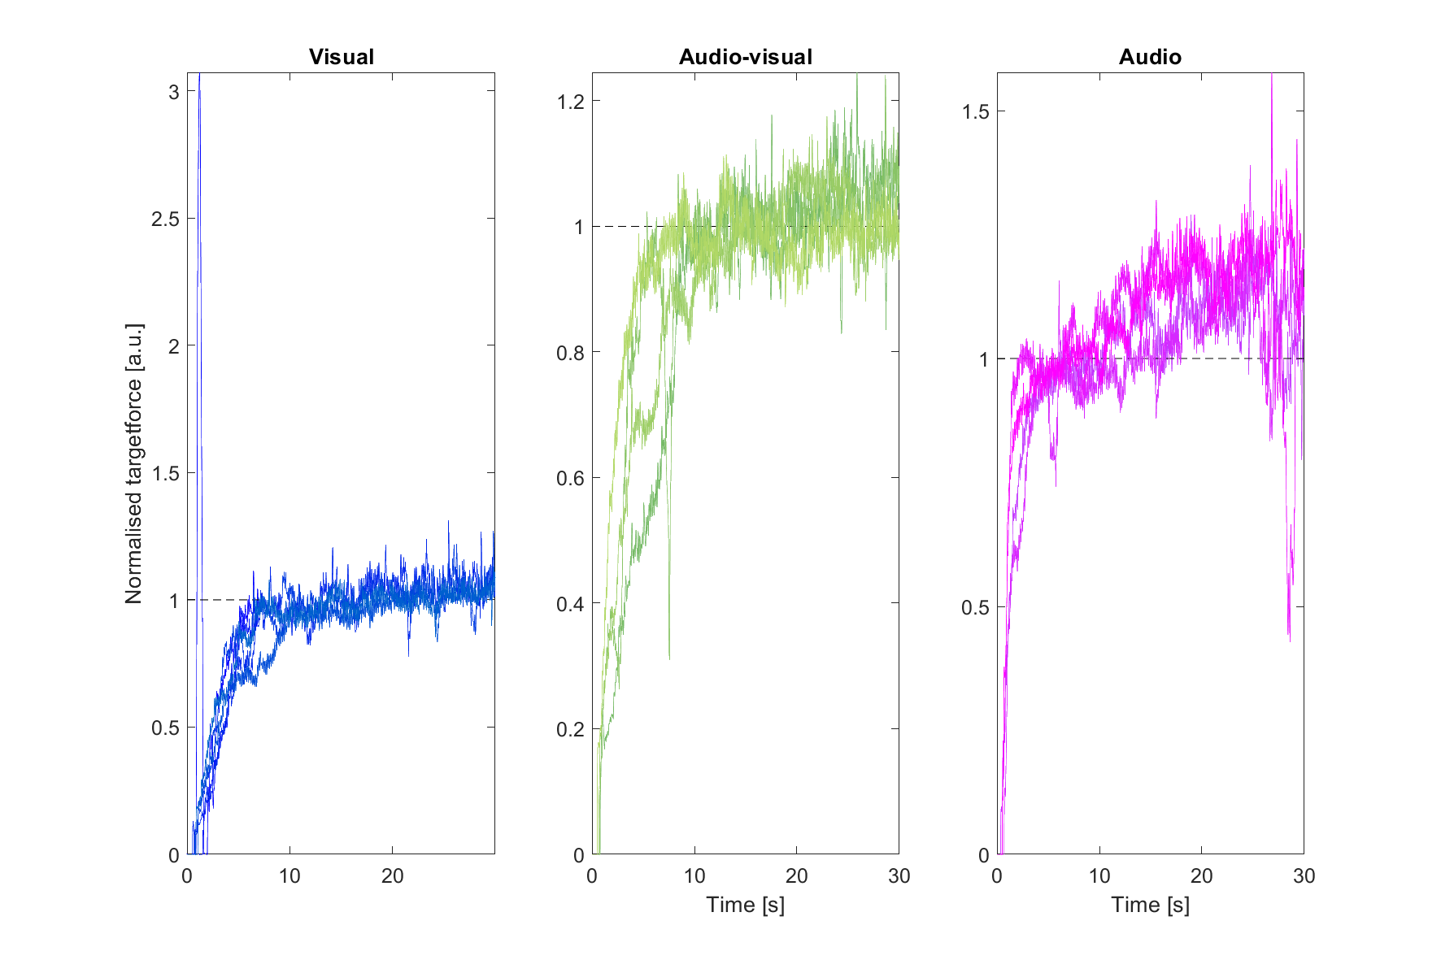
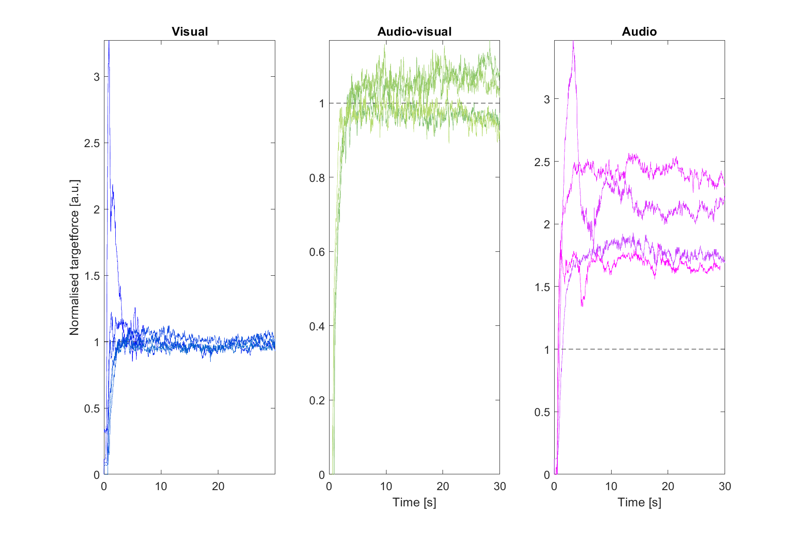
RMSE per feedback condition

Slide 12
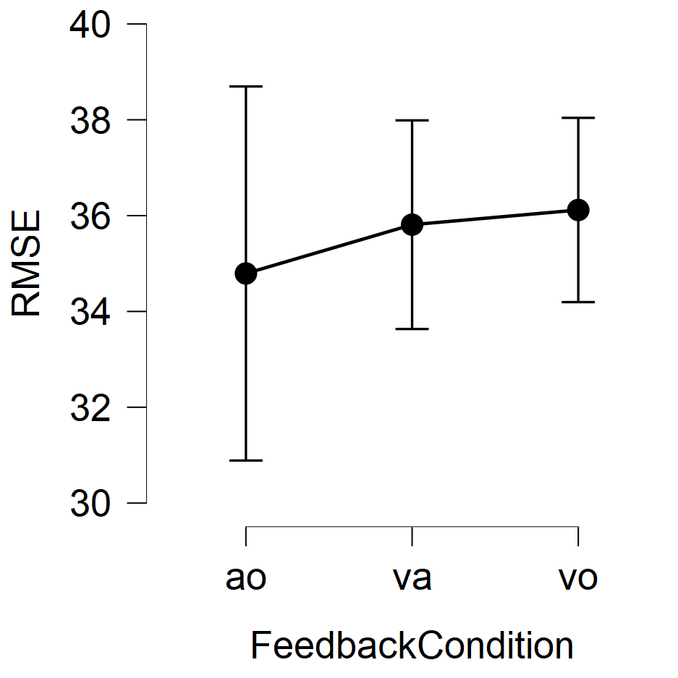
RMSE ANOVA
Remove 4 participants
ANOVA - RMSE
Cases |  | Sum of Squares | df |  | Mean Square |  | F |  | p
Feedback Condition |  | 25.196 | 2 |  | 12.598 |  | 0.256 |  | 0.774
Residuals |  | 5013.942 | 102 |  | 49.156
Note. Type III Sum of Squares

Slide 13
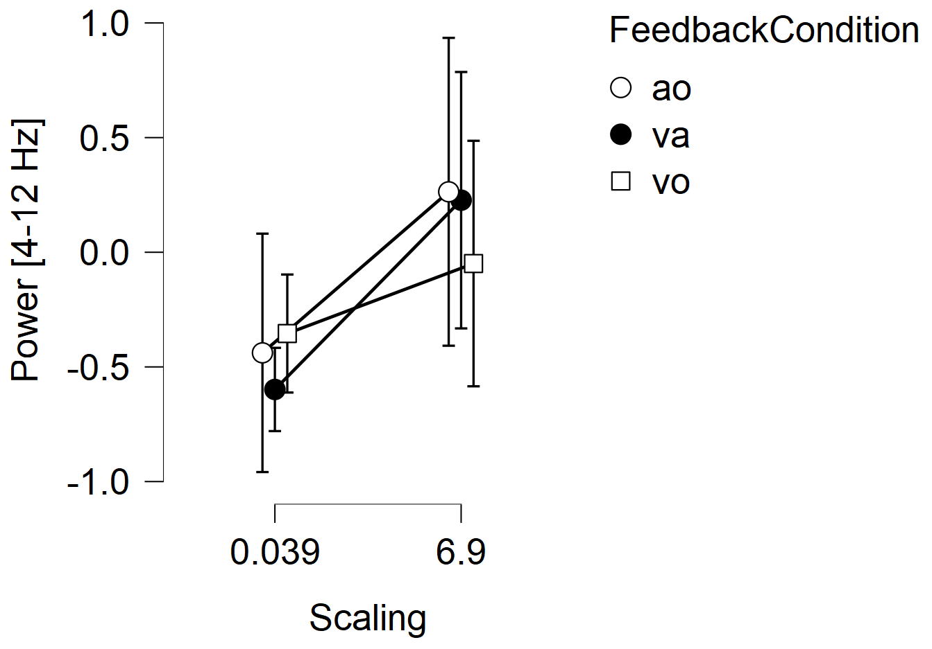
Target dataset

Slide 14
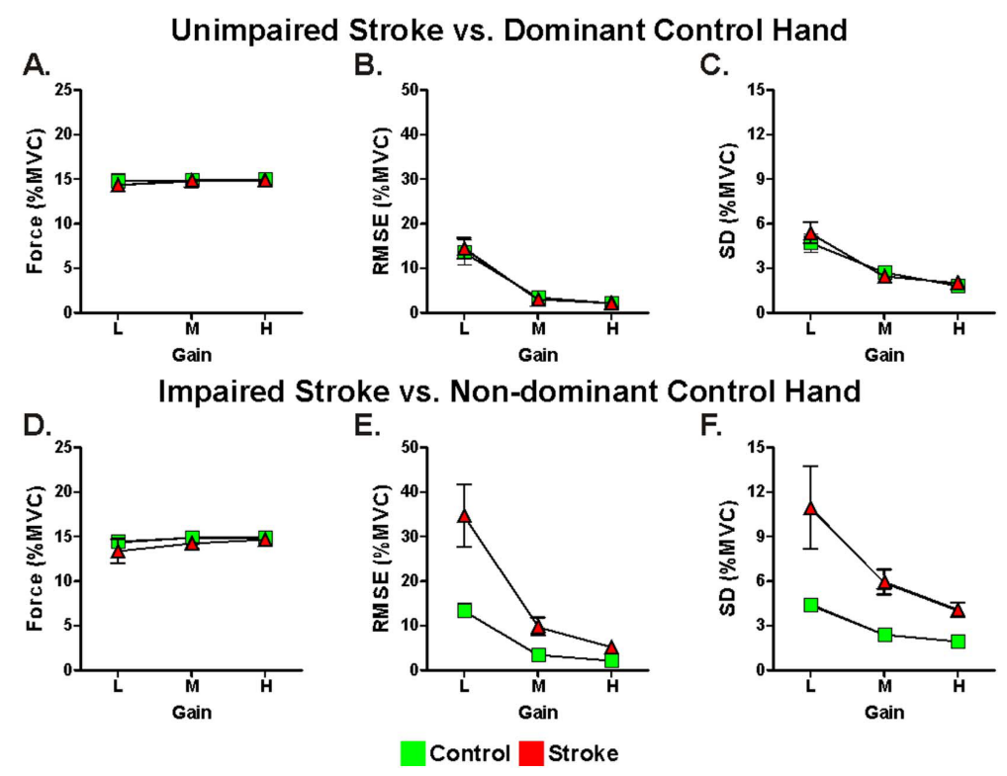
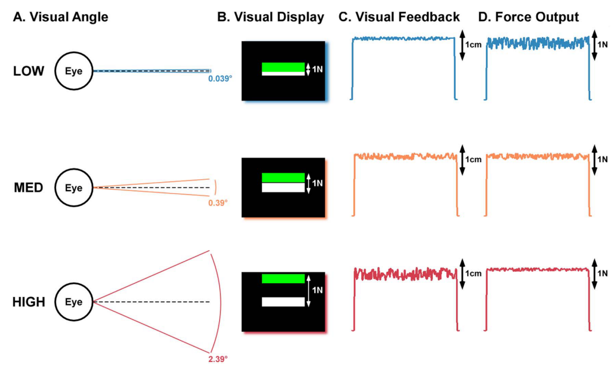
Visual feedback alters force control and functional activity in the visuomotor network after stroke
Archer ea., 2018

Slide 15
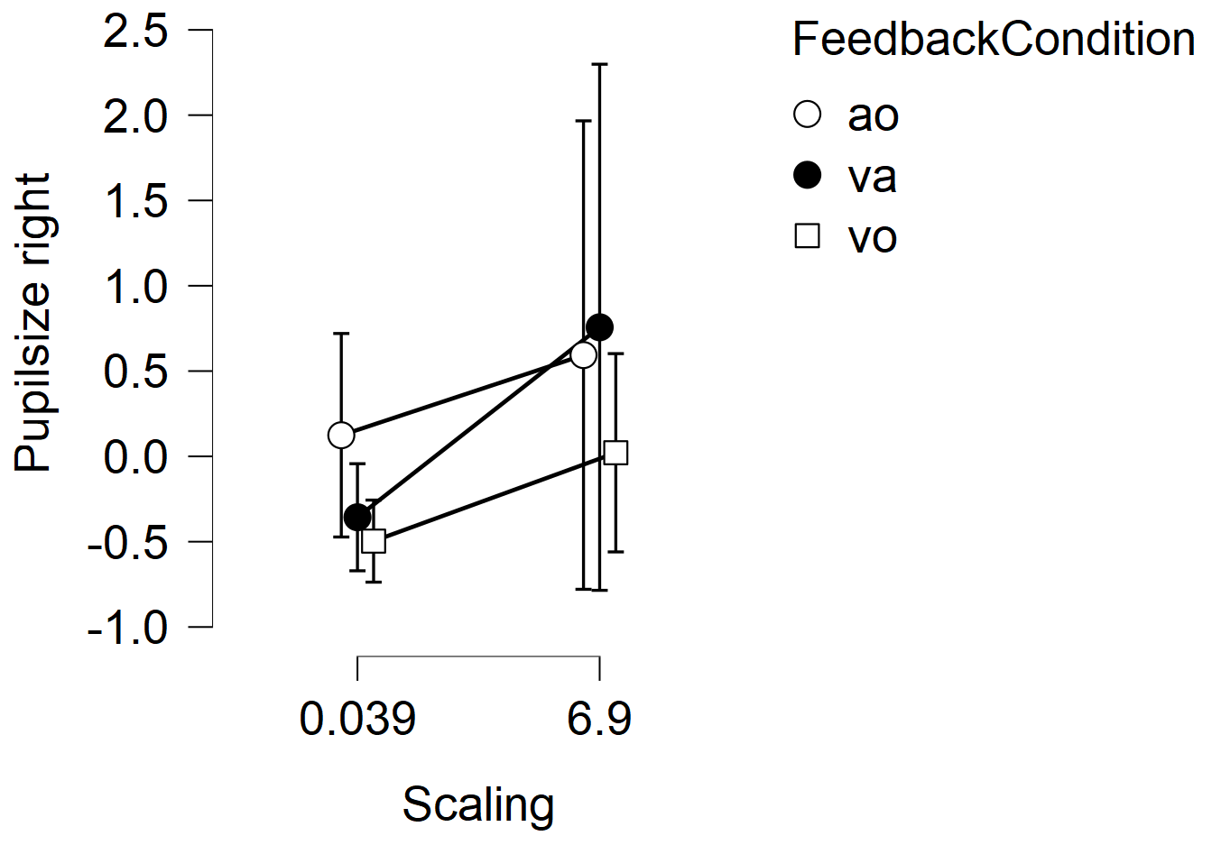
Pupil size
ANOVA - Pupilsize
Cases | Sum of Squares | df | Mean Square | F | p
FeedbackCondition | 2.737 | 2 | 1.368 | 1.244 | 0.300
Scaling | 5.375 | 1 | 5.375 | 4.885 | 0.033
FeedbackCondition ✻ Scaling | 0.952 | 2 | 0.476 | 0.433 | 0.652
Residuals | 41.811 | 38 | 1.100
Note. Type III Sum of Squares

Slide 16
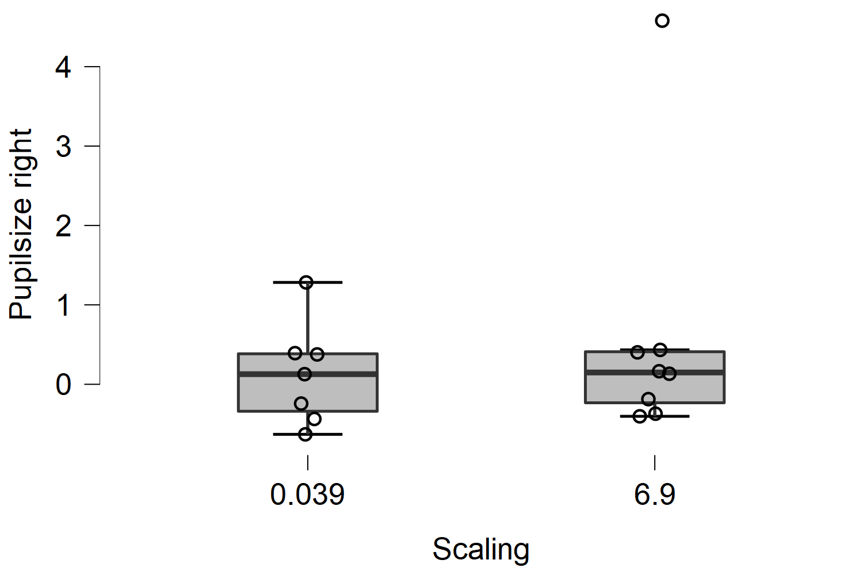
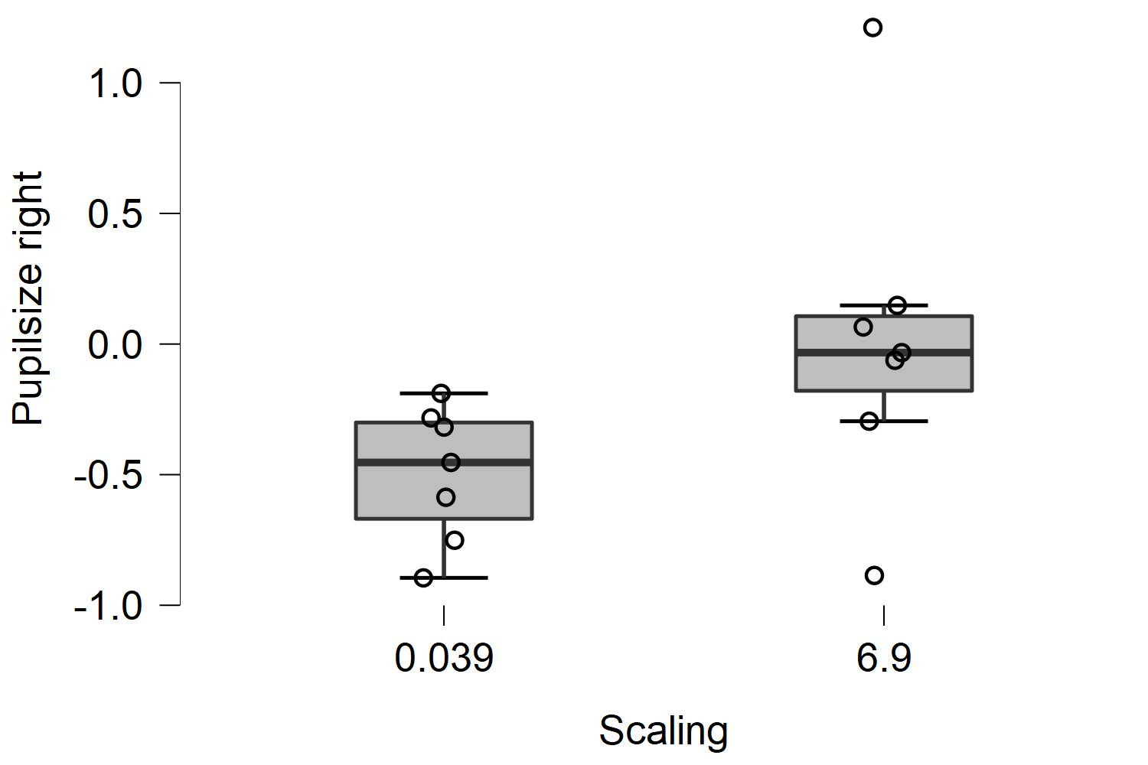
Pupil Size
Independent Samples T-Test
 | t | df | p
RMSE | -0.224 | 69 | 0.823
Power [0-3 Hz] | -0.923 | 69 | 0.359
Power [4-12 Hz] | -4.217 | 69 | < .001 | ᵃ
Pupilsize | -2.270 | 42 | 0.028 | ᵃ
Note. Student's t-test.
ᵃ Levene's test is significant (p < .05), suggesting a violation of the equal variance assumption

Slide 17
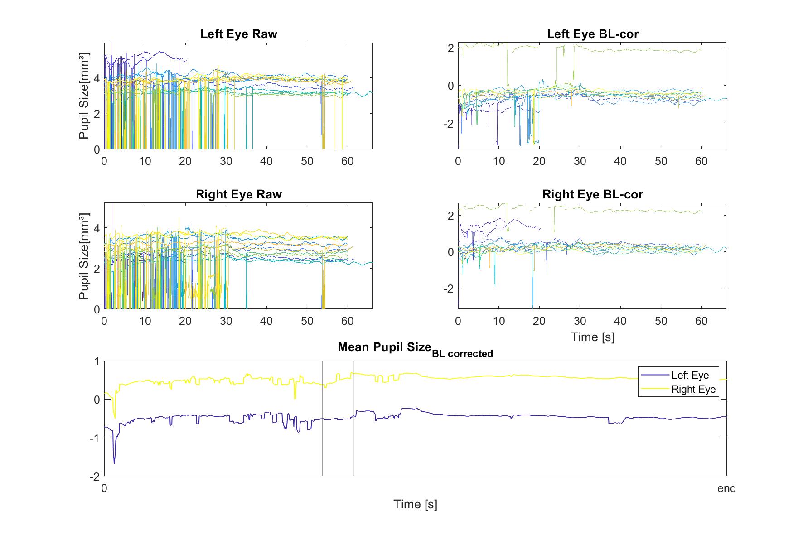
Single trial pupil

Slide 18
Supplementary Dirkx ea.
Supplement 3 – Pupil diameter versus luminance
We investigated the relationship between pupil diameter and luminance during the various trials by calculating the average pixel intensity per trial. Specifically, we used matlab to load 32bit screenshots of each trial which revealed the RGB values for every pixel ([0 0 0] representing a black pixel and [255 255 255] a white). This showed that the average pixel value was slightly larger for the rest trials compared to any of the cognitive load trial (supplementary table 2). However, there was no relationship between the average pixel value and pupil diameter for each cognitive load trial (supplementary figure 2A), nor was there a significant correlation between the relative increase in pupil diameter (cognitive load minus the preceding rest trial) and relative decrease in pixel intensity (supplementary figure 2B). If anything, pupil diameter increased more for cognitive load trials that showed little difference in pixel intensity compared to the rest trial (supplementary figure 2B), emphasizing that these effect are unrelated to luminance.

