Slide 1



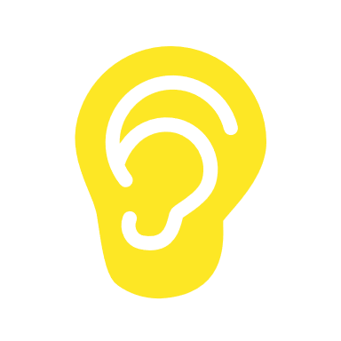


1 sec
PsychoPy
Visual only
Python
30 sec
Python
~0.04°
~6.9°
LabRecorder
30 sec
Force Sensor
PupilLabs
LSL

