Slide 1
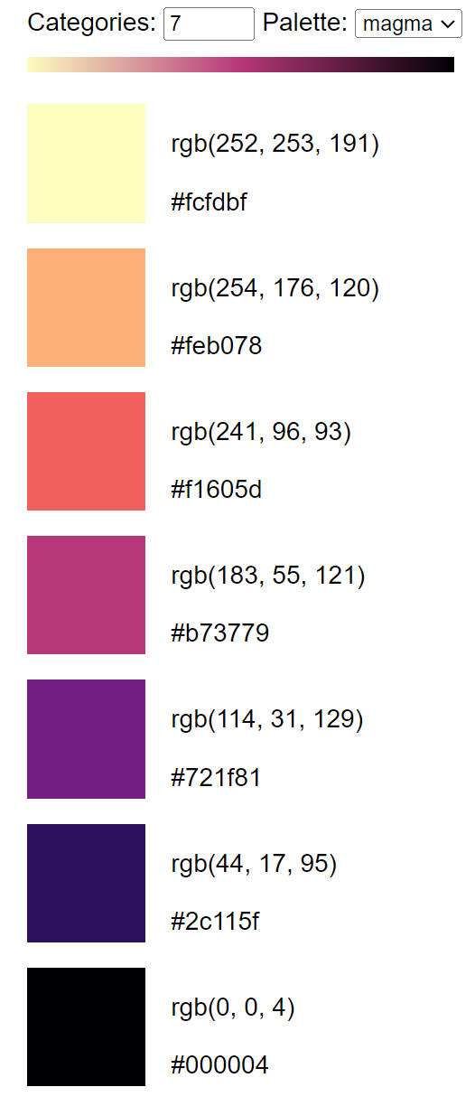

Slide 2



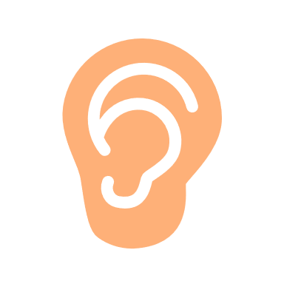


1 sec
Visual only
PsychoPy
30 sec
Python
Python
1.0 – 1.5 sec
~0.04°
~6.9°
+
Force Sensor
LabRecorder
30 sec
PupilLabs
LSL

