Slide 1
Second data aquisition phase
„Now really replicate“
01.08.2021
Julius Welzel

Slide 2


Paradigm
Task
6s “hit & hold” target with thumb & index finger
Archer: 30s “hit & hold” target with whole hand
Manipulations
Visual gain (viewing angle)
Uniformly distributed between 12.9° & 1.3°
Archer: 2 conditions – 0.039° & 6.9°
Max force (MVC)
15, 20 & 25 % of a 3 trial average of 3 seconds
Archer: only 15%
Feedback
Visual, auditory & combined
Archer: only visual
~12.9°
~1.3°

Slide 3
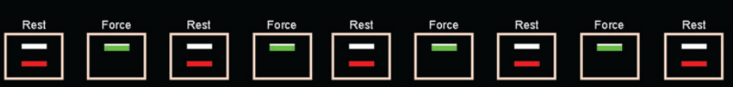
Archer 1to1
270 s total
5 rest periods (30s)
4 force periods (30s)
3 times for feedback condition
15% of max force as target force

Slide 4
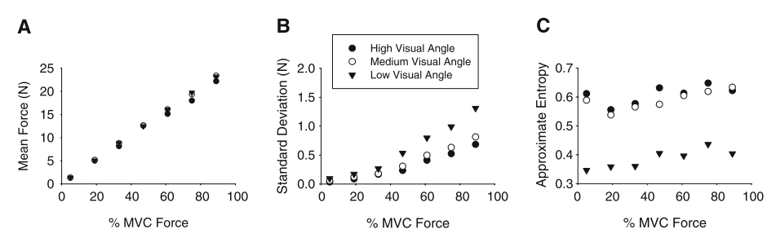
3 Experiments – visual gain
How the visual angle affected force variability across a range of target force levels. (high; (38°), medium (4.4°), and low (0.1°)

Slide 5
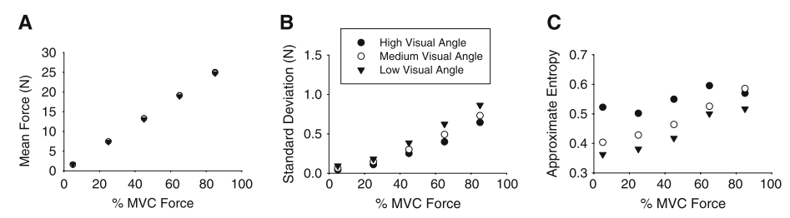
Monitor distance
How the visual angle affected force variability across a range of target force levels (Monitor distance)

Slide 6
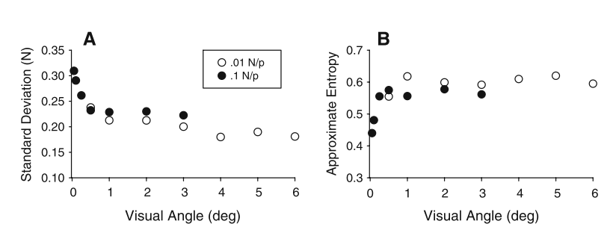
Combinations – 25% MVC
Force variability at two separate gain levels across the same visual angles in order to determine if the key informational variable was visual angle, gain, distance, or some combination of the three
Notes:
The two gain levels 0.1 and 0.01 (N/P ratio)
There were seven visual angle levels at the 0.1 gain level and seven visual angle levels at the 0.01 gain level

Slide 7
Archer
“[…] We chose visual gain levels below (0.039°) and above (6.9°) 0.5° […]”
0.074 cm & 13.31 cm

Slide 8
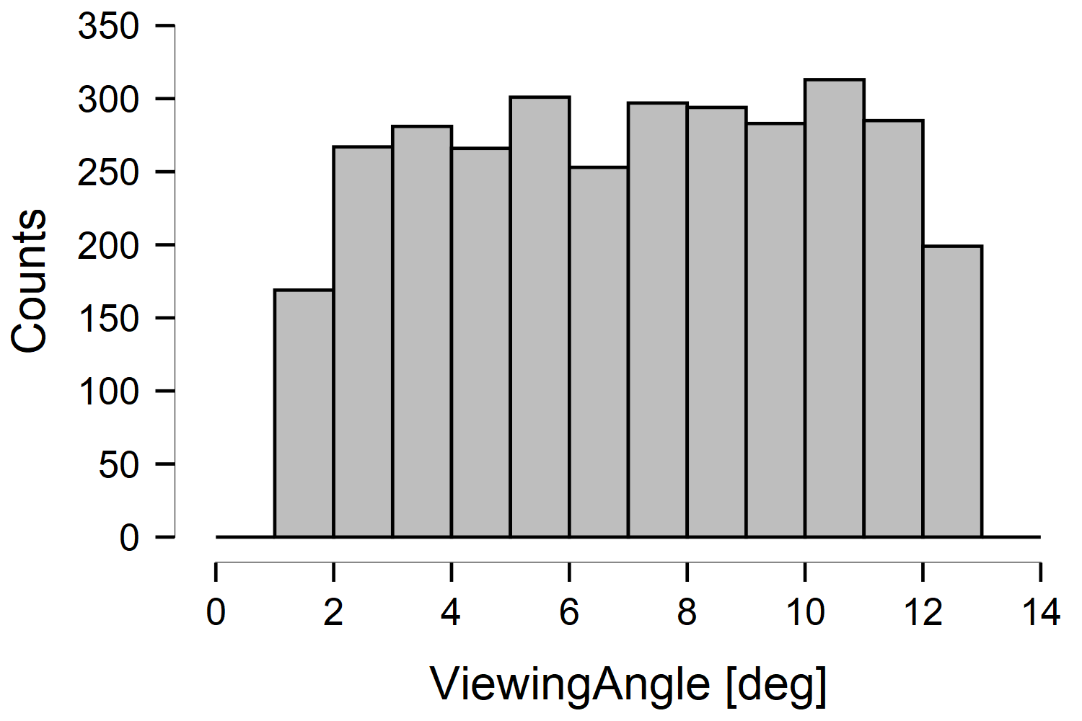
Next steps
0.039°
6.9°

Slide 9
Visual angle
0.039°
6.9°

Slide 10
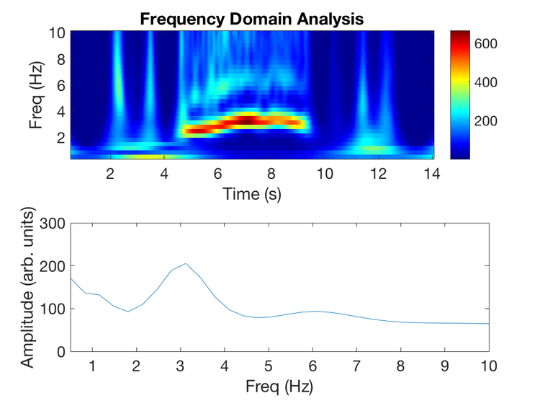
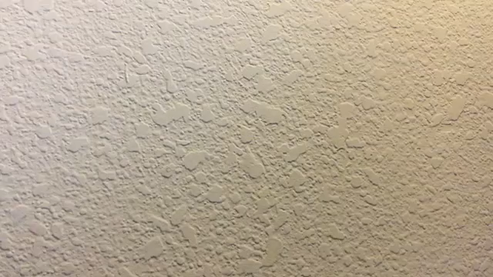
Tremor parameters
MVC vs. Power
Peak frequencies
Time variability
…
https://github.com/mattgaidica/MoveAlgorithms

