Slide 1
Feedback Tremor
Fourth results
22.12.2021
Julius Welzel

Slide 2
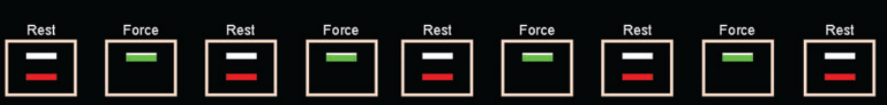
Improved paradigm
270 s total
5 rest periods (30s)
4 force periods (30s)
3 times for each feedback condition
15% of max force as target force
x3

Slide 3
Hypotheses
The viewing angles in first recordings is to similar to show tremor power differences in regression (t-test)
Auditory feedback shows higher RMSE compared to the other two (1-way ANOVA)
Pupil size is influenced differently in all three feedback conditions between scaling conditions (2x3 ANOVA)

Slide 4
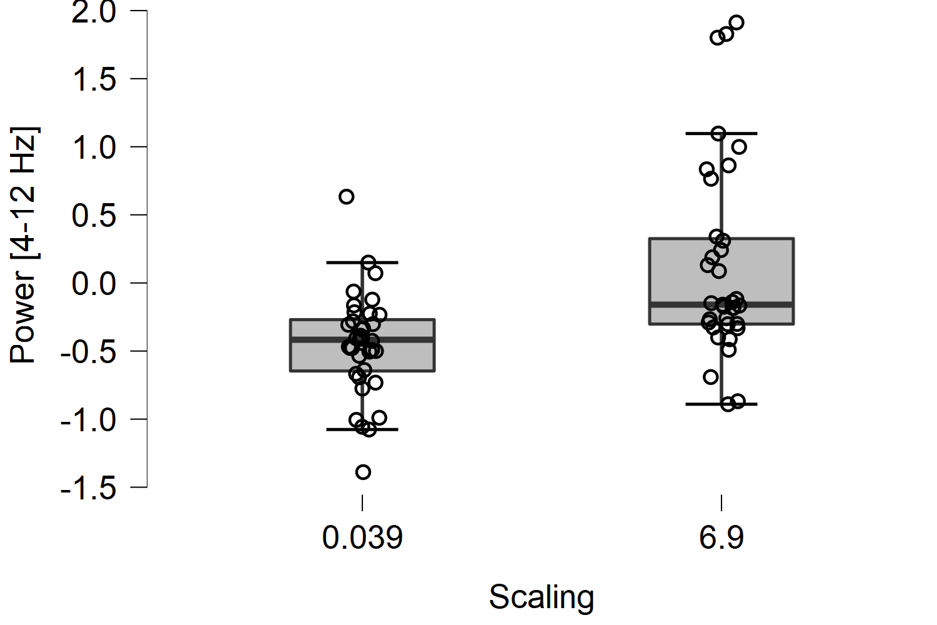
Tremor power [4-12 Hz] – vo,av,ao
Independent Samples T-Test
 | t | df | p
RMSE | -0.224 | 69 | 0.823
Power [0-3 Hz] | -0.923 | 69 | 0.359
Power [4-12 Hz] | -4.217 | 69 | < .001 | ᵃ
Pupilsize | -2.270 | 42 | 0.028 | ᵃ
Note. Student's t-test.
ᵃ Levene's test is significant (p < .05), suggesting a violation of the equal variance assumption

Slide 5
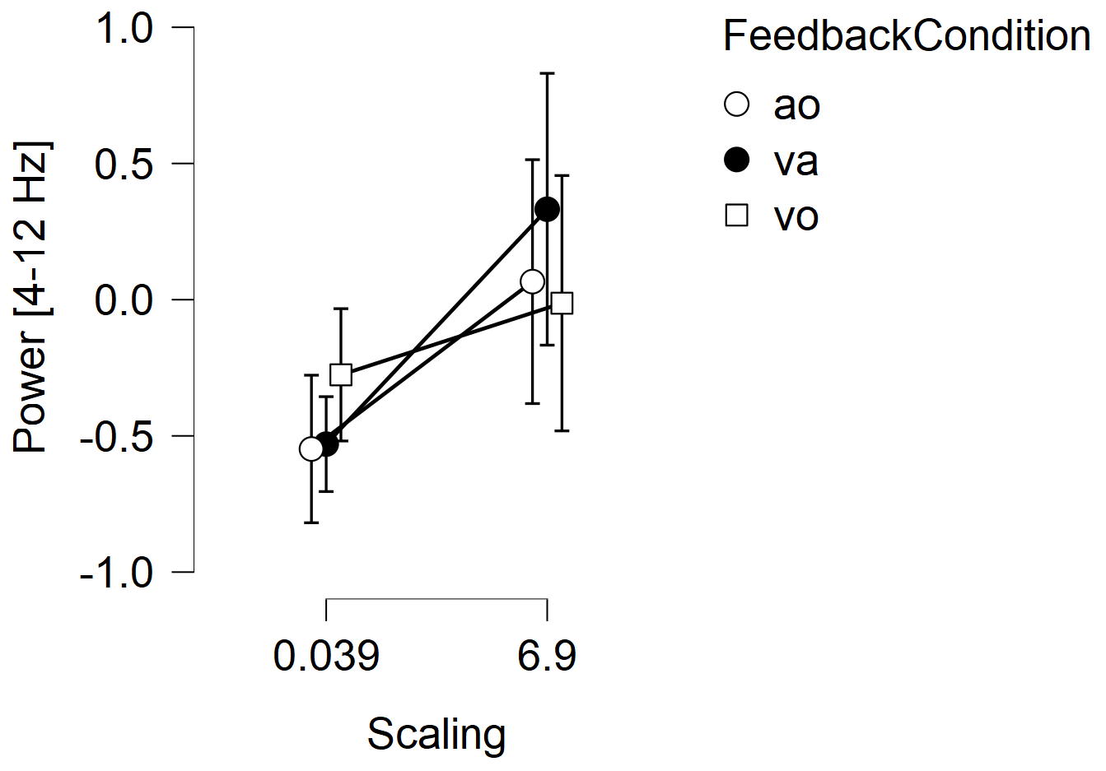
All conditions
ANOVA - Power [4-12 Hz]
Cases | Sum of Squares | df | Mean Square | F | p
Feedback Condition | 0.248 | 2 | 0.124 | 0.376 | 0.688
Scaling | 5.961 | 1 | 5.961 | 18.114 | < .001
FeedbackCondition ✻ Scaling | 1.067 | 2 | 0.534 | 1.621 | 0.206
Residuals | 21.392 | 65 | 0.329
Note. Type III Sum of Squares

Slide 6
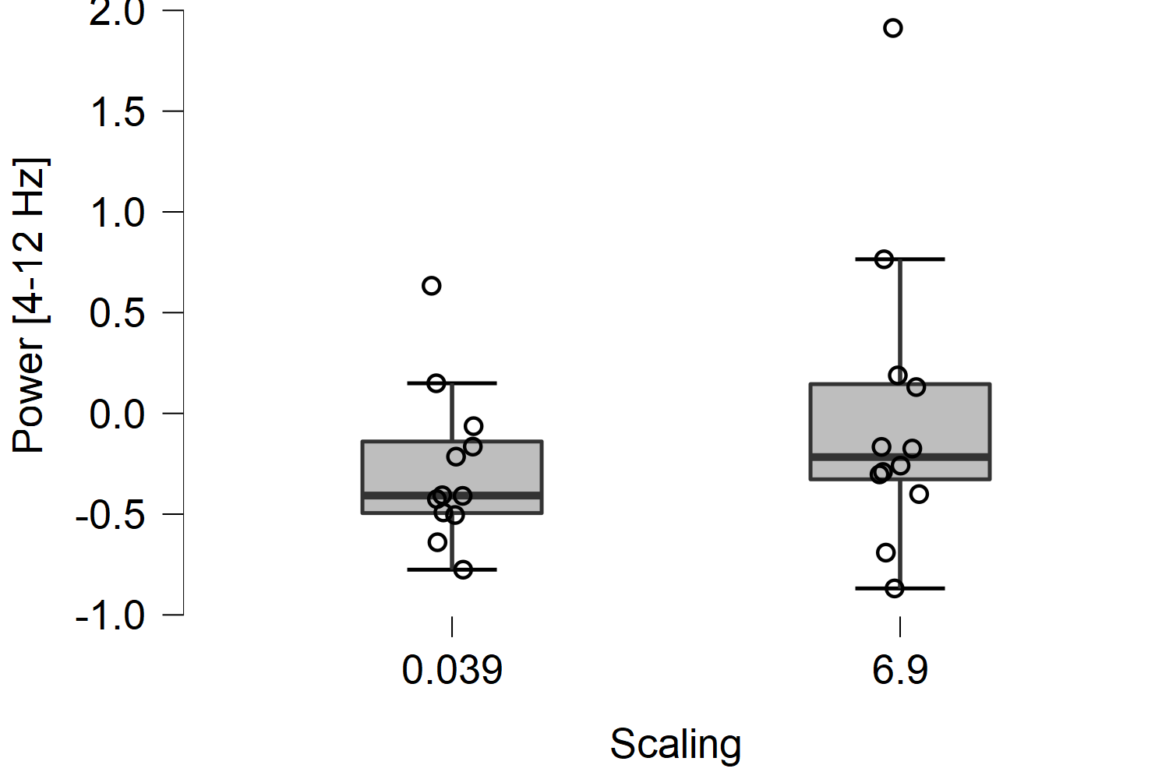
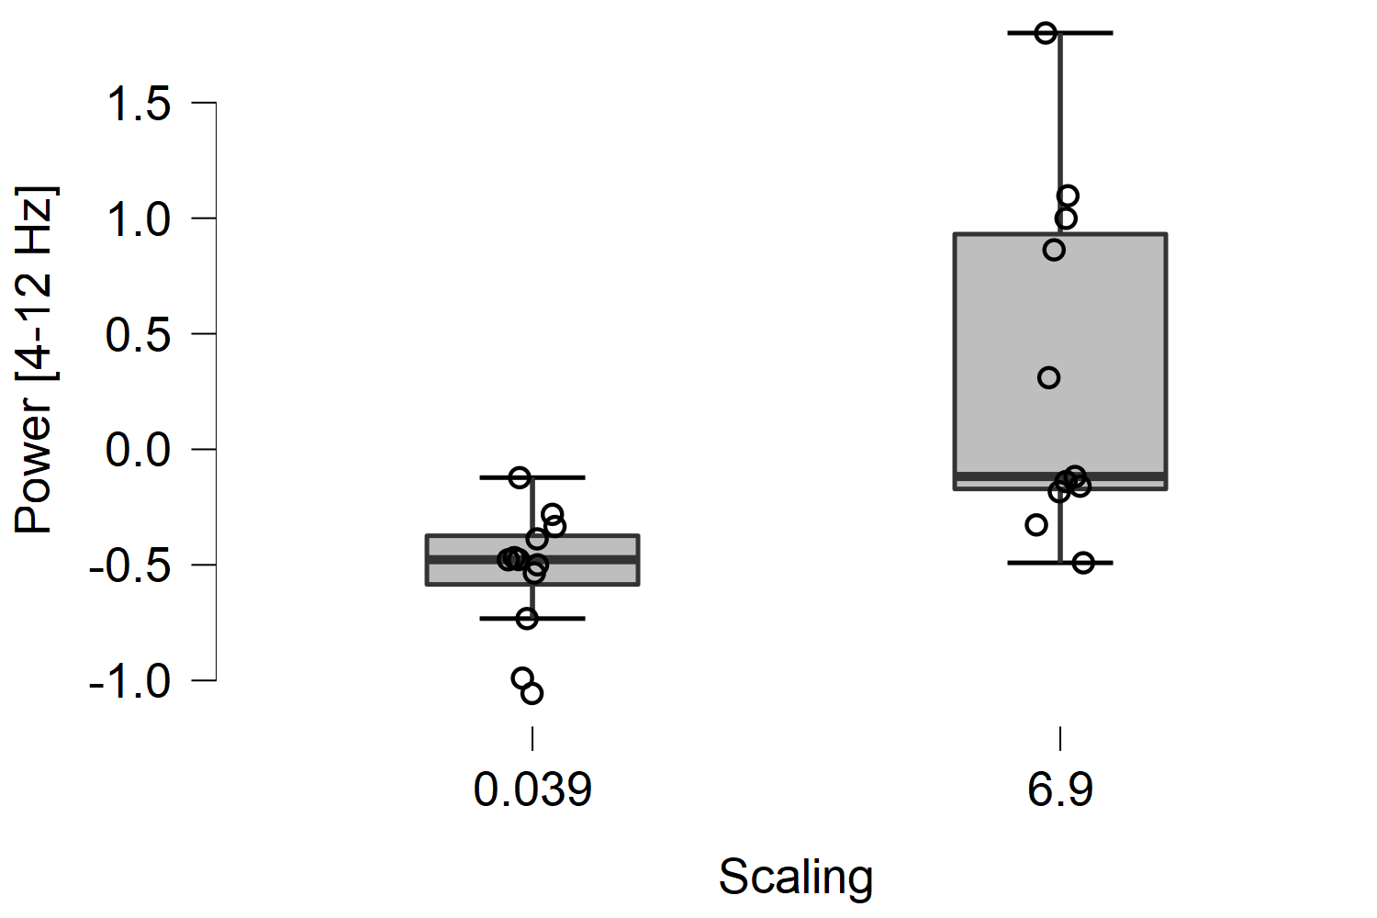
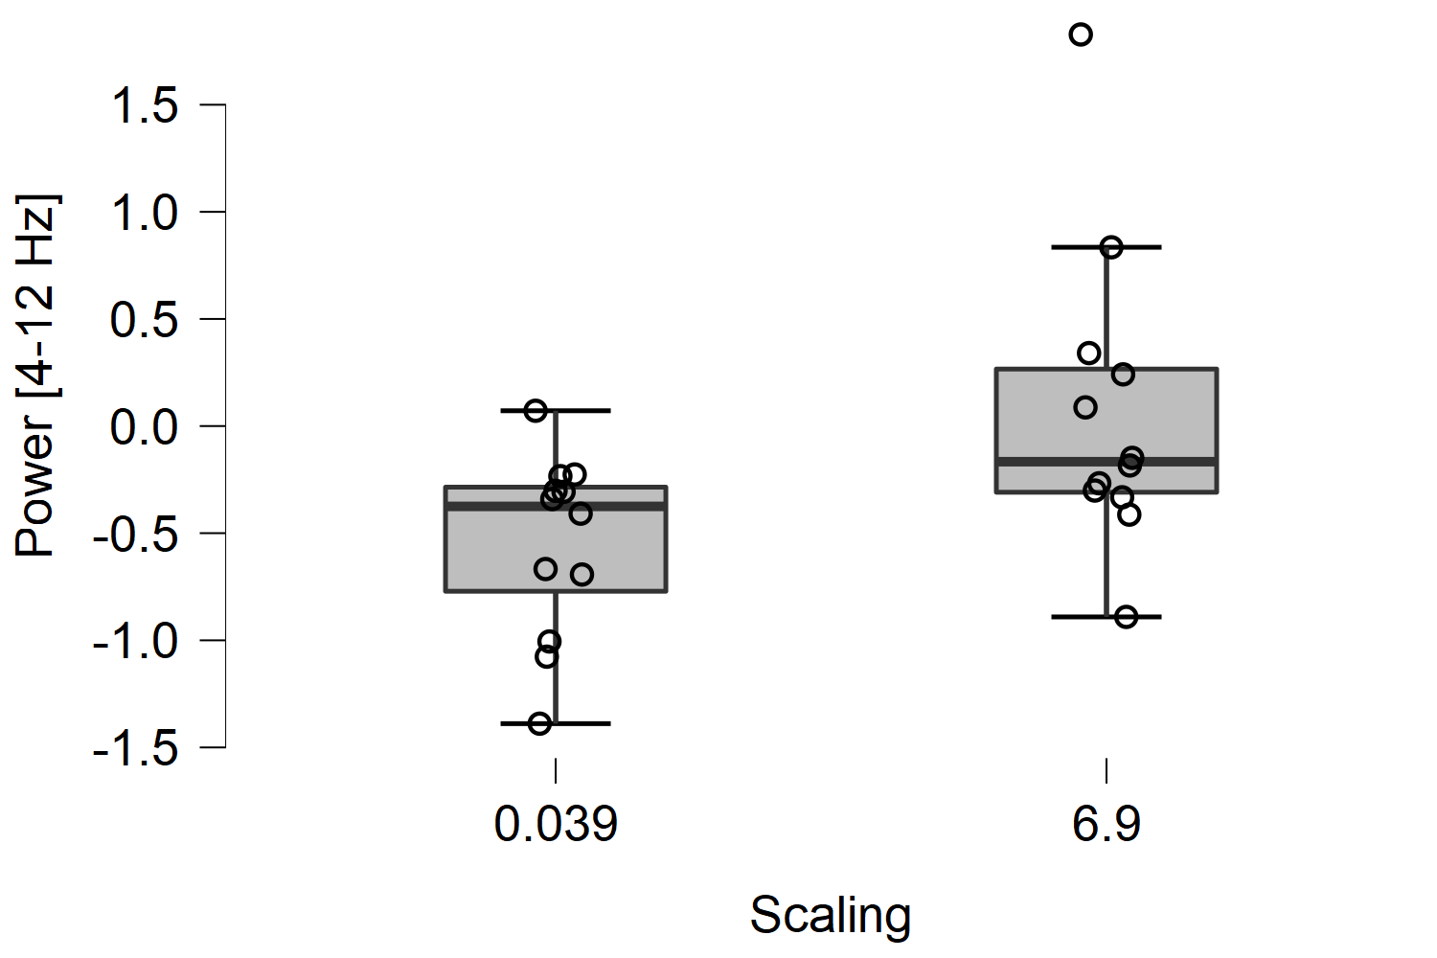
Per condition
Vo; p = 0.285 (n = 11*) – av; p = 0.001 – ao; p = 0.017

Slide 7
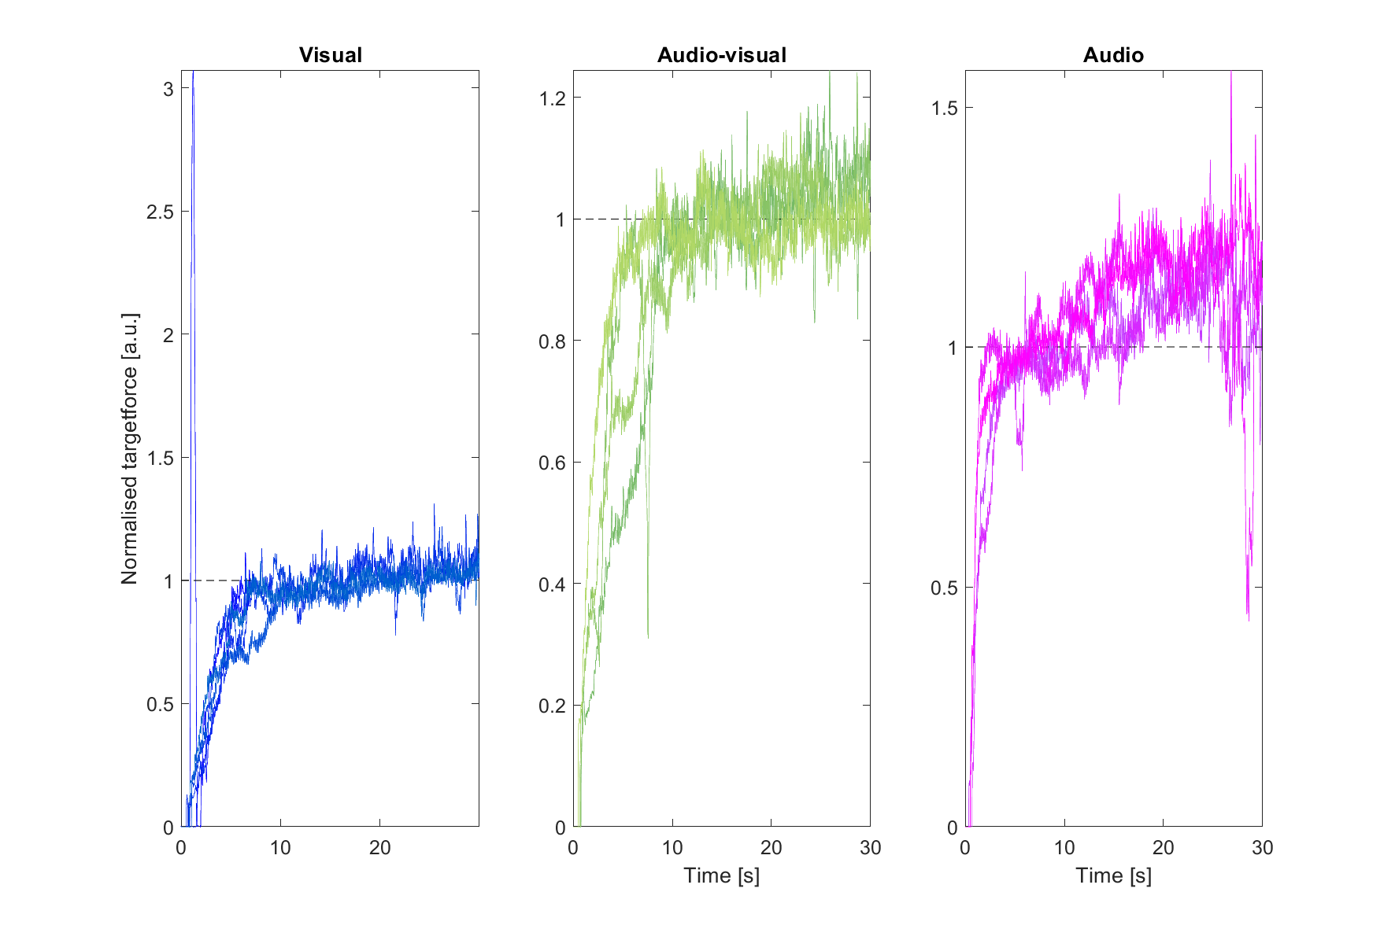
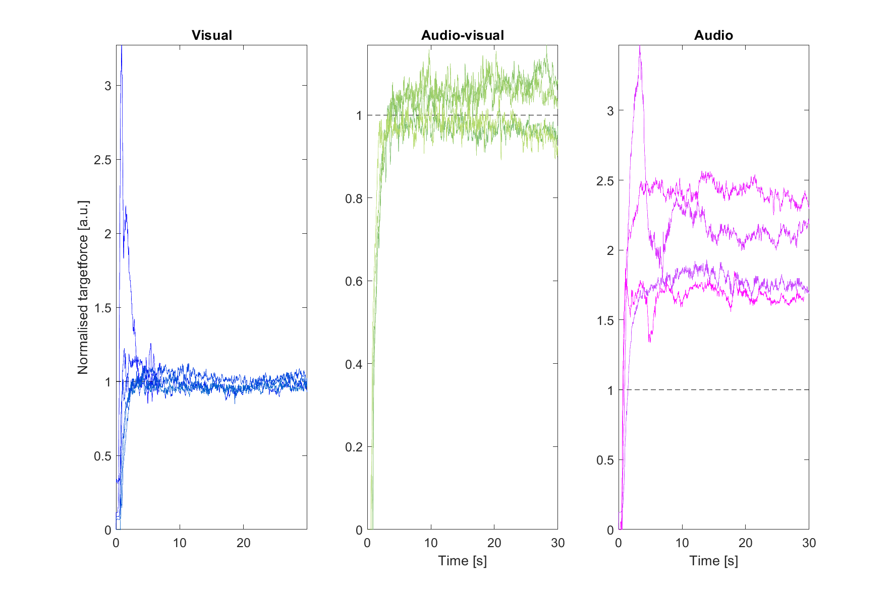
RMSE per feedback condition

Slide 8
Exploratory analysis

Slide 9
Target control

