Slide 1
Software Life Cycle Models
Y.D.

Slide 2
Waterfall model
The waterfall model is a breakdown of project activities into linear sequential phases, where each phase depends on the deliverables of the previous one and corresponds to a specialisation of tasks. The approach is typical for certain areas of engineering design. In software development, it tends to be among the less iterative and flexible approaches, as progress flows in largely one direction ("downwards" like a waterfall) through the phases of conception, initiation, analysis, design, construction, testing, deployment and maintenance.

Slide 3
In Royce's original waterfall model, the following phases are followed in order:
System and software requirements: captured in a product requirements document
Analysis: resulting in models, schema, and business rules
Design: resulting in the software architecture
Coding: the development, proving, and integration of software
Testing: the systematic discovery and debugging of defects
Operations: the installation, migration, support, and maintenance of complete systems
Thus the waterfall model maintains that one should move to a phase only when its preceding phase is reviewed and verified.

Slide 4
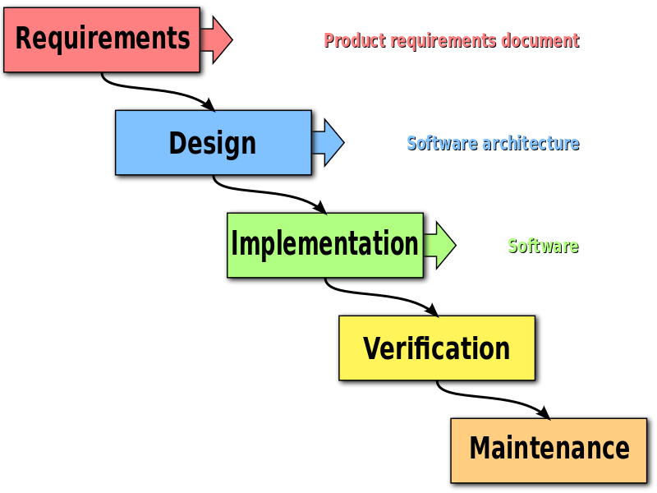
The unmodified "waterfall model". Progress flows from the top to the bottom, like a cascading waterfall.
Various modified waterfall models (including Royce's final model), however, can include slight or major variations on this process. These variations included returning to the previous cycle after flaws were found downstream, or returning all the way to the design phase if downstream phases deemed insufficient.

Slide 5
Supporting arguments
Time spent early in the software production cycle can reduce costs at later stages. For example, a problem found in the early stages (such as requirements specification) is cheaper to fix than the same bug found later on in the process (by a factor of 50 to 200).
In common practice, waterfall methodologies result in a project schedule with 20–40% of the time invested for the first two phases, 30–40% of the time to coding, and the rest dedicated to testing and implementation. The actual project organisation needs to be highly structured. Most medium and large projects will include a detailed set of procedures and controls, which regulate every process on the project.
A further argument for the waterfall model is that it places emphasis on documentation (such as requirements documents and design documents) as well as source code. In less thoroughly designed and documented methodologies, knowledge is lost if team members leave before the project is completed, and it may be difficult for a project to recover from the loss. If a fully working design document is present (as is the intent of Big Design Up Front and the waterfall model), new team members or even entirely new teams should be able to familiarise themselves by reading the documents.

Slide 6
The waterfall model provides a structured approach; the model itself progresses linearly through discrete, easily understandable and explainable phases and thus is easy to understand; it also provides easily identifiable milestones in the development process. It is perhaps for this reason that the waterfall model is used as a beginning example of a development model in many software engineering texts and courses.
It is argued that the waterfall model can be suited to projects where requirements and scope are fixed, the product itself is firm and stable, and the technology is clearly understood.

Slide 7
Criticism
Clients may not know exactly what their requirements are before they see working software and so change their requirements, leading to redesign, redevelopment, and retesting, and increased costs.
Designers may not be aware of future difficulties when designing a new software product or feature, in which case it is better to revise the design than persist in a design that does not account for any newly discovered constraints, requirements, or problems.
Organisations may attempt to deal with a lack of concrete requirements from clients by employing systems analysts to examine existing manual systems and analyse what they do and how they might be replaced. However, in practice, it is difficult to sustain a strict separation between systems analysis and programming. This is because implementing any non-trivial system will almost inevitably expose issues and edge cases that the systems analyst did not consider.
In response to the perceived problems with the pure waterfall model, modified waterfall models were introduced, such as "Sashimi (Waterfall with Overlapping Phases), Waterfall with Subprojects, and Waterfall with Risk Reduction".

Slide 8
Some organisations, such as the United States Department of Defense, now have a stated preference against waterfall-type methodologies, starting with MIL-STD-498, which encourages evolutionary acquisition and Iterative and Incremental Development.
While advocates of agile software development argue the waterfall model is an ineffective process for developing software, some sceptics suggest that the waterfall model is a false argument used purely to market alternative development methodologies.
Rational Unified Process (RUP) phases acknowledge the programmatic need for milestones, for keeping a project on track, but encourage iterations (especially within Disciplines) within the Phases. RUP Phases are often referred to as "waterfall-like".

Slide 9
Iterative and Incremental development
Iterative and Incremental development is any combination of both iterative design or iterative method and incremental build model for development.
In software, the relationship between iterations and increments is determined by the overall software development process.

Slide 10
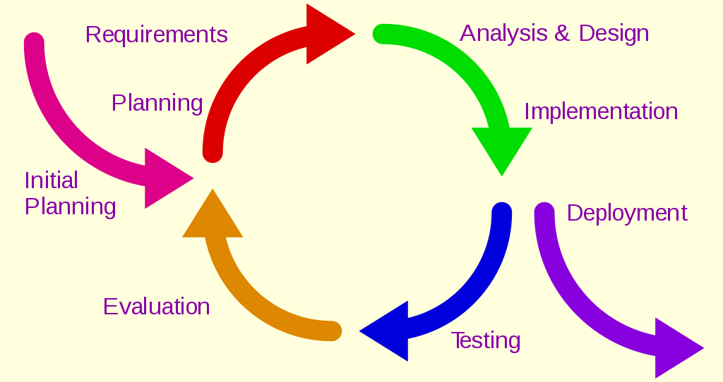
Iterative development model

Slide 11
The basic idea behind this method is to develop a system through repeated cycles (iterative) and in smaller portions at a time (incremental), allowing software developers to take advantage of what was learned during development of earlier parts or versions of the system. Learning comes from both the development and use of the system, where possible key steps in the process start with a simple implementation of a subset of the software requirements and iteratively enhance the evolving versions until the full system is implemented. At each iteration, design modifications are made and new functional capabilities are added.

Slide 12
The procedure itself consists of the initialization step, the iteration step, and the Project Control List. The initialization step creates a base version of the system. The goal for this initial implementation is to create a product to which the user can react. It should offer a sampling of the key aspects of the problem and provide a solution that is simple enough to understand and implement easily. To guide the iteration process, a project control list is created that contains a record of all tasks that need to be performed. It includes items such as new features to be implemented and areas of redesign of the existing solution. The control list is constantly being revised as a result of the analysis phase.

Slide 13
The iteration involves the redesign and implementation of iteration is to be simple, straightforward, and modular, supporting redesign at that stage or as a task added to the project control list. The level of design detail is not dictated by the iterative approach. In a light-weight iterative project the code may represent the major source of documentation of the system; however, in a critical iterative project a formal Software Design Document may be used. The analysis of an iteration is based upon user feedback, and the program analysis facilities available. It involves analysis of the structure, modularity, usability, reliability, efficiency, & achievement of goals. The project control list is modified in light of the analysis results.

Slide 14
Contrast with Waterfall development
The main cause due to which most of the software development projects fail is the choice of the model. Hence, it should be made with a great concern.
For example, the Waterfall development paradigm completes the project-wide work-products of each discipline in one step before moving on to the next discipline in the next step. Business value is delivered all at once, and only at the very end of the project, whereas backtracking is possible in an iterative approach. Comparing the two approaches, some patterns begin to emerge:
User involvement: In the waterfall model, the user is involved in two stages of the model, i.e. requirements and acceptance testing, and possibly creation of user education material. Whereas in the incremental model, the client is involved at each and every stage.
Variability: The software is delivered to the user only after the build stage of the life cycle is completed, for user acceptance testing. On the other hand, every increment is delivered to the user and after the approval of user, the developer is allowed to move towards the next module.
Human resources: In the incremental model fewer staff are potentially required as compared to the waterfall model.
Time limitation: An operational product is delivered after months while in the incremental model the product is given to the user within a few weeks.
Project size: Waterfall model is unsuitable for small projects while the incremental model is best suitable for small as well as lar

Slide 15
Spiral model
The spiral model is a risk-driven software development process model. Based on the unique risk patterns of a given project, the spiral model guides a team to adopt elements of one or more process models, such as incremental, waterfall, or evolutionary prototyping.

Slide 16
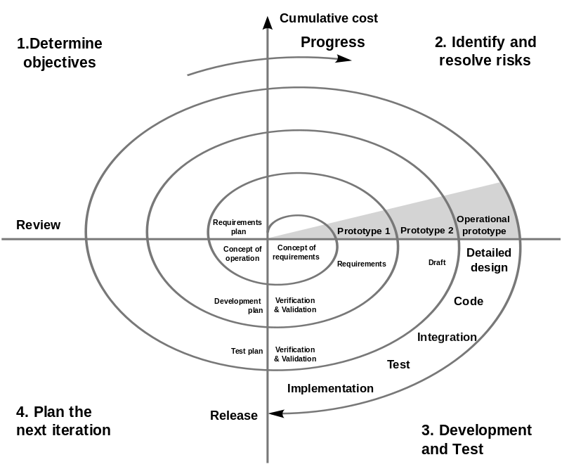
Spiral model (Boehm, 1988). A number of misconceptions stem from oversimplifications in this widely circulated diagram (there are some errors in this diagram)

Slide 17
A distinctive feature of this model is a special attention to risks that affect the organization of the life cycle. Boem formulates the ten most common (by priority) risks:
Shortage of specialists.
Unrealistic deadlines and budget.
Implementing inappropriate functionality.
Designing the wrong user interface.
“Golden serving”, perfectionism, unnecessary optimization and honing details.
A steady stream of change.
Lack of information about external components that determine the environment of the system or are involved in integration.
Deficiencies in the work performed by external (in relation to the project) resources.
Insufficient performance of the resulting system.
The gap between the qualifications of specialists and the requirements of the project.

Slide 18
Most of these risks are associated with the organizational and process aspects of the interaction of specialists in the project team.
Each coil of a spiral corresponds to the creation of a fragment or version of software, on it the goals and characteristics of the project are specified, its quality is determined and the work of the next coil of the spiral is planned. In this way, the details of the project are deepened and sequentially specified, and as a result, a reasonable option is selected, which is brought to implementation.
Each turn is divided into 4 sectors:
setting goals
risk assessment and resolution,
development and testing,
planning the next iteration.

Slide 19
At each turn of the spiral, different models of the software development process can be used. Ultimately, the final product is obtained.
Development by iterations reflects the objectively existing spiral cycle of system creation. Incomplete completion of work at each stage allows you to proceed to the next stage, without waiting for the complete completion of work at the current stage. With an iterative development method, the missing work can be done at the next iteration.
The main task is to show the users of the system a workable product as quickly as possible, thereby activating the process of clarifying and supplementing the requirements. The main problem of the spiral cycle is determining the moment of transition to the next stage. To solve it, it is necessary to introduce time limits for each of the stages of the life cycle. The transition is carried out in accordance with the plan, even if not all planned work is completed. The plan is compiled on the basis of statistics obtained in previous projects and the personal experience of developers

Slide 20
V-Model
The V-model is a graphical representation of a systems development lifecycle. It is used to produce rigorous development lifecycle models and project management models. The V-model falls into three broad categories, the German V-Modell, a general testing model and the US government standard.
The V-model summarizes the main steps to be taken in conjunction with the corresponding deliverables within computerized system validation framework, or project life cycle development. It describes the activities to be performed and the results that have to be produced during product development.

Slide 21
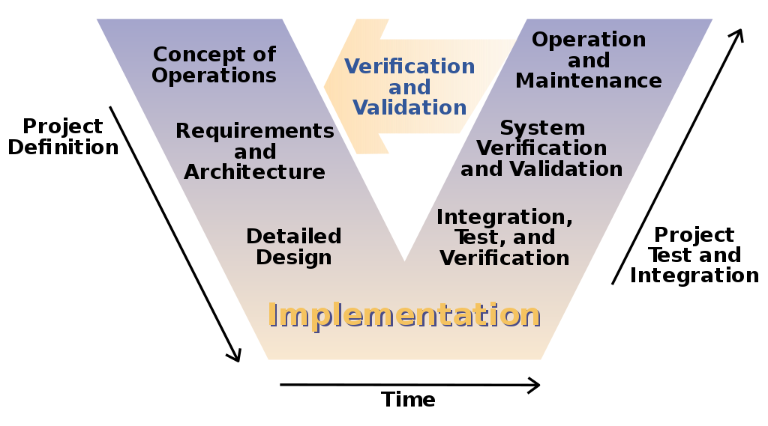
The V-model of the systems engineering process

Slide 22
Supporting arguments
The model attaches particular importance to planning aimed at verification and certification of the developed product at the early stages of its development. Unit testing phase confirms the correctness of detailed design. The phases of integration and testing implement architectural design or top-level design. The system testing phase confirms the correct implementation of the product requirements stage and its specifications.
The model provides certification and verification of all external and internal received data, and not just the software product itself.
In the V-shaped model, requirements are defined before the development of the system design, and software design is performed before the development of components.
The model defines the products that should be obtained as a result of the development process, and each received data should be tested.
Thanks to the model, project managers can track the progress of the development process, since in this case it is quite possible to use the timeline, and the completion of each phase is a reference point.

Slide 23
Criticism
The model does not provide work with parallel events.
The model does not provide for the introduction of requirements for dynamic changes at different stages of the life cycle.
Testing requirements in the life cycle occurs too late, as a result of which it is impossible to make changes without affecting the project schedule.
The model does not include actions aimed at risk analysis.
Some result can be seen only when reaching the bottom of the letter V.

Slide 24
Thanks for your attention!

Slide 25
Link :
https://en.wikipedia.org/wiki/V-Model
https://en.wikipedia.org/wiki/Spiral_model
https://en.wikipedia.org/wiki/Waterfall_model
https://en.wikipedia.org/wiki/Iterative_and_incremental_development

