Slide 1
Software Development Life Cycle Models
Y.D.

Slide 2
Table of contents
Waterfall model
Iterative and Incremental development model
Spiral model
V-Model
Сomparison of software development methodologies
Link

Slide 3
Waterfall model
The waterfall model is a breakdown of project activities into linear sequential phases, where each phase depends on the deliverables of the previous one and corresponds to a specialisation of tasks. In software development, it tends to be among the less iterative and flexible approaches, as progress flows in largely one direction ("downwards" like a waterfall) through the phases of conception, initiation, analysis, design, construction, testing, deployment and maintenance.

Slide 4
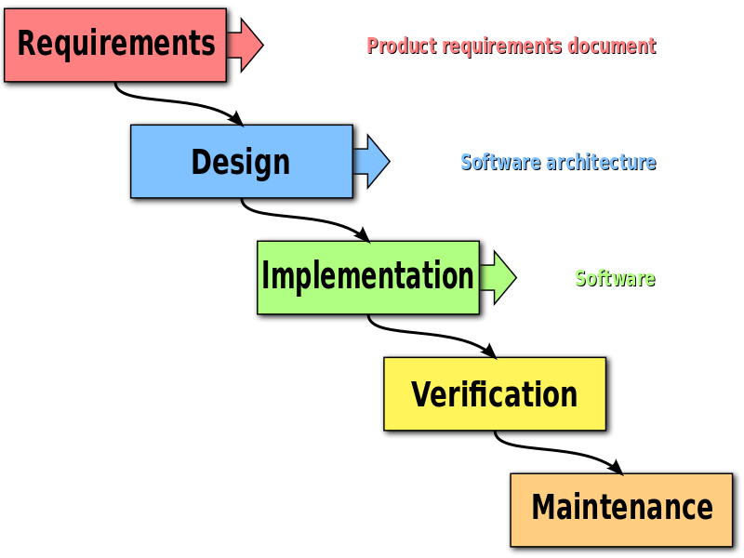
The unmodified "waterfall model". Progress flows from the top to the bottom, like a cascading waterfall.
In Royce's original waterfall model, the following phases are followed in order:
System and software requirements: captured in a product requirements document
Analysis: resulting in models, schema, and business rules
Design: resulting in the software architecture
Coding: the development, proving, and integration of software
Testing: the systematic discovery and debugging of defects
Operations: the installation, migration, support, and maintenance of complete systems

Slide 5
The pros and cons of Waterfall Development
Pros
Cons
Everyone gets up to speed quickly (The availability of technical documentation help everyone quickly understands the objectives. New developers can get up to speed quickly – even during the maintenance phase.)
Timescales are kept (Each step has a clearly defined starting point and conclusion, which makes progress easy to monitor. This helps reduce any project “slippage” from agreed timescales.)
No financial surprises (Costs can be estimated with a fairly high degree of accuracy once the requirements have been defined.)
Testing is made easy (Test scenarios are already detailed in the functional specification of the requirements phase, which makes the testing process easier and more transparent.)
The outcome is crystal clear (The result is clear since the design will be worked out in detail before software development.)
Deal with issues in the design (Potential development issues can be researched and tackled in the design stage – and alternative solutions planned – before any programming takes place)
Needs can be difficult to define (Clients may find it challenging to conceptualise their needs in terms of a functional specification during the requirements phase. This means that they may change their minds once they see the end product, which is difficult to address if the application needs to be re-engineered to any large extent.)
Potential lack of flexibility (There may be issues with the flexibility of the model to cater for new developments or changes of requirements which may occur after the initial consultation. Changes due to business plans or market influences may not have been taken into account when planning is all done up front.)
Longer delivery time (Projects may take longer to deliver, compared to using an iterative methodology such as Agile.)

Slide 6
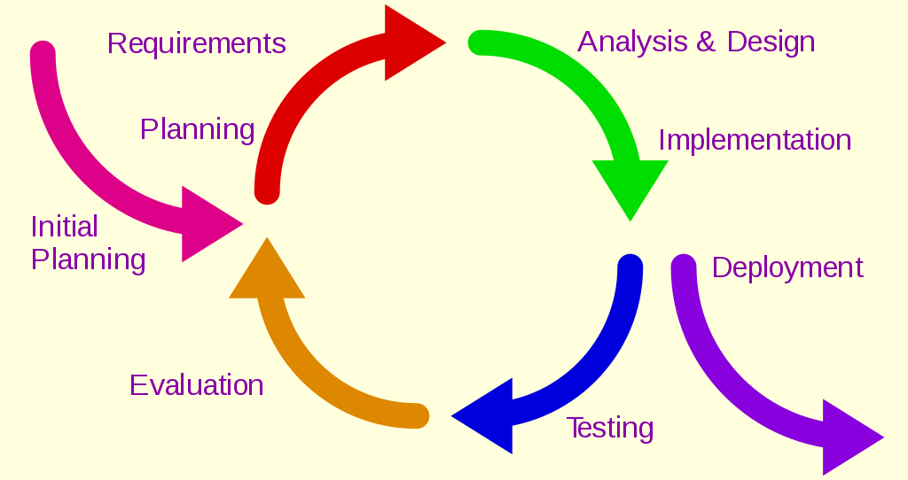
Iterative and Incremental development model
Iterative and Incremental development is any combination of both iterative design or iterative method and incremental build model for development.
In software, the relationship between iterations and increments is determined by the overall software development process.

Slide 7
The basic idea behind this method is to develop a system through repeated cycles (iterative) and in smaller portions at a time (incremental), allowing software developers to take advantage of what was learned during development of earlier parts or versions of the system. At each iteration, design modifications are made and new functional capabilities are added.
The procedure itself consists of the initialization step, the iteration step, and the Project Control List. The initialization step creates a base version of the system. To guide the iteration process, a project control list is created that contains a record of all tasks that need to be performed. It includes items such as new features to be implemented and areas of redesign of the existing solution. The control list is constantly being revised as a result of the analysis phase.

Slide 8
The pros and cons of Iterative Development
Pros
Cons
Potential defects are spotted and dealt with early
Functional prototypes are developed early in the project life cycle
Less time is spent on documenting and more on designing
Progress is easily measured
Changes to project scope are less costly and easier to implement
Testing is facilitated by the modules being relatively small
Most risks can be identified during iteration and higher risks can be dealt with as an early priority
Successive iterations can be managed easily as milestones
An operational product is delivered with every iteration
Operating time is reduced
Customer feedback is based on working products rather than technical specifications
More resources may be required
Each successive phase is rigid with no overlaps
The need for more intensive project management may be required
Issues about system architecture may turn out to be a constraining factor because of the lack of a full requirements specification for the entire system
It may be difficult to pin down an end date for the project conclusion
Highly skilled talent is required for risk analysis

Slide 9
Spiral model
The spiral model is a risk-driven software development process model. Based on the unique risk patterns of a given project, the spiral model guides a team to adopt elements of one or more process models, such as incremental, waterfall, or evolutionary prototyping.
Most of these risks are associated with the organizational and process aspects of the interaction of specialists in the project team.
Each coil of a spiral corresponds to the creation of a fragment or version of software, on it the goals and characteristics of the project are specified, its quality is determined and the work of the next coil of the spiral is planned. In this way, the details of the project are deepened and sequentially specified, and as a result, a reasonable option is selected, which is brought to implementation.

Slide 10
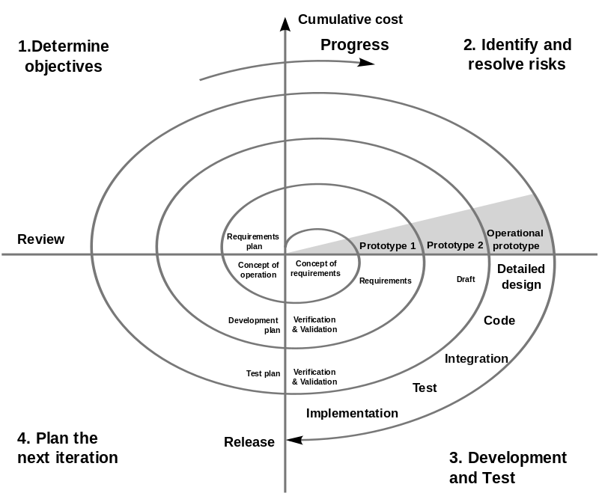
Spiral model (Boehm, 1988). A number of misconceptions stem from oversimplifications in this widely circulated diagram (there are some errors in this diagram)

Slide 11
The pros and cons of Spiral model
Pros
Cons
Highly flexible model
Fast and cost-effective development
Well-suited for large scale projects and mission-critical developments
Monitoring is easy and effective
Strong emphasis on client approval
Focus on documentation control
Potential for additional post-project functionality
Software is produced early on in the project lifecycle
Risk analysis helps to eliminate and avoid risk
Changed requirements are accommodated during the project lifespan
The end product can be highly customised
Can be expensive to implement – especially if spirals continue infinitely
The risk analysis aspect of the project may require specialist expertise
Not an ideal fit for smaller or low-risk projects
Success may depend greatly on the risk analysis
Documentation can be heavy, due to the number of intermediate stages
End of project may be difficult to define beforehand
Spiral is widely regarded as a complex process
Rules and protocols must be adhered to strictly throughout the development

Slide 12
V-Model
The V-model is a graphical representation of a systems development lifecycle.
The V-model summarizes the main steps to be taken in conjunction with the corresponding deliverables within computerized system validation framework, or project life cycle development. It describes the activities to be performed and the results that have to be produced during product development.

Slide 13
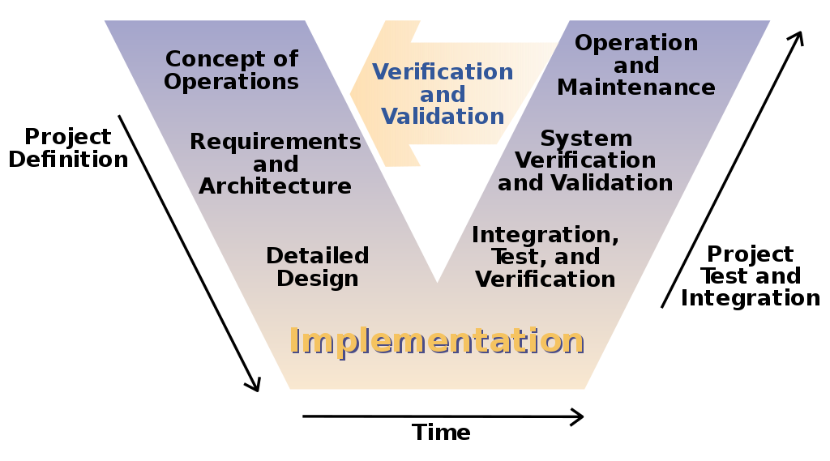
The V-model of the systems engineering process

Slide 14
The pros and cons of V-model
Pros
Cons
High success rate (Testing starts as soon as the project requirements are written. Test activities like planning, component checking, and designing are conducted before coding takes place to detect bugs at early stages. )
Easy to manage ( The model is simple to develop and easy to use. Each development phase has well-defined objectives.)
Defects tracking ( It uses proactive defect tracking to ensure any defects in the product are caught in the early development stages. )
Effective for small projects (V-model lifecycle works well with small projects where system requirements are well known and not expected to change.)
Specific deliverables (Each phase of the product development life-cycle has specific deliverables which are well defined and a test plan is prepared to test the product in that phase.)
Cost effective ( Since testing starts early in the development process, the project takes less time and cost.)
Functional areas (It covers all functional areas to ensure instructions are recommendations are provided and give a detailed explanation of the problem involved.)
Rigid procedures: V model sequential processes are rigid and not suitable if the requirements are not consistent.
Final product: The client can only see the final product, he can’t see the intermediate modules of the product being designed.
Not suitable for complex projects: This software development model is not suitable for large and complex projects.
Inflexible: V-model is inflexible and encourages a linear view of software development and has no inherent ability to respond to any software changes. Adjusting the scope of the project is very expensive.
Frequent updates: If there are changes in the product, the test documents and requirement documents need to be updated.
The risk in meeting customer expectations: Since there are no prototypes designed as a working model for the project, sometime it may be difficult to meet the customer expectation.

Slide 15
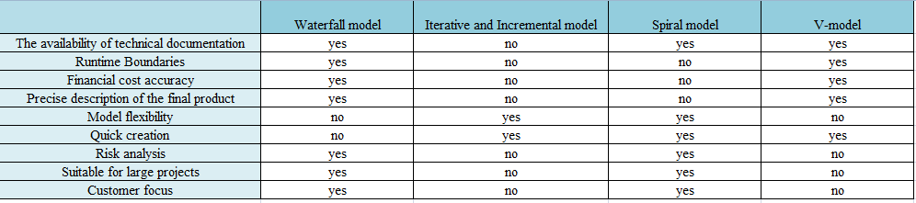
Сomparison of software development methodologies

Slide 16
Thanks for your attention!

Slide 17
Link :
https://en.wikipedia.org/wiki/V-Model
https://en.wikipedia.org/wiki/Spiral_model
https://en.wikipedia.org/wiki/Waterfall_model
https://en.wikipedia.org/wiki/Iterative_and_incremental_development
https://www.dcslsoftware.com/

