Slide 1
Beta band oscillations in the anticipation of nociceptive stimuli

Slide 2
BBOs
BBOs are a periodic fluctuation of the EEG activity in the 15-30 Hz range
BBOs are coherent in primary somatosensory and motor cortices, thalamus, spinal cord, and, crucially, even at the level of the muscles (van Ede et al., 2010, 2011, 2013)
BBOs are reduced during the anticipation of tactile stimuli, both at the level of the contralateral somatosensory cortex and at the level of the muscles, measured by electromyography (EMG)
This reduction is coherent (i.e. correlated)

Slide 3
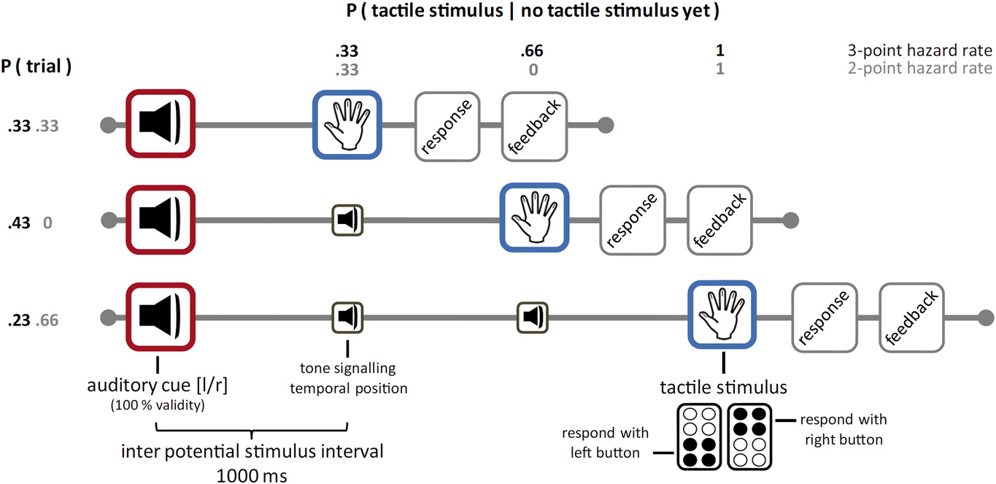
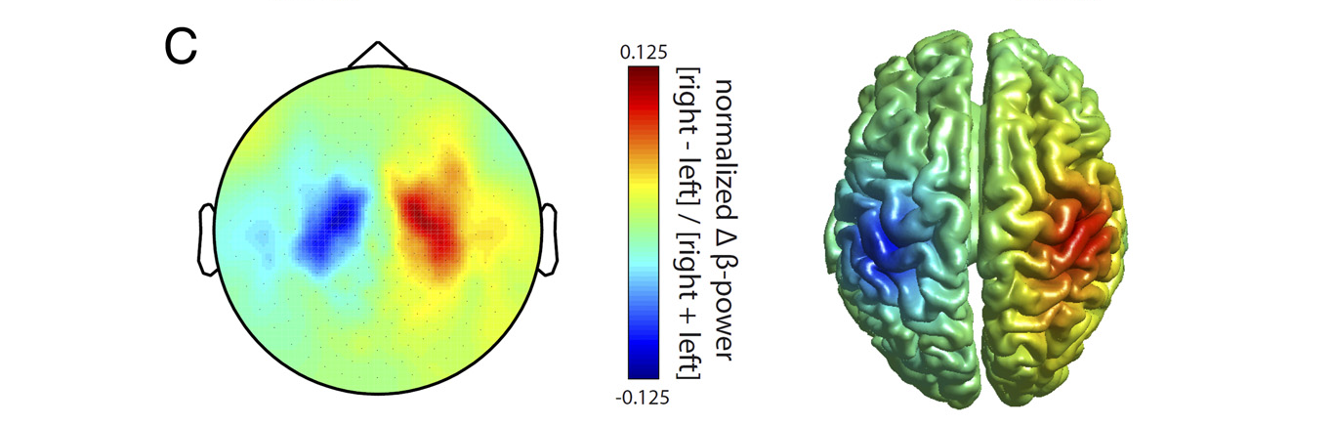
Anticipation modulates BBOs
Van ede et al., 2011

Slide 4
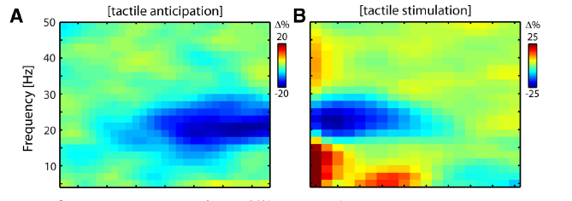
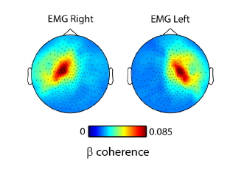
This modulation occurs at the level of the EMG as well
Van Ede et al., 2013

Slide 5
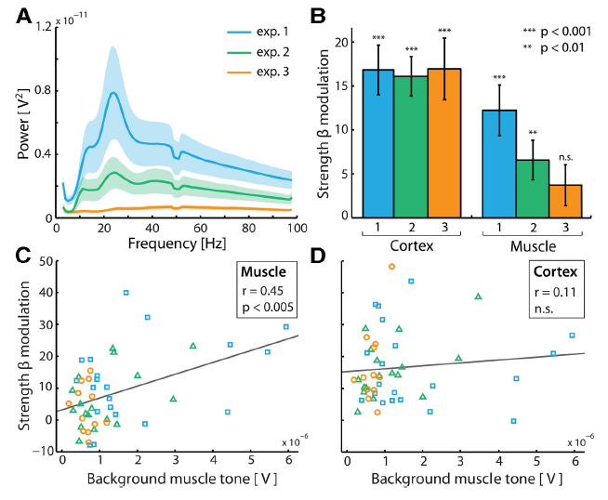
EMG depends on muscle tone
Van Ede et al., 2013

Slide 6
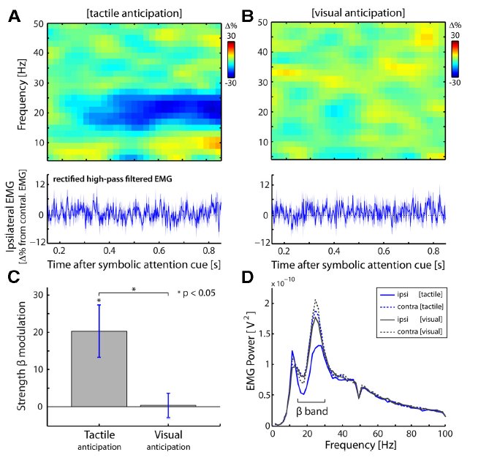
But not on the motor response to the task
Only EMG recorded vocal response to discrimination of a stimulus
Van Ede et al., 2013

Slide 7
Aim
Investigate BBOs in anticipation to nociceptive stimuli and compare with BBOs in anticipation to non-nociceptive stimuli

Slide 8
Experimental design
Stimulus (laser/electrical)
response
1000 ms

