Slide 1

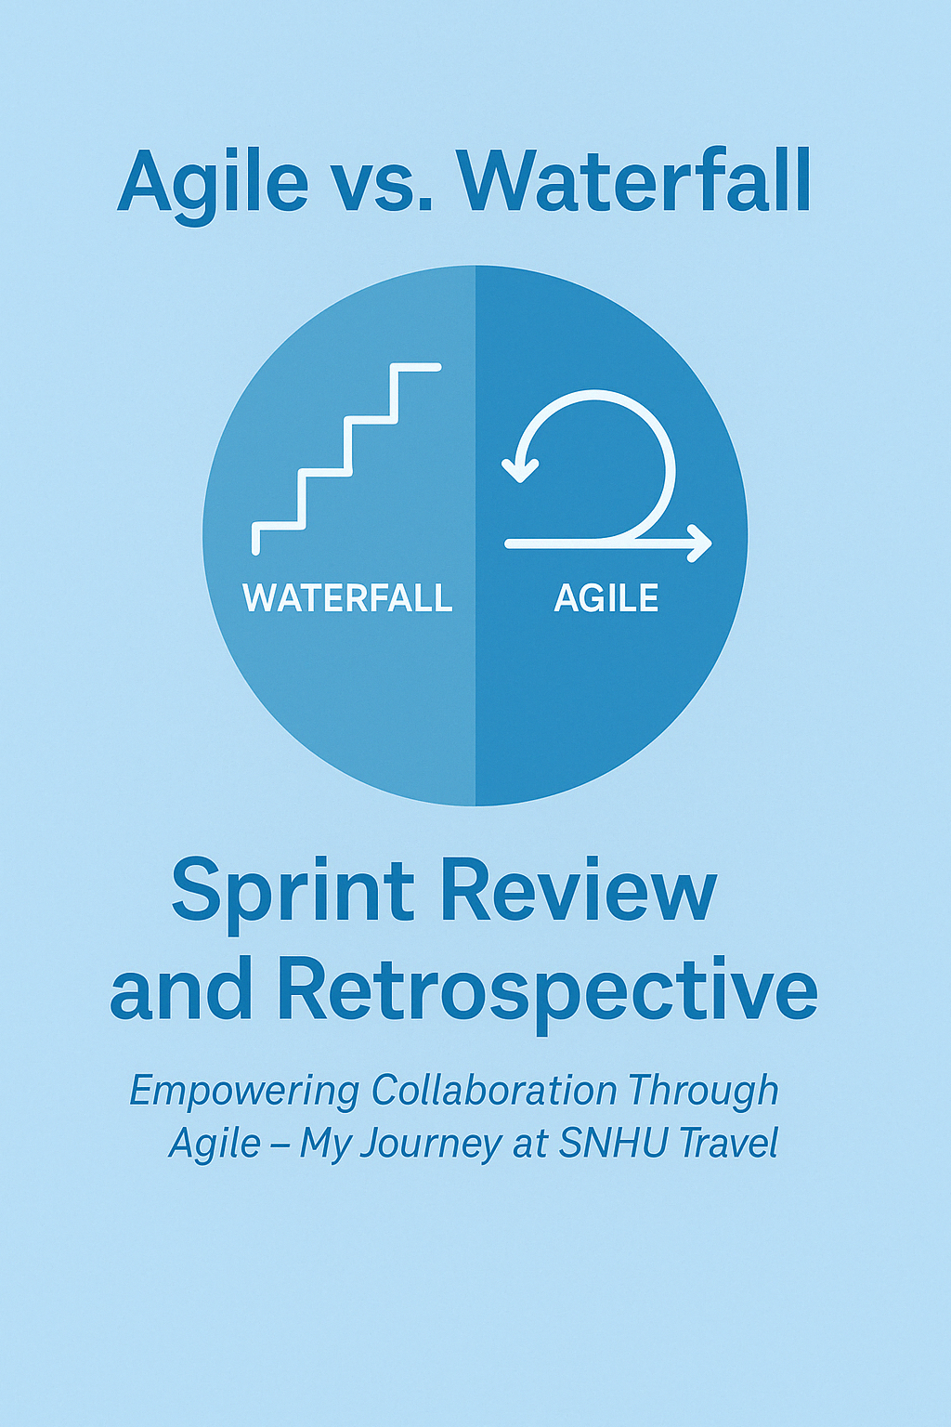
Agile vs. Waterfall: Lessons from the SNHU Travel Project
CS 250 - Final Project Presentation
Presented by: Julliane Pamfilo
Date: 04.17.20225

Slide 2

Agile Roles in Scrum
- Scrum Master: Facilitates Scrum processes, removes blockers, ensures team follows Agile principles.
- Product Owner: Defines and prioritizes the product backlog to deliver maximum value.
- Development Team: Cross-functional team that delivers product increments during sprints.

Slide 3

Agile Phases of the SDLC
- Planning: Collaborative sprint planning with story point estimation.
- Analysis & Design: Done iteratively; designs evolve during development.
- Implementation: Development in 1–2 week sprints.
- Testing: Continuous testing; QA integrated in each sprint.
- Deployment: Incremental delivery of features.
- Maintenance: Adjustments made based on stakeholder feedback.

Slide 4
Waterfall vs. Agile
Aspect | Waterfall | Agile (Scrum)
- Approach: Sequential | Iterative
- Flexibility: Low | High
- Client Involvement: Low after planning | Continuous
- Risk of Rework: High if late changes | Low due to early feedback
- SNHU Travel Example: Major rework in Waterfall | Backlog adjustment in Agile

Slide 5
Choosing Waterfall or Agile
Use Waterfall when:
- Requirements are fixed
- Projects are simple or short-term
- Stakeholder involvement is limited
Use Agile when:
- Requirements may evolve
- Projects are complex and user-focused
- Frequent feedback is required

Slide 6
References
Schwaber, K., & Sutherland, J. (2020). The Scrum guide. Scrum.org. https://scrumguides.org/scrum-guide.html
Pressman, R. S., & Maxim, B. R. (2020). Software Engineering: A Practitioner’s Approach (9th ed.). McGraw-Hill.
Agile Alliance. (n.d.). What is Agile Software Development? https://www.agilealliance.org/agile101
Project Management Institute. (2021). A guide to the project management body of knowledge (PMBOK® guide) (7th ed.). Project Management Institute.

