Slide 1
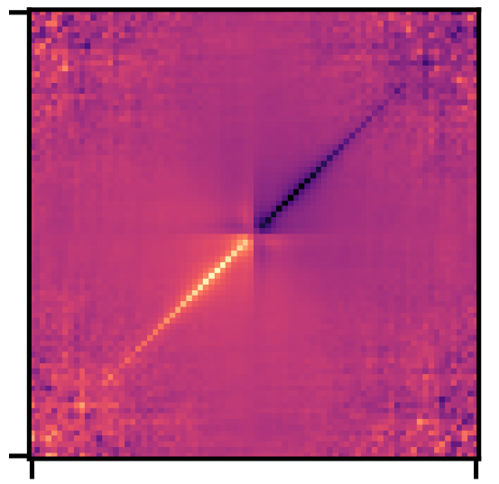
Multi-orbital dynamical vertex approximation (DΓA)
Γ
Julian Peil
Supervision:
Prof. Karsten Held
Viktor Christiansson, PhD
Eric Jacob, MSc

Slide 2
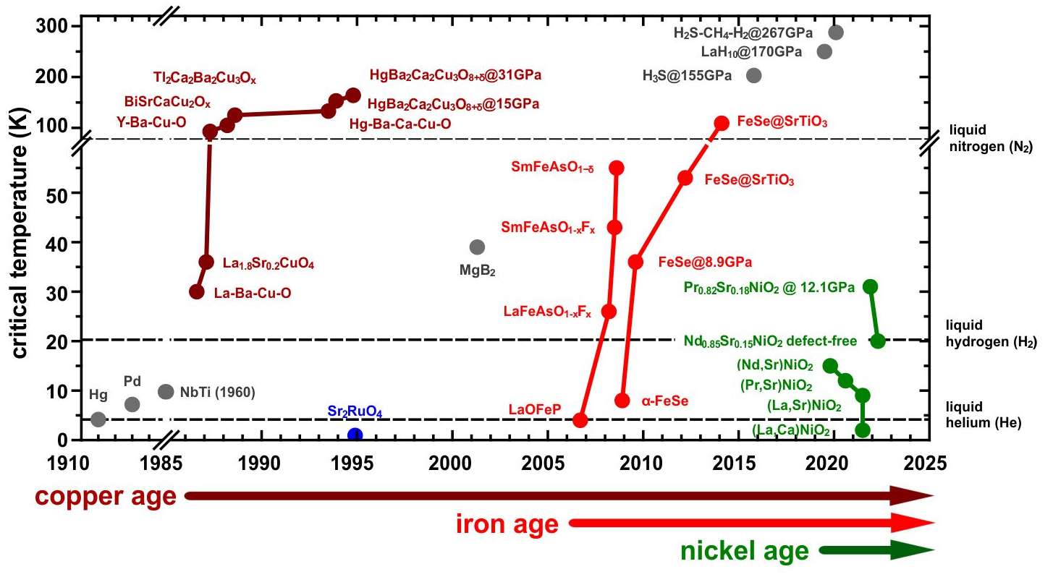
Motivation
La₃Ni₂O₇
@ 14 GPa
Unconventional superconductivity (e.g. in cuprates or nickelates) requires special treatment DMFT → DΓA [1]
DΓA & superconductivity only implemented for one orbital [2, 3]
Many correlated materials (e.g. La₃Ni₂O₇) need a multi-orbital description [4]
Calculations down to low temperatures → vertex asymptotics [5]
[1] G. Rohringer et. al., Rev. Mod. Phys. 90 (2018)
[2] P. Worm, Zenodo (2023)
[3] A. Galler et al., Comput. Phys. Commun. 245 (2019)
[4] H.Sun et al., Nature 621 (2023)
[5] M. Kitatani et al., J. Phys. Mater 5 (2022)

Slide 3
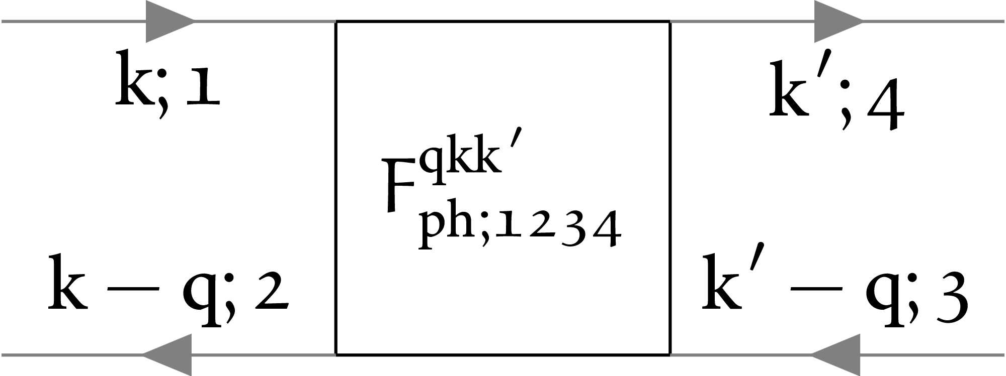
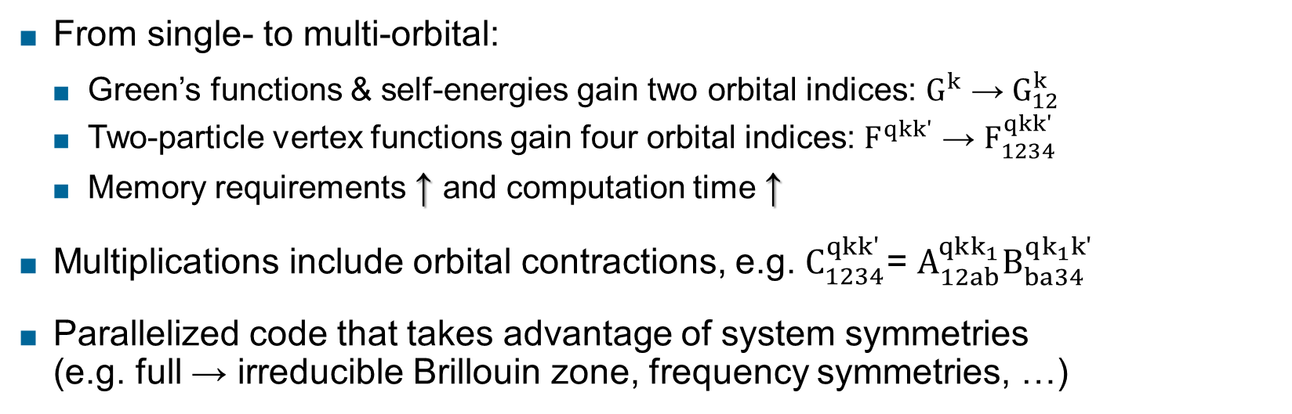
Implementation details ^{[6]}
From single- to multi-orbital:
Green’s functions & self-energies gain two orbital indices: $G^{k}$ → $G_{12}^{k}$
Two-particle vertex functions gain four orbital indices: $F^{qkk′}$ → $F_{1234}^{qkk′}$
Memory requirements ↑ and computation time ↑
Multiplications include orbital contractions, e.g. $C_{1234}^{qkk′}$= $A_{12ab}^{qkk_{1}}B_{ba34}^{qk_{1}k′}$
Parallelized code that takes advantage of system symmetries (e.g. full → irreducible Brillouin zone, frequency symmetries, …)
[6] https://github.com/Julpe/moLDGA

Slide 4
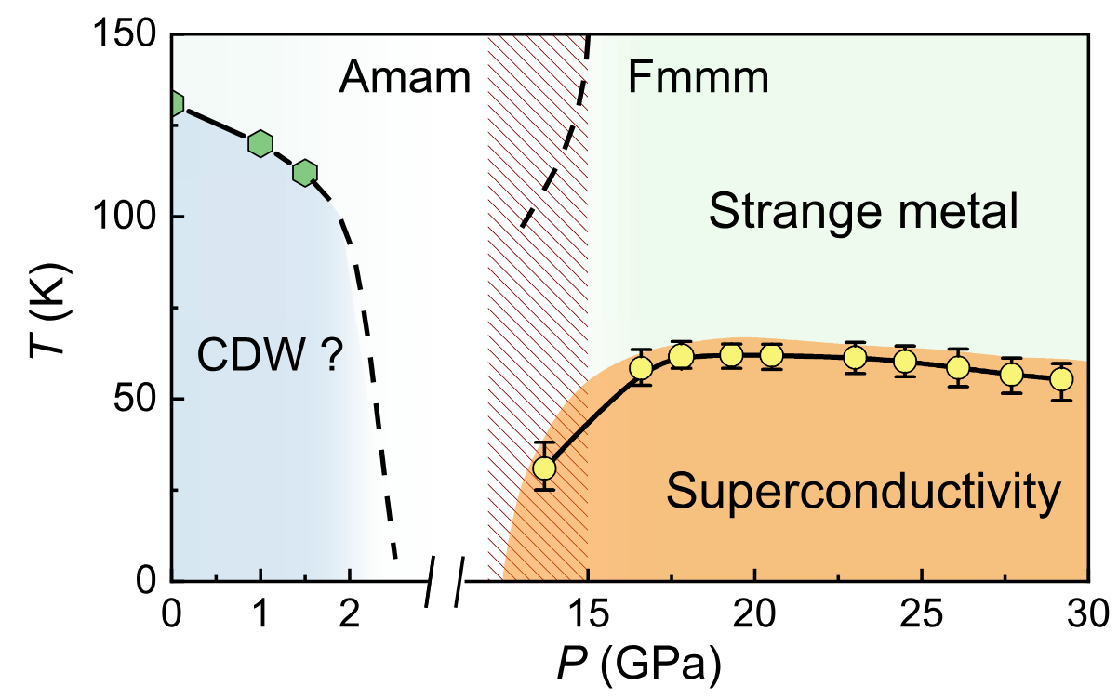

Benchmarks
Outlook
[8]
Agreement with single-band code up to numerical precision [1]
Correct decoupling for disconnected two-band tests
Performance: ~12 h → ~30 min for low-temperature data compared to [1]
Testing limits of the code
Benchmarks against multi-orbital calculations performed by [2, 7] (SrVO₃)
Calculation of realistic materials (especially La₃Ni₂O₇)
[1] P. Worm, Zenodo (2023)
[2] A. Galler et al., Comput. Phys. Commun. 245 (2019)
[7] J. Kaufmann et. al., Phys. Rev. B 103 (2021)
[8] Y. Zhang et al., Nature 20 (2024)

Slide 5

Summary
Motivation
Study realistic multi-orbital materials (e.g. La₃Ni₂O₇) with DΓA
Implementation
Additional orbital degrees of freedom
Taking advantage of system symmetries
Successful execution of benchmarks
Single- and two-orbital calculations

Slide 6
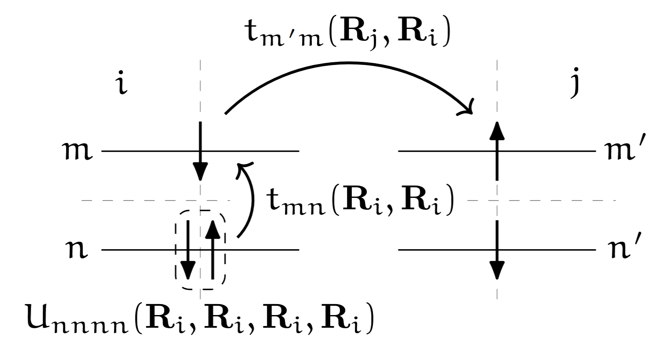
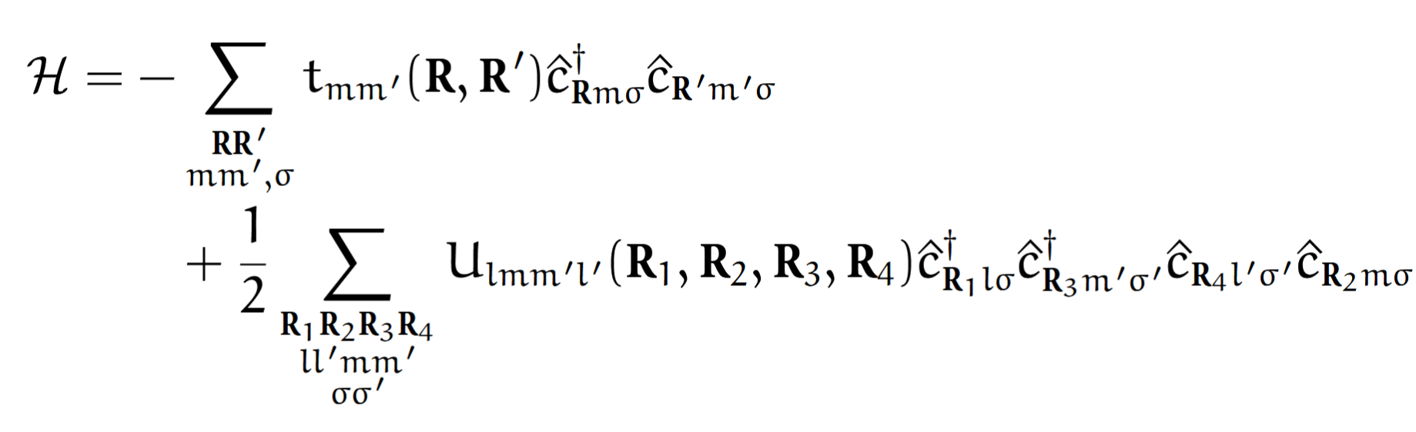
Model
Multi-orbital Hubbard Model

