Slide 1

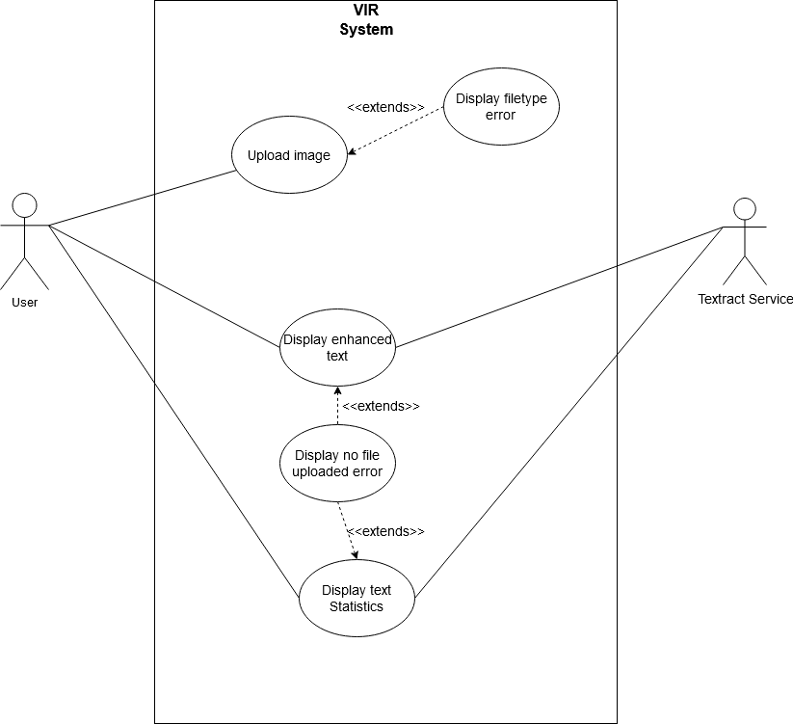
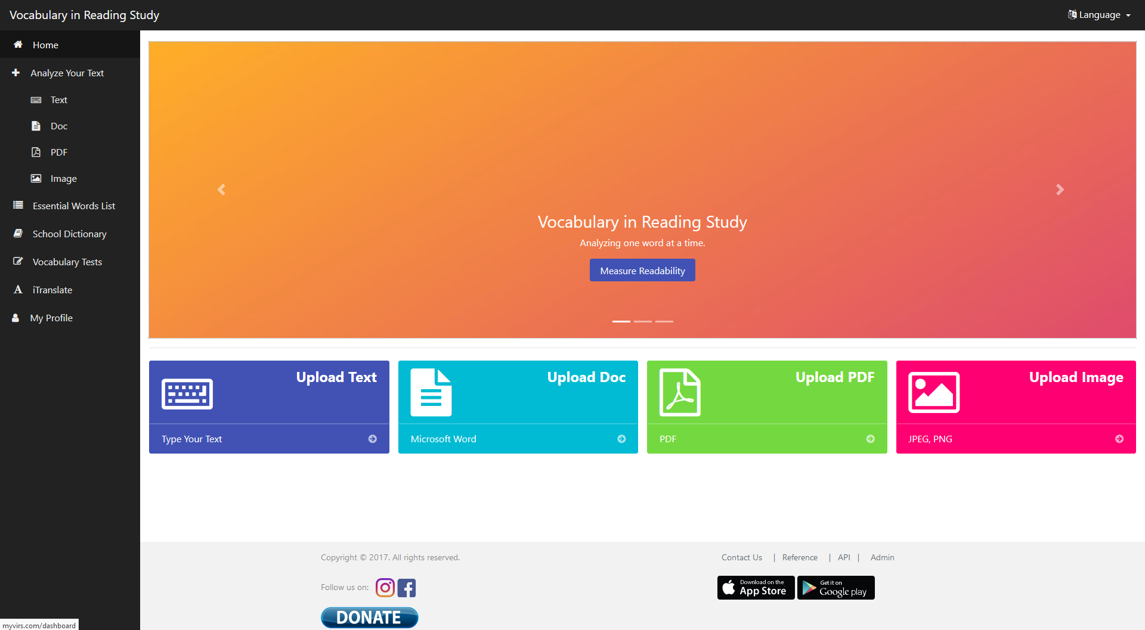
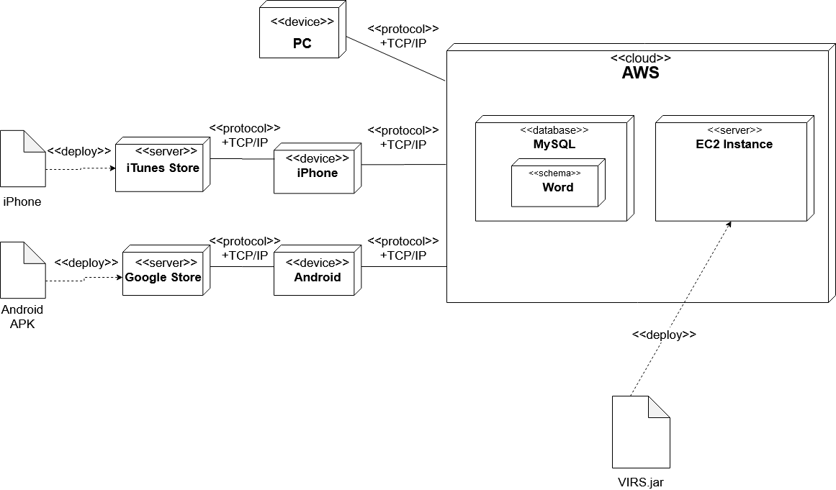
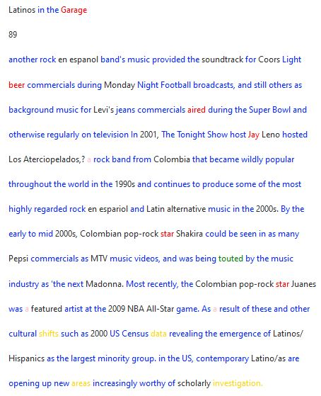
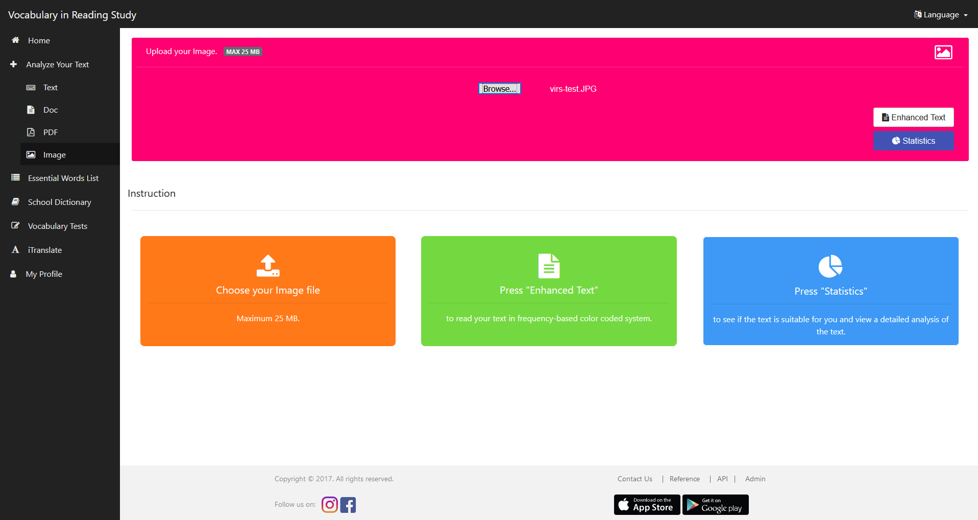
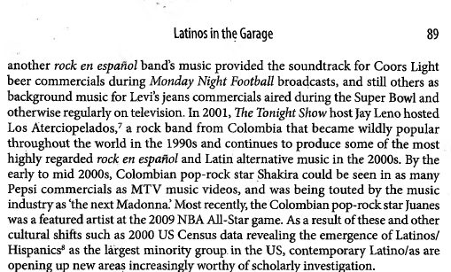
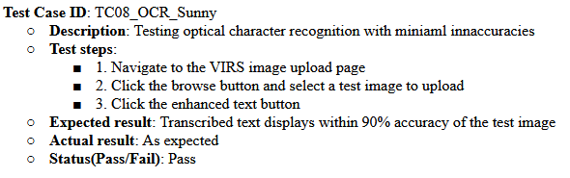
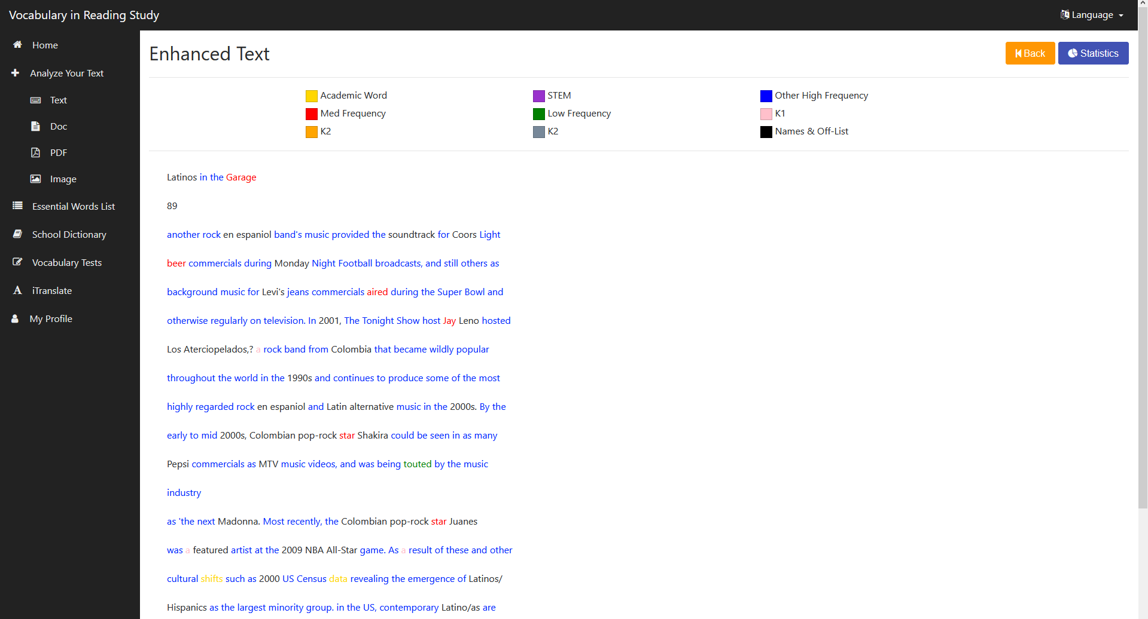
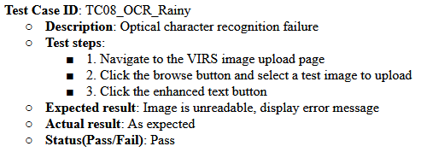
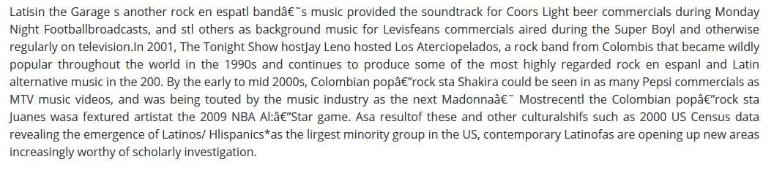
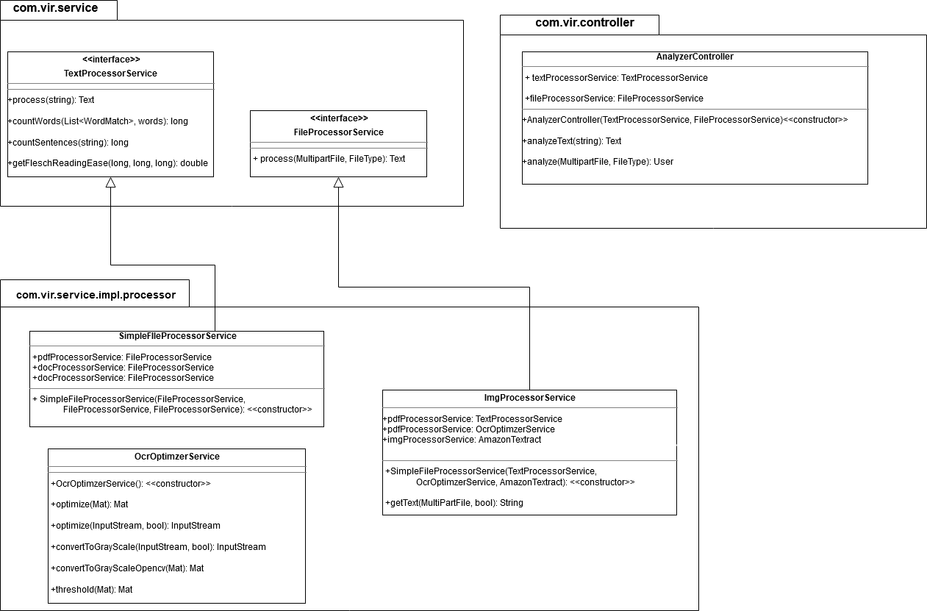
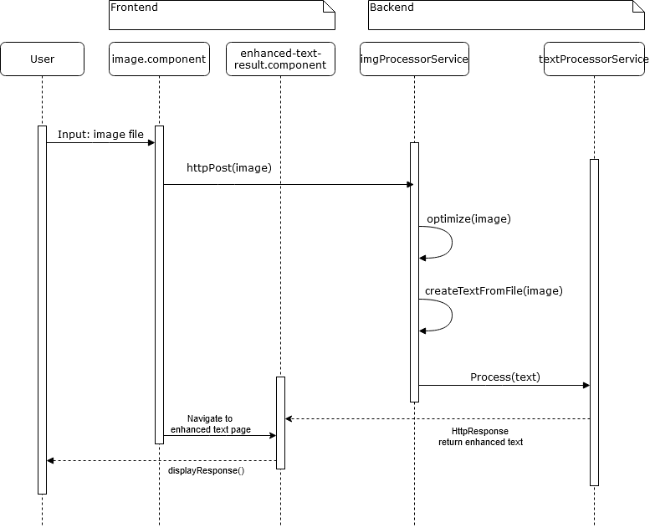
School of Computing & Information Sciences
Spring 2020 Senior Design Project
VIRS v5.0
Students: Jorge Costa
Mentor: Seyedjafar Ehsanzadehsorati
Instructor: Dr. Masoud Sadjadi, Florida International University
Problem
Current System
Requirements
1. Navigating to the AWS hosted site returns an error
2. The existing OCR service cannot accurately read most scanned documents
VIRS is an application designed to facilitate the learning of a new language through analysis of text
Currently, a rudimentary OCR system exists that allows users to upload an image which is then converted to analyzed text. However, that conversion is flawed and usually produces gibberish, especially under low light, blurry and skewed conditions.
Additionally, the site, which is hosted on AWS, is non functional and cannot be accessed from the outside
System Design
1. Users must be able to access the VIRS application online via the myvirs.com URL
2. Users must be able to upload imperfect images of text to VIRS and have them transcribed with high accuracy
Frontend: Angular TypeScript, Bootstrap, CSS, HTML5.
Backend: Java SpringBoot, MySQL
Screenshots
New OCR Results
OCR Upload UI
Verification
Scanned document
Old OCR Results
Object Design
Implementation
Summary
The site is securely hosted on AWS and users can now access the VIRS web application via the URL www.myvirs.com.
Users can now upload scanned images of text that can be recognized with high accuracy, even in cases of graininess, slant and low resolution.
Acknowledgement
The material presented in this poster is based upon the work supported by FIU. I thank Seyedjafar Ehsanzadehsorati for assistance, cooperation, and mentorship that I received throughout this process.

