Slide 1
<VIRS 5.0> Team Member(s): <Julian Pineiro, Jorge Costa> Product Owner(s): <Eric Dweyer, Seyedjafar Ehsanzadehsorati> Professor: Masoud Sadjadi School of Computing and Information Sciences Florida International University
VIP/Senior Project Final Presentation <2020>
<4/27/2020>
Notes:
Greet your audience, thank them for attending your presentation, introduce yourself, introduce your project, introduce your team members, and quickly indicate what each of you did in a high-level manner, and put more emphasis on your part/contribution.

Slide 2
Problem definition
One of the major problems that ESOL, as well as regular students face is the lack of a reliable source to acquire and expand their vocabulary repertoire. If a student is reading a piece of text and does not know what the definition is, they find themselves stopping their reading and fetching for a dictionary. Making study sessions time consuming. There is also no easy way to validate the difficulty of text, which allows professors to select the correct and most adequate material for the targeted class. The Purpose of the VIRS project is to provide a tool to evaluate the difficulty of text for new language learners.
VIRS 4.0 had a rudimentary optical character recognition which could not accurately recognize scanned documents or most images of text and there was no way for administrators to upload words to the database in bulk. Additionally, at the start of the project both the local and AWS hosted versions of the project were non-functional. These were the primary problems tackled during the implementation of VIRS 5.0
Notes:
Introduce the problem that the whole project tackles and stay focused on the parts that you have been working. Indicate if there is an existing previous system, enumerate its problems/limitations, etc.

Slide 3
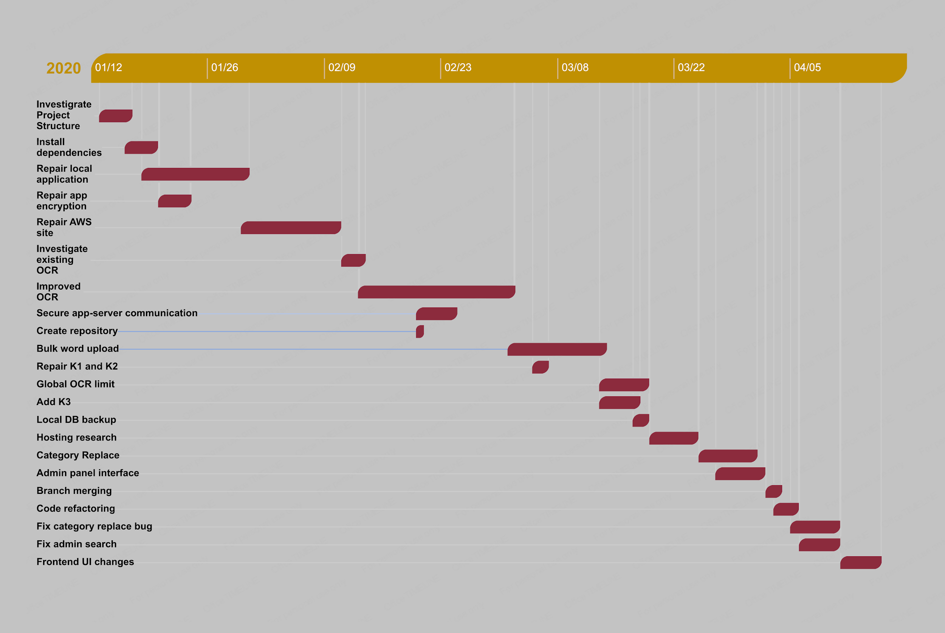
Gantt Chart
Notes:
Project Management (schedule for entire semester) (one slide; Gantt Chart).

Slide 4
User Stories
U01_Install_Frontend
U02_Investigate_Structure
U03_Install_Backend
U04_Investigate_Hosting
U05_Create_IAM
U06_Meeting_dates
U07_Run_Local
U08_Local_Features
U09_Encryption
U10_AWS_Billing
U11_Continous_Integration
U12_Database_Errors
U13_Port_Communication
U14_Beanstalk_Bundling
U15_Investigate_OCR
U16_Investigate_CSV
U17_Implement_OCR
U18_Dictionary_Header
U19_Secure_Server_Communications
U20_RDS_Pricing
U21_Repository
U22_Bulk_Word_Upload
U23_K1_K2_Update
U24_K3_Category
U25_Repair_Tests
U26_OCR_Global_Limit
U27_Backup_Host_research
U28_Local_Backup
U29_Category_Coloring
U30_Category_replace
U31_Upgrade_Admin_Panel_UI
U32_EC2_Billing
U33_Merge_branches
U34_Code_Refactor
U35_Admin_Search
U36_Category_Replace_Bugfix
U37_Dictionary_Frontend_Changes
Notes:
4. Requirements:
4.1. User stories implemented (one or more slides).
4.2. UML use cases and the use case diagram for the implemented use cases (one or more slides).
4.3. UML sequence diagrams for the implemented use cases.

Slide 5
Use Case: Bulk Word Upload (Julian)
Name: Implement bulk word upload to the DB by admin via CSV
ID: U22
Actor: Admin User
Preconditions:
1. The system must be up and running
2. The user has navigated to the admin panel
3. The user has logged in as an admin
4. The user has a list of words organized as a column in a csv
Description:
1. The user clicks the ‘Browse..’ button and uploads a csv file to the application
2. The user selects a category via dropdown to upload the words contained in the csv to
3. The user presses the upload button
3.1. If no file was uploaded, display an error message
3.2 If the file is not of the type csv, display an error message
4. The words from the csv are uploaded to the database under the selected category
Postconditions:
1. The database contains the words from the csv, associated with their respective categories

Slide 6
Use Case: Image Upload OCR (Jorge)
Name: Implement optical character recognition with minimal inaccuracies
ID: U17
Actor: Web User
Preconditions:
1. System must be up and running
2. The user must be on the dashboard
Description:
1. Web user clicks on the ‘Upload Image’ Panel on the dashboard
2. Site displays the image upload page
3. Web user clicks the ‘Browse..’ button to browse for an image of text to upload
4. Message displayed confirming file upload
5. User clicks the enhanced text button
5.1. If file type is not an image, error message displays, return to step 3
5.2 If there is no file uploaded, display an error message, return to step 3
6. Application navigates to enhanced text page, displaying text from the image as plain text, highlighted by word category
Postconditions:
1. The text displayed must be at least 90% accurate to the images uploaded
Notes:
4. Requirements:
4.1. User stories implemented (one or more slides).
4.2. UML use cases and the use case diagram for the implemented use cases (one or more slides).
4.3. UML sequence diagrams for the implemented use cases.

Slide 7
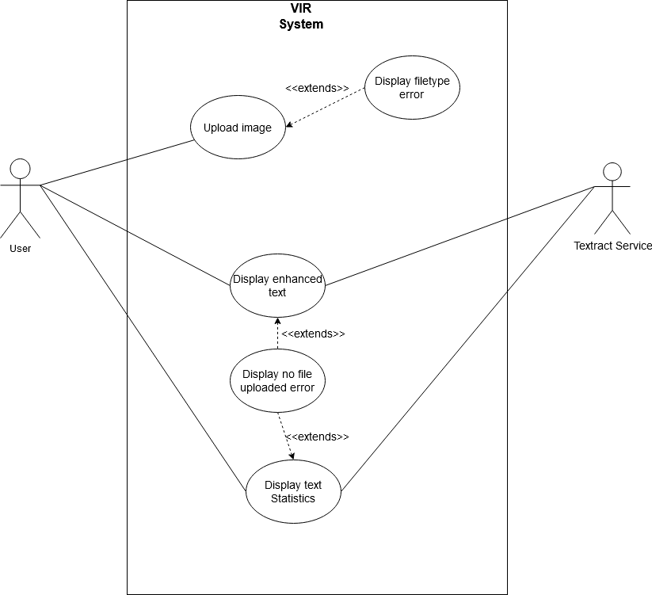
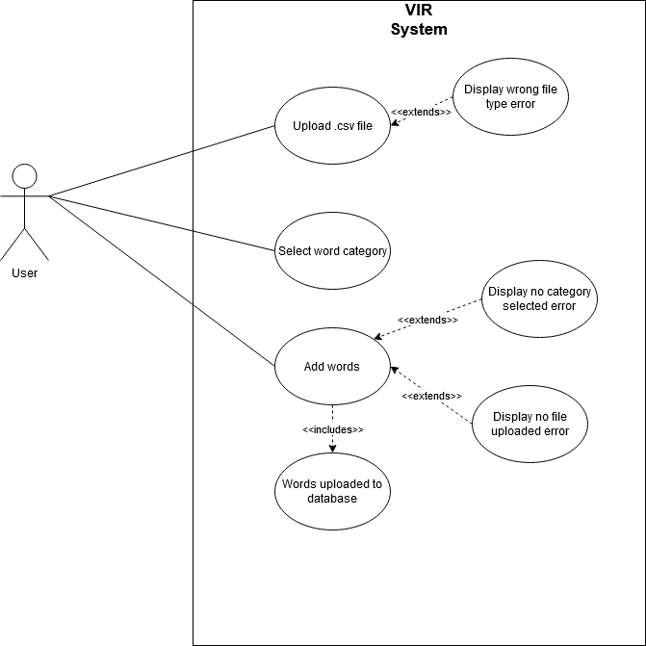
Use Case Diagrams
Use Case: OCR image upload
Use Case: Bulk Word Upload

Slide 8
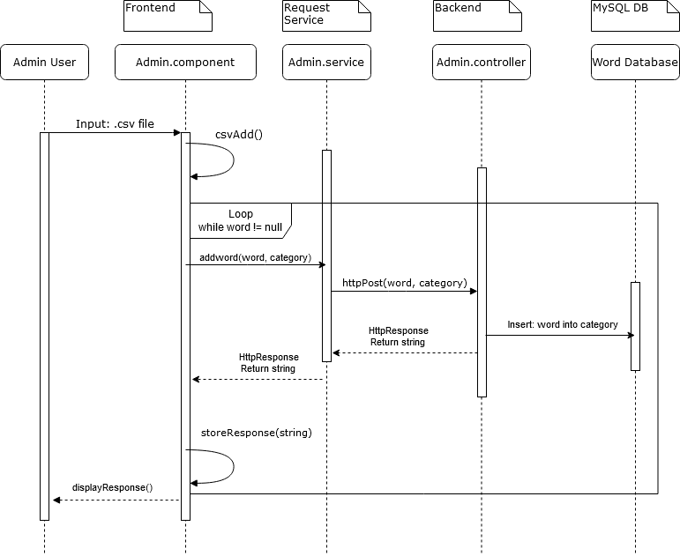
Sequence Diagram: Bulk Word Upload

Slide 9
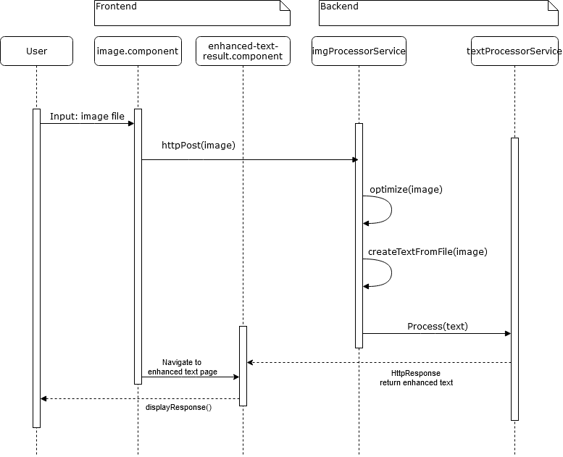
Sequence Diagram: Image Upload OCR
Notes:
4. Requirements:
4.1. User stories implemented (one or more slides).
4.2. UML use cases and the use case diagram for the implemented use cases (one or more slides).
4.3. UML sequence diagrams for the implemented use cases.

Slide 10
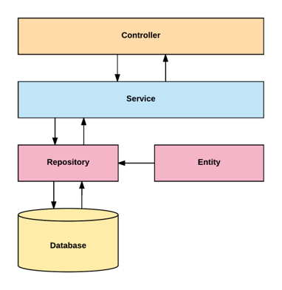
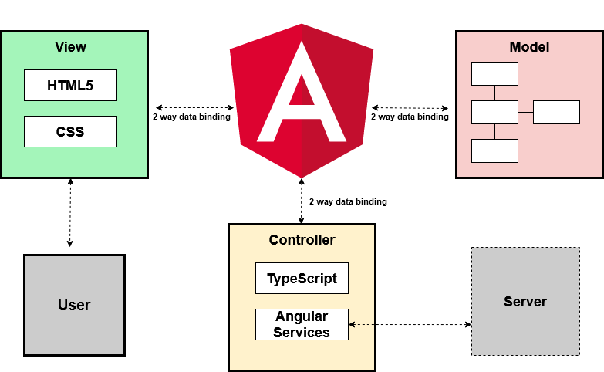
System Design: Architecture
Angular Model-View-Controller
Server System Design
Notes:
5. System design:
5.1. System decomposition; identify the architecture patterns used (one slide).
5.2. System deployment – h/w and s/w requirements (one slide).
5.3. Persistent data design (one slide).
5.4. Security/Privacy (one slide).

Slide 11
System Design: Deployment Requirements
Front end:
● Angular 4.3.1
● Ng-Bootstrap 1.0.0
● Ng-Translate 7.0.0
● Chat.js 2.7.1
● Font-Awesome 4.7.0
● Ng2-Charts 1.6.0
● Rxjs 5.1.0
● Jasmine 2.5.45
● Karma 1.7
● Typescript 2.3.3
Back end:
● Maven 3.5:
○ Commons-lang3 3.4
○ HikariCP 1.5.6.RELEASE
○ Jai-imageio-core 1.3.1
○ Jai-imageio-jpeg2000 1.3.0
○ Jasypt-spring-boot-starter 1.16
○ Levigo-jbig2-imageio 2.0
○ Mysql-connector-java 1.5.6.RELEASE
○ Opencsv 3.3
○ Opencv 3.2.0-1
○ Spring-boot-starter-data-jpa 1.5.6.RELEASE
○ Spring-boot-starter-security 1.5.6.RELEASE
○ Spring-boot-starter-test 1.5.6
○ Spring-boot-starter-web 1.5.6
○ Springfox-swagger-ui 2.7.0
○ Springfox-swagger2 2.7.0
○ Sqlite-jdbc 1.5.6.RELEASE
○ Tess4j 3.4.1
○ Thucydides-core 0.9.275
○ Tika-parsers 1.16
● Leptonica 1.74.4
● Mysql 14.14
● Java 1.8.0
● Spring Developer Suite 3.9
Notes:
5. System design:
5.1. System decomposition; identify the architecture patterns used (one slide).
5.2. System deployment – h/w and s/w requirements (one slide).
5.3. Persistent data design (one slide).
5.4. Security/Privacy (one slide).

Slide 12
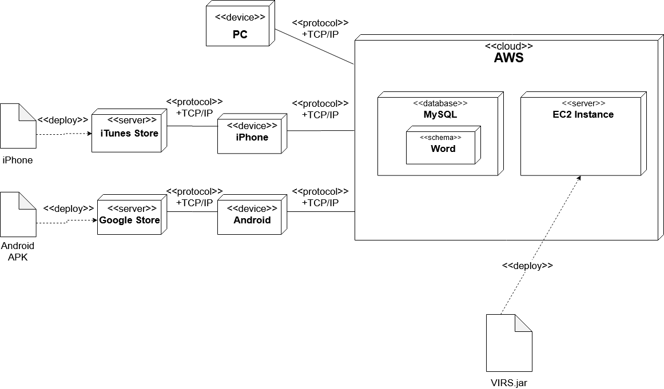
System Design: Deployment Diagram

Slide 13
System Design
Persistent data design
MySql schema with separate tables for storing words and user data
Hosted on AWS’ RDS platform, integrated with their elastic beanstalk platform
Security/Privacy
All API keys are encrypted by Jasypt configured for Spring Boot
Communication between the application and server is secured and takes place entirely within AWS
Notes:
5. System design:
5.1. System decomposition; identify the architecture patterns used (one slide).
5.2. System deployment – h/w and s/w requirements (one slide).
5.3. Persistent data design (one slide).
5.4. Security/Privacy (one slide).

Slide 14
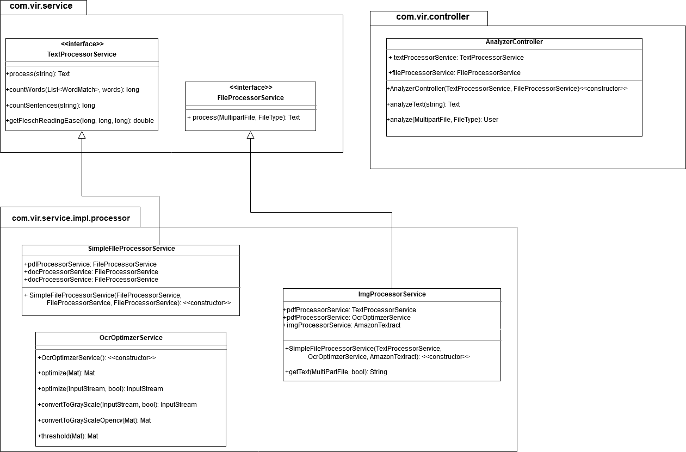
Minimal Class Diagram: OCR
Notes:
6. Detailed design:
6.1. Minimal class diagram. Identify the design patterns used (one or more slides).
6.2. State machine for the main control object or the most important object of the implemented uses cases (one or more slides).
6.3. Main algorithm used related to an implemented use case described above (one or more slides).

Slide 15
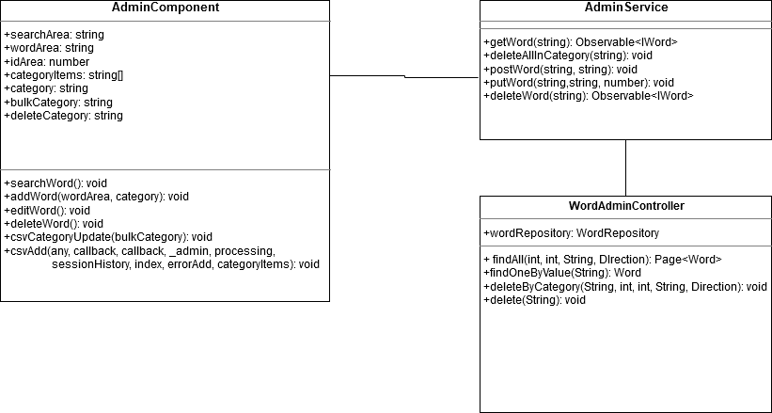
Minimal Class Diagram: Bulk Word Upload

Slide 16
Main algorithm: Optical Character Recognition
INPUT: Image file as a byte stream
ALGORITHM:
Optimize image byte stream by converting to RAW
Optimize image byte stream again by removing noise
client = new Textract Client
Request = new detectTextRequest(optimized image)
Blocks = client(request)
awsStringResults = “”
FOR EACH Block in Blocks {
IF(block type == "LINE") THEN awsStringResults = awsStringResults + newline + Block.getText
}
RETURN awsStringResults
Notes:
6. Detailed design:
6.1. Minimal class diagram. Identify the design patterns used (one or more slides).
6.2. State machine for the main control object or the most important object of the implemented uses cases (one or more slides).
6.3. Main algorithm used related to an implemented use case described above (one or more slides).

Slide 17
Test Suites
TC01_Frontend_Dependencies
TC02_Backend_dependencies
TC03_IAM_Users
TC04_AWS_Host
TC05_Decryption
TC06_Database_Running
TC07_Server_communication
TC08_Beanstalk_Integration
TC09_OCR_Sunny
TC09_OCR_Rainy
TC10_Dictionary_Header
TC10_Dictionary_Header
TC11_Bulk_Upload_Sunny
TC11_Bulk_Upload_Rainy
TC12_Global_Limit_Sunny
TC12_Global_Limit_Rainy
TC13_Database_Local_Backup
TC14_Upload_and_Replace_Sunny
TC14_Upload_and_Replace_Rainy
TC15_Admin_Search_Sunny
TC15_Admin_Search_Rainy
Notes:
7. Test Suites and Test Cases (one sunny day and one rainy day) for the use case represented in part (5) above (2 slides).
7.1 One sunny day and one rainy day for the implemented use cases (one or more slides).
7.2 Automated test scripts for the implemented use cases (one or more slides).

Slide 18
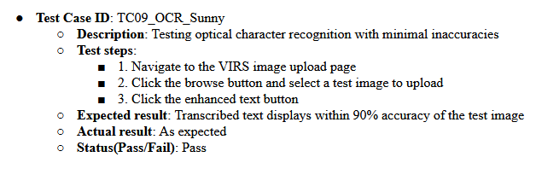
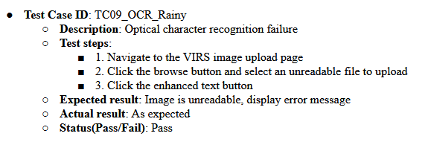
Test Cases for Image Upload OCR

Slide 19
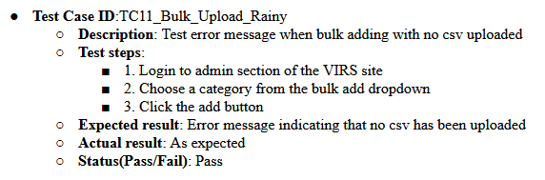
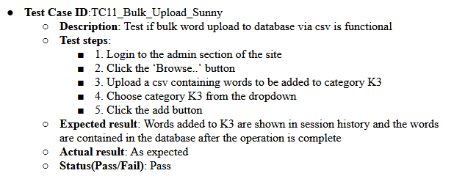
Test Cases for Bulk Word Upload

Slide 20
Summary
The local version of the application is now fully functional
The AWS hosted version of the app is fully functional and can be accessed at www.myvirs.com
Users can now upload scans of images and they will be transcribed with high accuracy
Administrative users can now add categories of words in bulk and replace entire categories if needed
Notes:
Summarize your contribution
Include your contact information
Ask if anyone has any questions for you.
Thank your audience

Slide 21
Contact info
Jorge: Jcost035@fiu.edu
Julian: Jpine084@fiu.edu

Slide 22
Questions?

Slide 23
Thank you!

