Slide 1
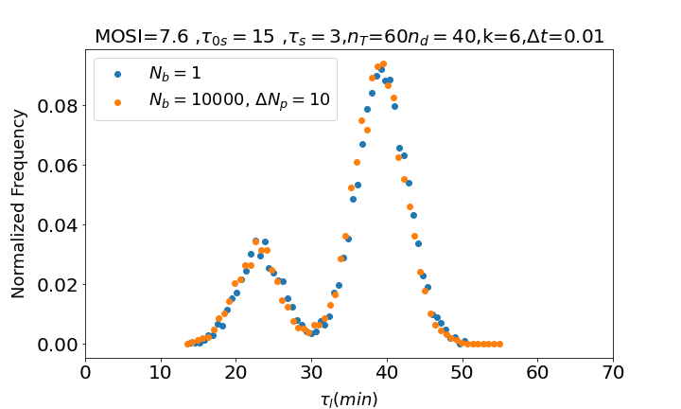
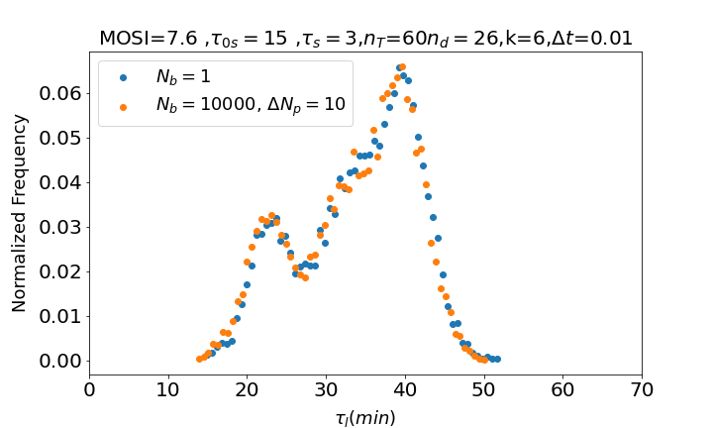
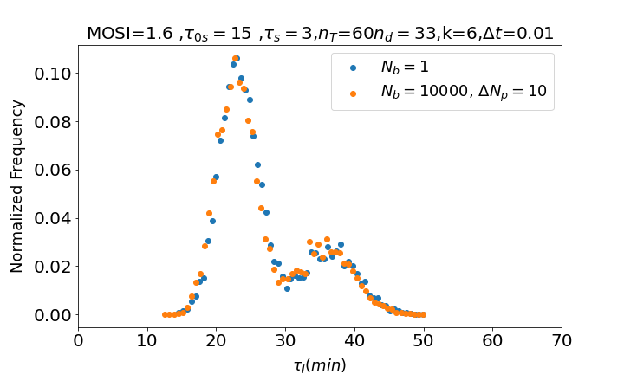
This week, I have made sure that the “constant time Interval” algortithm with one bacteria and with several bacteria gave the same results (to make sure the one with several bacteria was well coded)
GOOD

Slide 2
Code
We calculate the volumen of the system according to number of bacteria (Nb) and concentration of bacteria (B)
According to the desired MOSI, we calculate the initial concentration of phage P0
With P0 and the volumen we calculate the number of phages Np we have
We initialize variables: probability of superinfection is still 0, the number of timer molecules in each bacteria is 0 and the probability of a timer molecule appearing is k·Δt
We initialize a loop that iterates until all the bacteria are dead:
  If the time when superinfection starts arrives, it initializes the probability of superinfection to
  If the time when superinfection ends arrives, then it sets the probability again to 0
  A loop iterates over all the bacteria that are alive:
    A random number is chosen between 0 and 1
    If the random number is less than the probability of a new timer molecule being born, then a new timer molecule is born in that bacteria
    If the random number is between the probability of a new timer molecule being born and the sum of this with the probability of superinfection: the bacteria is superinfected
    If superinfected, then the number of timer molecules decreases by Nd
  We check if any bacteria has the maximum number of timer molecules. If it does:
    Bacteria is eliminated and time of death is registered
    Np = Np + burst size

Slide 3
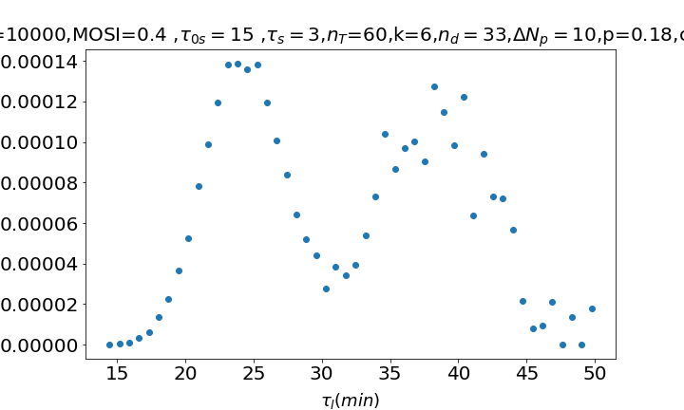
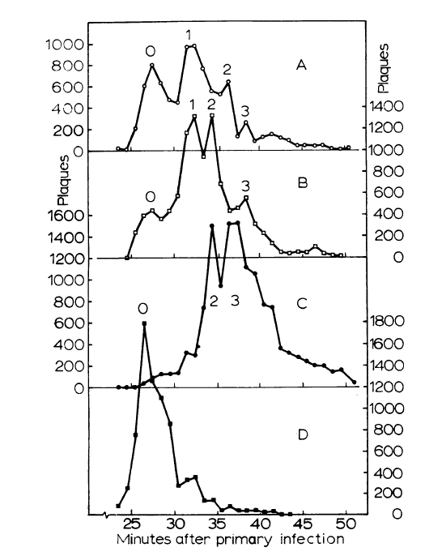
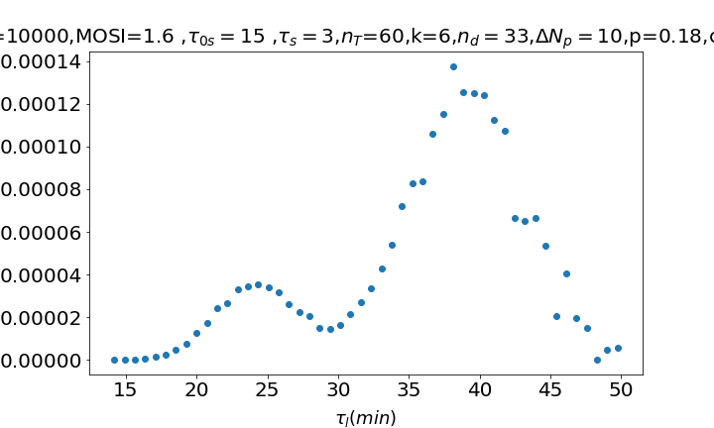
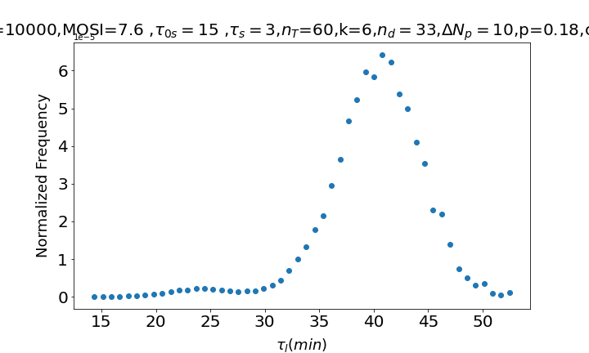
Also, we commented that it might be a good idea to multiply the histogram of the death times by a function that depends linearly on time for results to be more similar to the ones in the experiment → For results to really change and become more similar to results in the experiments, I had to multiply by an exponential function of time. Does that make sense? Not really
A
B
C

Slide 4
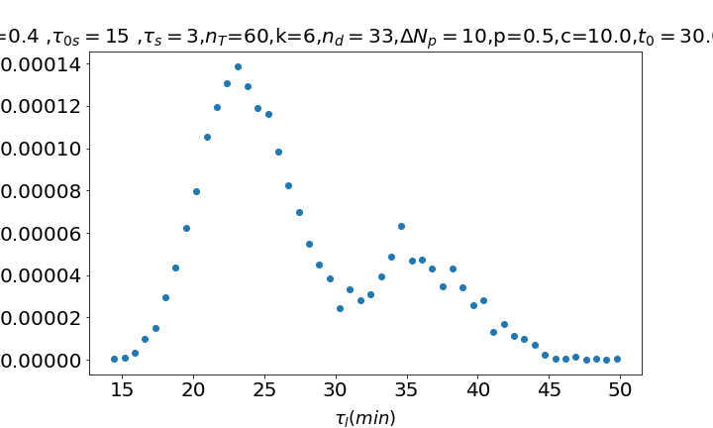
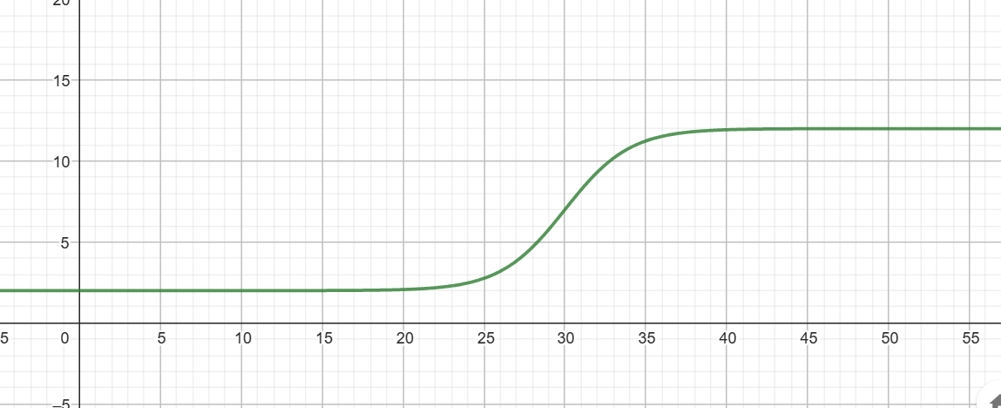
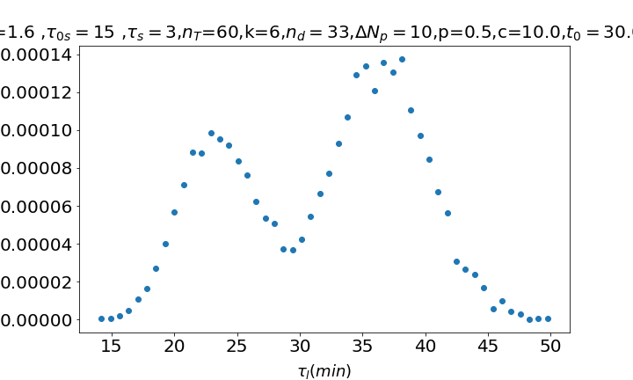

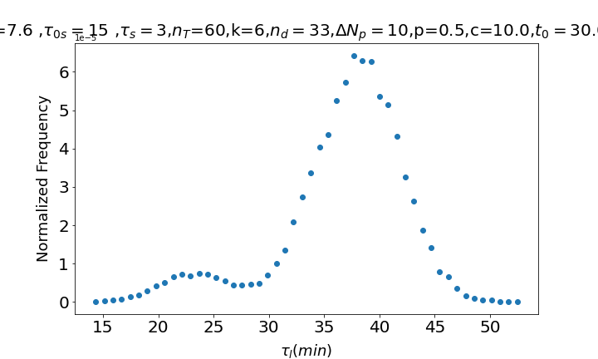
Sigmoidal?
GOOD
Make it similar to reference titled: Bacteriophage T4 development depends on the
physiology of its host Escherichia coli
In figure 5, the one with the black squares

Slide 5
Predictive model. Code
Suggestion from Namiko:
Maybe the code would be faster if the superinfection is decided by taking the concentration of bacteria, calculating the probability of being superinfected, then choosing some bacteria (according to the probability) with a binomial distribution.
We calculate the volume of the system according to Nb and B
We loop over the number of iterations:
  Probability of infection at this time step is
  Probability of a new timer molecule being born is k·
  We iterate over all the already infected infected cells
    We decide if some of them get superinfected, some have a new timer molecule or nothing happens to them.
    If it gets superinfected we decrease the number of timer molecules to by Nd
    When a new timer molecule is born, we check if the number of timer molecules is already maximum. If it is, then we just make them die and call the burst function that gives us the number of offspring, which we add to the number of phages in the environment.
    We register the time of death of the cell as the actual time – the time when the cell was first infected
  We iterate over all the non infected ones:
    We check if they get infected or they don’t in this time step. If they do, then the state is infected and their time of infection is registered
    If they don`t get infected they grow α·Δt units of volume. When it arrives to the máximum volumen it divides.
  For every iteration I store the time, the number of free phages and the number of bacteria that are alive
GOOD
Dependence of the burst size as a function of time: 0 until 15 minutes and then burst linearly with time. Start with slope10 (if cell diez in 25 minutes it bursts 100)

Slide 6

Predictive model. Input parameters
Time Interval (Δt = 0.01 min)
Initial number of bacteria (Nb0 = 3)
Initial concentration of bacteria (B = 2.0e7 cells/ml)
Initial number of phages (Np0 = 100 )
Growth rate of bacteria (α = 40.0 a.u/min )
Maximum size of bacteria before dividing (
Adsorption rate (η = 5e-9 cells·ml/min)
Birth rate of timer molecules (K = 6.0 molecules/min)
Maximum number of timer molecules (
Number of timer molecules decreased when superinfection happens (
Cells are dividing too fast. We need them to divide every 20 mins or so

Slide 7
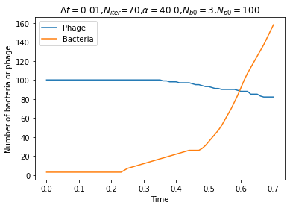
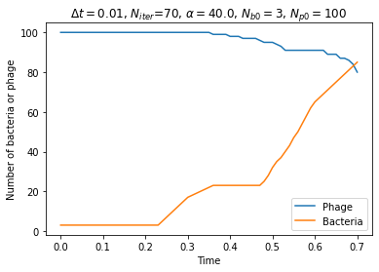
Predictive model. Some results
VERY SLOW!!! → Start using Numba or the server or both ☺ Optimize code???
LOOKS GOOD

