Slide 1
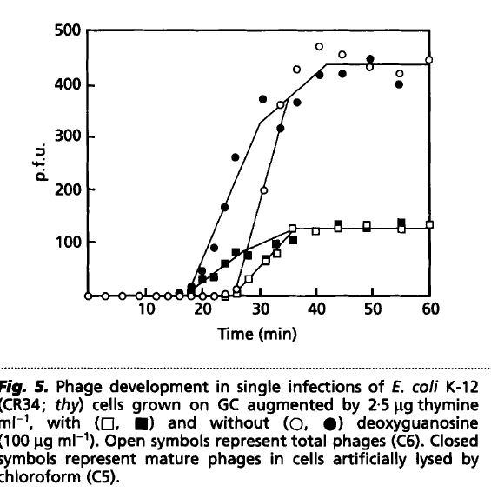
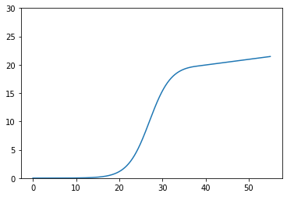

Sigmoidal burst size

Slide 2
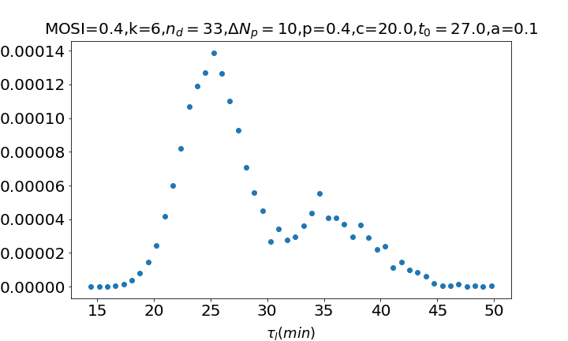
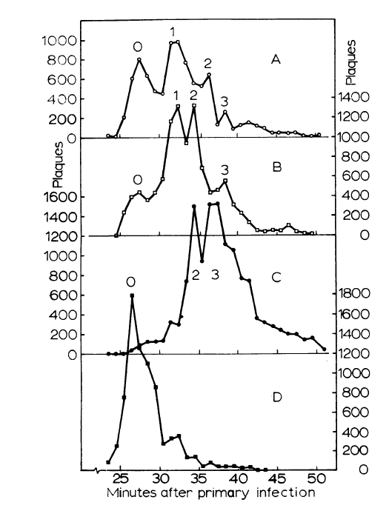
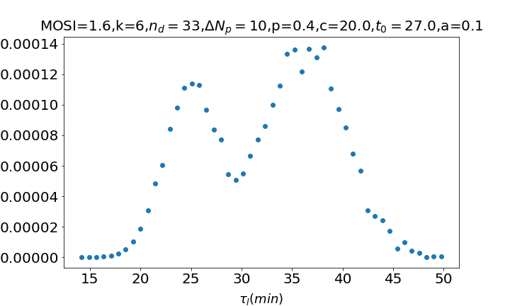
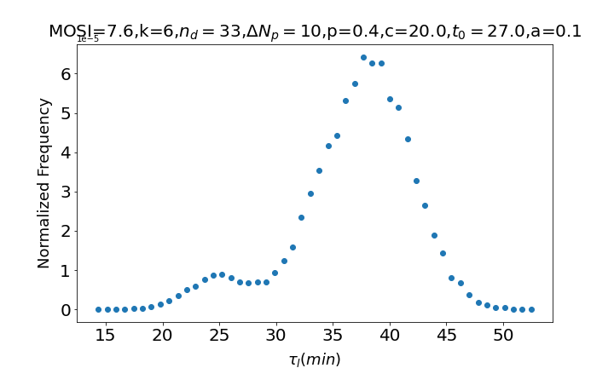
Results ☺
A
B
C

Slide 3
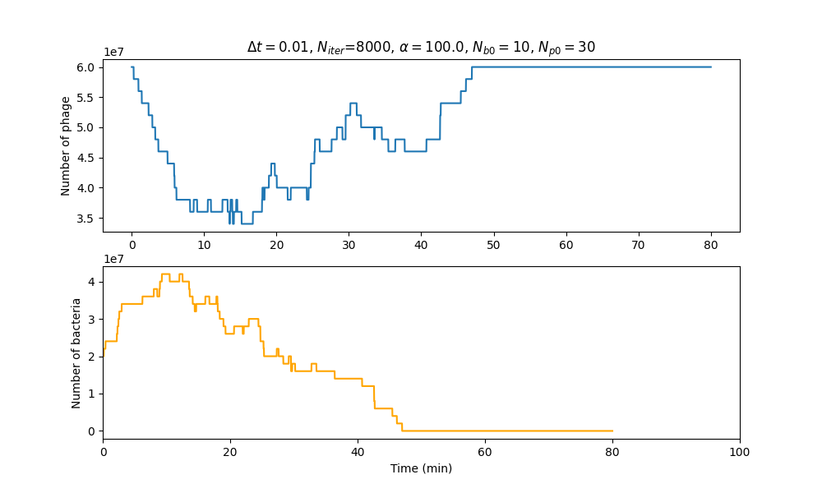
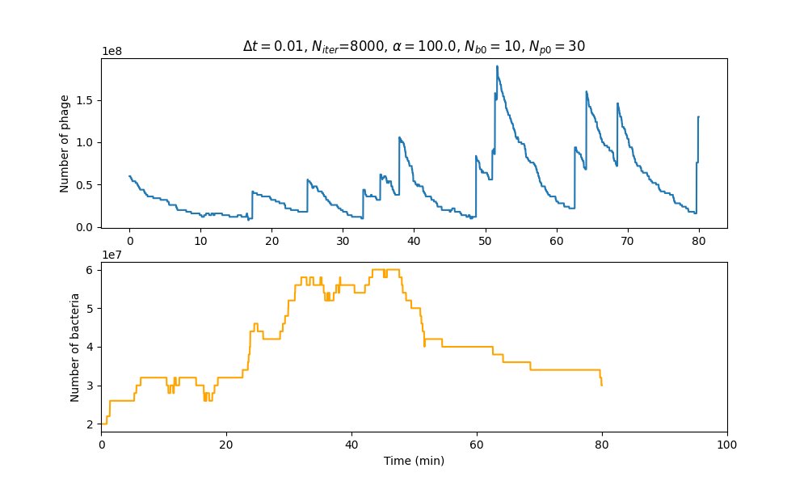
Predictive model
NO SUPERINFECTION
SUPERINFECTION

Slide 4
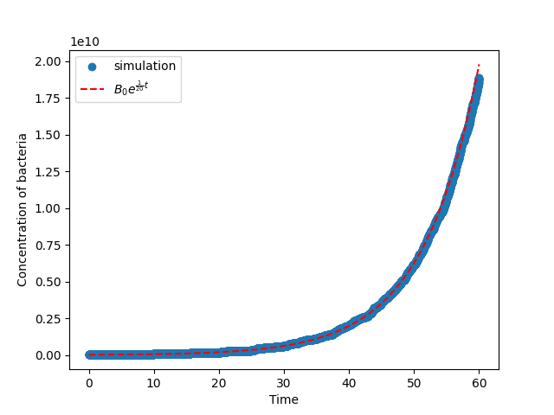
Cell growth with doubling time 20 mins
If I put the initial phages to 0, then no bacteria gets infected. Therefore, the only possible processes are growth and divisioin of the bacteria.
For the growth, I set a doubling time of 20 minutes. For the data of the simulation to obey the expected exponential evolution, I have to add some additive noise to the growth.
Every cell has a uniform number between 0 and 1 assigned and the growth at every step is Alpha*delta_t + noise.
The data only fits exactly the exponential curve if the noise is máximum 0.83. It is very strange.

Slide 5
How to make code faster
Program it in C++ or FORTRAN
Use the server
Both? Which one first?

Slide 6
Predictive model: the code
We calculate the volume of the system according to Nb and B
We loop over the number of iterations:
  Probability of infection at this time step is
  Probability of a new timer molecule being born is k·
  We iterate over all the already infected infected cells
    We decide if some of them get superinfected, some have a new timer molecule or nothing happens to them.
    If it gets superinfected we decrease the number of timer molecules to by Nd
    When a new timer molecule is born, we check if the number of timer molecules is already maximum. If it is, then we just make them die and call the burst function that gives us the number of offspring, which we add to the number of phages in the environment.
    We register the time of death of the cell as the actual time – the time when the cell was first infected
  We iterate over all the non infected ones:
    We check if they get infected or they don’t in this time step. If they do, then the state is infected and their time of infection is registered
    If they don`t get infected they grow α·Δt units of volume. When it arrives to the máximum volumen it divides.
  For every iteration I store the time, the number of free phages and the number of bacteria that are alive

Slide 7
Predictive model. Parameters
Time Interval (Δt = 0.01 min)
Initial number of bacteria (Nb0 = 3)
Initial concentration of bacteria (B = 2.0e7 cells/ml)
Initial number of phages (Np0 = 100 )
Growth rate of bacteria (α = 100.0 a.u/min )
Maximum size of bacteria before dividing (
Adsorption rate (η = 5e-9 cells·ml/min)
Birth rate of timer molecules (K = 6.0 molecules/min)
Maximum number of timer molecules (
Number of timer molecules decreased when superinfection happens (

Slide 8
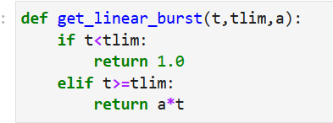
Burst function
Tlim = 15 mins
a = 1.0

