Slide 1
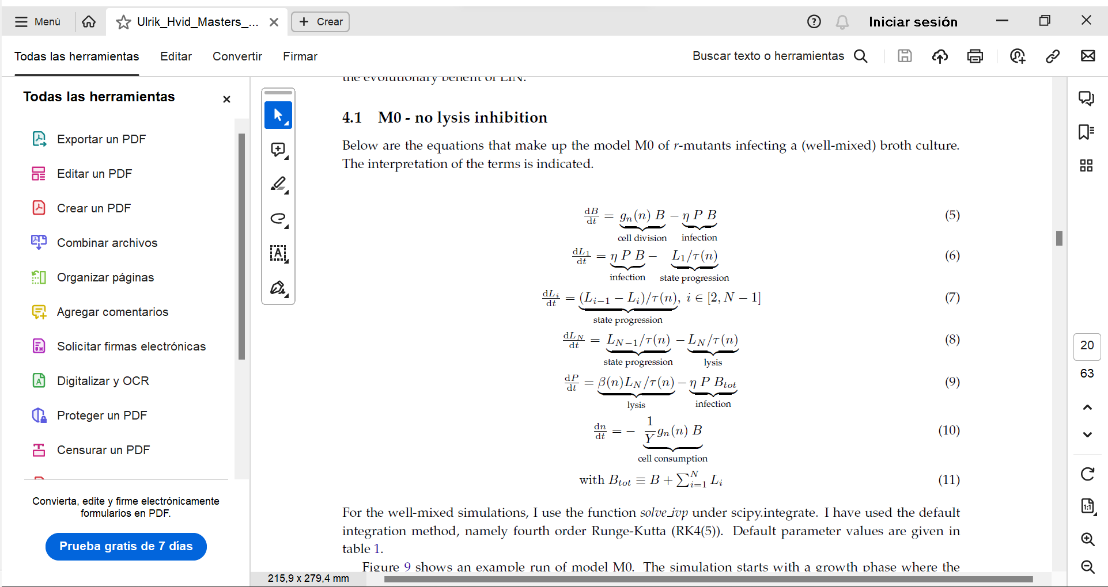
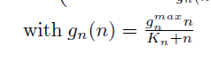
Nutrient limited growth
Try simulating without phage and solve this equations analytitcally to see if the siomulation results fit them
With Y = 1, then the rate of divison and rate of nutrient consumption is the same. (Ulrik uses Y = 1)
Monod growth law.
N is the concentration of nutrients in the médium
kn = n_0/5 where n_0 is the initial number of nutrients.
Gnmax is the máximum división rate which in our case is 0.034 min-1

Slide 2
How did I implement that in my code?
We calculate the volume of the system according to Nb and B
We loop over the number of iterations:
  Probability of infection at this time step is
  Probability of a new timer molecule being born is k·
  We iterate over all the already infected infected cells
    We decide if some of them get superinfected, some have a new timer molecule or nothing happens to them.
    If it gets superinfected we decrease the number of timer molecules to by Nd
    When a new timer molecule is born, we check if the number of timer molecules is already maximum. If it is, then we just make them die and call the burst function that gives us the number of offspring, which we add to the number of phages in the environment.
    We register the time of death of the cell as the actual time – the time when the cell was first infected
  We iterate over all the non infected ones:
    We check if they get infected or they don’t in this time step. If they do, then the state is infected and their time of infection is registered
    We check if they divide. The probability of division is g(n)·
    We check if they ingest a nutrient. The probability of nutrient ingestion is g(n)·. Then the number of nutrients is reduced by 1.
  For every iteration I store the time, the number of free phages and the number of bacteria that are alive and also the number of nutrients left in the medium
Do the same as I had before, cells grow at every step with probability alpha and when they reach a certain size then they divide. Make alpha proportional to the nutrients.

Slide 3
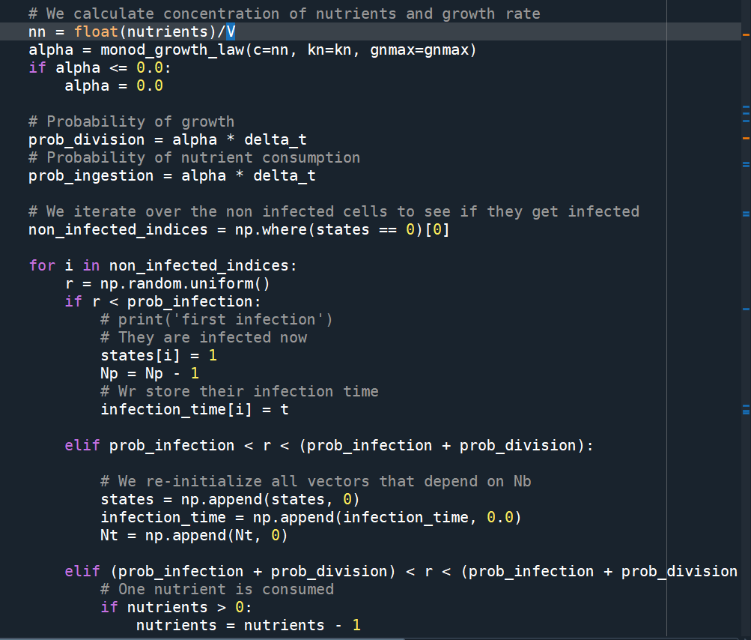
The piece of code

Slide 4
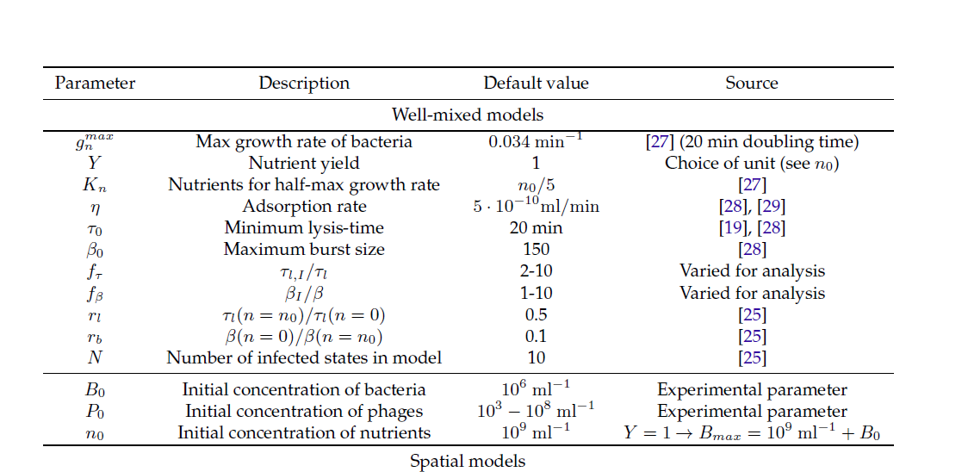











Values of the parameters
Try to run the simulation once it Works with different parameters: number of initialphage compared to bacteria, etc.
We used 23 minutes in the previous model when we reproduced Bode’s experiments. We could use 20 mins for simplicity, but maybe I would have to check with the previous model how it looks and how I would have to change the number of timer molecules or their birth rate.
I started with 10^7 nutrients/ml so that the population of bacteria does not grow so much

Slide 5
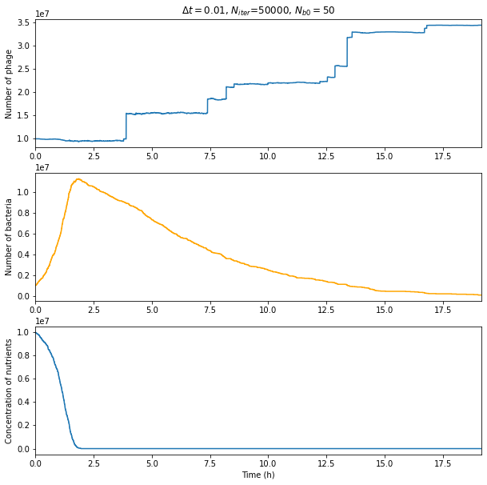
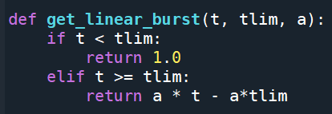
Some results
Tlim = 15 mins
A = 100
Represent axis y with the number and not the concentration

Slide 6
TO DO FOR NEXT MEETING
Implement Alpha again but nutrient dependent (Monday Tuesday)
To check if it Works properly, calculate analytical evolution of bacteria and nutrients (first slide) and then compare. (0 phages) (Monday tuesday)
Use numba and server (to test different combinations of initial parameters) (Thursday, Friday, Weekend)
Add phages and try different combinations of parameters

