Slide 1
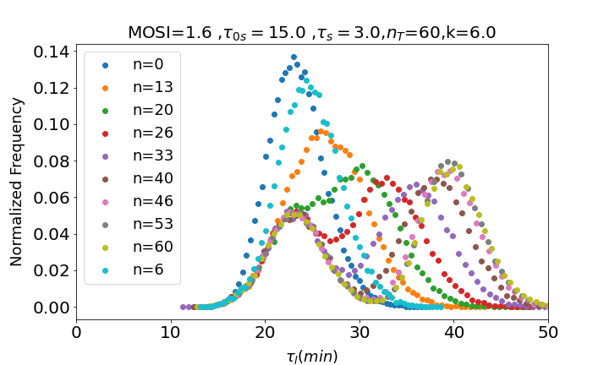
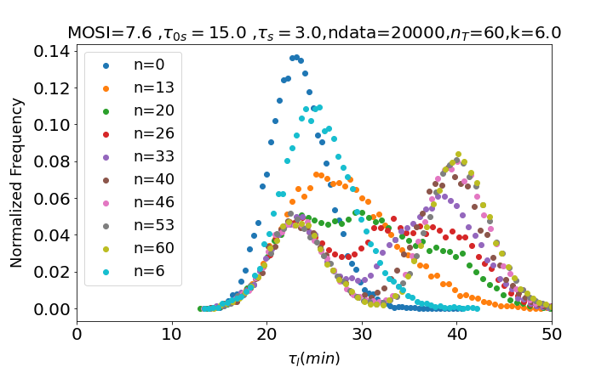
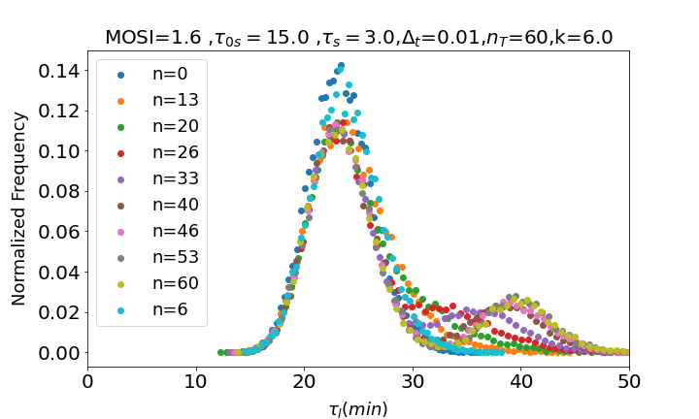
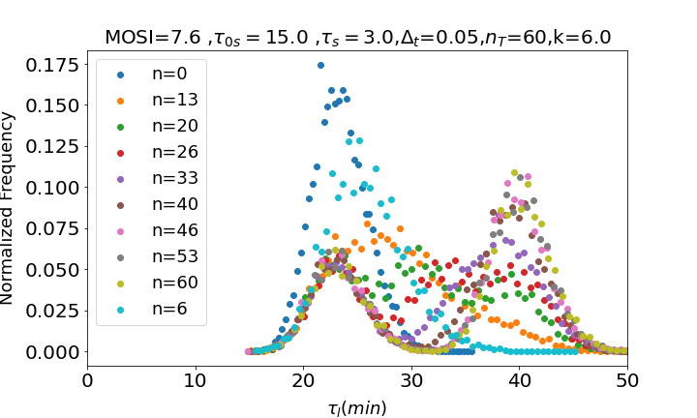
MOSI = 1.6
MOSI = 7.6
GILLESPIE
CONSTANT TIME INTERVAL

Slide 2
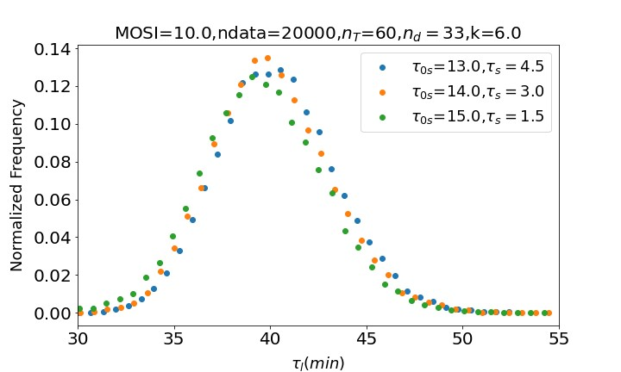
CONSTANT TIME INTERVAL.
FIGURE 4.

Slide 3
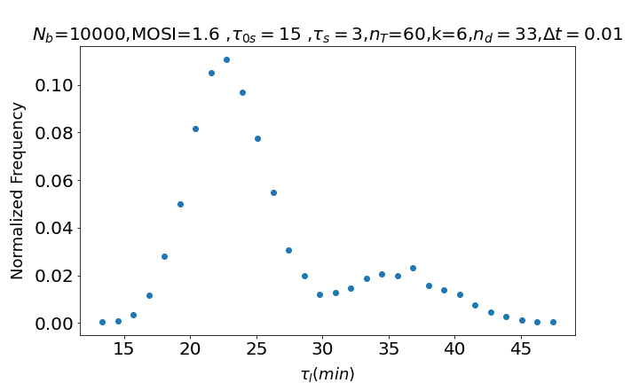
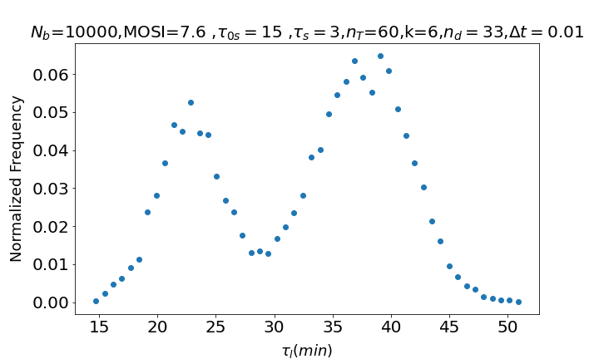
CONSTANT TIME INTERVAL WITH SEVERAL BACTERIA. NO BURSTING OF BACTERIA.

Slide 4
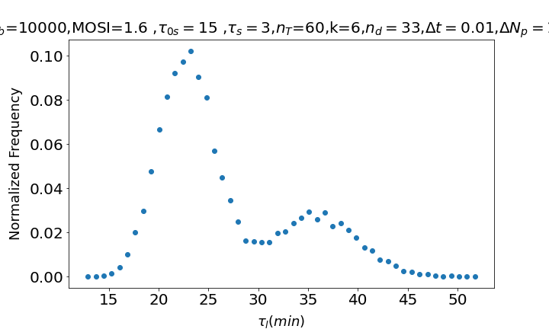
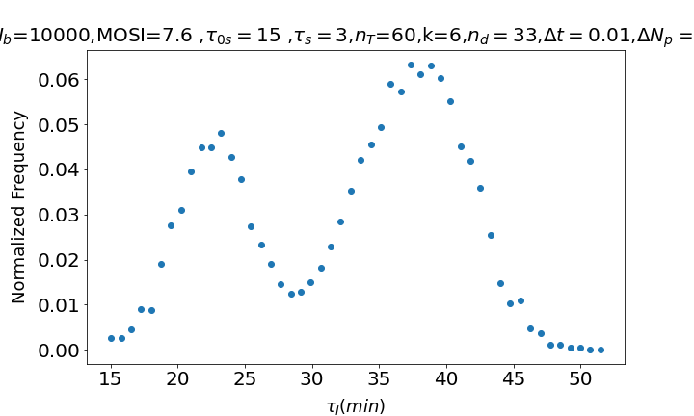
CONSTANT TIME INTERVAL WITH SEVERAL BACTERIA. BURSTING OF BACTERIA, BUT AFTER SOME TIME THE FREE PHAGES ARE FILTERED SO OFFSPRING CANNOT REINFECT ANYMORE (CONDITIONS OF THE EXPERIMENT OF THE ARTICLE)

Slide 5
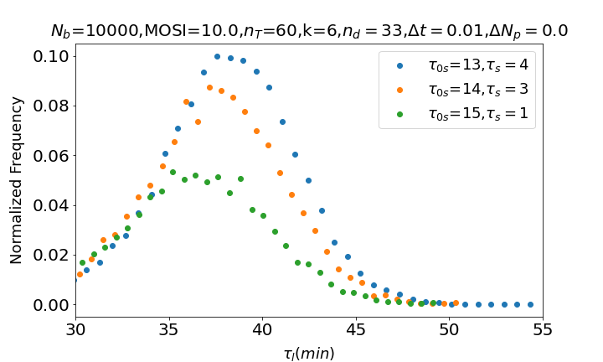
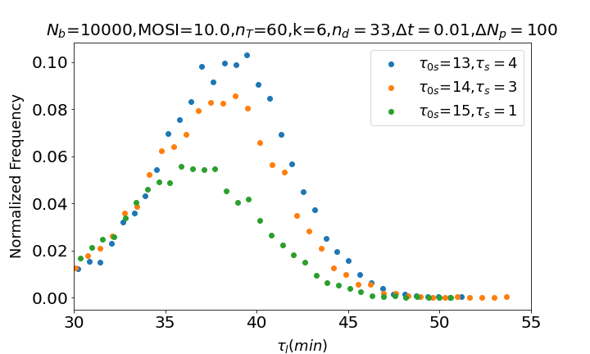
Figure 4

Slide 6
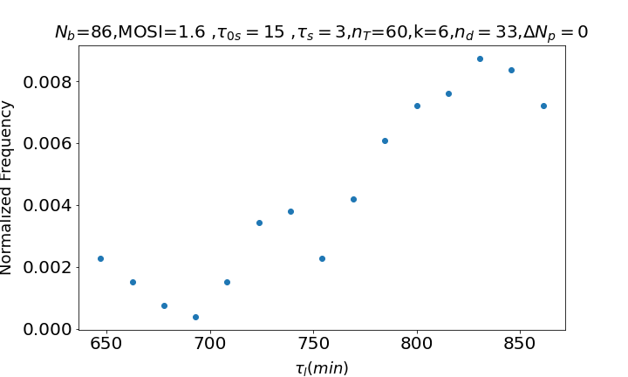
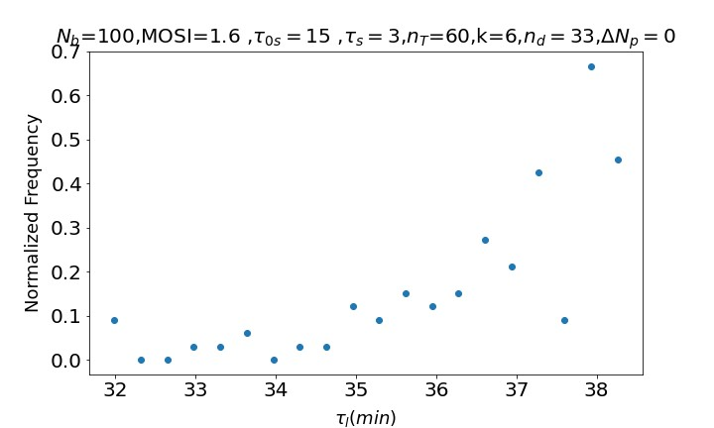
Problems: Gillespie with several bacteria does not work

