Slide 1
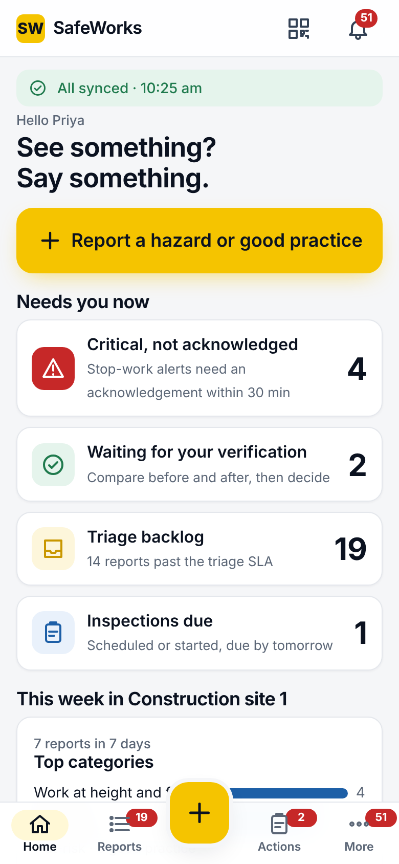
The complete guide: every screen, every option
SW
SafeWorks
Phone app · QR form · Admin console · Settings and background jobs. Portal 2.1, UI version 2.
November 2026
Notes:
This deck walks through every screen and every option of SafeWorks, in the order a new team meets them: the phone app, the QR form for people without an account, the admin console, and finally the settings and background jobs that shape how a site runs. Use it as a training deck or a reference; each slide's notes carry the detail.

Slide 2




What this guide covers
Phone app
QR form
Sign-in, Home, Quick report, Reports, Triage, Actions, Verification, Inspections, Charts, Notifications, Outbox, Settings
Sign-in-free reporting for visitors and contract workers, in four languages
Admin console
Settings and jobs
Dashboard, Attention, three registers, 18 configuration pages, oversight pages, command menu
Every company setting with its default; the reminders, alerts, digests and retention that run on their own
Notes:
Four parts. We start where most people start, on the phone, then the QR form, then the console pages one by one, and finish with the settings and the jobs that run in the background.

Slide 3
Roles: who can do what
Role | Scope | Phone | Console | Report | Triage | Verify | Configure | Export
Reporter | Per site | Yes | No | Yes | No | No | No | No
Action owner | Per site | Yes | No | Yes | No | No | No | No
Verifier | Per site | Yes | No | Yes | No | Yes | No | No
Site safety officer | Per site | Yes | Yes | Yes | Yes | Yes | Users at own sites | Own sites
Site head | Per site | Yes | Yes | Yes | Yes | Yes | Users at own sites | Own sites
HSE manager | All sites | Yes | Yes | Yes | Yes | Yes | Safety config | All
Admin | All sites | Yes | Yes | Yes | No | No | Everything | All
External auditor | All sites, expires | Read only | Read only | No | No | No | No | All
Safety configuration (templates, categories, risk matrix, due dates, ladders, rule sets) is the HSE manager's. Admin owns sites, users, QR codes, settings, privacy, retention and health. Officers and site heads manage users below them at their own sites.
Notes:
Eight roles. Reporter, action owner and verifier are per site and use only the phone. Site safety officer and site head run their sites: triage, verify, manage users below them. HSE manager and admin are company-wide; the HSE manager owns the safety configuration, the admin owns the platform. External auditors read and export everything, change nothing, and their access expires.

Slide 4
Phone app
SW
Sixteen screens, built for one hand, gloves, sunlight and no signal.
Notes:
The phone app is an installable web app, also packaged for Android. Everything you do on it is kept on the phone first and synced when there is signal.

Slide 5
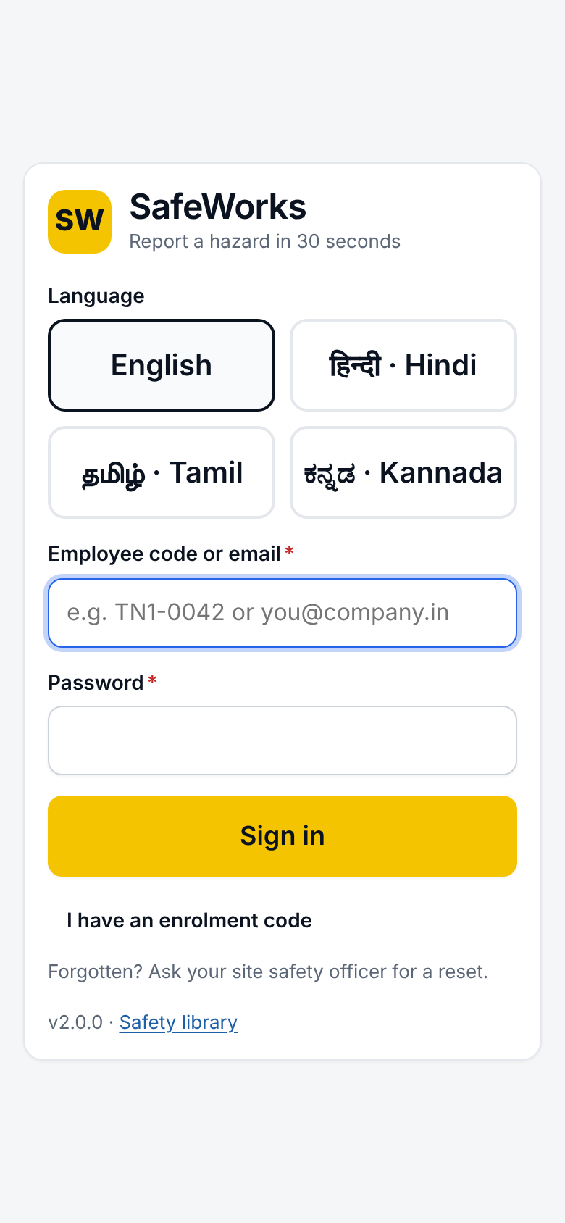
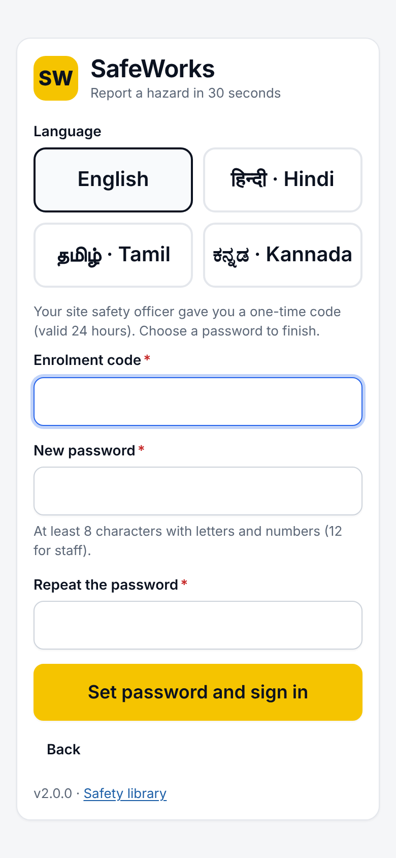
Sign in and enrolment
Sign-in screen
Language: English, हिन्दी, தமிழ், ಕನ್ನಡ; English by default
Login: employee code or email, plus password
Password rule: 8+ characters with letters and numbers; 12 for staff
Lockout: 10 wrong passwords lock the account for 15 minutes
Unsent items: kept on the phone and sent after sign-in
Enrolment code
One-time code from the safety officer, valid 24 hours
Choose a password, then sign in
Roles that need MFA still get the authenticator step
Two-step sign-in (MFA)
Admin, HSE manager and site head by default (configurable)
Authenticator app key shown once at first sign-in
Lost phone: an administrator resets it
Notes:
Three ways in: employee code, email, or a one-time enrolment code. Staff roles add an authenticator code. The language choice here is remembered and later saved to the account.

Slide 6
Home
Top
Sync banner: All synced, Offline, pending count, or failed; tap to open the Outbox
Report button: Report a hazard or good practice
Top bar: QR scan and Notifications with unread badge
Needs you now (by role)
Critical alerts not acknowledged (with the minutes target)
Actions overdue, and due today
Waiting for your verification
Triage backlog, with the next SLA due time
Inspections due by tomorrow
Returned to you with a question
This week at your site
Top categories, at-risk vs good practice
Repeat findings: a category reported more than once, failed inspections
Lists
My next actions, My recent reports, with All links
Notes:
Home is personal: a worker sees sync status, the Report button, this week's picture and their reports; an officer also sees the triage backlog and alerts to acknowledge; an owner sees overdue and due-today actions; a verifier sees what is waiting.

Slide 7
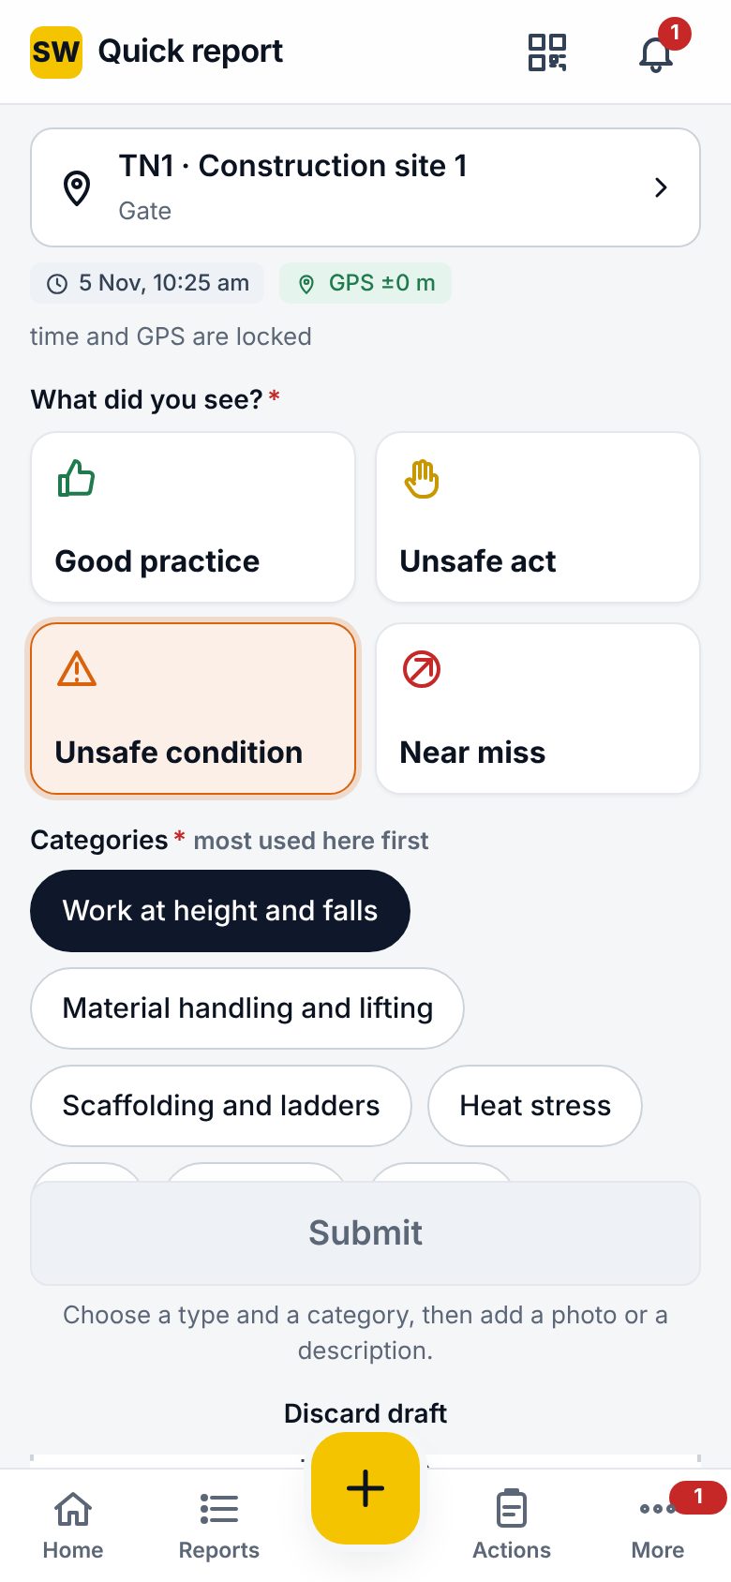
Quick report, part 1: location, type, photos
Location
Card: site, area and equipment; tap to change
GPS: locked at capture with the time; geofence flags reports outside the site
QR: scan a poster to prefill the area or equipment
What did you see?
Good practice, Unsafe act, Unsafe condition, Near miss
Categories
Most used at the site first; More opens the full list
Some categories ask required extra fields
Photos
Take photo or From gallery; up to 10 per record
Blur boxes over faces before sending
Resized on the phone (max edge and quality from Settings)
Describe
Up to 500 characters; voice-to-text; voice note up to 60 s
Guidance: say what, where and who could be hurt, not who did it
Notes:
Everything needed for a report is on one screen. The location is already right in most cases, and the category chips are ordered by what the site reports most.

Slide 8
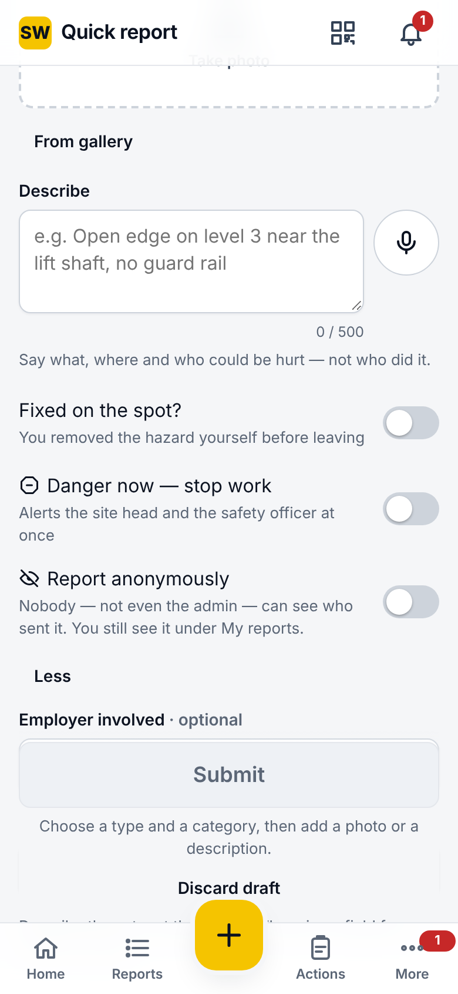
Quick report, part 2: switches, details and saving
Switches
Fixed on the spot?: then say what you did (required)
Danger now, stop work: alerts the site head and safety officer at once
Report anonymously: nobody, not even the admin, sees who sent it; it still shows under My reports
More details
Employer involved: own company or a contractor
Trade: of the people involved
Checks before sending
Site, area (without GPS), type, at least one category
A photo or a short description
What you did, when fixed on the spot
Drafts and saving
An unfinished report is kept; Discard draft removes it
Saved screen: case number, or a pending number when offline
Report another, View report, Home
Notes:
The three switches change what happens next: fixed on the spot credits the reporter and records the fix; danger now starts the stop-work alert; anonymous seals the reporter's identity.

Slide 9
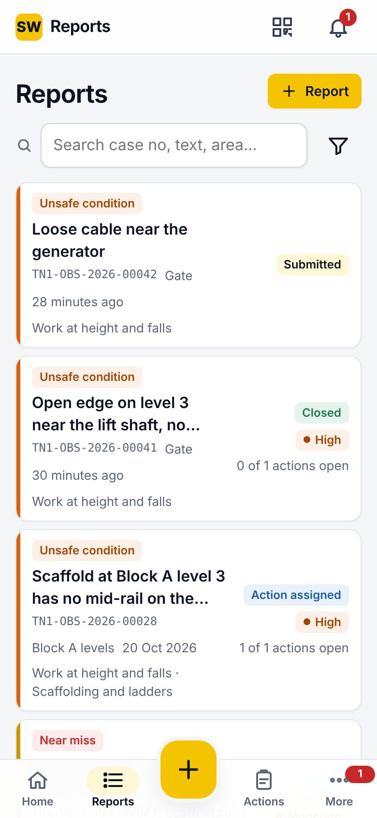
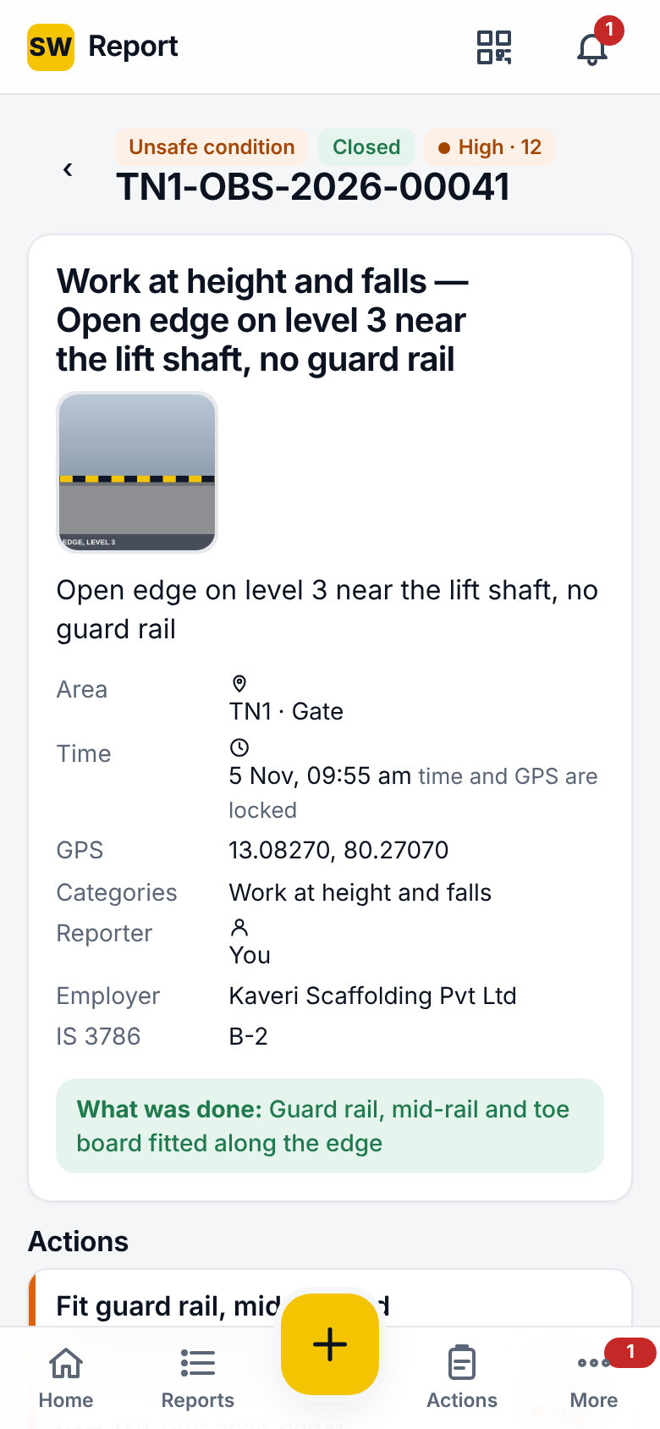
Reports and the report page
Reports
Tabs: My reports; Triage and Site for officers
Search: case number, text, area
Filters: status, type, band; Save filter with a name
Offline: your reports are listed with their status, offline too
Report statuses
Submitted, Returned to reporter, Action assigned, Merged, Discarded, Escalated to incident, Closed
Report page
Photos (tap to enlarge), description, area, time, GPS, categories, reporter, employer, IS 3786 class
Danger banner with Acknowledge for officers
What was done, closure summary, actions with status
Timeline, comments and replies
Triage button for officers; Report link for a new tab
Notes:
My reports shows a reporter what happened to each report, through to Closed. Officers get two more tabs: Triage, the queue, and Site, everything at the site.

Slide 10
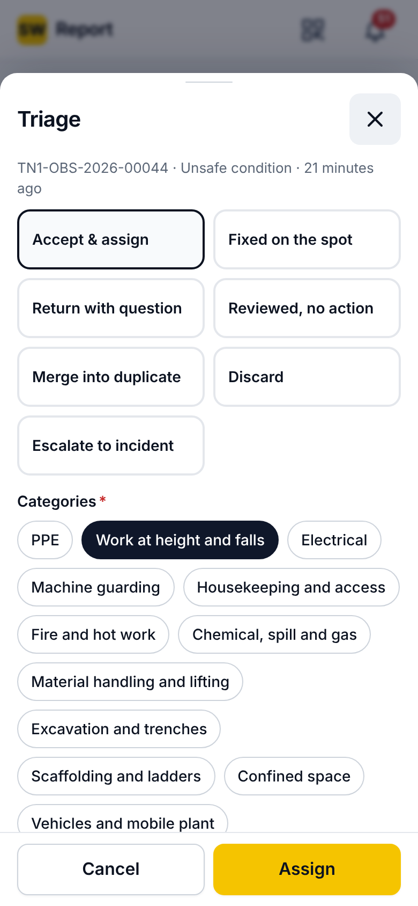
Triage: the seven decisions
Decisions
Accept & assign: score the risk and create actions (next slide)
Fixed on the spot: accept the reporter's own fix
Return with question: the reporter replies from My reports
Reviewed, no action: noted, nothing to do
Merge into duplicate: choose the master case; suggestions use the duplicate window and GPS radius
Discard: with a reason
Escalate to incident: records when it was learned and shows the rule set's statutory timers
Discard reasons
Not a hazard, Test entry, Not enough information, Out of scope, Already controlled, Accepted risk, Not applicable here, Resolved elsewhere, Other
Also
Reopen a decided report; every decision is in the timeline and audit log
Triage SLA: 1 working day by default, site head reminded at 2
Notes:
Every report gets one of seven decisions. Discards need a reason from a fixed list; merges pick the master case; escalations record the moment the organisation learned of it, which starts statutory clocks.

Slide 11
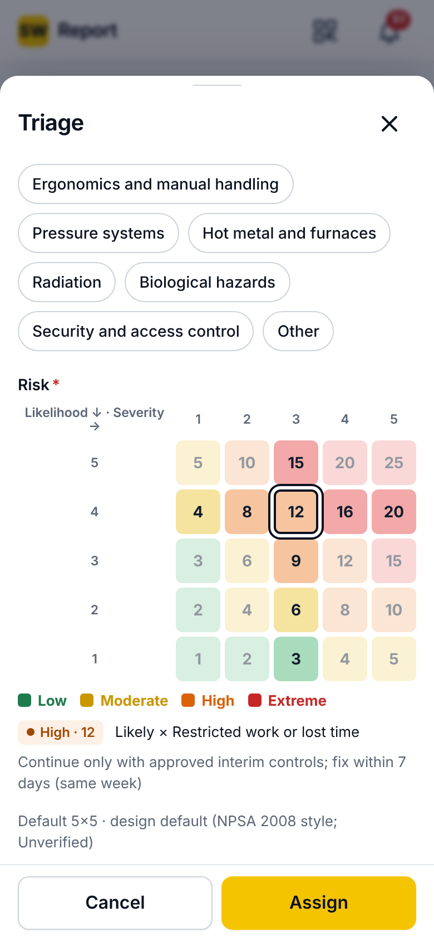
Accept and assign: scoring and actions
Scoring
Categories: confirm or change
Risk matrix: likelihood × severity, 5 × 5; the version is frozen on the record
Bands: Low 1–3, Moderate 4–6, High 8–12, Extreme 15–25 (default)
IS 3786 class: required
Employer involved: own company or a contractor
Interim control: required for Extreme, danger-now and where the band rule says so
Each action
Title, problem, owner, due date (from the band rule), type and control level
Employer, interim control with a review time
Add action for more than one
Officers' shortcut
Report and assign: score and assign right after submitting, offline too
Notes:
Accept and assign is where the risk decision is made. The matrix gives a band; the band sets the due date and how hard reminders push. High and extreme risks need an interim control, something done this shift.

Slide 12
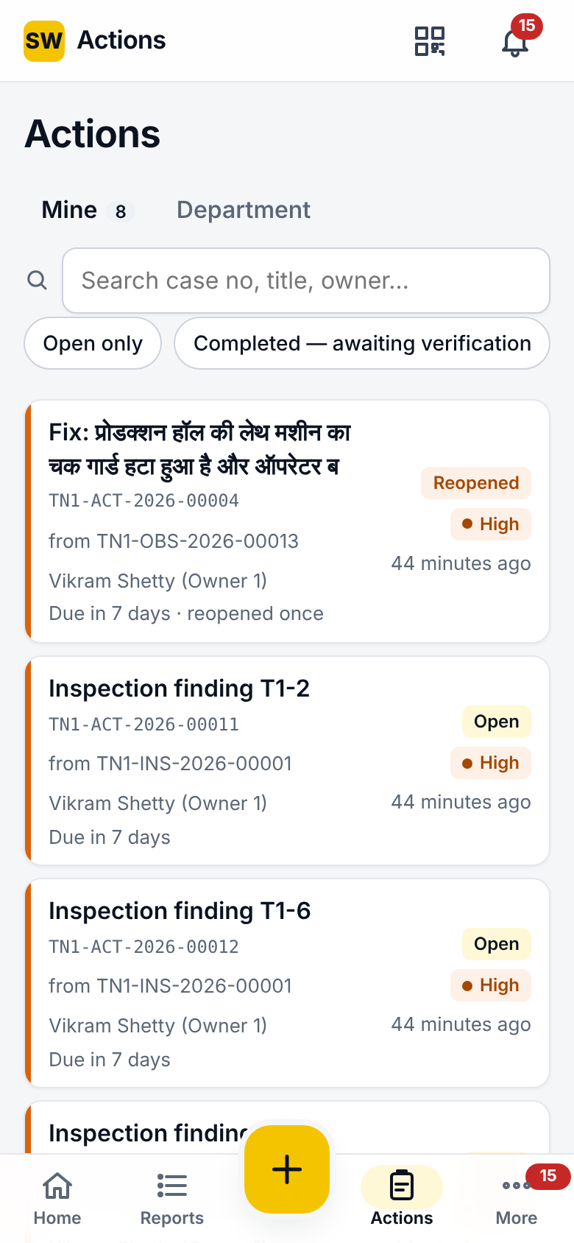
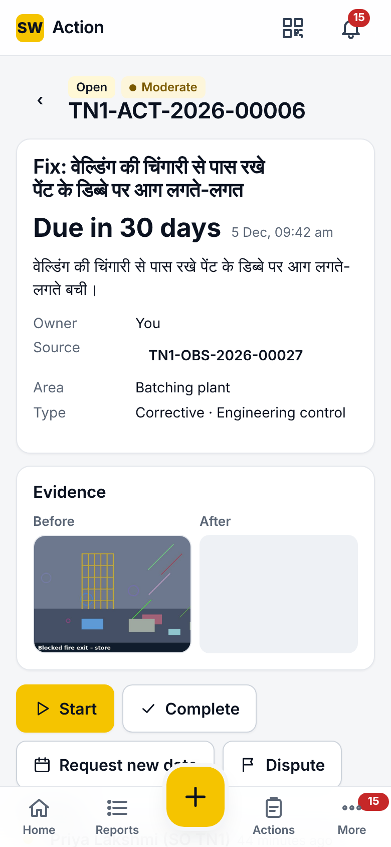
Actions
Actions list
Tabs: Mine; To verify for verifiers; Department
Filters: open only, completed awaiting verification; search by case, title, owner
Order: overdue first
Action page
Status and band, title, due date (Due in N days, overdue in red)
Owner, source report, area, type and control level, interim control and review time
Evidence: before and after photos
Timeline and comments
Buttons
Start · Complete · Request new date · Dispute
Statuses
Open, In progress, Completed (awaiting verification), Verified, Reopened, Disputed, Cancelled
Notes:
Owners work from the Actions list, overdue first. The action page carries everything they need, including the interim control agreed at triage and the before photo.

Slide 13
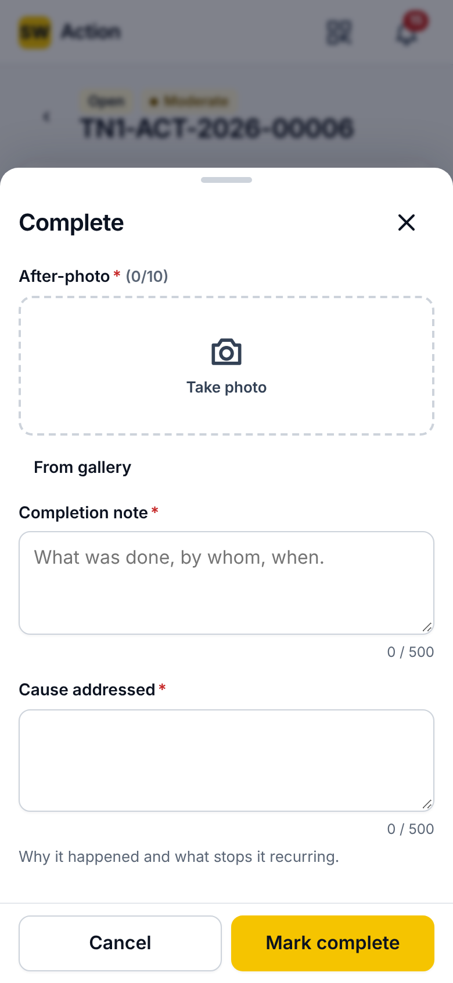
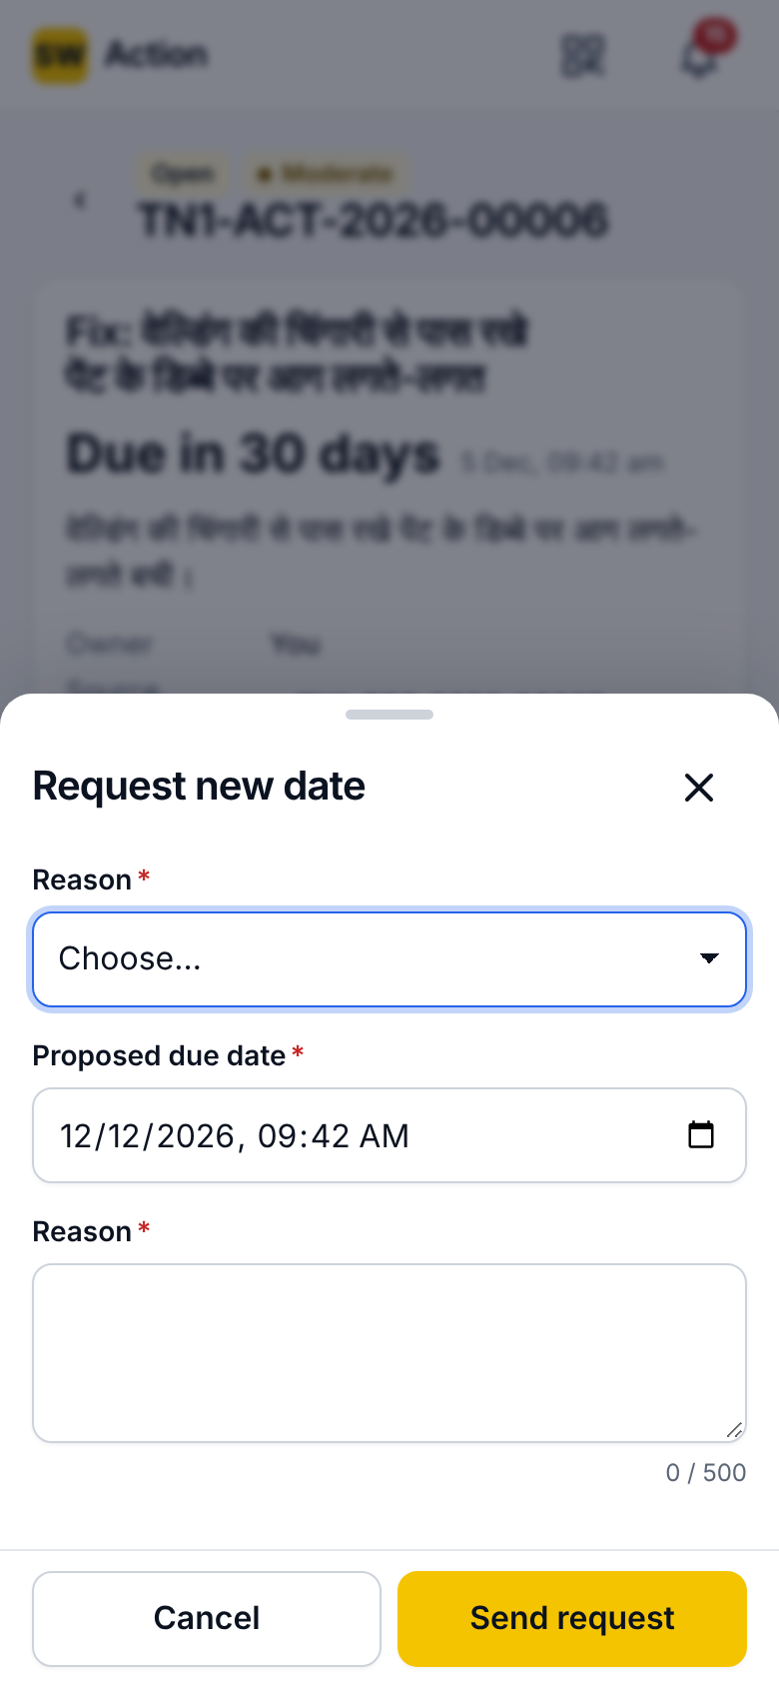
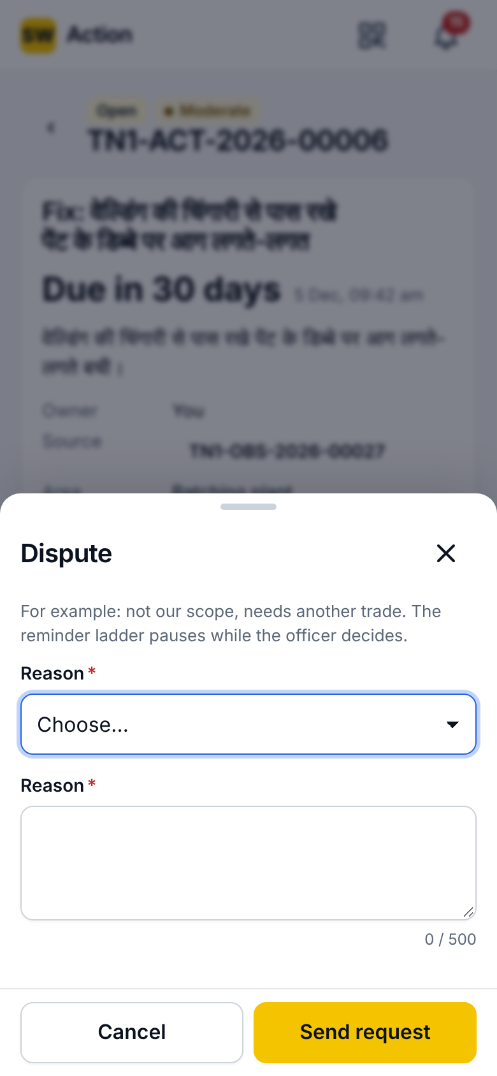
Complete, request a new date, dispute
Complete
What was done, cause addressed
After-photo required (the fix is refused without it)
Then the verifier is notified
Request new date
Proposed date, in the future only, and a reason
The officer decides; the third request goes to the site head
Approval moves the due date; refusal keeps it
Dispute
Reason, e.g. not our scope, needs another trade
The reminder ladder pauses (3 days by default)
Approving reassigns the action to a new owner
Notes:
Three sheets. Complete needs an after-photo and the cause addressed. Request new date and Dispute both go to the officer; a dispute pauses reminders while it is decided, and the third date request escalates to the site head.

Slide 14
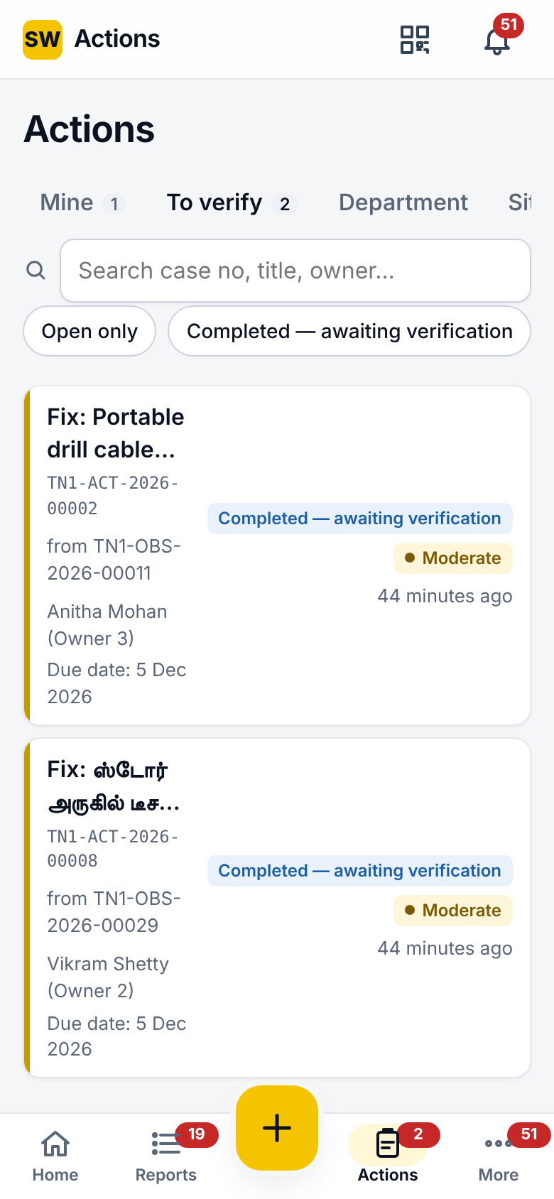
Verification and closure
To verify
Completed actions at the verifier's sites, never their own
Compare before and after photos side by side
Result
Effective: the action is verified
Not effective: with a reason; the action reopens to the owner
Photo: an optional verification photo
Closure
When every action on a report is verified, the report closes
Closure summary on the report; the reporter is notified
Verification SLA reminder if a completed action waits too long
Notes:
Verification is by a different person, by design. Effective closes the action; not effective sends it back with a reason. When the last action is verified, the report closes and the reporter sees it.

Slide 15
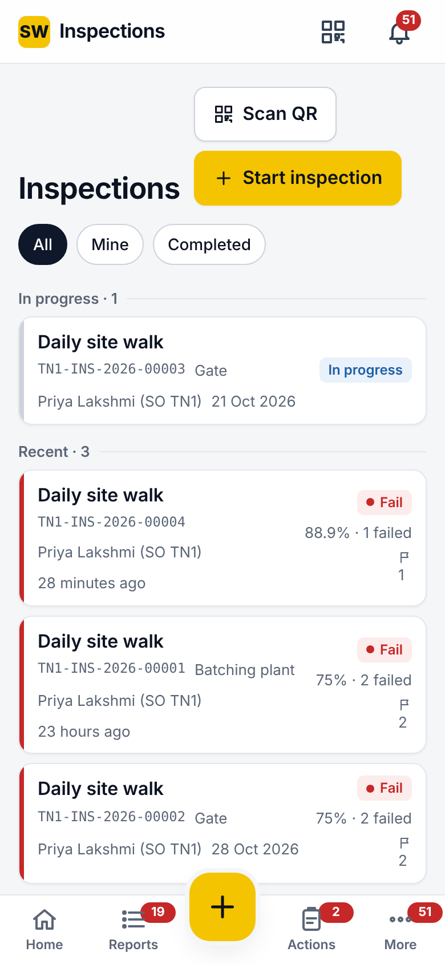
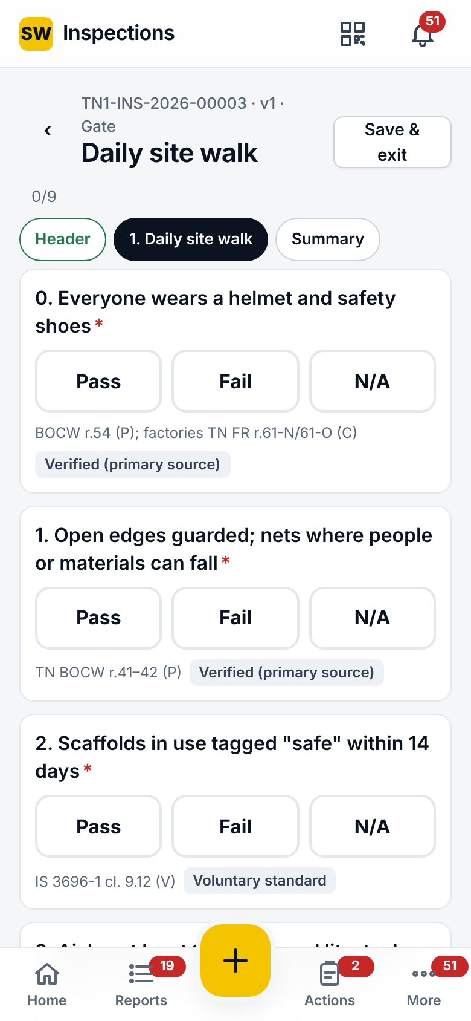
Inspections
List
All, Mine, Completed; Scan QR; Start inspection
Statuses: Scheduled, In progress, Completed, Missed, Reopened, Cancelled, Closed
Run
Template, site, area or equipment; header fields asked once
Sections (some repeatable, e.g. per scaffold bay)
Answers: pass / fail / N/A, number with unit, text, date, single or multiple choice, photo, signature
On a Fail
Photo on fail, note on fail, action on fail (draft with owner and interim control)
Submit is blocked while a required action is missing
Finish
Signature on screen; score excludes N/A; pass mark and any-fail rule
Report link (5-minute signed link) for a new tab
Notes:
Inspections use the same loop. A checklist run collects answers of eight types; a fail can demand a photo, a note and a corrective action; the inspector signs; the run is scored against its pass mark.

Slide 16
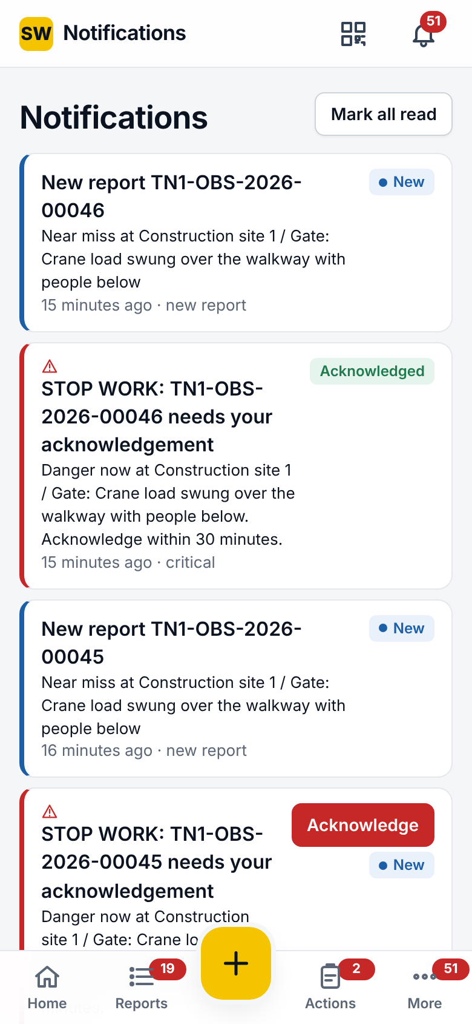
Notifications and the danger-now alert
Inbox
New pill until read; Mark all read; tap to open the record
Critical items carry Acknowledge; acknowledged shown afterwards
Reports
New report, STOP WORK alert and repeat, question about your report, reply, closed, reviewed, reopened, escalated
Actions
Assigned, due soon, due today, overdue, ready to verify, verified, reopened, cancelled, reassigned, date change requested, dispute raised, your request decided, waits for verification
Site and system
Reports waiting for triage, triage overdue, inspection due, missed, submitted
Daily and weekly digests, authenticator reset
Channels
In app, push and email; quiet hours and a daily push cap, which Extreme alerts ignore
Notes:
Every event in the loop can notify someone. Danger-now alerts are critical: they bypass quiet hours and must be acknowledged within the target, or they repeat and escalate.

Slide 17
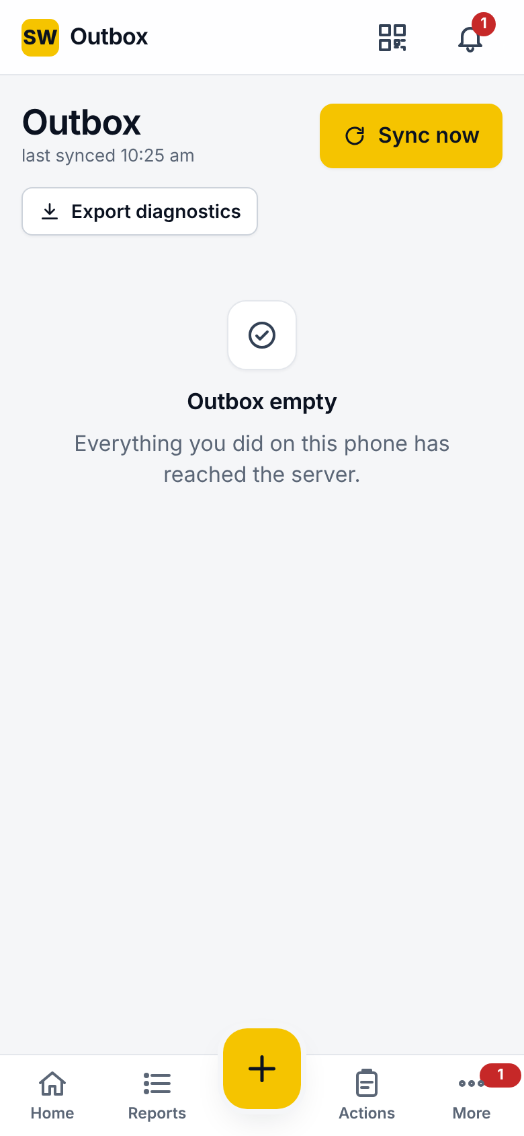
Outbox and working offline
What is kept
New reports, comments and replies, triage decisions, new actions, start, complete, verify, requests, comments; photos with their fingerprints
Item states
Pending, sending, synced, failed (rejected by the server), conflict (someone changed the record first)
Buttons
Sync now: send everything at once
Retry failed: after fixing the cause
Fix and resend: loads a rejected report back into the form
Export diagnostics: for support
Clear synced: tidy the list
How retries work
Back-off after a failed send: 5 s, 15 s, 1 min, 5 min, 15 min, then hourly
Sent at once when signal returns or the app reopens
Every page is cached after sign-in, so all screens open offline
Notes:
The Outbox is the phone's memory. Nothing is lost without signal; failed items say why; a rejected report can be fixed and resent.

Slide 18
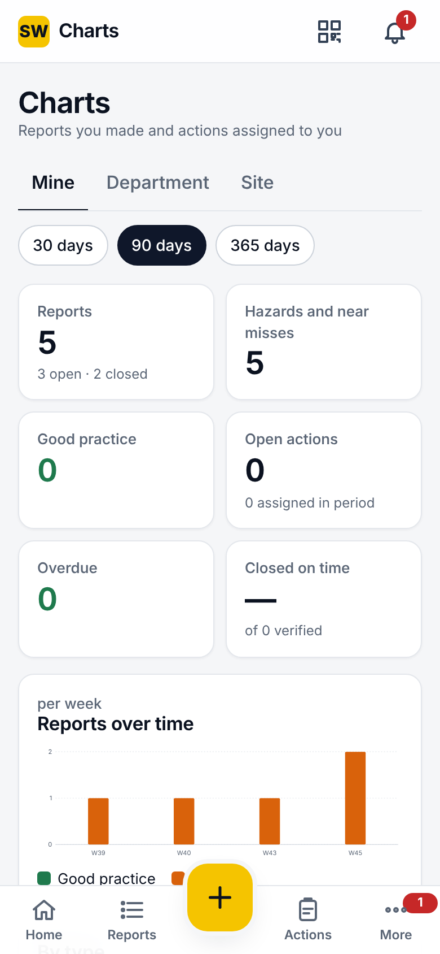
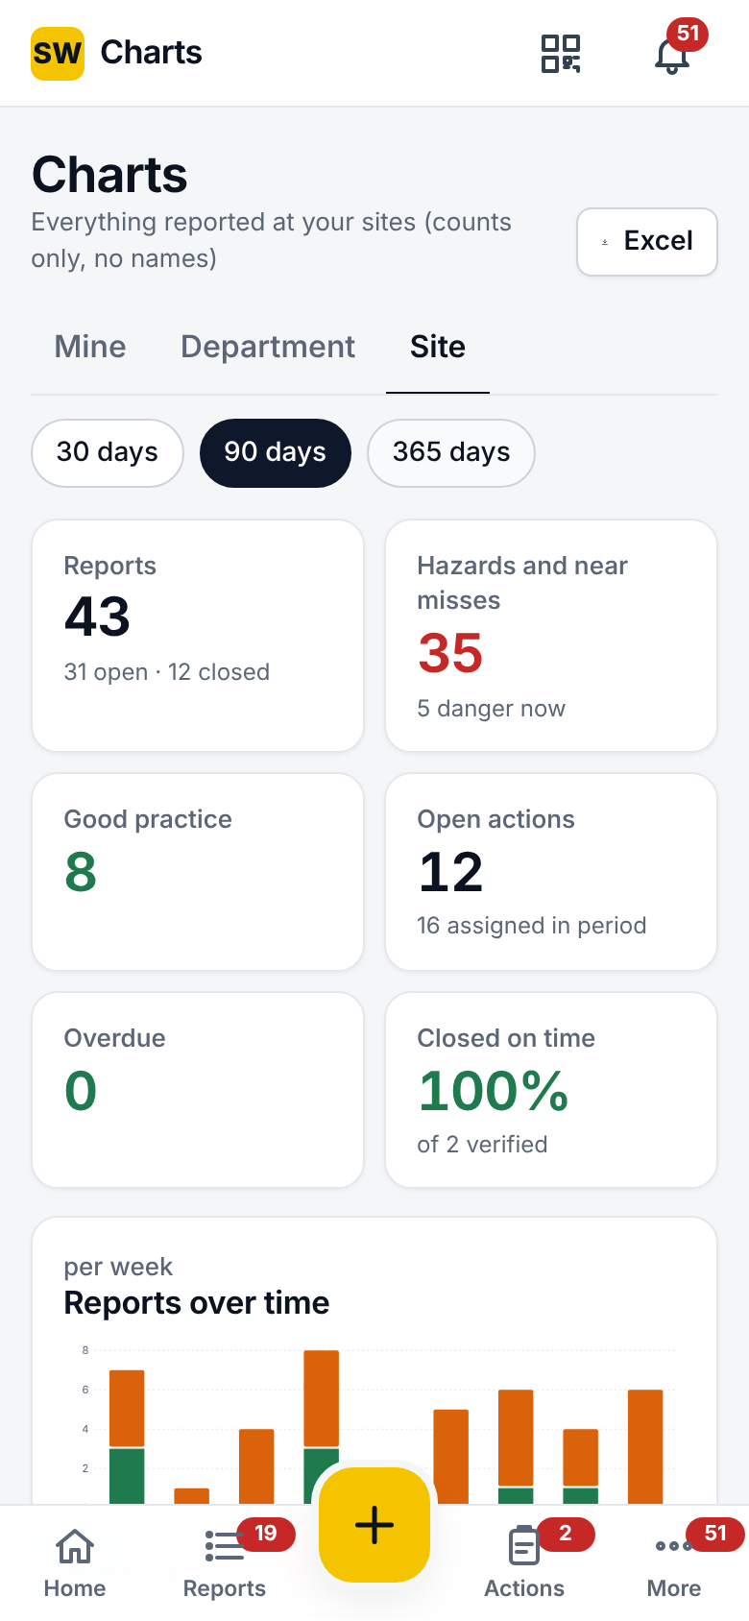
Charts
Levels and periods
Mine, Department (if you have one), Site; a site picker for people at several sites
Last 30, 90 or 365 days
Tiles
Reports (open/closed), hazards and near misses (danger-now count), good practice
Open actions (assigned), overdue, on-time closure % (verified)
Charts
Trend per week or month
By type, by risk band, by category, report status, action status
Site level adds the department table
Export
Officers: Full report as an Excel workbook (Summary, Reports, Actions, Departments), downloaded or shared
Connection
Charts need the server; a notice shows when figures could not be refreshed
Notes:
Charts give everyone the same picture at three levels. Officers can take the full Excel report from the phone and share it.

Slide 19
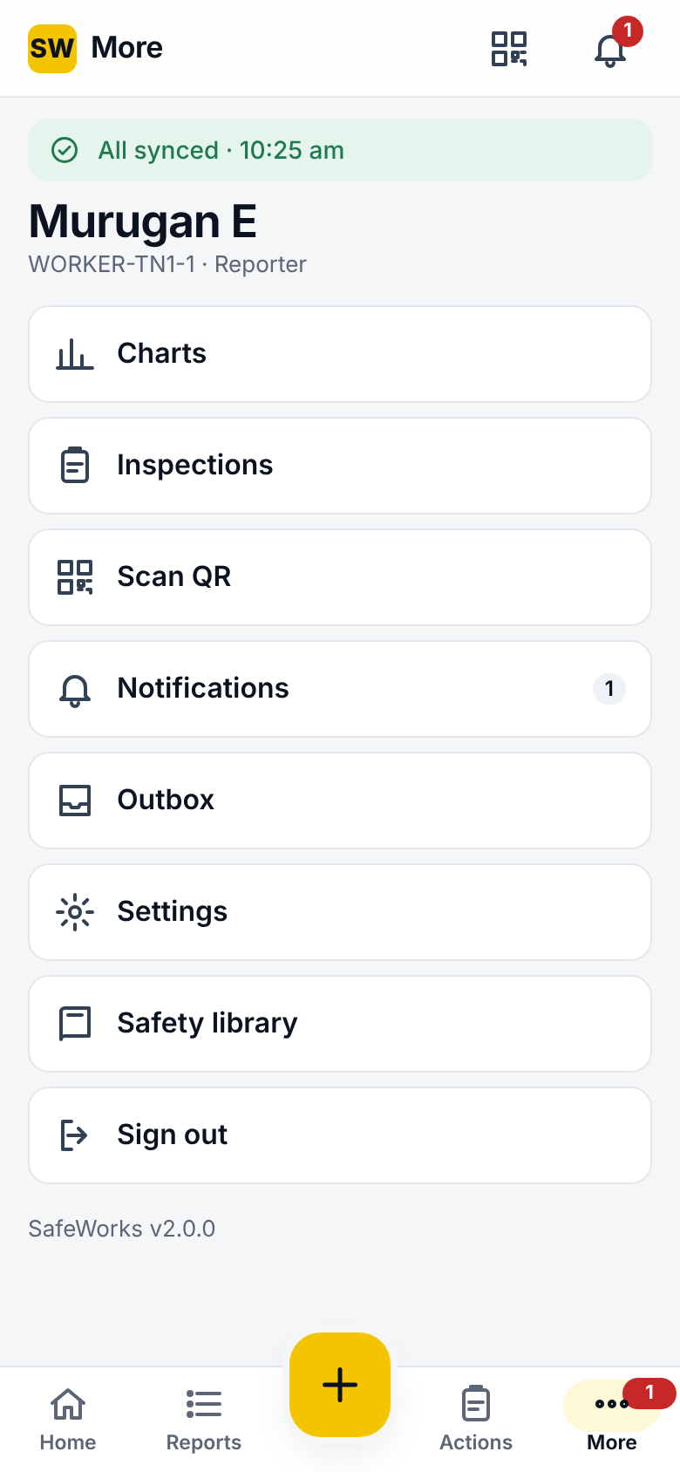
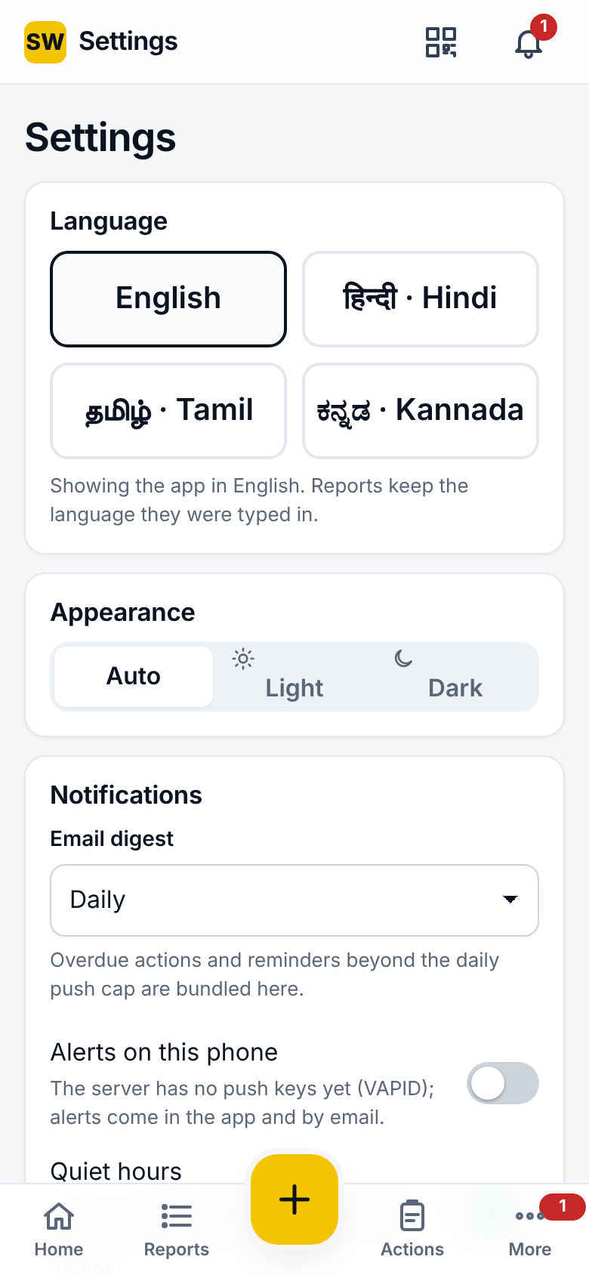
More and Settings
More
Inspections, Charts, Notifications, Outbox, Settings
Scan QR, Safety library, Report a problem, Sign out
Settings
Language: English, Hindi, Tamil, Kannada; saved to your account
Appearance: Auto, Light, Dark
Email digest: Daily, Weekly, Off
Quiet hours: no non-critical pushes at night; stop-work alerts still come
Push notifications: enable in the browser where available
Privacy notice: read and acknowledge the current version
Android app
Server address screen, hardware back button, installable from the store build
Notes:
Settings are personal and follow the account: the language chosen here is the language of the console and of emails too.

Slide 20
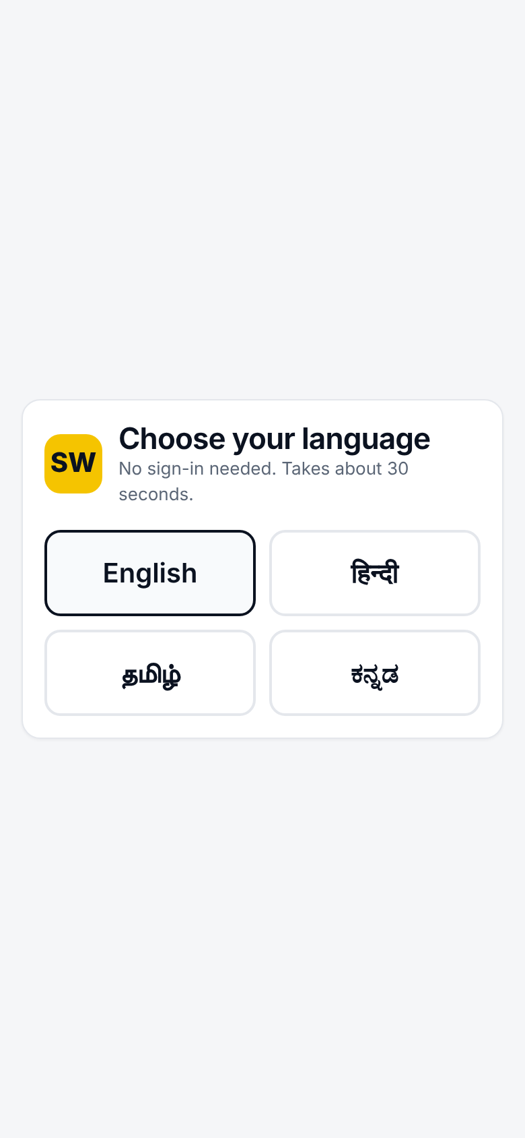
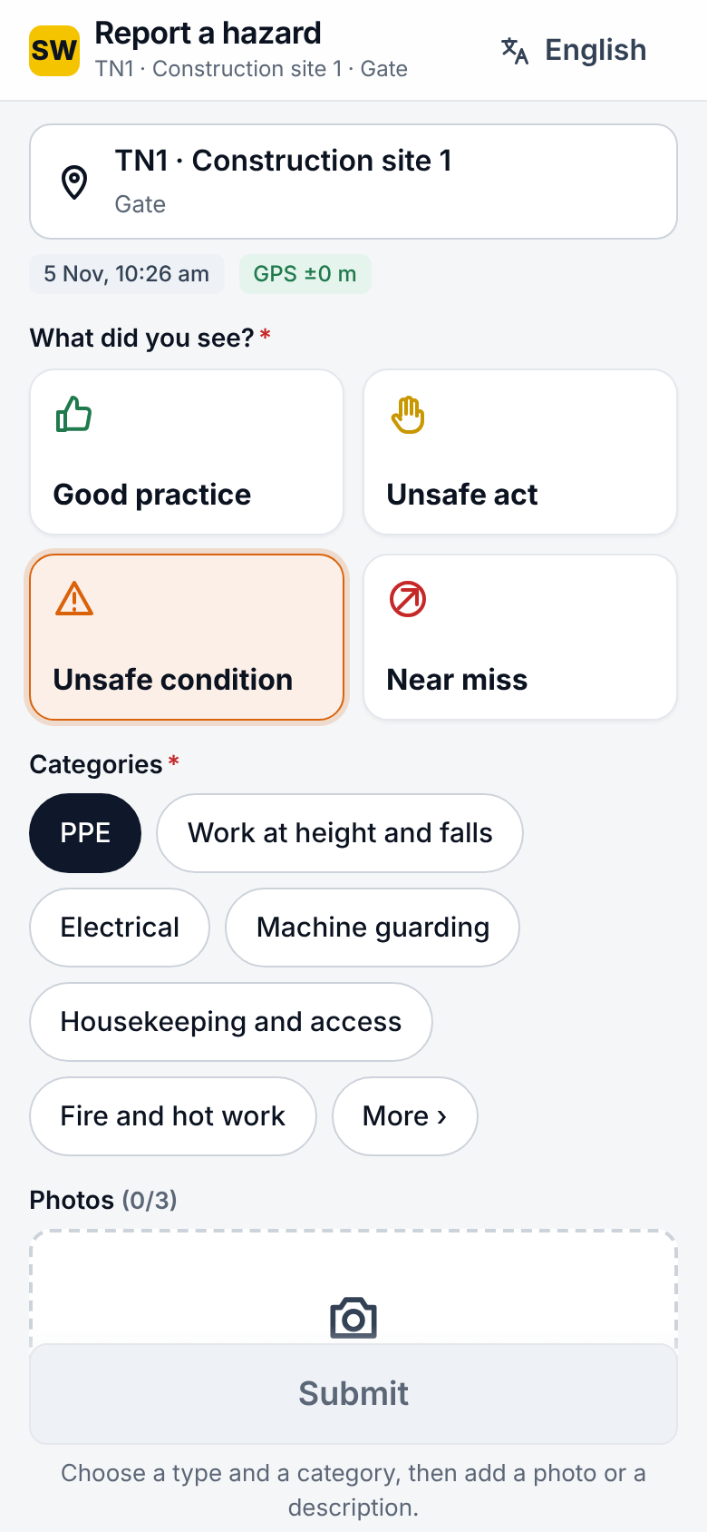
QR form: reporting without an account
Steps
Scan the poster at the area or equipment
Choose a language (4), the type, categories
Up to 3 photos, description, Fixed on the spot, Danger now
Identity
Anonymous by default; or give a name and phone, seen by the site safety team only
Privacy line names the company
After sending
Case number and a private status link to follow progress
Report another
Protection
Rate limits per poster and per address; honeypot field; 15 MB limit
Posters: A4 or A5, with the four languages; codes can be rotated
Notes:
The QR form needs no account. It is deliberately short: language, type, category, photo, description, and the two safety switches. The reporter gets a private link to follow what happens.

Slide 21
Admin console
SW
Dashboard, Attention, three registers, eighteen configuration pages, five oversight pages, and a command menu.
Notes:
The console is for officers, site heads, HSE managers, admins and auditors. The left menu groups Overview, Registers, Configure and Oversight; the top bar has the case search, Go to (Ctrl+K), the site filter, the language and your account.

Slide 22
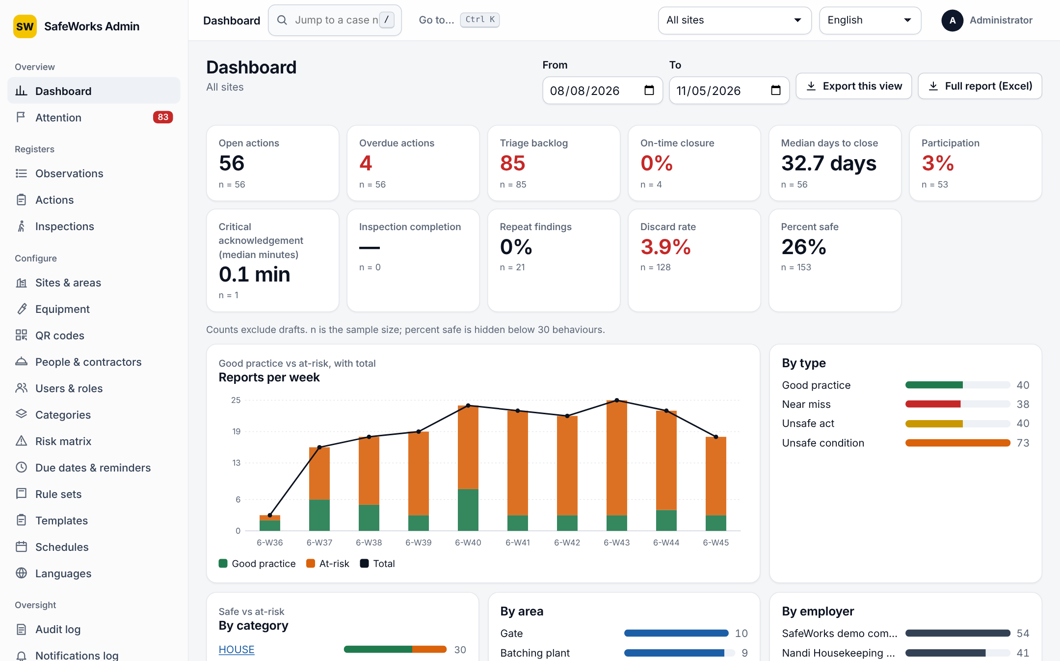
Dashboard
Filters
Site or All sites, From and To dates (swapped if reversed)
KPI tiles
Open actions, Overdue actions, Triage backlog, On-time closure, Median days to close, Participation, Critical acknowledgement (median minutes), Inspection completion, Repeat findings, Discard rate, Percent safe (hidden below 30 behaviours)
Charts
Reports per week (good vs at-risk, with total)
By type, by category (safe vs at-risk), by area, by employer, by department
Exports
Export this view (CSV); Full report (Excel): Summary, Reports, Actions, Departments
Notes:
The dashboard answers the monthly review's questions in one place. Every tile shows n, the sample size, and the KPIs are defined in the hover hints.

Slide 23
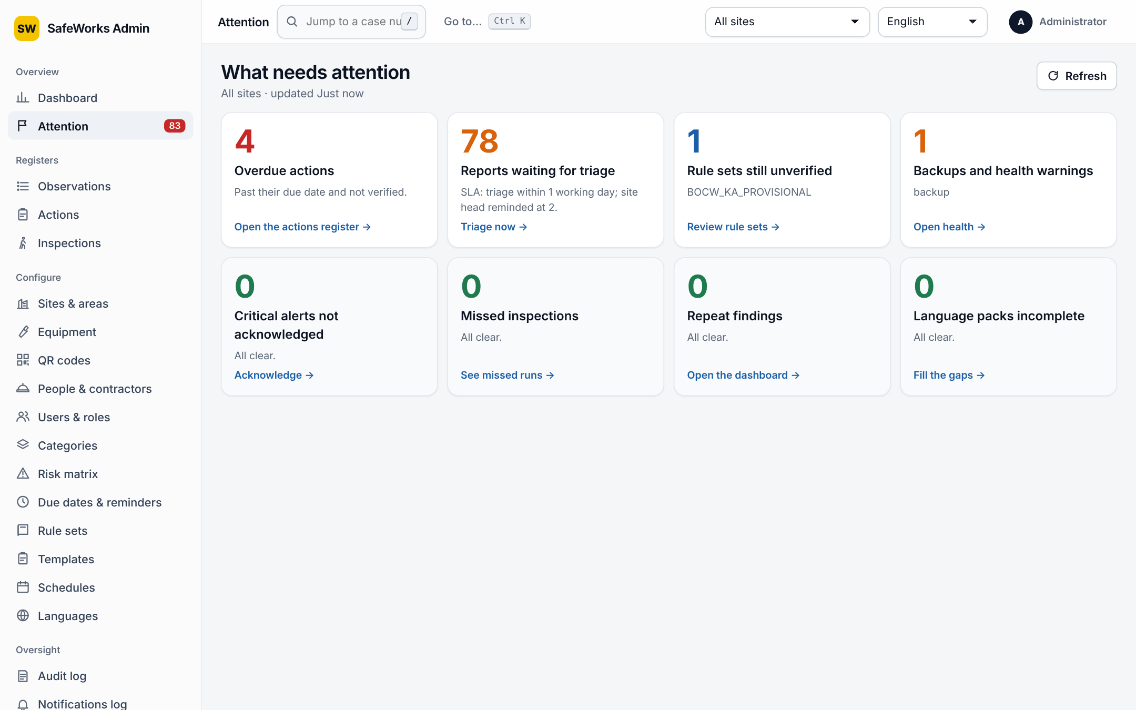
Attention board
Cards (each links to the fix)
Reports waiting for triage (with the SLA)
Critical alerts not acknowledged
Overdue actions
Missed inspections
Repeat findings
Rule sets still unverified
Language packs incomplete
Backups and health warnings
Behaviour
Scoped by the site filter; Refresh; counts in the sidebar badge
All clear cards stay visible so the list is complete
Notes:
Managers start the day here. Each card is a count and a link to the page where it is handled.

Slide 24
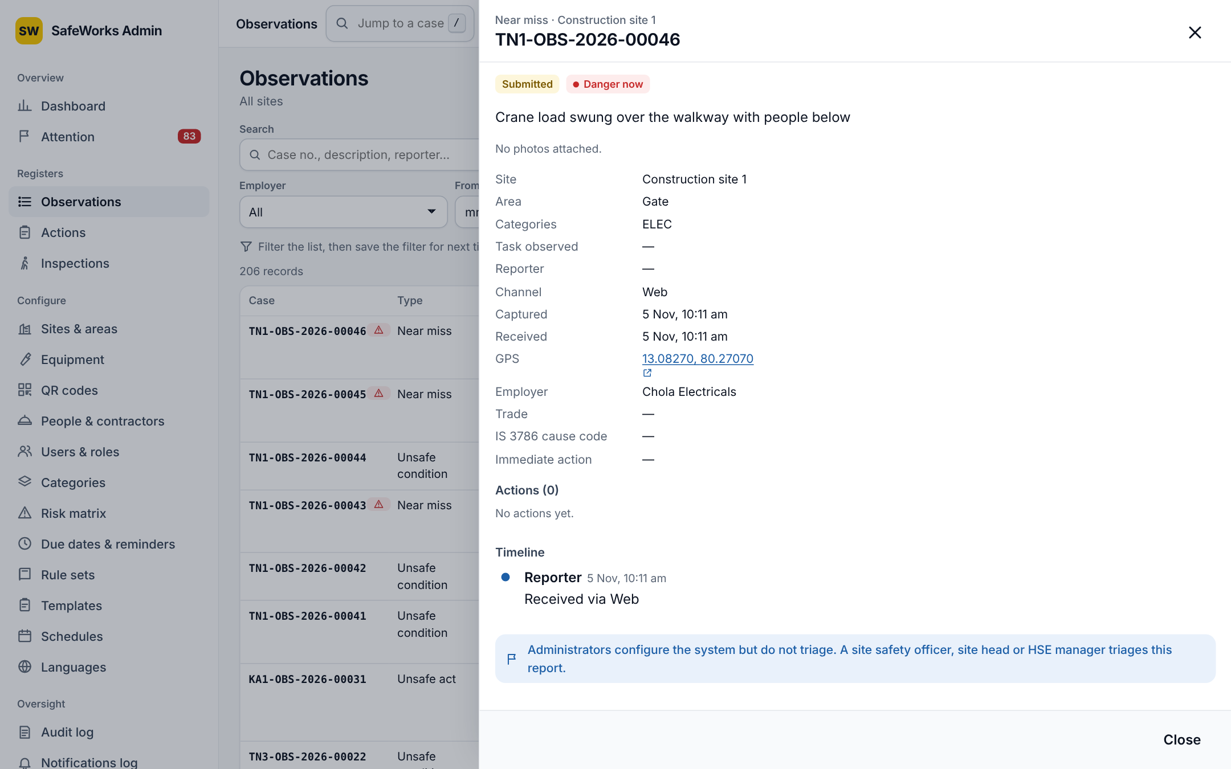
Registers: Observations, Actions, Inspections
Filters
Search (case, description, reporter), status, risk, type, category, employer, from and to; saved filters with names; count line
Rows and side panel
Case, type, description with category and area, risk, status, received, reporter, actions
Click a row: details, photos, timeline, actions; triage from the console
Finding things
Case search in the top bar jumps to the case
Keyboard: g d/t/o/a/i/u/s, / search, j k Enter Esc, ? help
Go to… (Ctrl+K / ⌘K) for pages and case numbers
Exports
CSV and Excel per register with the current filters; officers and above, own sites; audited
Notes:
Three registers share the same filters, saved filters and export buttons. Rows open a side panel so the list stays in view.

Slide 25
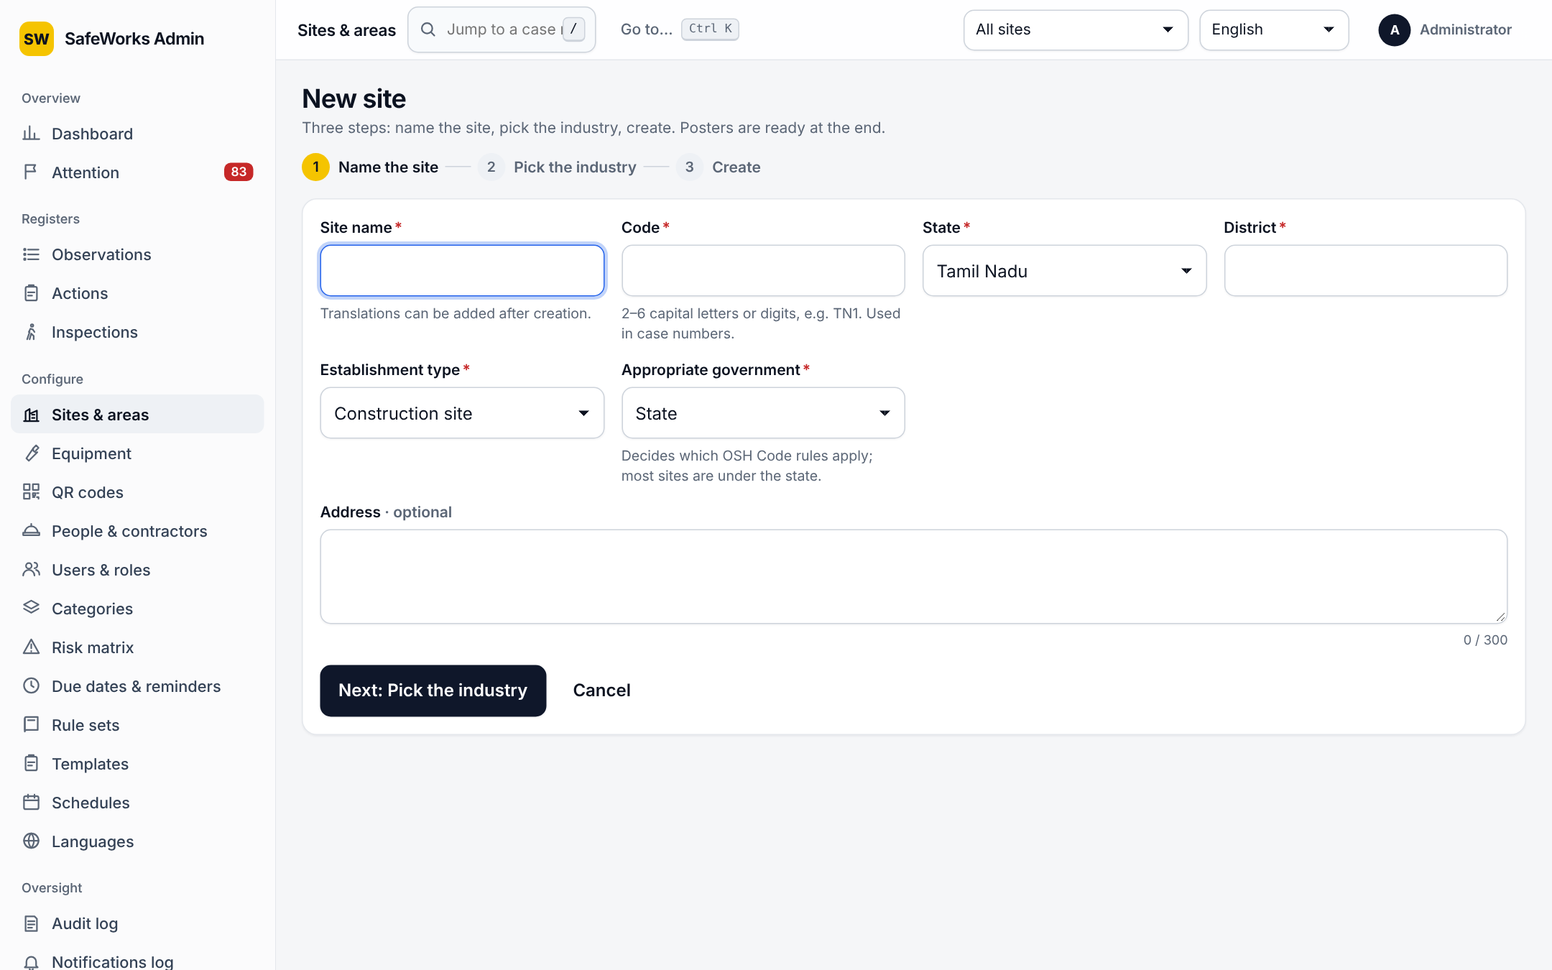
Sites and areas
New site wizard
Name and code (2–6 capitals or digits, used in case numbers), establishment type, state, district, address, appropriate government
Pick the industry: preview of default areas, hazards, templates and categories
Create: areas, templates, categories and printable QR posters are ready
Site details
Rule set with effective-from date, risk matrix version, worker count, site head, hazardous process (MSIHC timers)
Latitude, longitude, geofence radius (flags, never blocks)
Working calendar: weekly off, shift start and end
Deactivate with a reason (records kept)
Areas
Tree with codes and types; drag to reorder; add, rename, remove (with reason)
Notes:
A site goes live in three steps. Afterwards, every detail that drives the rules lives on the site: rule set, matrix version, calendar, geofence.

Slide 26
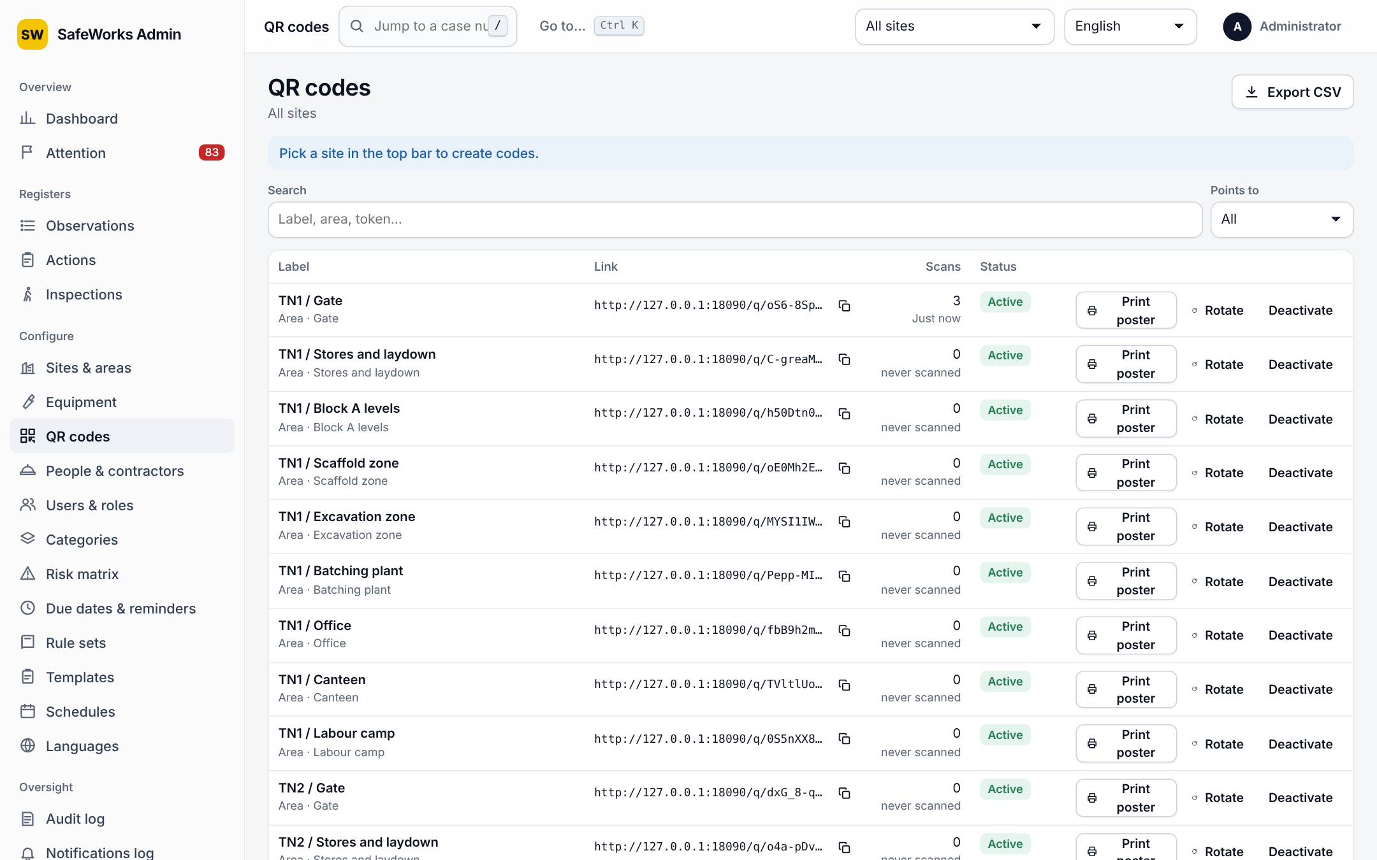
Equipment and QR codes
Equipment (per site)
Class, tag number, make and model, serial, SWL (kg), owner employer, area
Next exam due: overdue shows DO NOT USE on scan, offline too
Status and reason (retired), CSV import
QR codes
Points to: site, area or equipment; label printed under the code
Link, scan count, never scanned
Rotate: the old code answers 410 Gone; reason recorded
Print or open the poster: A4 or A5, with the languages on it
Notes:
QR codes are the reporting points. Equipment codes add a safety check: scanning an item past its examination date shows DO NOT USE.

Slide 27
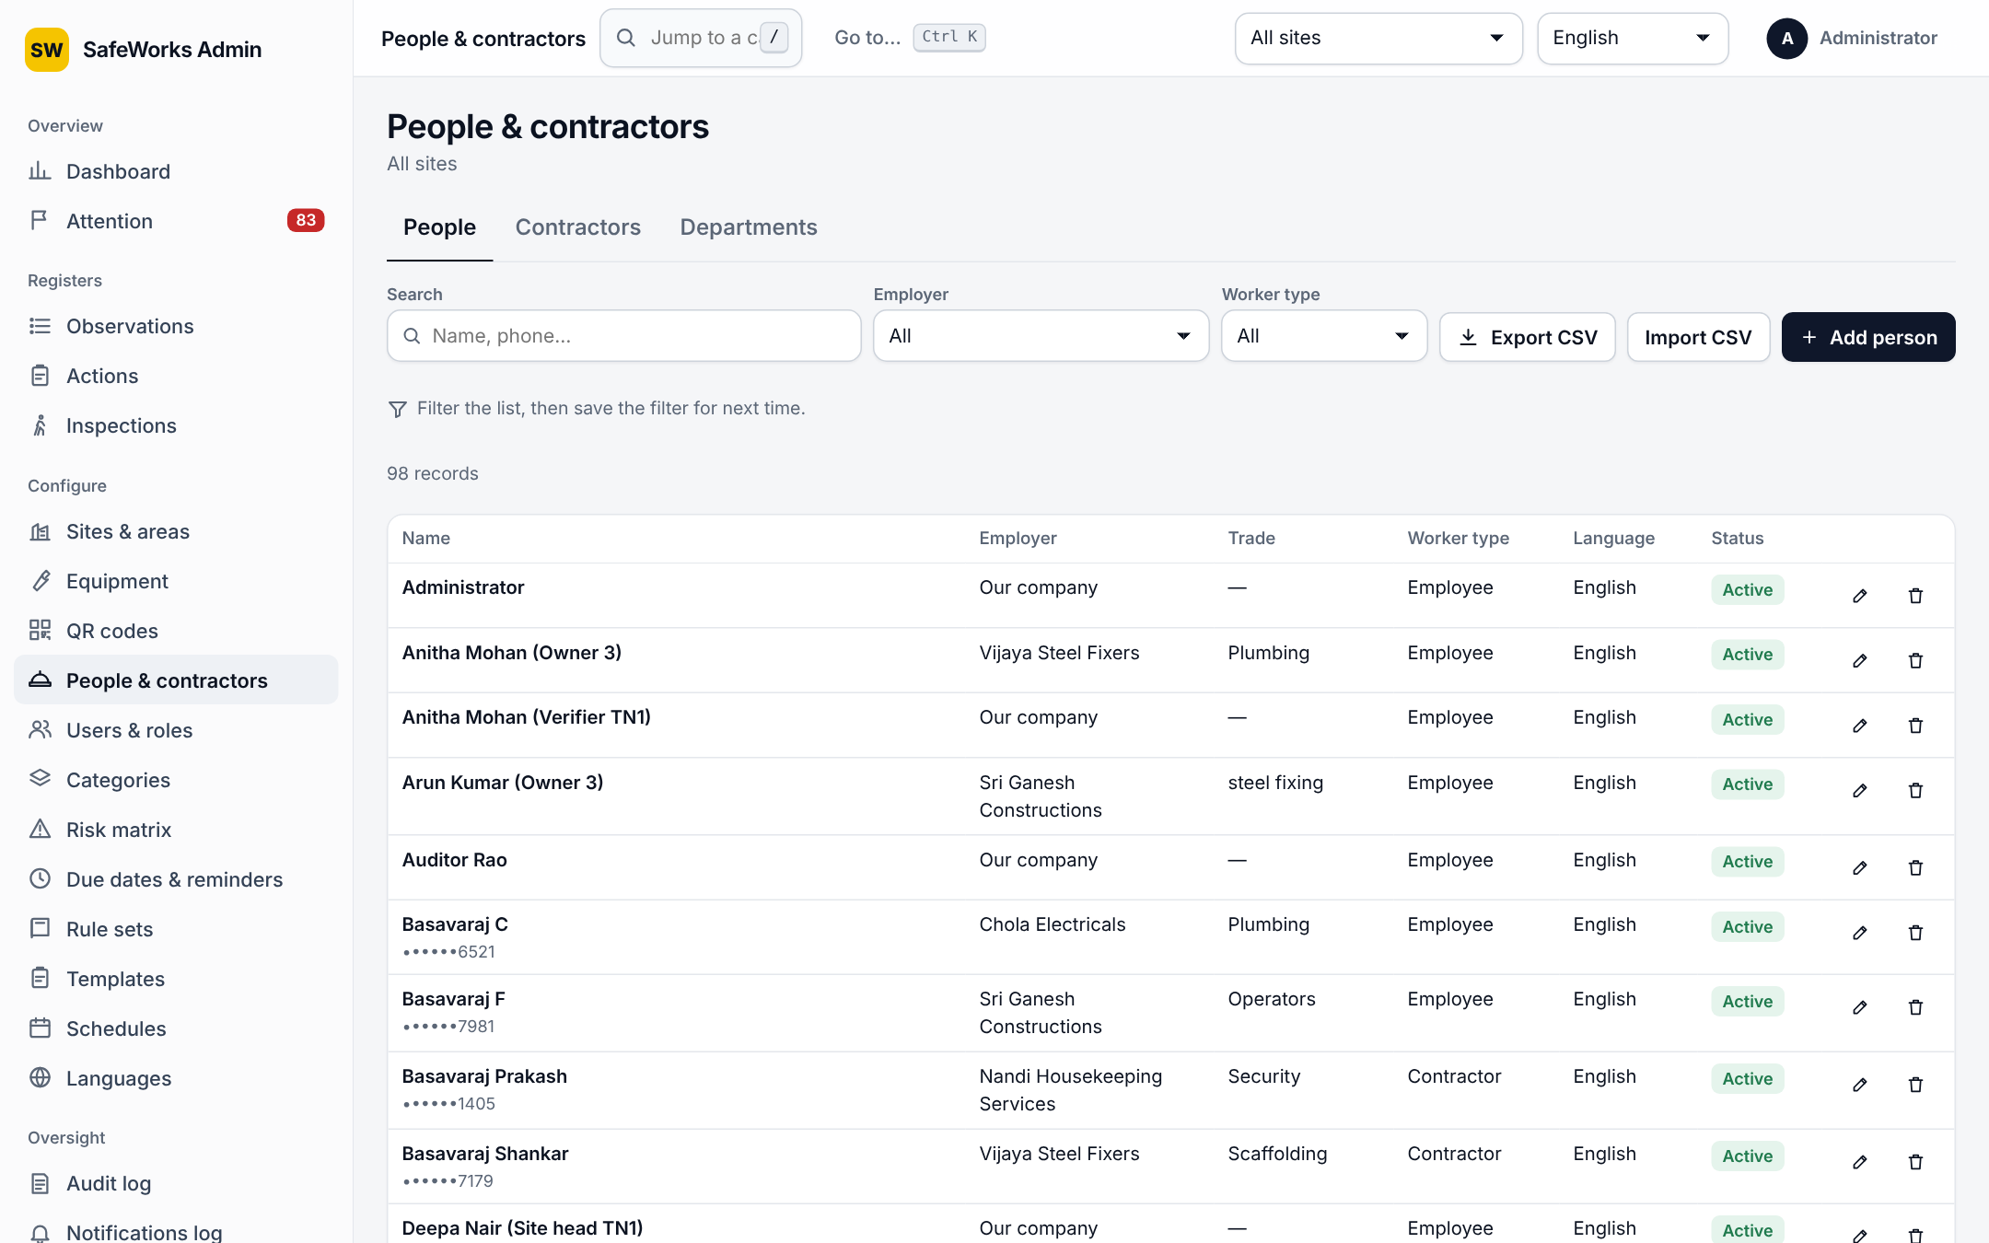
People, contractors and departments
People (no login)
Name, phone (stored encrypted, shown masked), employer, trade, worker type, language
Used for names on reports and on-behalf entries; CSV import skips bad rows with a reason
Contractors
Name, contact, email, trades, registration number, sub-contractor of, sites where they work
Named as employer involved on reports and actions
Departments
One company-wide list; each user belongs to one
Reports and actions count per department on the dashboard and in Charts
Notes:
People and contractors give the reports accurate names and employers without creating logins. Departments give accountability by team.

Slide 28
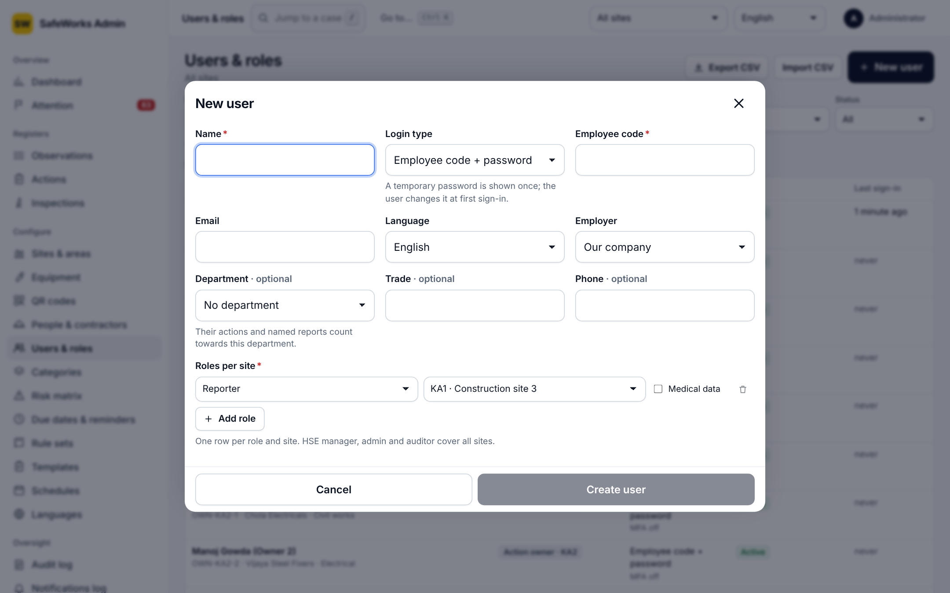
Users and roles
New user
Name, login type: employee code + password, email + password + authenticator, or enrolment code
Employer, department, trade, phone, language
Roles: per site (reporter, action owner, verifier, safety officer, site head) or company-wide (HSE manager, admin, auditor); medical data flag; expiry per role
Auditor accounts must have an expiry date
On a user
Issue enrolment code (24 h), reset password (temporary, must change), reset authenticator, unlock, deactivate with Undo, change roles
Officers and site heads only for people below them at their own sites
Import
CSV with name, code, email, language, employer, department, trade, phone, role, site
Notes:
Users carry roles per site. Managers below the admin can only act on people below them, which keeps a safety officer from taking over a site head's account.

Slide 29
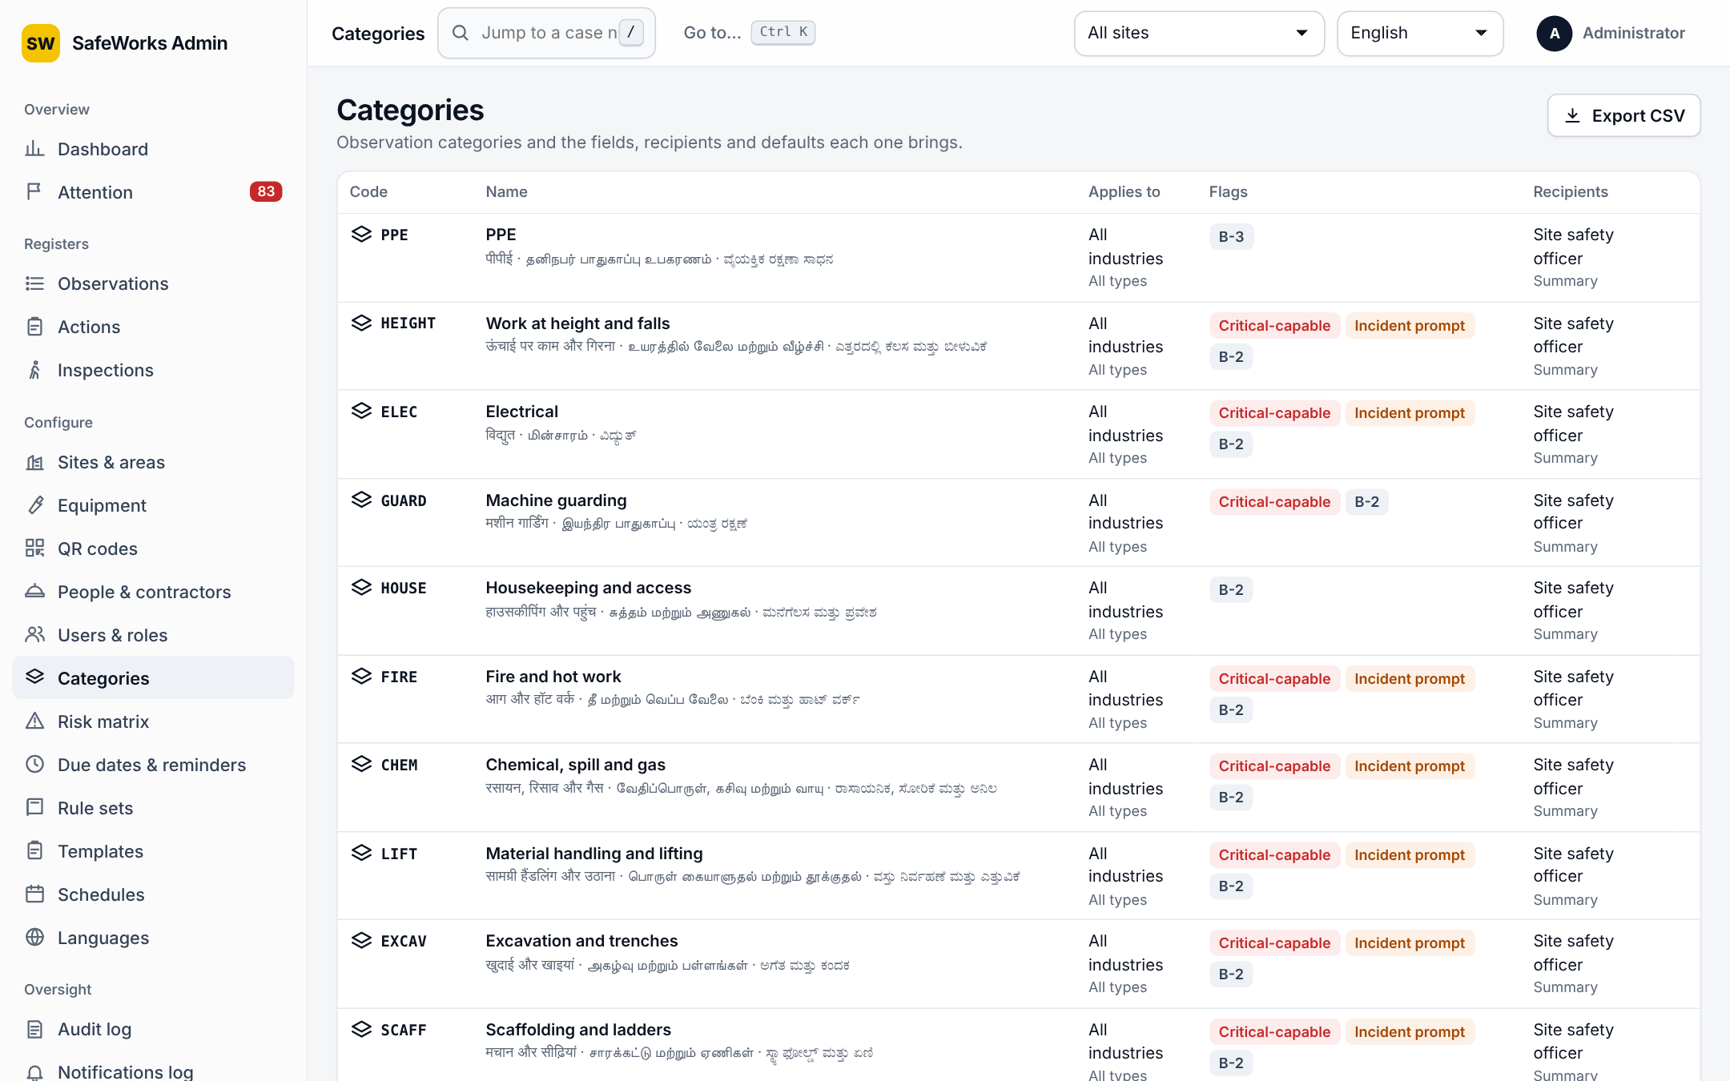
Categories and rule sets
Category
Code, name in four languages, parent, icon
Applies to: industries and report types (empty = all)
Flags: critical-capable (may be Extreme and raise the stop-work alert), incident prompt text
Recipients: roles notified on a new report
Extra fields: typed, optionally required, asked on the phone and checked by the server
IS 3786 default class, email detail
Rule sets
Statutory timer packs per site (for example BOCW rules), draft until a reviewer verifies them
Shown when a report is escalated to an incident; effective-from date
Notes:
Categories carry behaviour, not just a name: who is told, what extra details are asked, and whether the category can be critical.

Slide 30
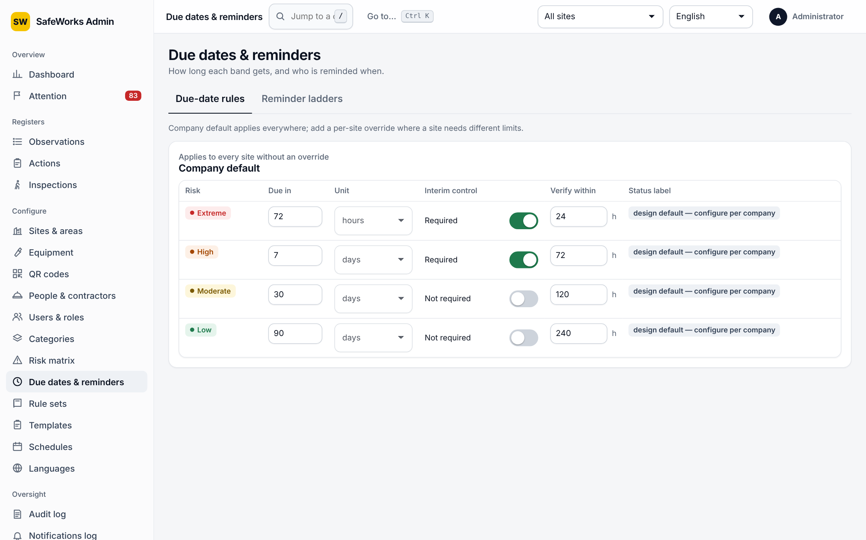
Risk matrix, due dates and reminders
Risk matrix
Versions: new draft, edit bands (min, max, colour, response text), activate; records keep the version they were rated with
Due-date rules per band
Days to due date; interim control required; interim review hours
Defaults: Low 90 days, Moderate 30, High 7 with interim control, Extreme 72 hours with interim control this shift
Reminder ladder
Steps before and after the due date: who is told (owner, officer, site head) and how
Extreme actions ignore quiet hours and the push cap
Dispute pause days and date-change requests before the site head come from Settings
Notes:
The matrix decides the band; the band decides the due date and the reminders. Everything here is versioned or logged, so a decision can always be explained.

Slide 31
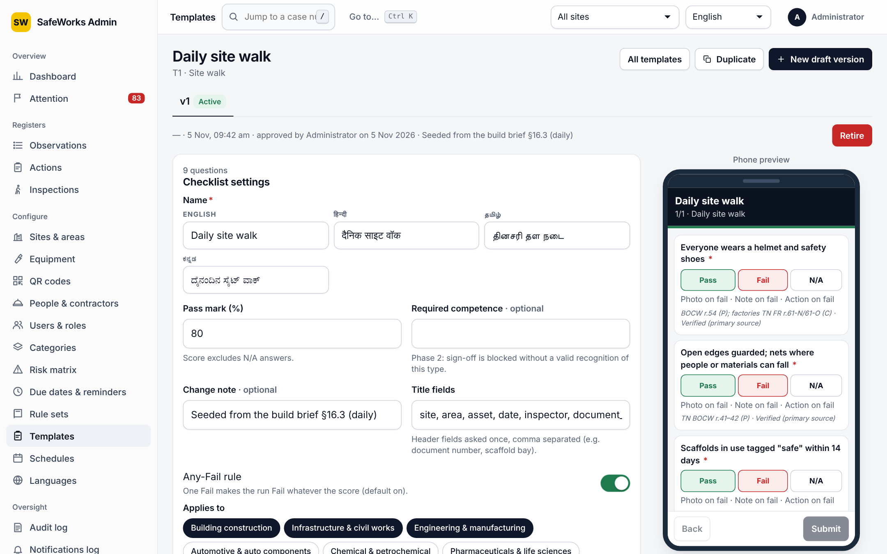
Templates and schedules
Checklist settings
Name in four languages, pass mark %, any-fail rule, required competence, title fields, applies to sites/industries, change note
Sections and questions
Sections, repeatable with a label
Question: code, text, 8 answer types, guidance, responses with flag and score, unit, min, max, required
Photo, note and action on fail
Versions
Draft, in review, active, retired; approved by a second person
Schedules
Template, place, every N days, weeks or months; assignee user or role
Lead days; grace hours, then Missed; next due
Notes:
The builder shows a live phone preview while you work. Approval by a second person makes checklists auditable; schedules make them happen on time.

Slide 32
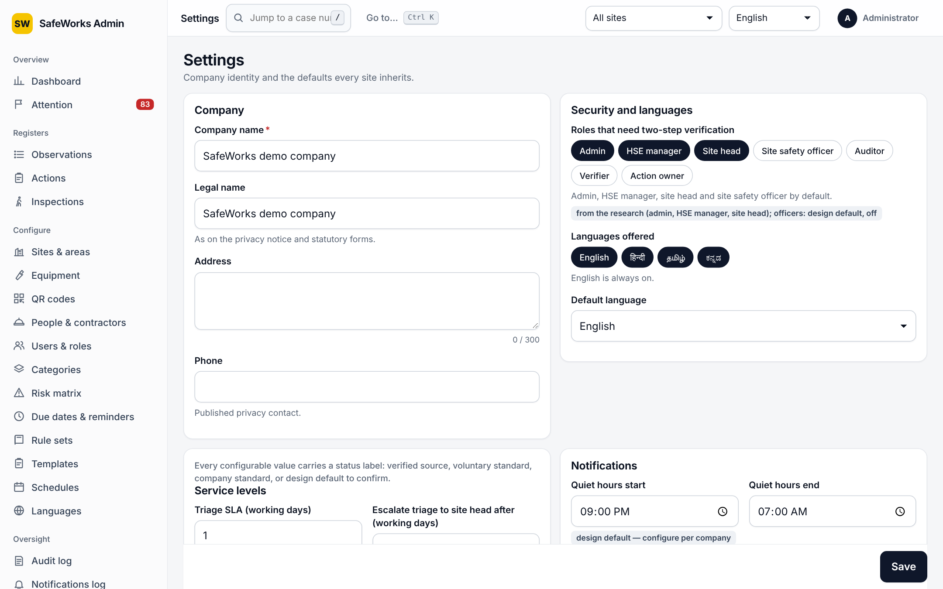
Languages and Settings
Languages
Completeness per pack (English, Hindi, Tamil, Kannada); edit any wording as an override
Company
Company name, legal name, address, privacy contact phone
Security and languages
Roles that need two-step sign-in; languages offered; default language
Service levels
Triage SLA 1 working day; escalate at 2; critical acknowledgement 30 min; date-change requests before the site head 3; dispute pause 3 days
Notifications, duplicates, photos
Quiet hours 21:00–07:00; daily push cap 5
Duplicate window 24 h, GPS radius 30 m
Max edge 1,600 px, JPEG quality 0.8; photos per record 10, per QR form 3; voice note 60 s
Notes:
Settings are the company's defaults; every site inherits them. The values shown are the defaults the system ships with.

Slide 33
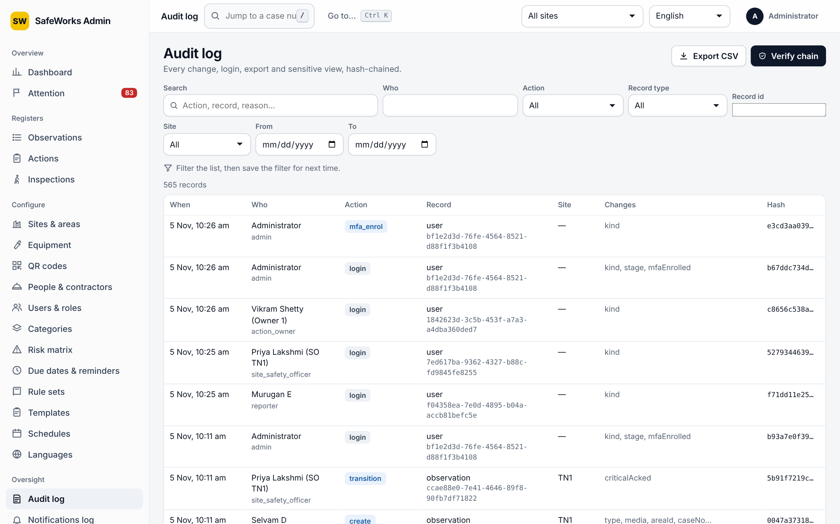
Oversight pages
Audit log
Every change, sign-in, export and sensitive view; filter by actor, record, action, dates
Diff view of what changed; Verify chain checks the tamper-evident hash chain
Notifications log
Every delivery: channel, status, attempts, errors
Health
Backups, jobs, queues and warnings; also on the attention board
Privacy
Notice versions in four languages; workers acknowledge on the phone
Retention
Policy per record type (years, end action), legal holds, dry run before anything is removed
Notes:
Oversight pages are where auditors live. The audit log is chained, so any tampering shows up in the verify check.

Slide 34
Security options and background jobs
Security
Two-step sign-in for chosen roles; an enrolled authenticator cannot be replaced with a password alone
10 wrong passwords lock the account for 15 minutes
Auditors are read-only everywhere and expire
Exports limited to officers and above, for their own sites, and audited
Phone numbers encrypted; anonymous reports sealed
Signed, short-lived links for posters and reports; strict content security headers; CSV formula guard
Jobs that run on their own
Reminder ladder: before and after due dates, escalating
Triage clock: reminds officers, then the site head
Danger-now watcher: repeats and escalates unacknowledged alerts
Inspection scheduler: creates runs, marks Missed
Closure notices: tells reporters when their report closes
Digests: daily and weekly emails
Senders: push and email delivery with retries
Retention: applies policies after a dry run
Notes:
Two lists that are easy to forget in a demo: the security rules that are always on, and the jobs that run without anyone clicking.

Slide 35
Where to go next
SW
User guide and complete reference (Word) · Product walkthrough video · API reference for integrations · Your pilot site, this week.
Notes:
The companion documents carry the same content in more depth: the complete reference for every option, the walkthrough video for training, and the API reference for IT. The next step is the pilot site.

