Slide 1
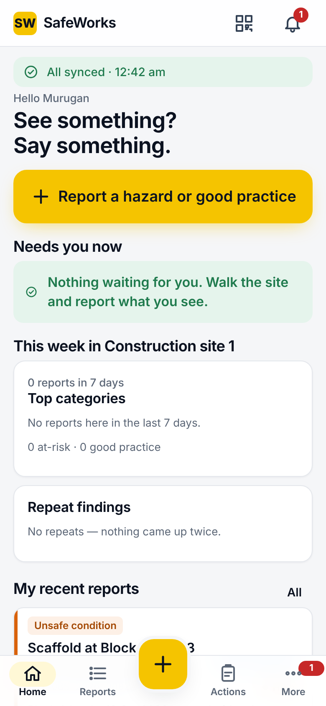
Every hazard noticed. Every fix proven.
SW
SafeWorks
Workplace safety, connected. Report in 30 seconds, close with proof, in four languages.
Client onboarding · November 2026
Notes:
Welcome, and thank you for choosing SafeWorks. Think about the last near miss on your site. Someone saw it. Did it get written down, did someone own the fix, and can you prove today that it was fixed? SafeWorks exists so the answer to all three is always yes. Over the next few minutes I will show you how the platform works, what your teams will do day to day, and how you will measure the difference.

Slide 2




The problem: safety information leaks
Most sites do not lack people who care. They lack a system that holds on to what those people notice. At every hand-off, something is lost.
Lost
Paper cards go missing; photos sit in group chats
Unowned
No single owner and no due date for the fix
Four leaks in the pipeline, shown on the right
Unproven
Fixes are claimed, never independently checked
Late
Audit trails rebuilt by hand, days before the audit
Notes:
Most sites do not lack people who care about safety. They lack a system that holds on to what those people notice. Observations live on paper cards that go missing, and photos sit in group chats. Actions have no single owner and no deadline. When something is fixed, nobody independently checks it, and when the auditor arrives, someone spends days rebuilding the trail from spreadsheets. Every leak in that pipeline is a hazard that can come back.

Slide 3









The solution: one connected safety loop
Report
Triage
Action
Complete
Verify
Closed
Phone app
QR form
Admin console
Workers, owners, officers and verifiers. Works offline and syncs by itself.
Visitors and contract workers scan a poster. No account, four languages, anonymous if they wish.
Registers, dashboards, Excel reports, roles, checklists and the audit log.
Notes:
SafeWorks closes that pipeline into a single loop. Workers report from the phone app, or visitors and contract workers scan a QR poster with no account at all. Safety officers triage and assign. Owners fix and prove it with photos, and an independent verifier confirms it worked. Your managers watch it all live in the admin console. Because the app works offline, a site with patchy signal loses nothing, and because every step is recorded in a tamper-evident audit log, your evidence builds itself as people work.

Slide 4
How it works, in seven steps
1
Sign in
Worker
2
Report
Worker
3
Triage
Safety officer
4
Fix
Action owner
In English, Hindi, Tamil or Kannada
Type, category, photo, submit, in about 30 seconds
Risk score sets the band and the due date; owner assigned
Start, then complete with an after-photo
5
Verify
Verifier
6
Close
SafeWorks
7
Measure
Manager
Effective or not effective, by a different person
Report closes; the reporter sees the result
Dashboards, digests and Excel
Reminders, escalations and danger-now alerts run in the background the whole time.
Notes:
Here is the journey. A worker signs in, in English, Hindi, Tamil or Kannada, and reports in about thirty seconds. A safety officer scores the risk on your matrix, which sets the band and the due date, and assigns an owner. The owner gets reminders, does the work and completes it with an after-photo. A verifier, never the same person, marks it effective. The report closes, and the person who raised it sees that it closed. That visible result is what keeps people reporting. Meanwhile, reminders and escalations run automatically, so nothing goes overdue quietly.

Slide 5
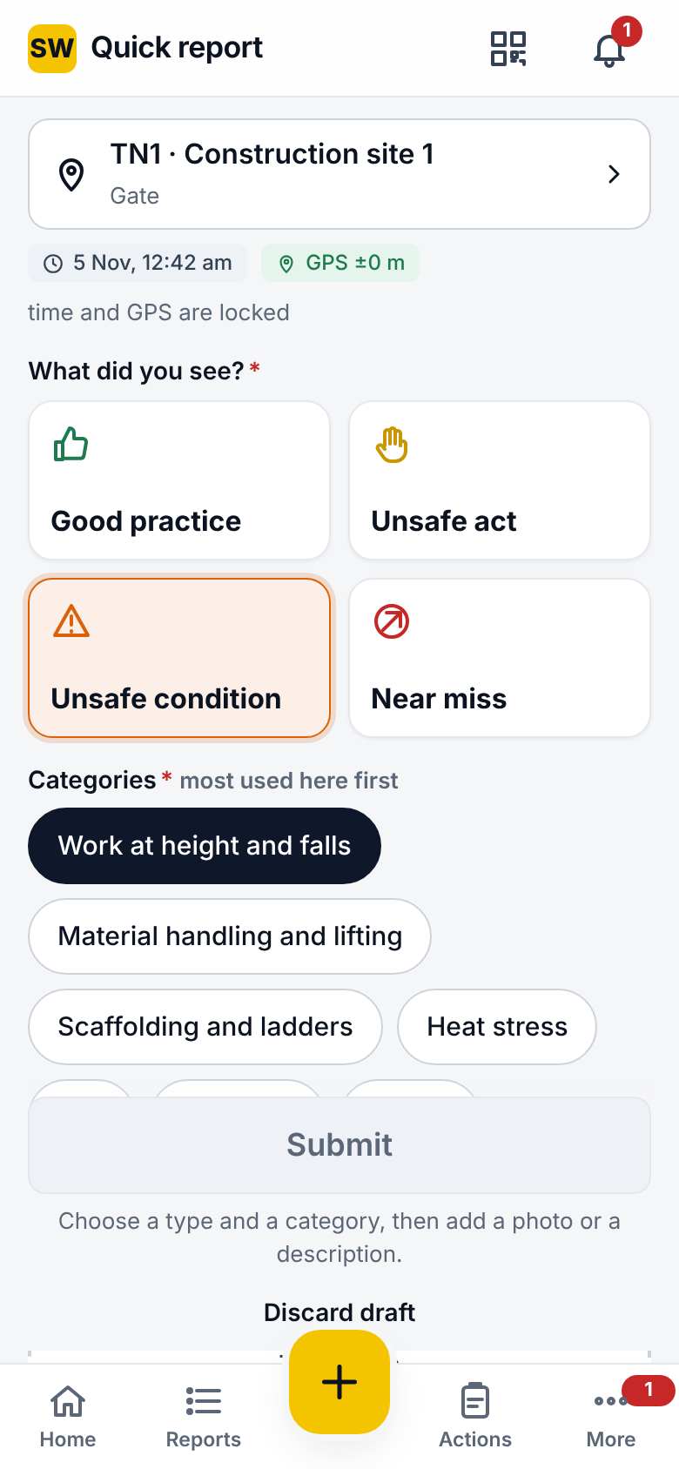




Reporting that people actually use
Four types, including good practice
Not only about blame; safe behaviour is recorded too
Up to 10 photos and voice input
Time and GPS locked at capture
Danger now
Urgent alert to officers, site head and HSE; must be acknowledged
Anonymous and QR options
Report without a name, or without an account
Offline outbox
Saves without signal and sends itself later
Notes:
Reporting has to be faster than not reporting, or people will not do it. One big yellow button, four clear types including good practice, so it is not only about blame, and category chips ordered by what your site sees most. Time and GPS are locked at capture. If someone is in immediate danger, the Danger now switch alerts your officers, site head and HSE managers, and they must acknowledge it. Workers can report anonymously, visitors can scan a QR poster, and with no signal, the report waits in the outbox and sends itself when signal returns.

Slide 6
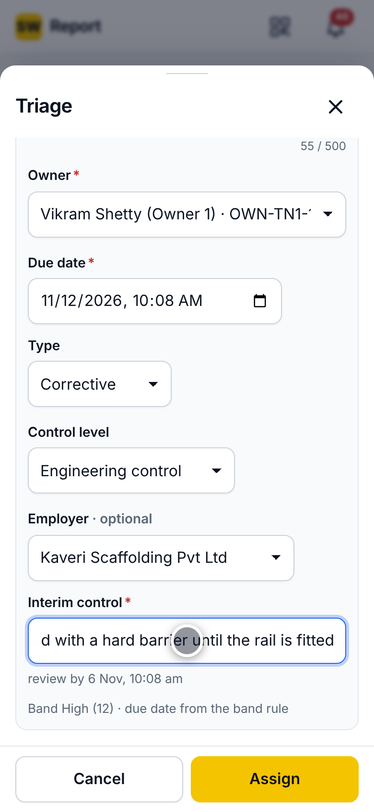



Triage and actions with clear ownership
Your risk matrix sets band and due date
Likelihood × severity: Low, Moderate, High or Extreme
IS 3786 classification, employer involved
Real contractor data for every hazard
One owner, reminders, escalation ladder
Before and after the due date, up to the site head
Complete needs an after-photo
Plus the root cause addressed; owners can request a new date or dispute
Independent verification
A different person marks the fix effective or not
Notes:
Triage is where SafeWorks makes risk decisions consistent. Officers score likelihood and severity on your own matrix; the band sets the due date and how hard reminders push. They record the IS 3786 classification and the employer involved, which gives you real contractor data. Each action has one owner. Completing it requires an after-photo and the root cause addressed, and a different person verifies it. Owners can request a new date or dispute an action, and both are recorded and decided, not lost in a conversation.

Slide 7
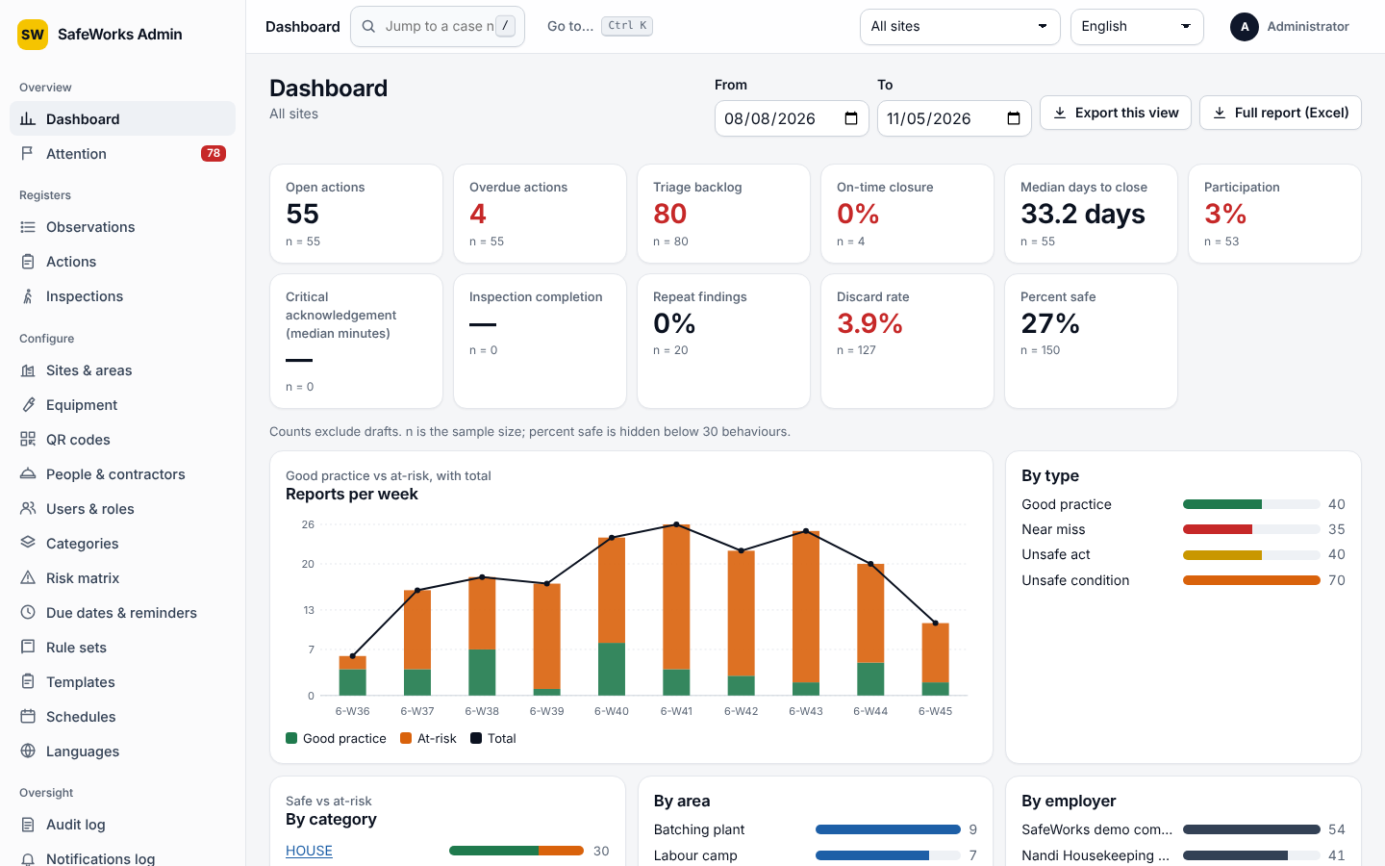





Visibility and control for managers
Live KPIs
By site, date and department
Attention board
What needs action today
Full report (Excel)
One click, four sheets
Roles, MFA, auditors
Time-limited, read-only auditor access
Audit log
Tamper-evident, verified in one click
Notes:
For managers, the admin console is the control room. The dashboard shows open and overdue actions, triage backlog, on-time closure, median days to close and participation, filtered by site, dates and department. The attention board lists what needs someone today. One click produces a full Excel report for your monthly review. Access is role-based per site, admins and site heads use an authenticator code, and external auditors get read-only access that expires. Every change is in an audit log you can verify in one click.

Slide 8
A near miss on level 3, start to finish
10:02
10:04
10:15
Bricks fall from the hoist landing. Nobody hurt. A worker reports a near miss with a photo, offline at first.
Signal returns on the way back; the outbox sends it. Case number assigned.
The safety officer scores it High and assigns edge protection to the site engineer.
Next day
Next day
Month end
Guard rail, mid-rail and toe board fitted. Completed with an after-photo and the cause addressed.
The verifier marks it effective. The report closes; the worker sees Closed in My reports.
The fix appears in the Excel report, with nothing retyped.
Notes:
Here is a real pattern. At 10:02, bricks fall from the hoist landing; nobody is hurt. A worker reports a near miss with a photo, offline at first, and it syncs as he walks back. By 10:15 the safety officer has scored it High and assigned edge protection to the site engineer, with a due date set by the band. The next day the guard rail, mid-rail and toe board are fitted, photographed and completed. The verifier walks past, marks it effective, and the report closes. The worker sees it closed, and at month end the fix appears in the Excel report without anyone retyping it.

Slide 9
What you will measure from day one
Participation
share of workers reporting
On-time closure
and median days to close
Overdue actions
and triage backlog
Danger-now
acknowledgement time
Repeat findings
same hazard, same place
Percent safe
from inspections
Assumes one officer spending about three days a month compiling registers and reports, replaced by minutes of review. An example of scale, not a guarantee; agree your own baseline in week one.
Notes:
We will not ask you to take ROI on faith. SafeWorks measures it for you from the first day: participation, on-time closure, median days to close, overdue actions, how quickly danger-now alerts are acknowledged, and repeat findings. Agree your baseline with us in week one and track it monthly. To give a sense of scale, here is an illustrative example, not a guarantee. If one officer currently spends about three days a month compiling registers and reports, Full report Excel replaces that with a few minutes of review. The bigger return is harder to put a number on: hazards that get fixed before they hurt someone.

Slide 10
Let's go live
SW
Week 1
Week 2
Week 3
Set up
Pilot
Roll out
Sites by industry wizard, users imported, QR posters printed in four languages
One site live; safety officers trained on triage and actions
All sites live; first monthly report from the dashboard
Next step: confirm your pilot site today, and your first reports come in this week.
Notes:
Going live is quick. In week one we set up your sites with the industry wizard, import your users and print QR posters in four languages. In week two we run a pilot on one site and train your safety officers on triage. In week three we roll out across sites, and you produce your first monthly report from the dashboard. The one decision we need today is your pilot site. Choose it with us, and we will have your first reports coming in this week.

