Slide 1
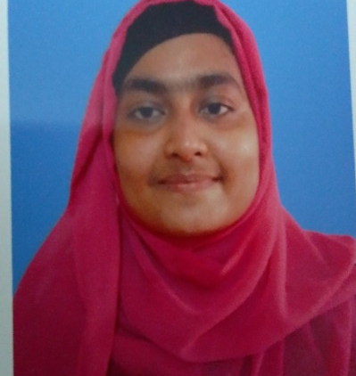
SHAMSI JUMA
Web Designer
To obtain a challenging position as a web designer in a dynamic organization where I can utilize my creative and technical skills to design and develop visually appealing and user-friendly websites that exceed client expectations.
As a web designer, my goal is to combine my knowledge of design principles and programming languages to create innovative web experiences that engage and inspire users. I am passionate about staying up-to-date with the latest trends and technologies in the field and collaborating with cross-functional teams to deliver high-quality solutions that meet business objectives.
My objective is to work in a company that values creativity, collaboration, and continuous learning, and where I can grow my skills as a web designer while contributing to the success of the organization.
PROFESSIONAL SKILLS
HTML
CSS
AREAS OF EXPERTISE
Bootstrap
Creating responsive web pages that work well on different devices.
Implementing designs using HTML, CSS, and Bootstrap.
Ensuring that web pages are optimized and mobile responsive.
Working with JavaScript libraries and frameworks to create interactive user interfaces.
Conducting user research to understand the needs and behaviors of website visitors.
Creating visual designs that are aesthetically pleasing and on-brand.
Selecting and manipulating images, typography, and other design elements.
WordPress website design and theme customization.
JavaScript
PHP
WordPress
SPECIAL QUALIFICATION
Creativity
Attention to Detail
Communication Skills
KEY ATTRIBUTES
➊ Ability to come up with original ideas and concepts for website designs.
➋ Willingness to think outside of the box and experiment with new design techniques.
➌ Understanding of current design trends and the ability to incorporate them into designs.
PROFESSIONAL COURSES
Certification | Institute | Location
Web Design | Sheikh Fazilatunnesa Mujib Mohila TTC | Dhaka
Web Development NTVQF Level 4 | Engineering computing and computers(ECC) | Dhaka
Graphics & Web UI design | Udemy.com | Online

Slide 2

CONTACT DETAILS
EDUCATION
Mobile: +8801318515697
Exam | Group | Institute | Result | Year
S.S.C | Science | Kamrunnesa Govt.Girls High school | 5.00 | 2018
Diploma in Engineering | CSE | Dhaka Mohila Polytechnic Institute | 3.95 | 2023
juma858690@gmail.com
www.linkedin.com
WORKING EXPERIENCE
Internship at IIST
(Oct 10-January 10)
As a web design intern at IIST Polytechnic, I had the opportunity to work alongside experienced professionals and learn valuable skills in web design. Through this experience, I gained hands-on experience in web design.
In my free time, I enjoy exploring typography and experimenting with new design techniques, which has helped me develop a strong creative vision and passion for web design.
Fathers Name: Md. Mohammad Ali
Mothers Name: Mst. Bilkis Begum
Birthday: May 11, 2002
Marital Status: Unmarried
Present Address: 25/41,Rajabari,Genda,Savar -1340, Dhaka
Permanent Address: 25/41,Rajabari,Genda,Savar -1340, Dhaka
The information provided in this CV is accurate and complete to the best of my knowledge and belief.
Sincerely yours,
Shamsi Juma
ADDITIONAL INFO
HOBBIES & INTERESTS
Name: Dr. Sheikh Abu Reza
Organization: IIST Polytechnic
Designation: Director (Admin)
Mobile: +8801711802800
Relation: Teacher
Name: Md Abidur Rahman Shaon
Organization: SEIP
Designation: Web Designer
Mobile: +8801531958323
Relation: Teacher
REFFERENCE

