Slide 1
Introduction to Big Data: Final Project
Group 3 Members:
1.
2.
3.
4.

Slide 2

Objectives
What is Text mining and Sentiment Analysis
What are the main R packages used in Text mining
Installation of R packages

Slide 3
What is Text mining and Sentiment Analysis
Text mining is the process of transforming unstructured text into a structured format to identify meaningful patterns and new insights
Sentiment Analysis is the a data mining technique that measures and tries to understand people's opinions and stances through NLP. Computational linguistics and text analysis inspect information from the web, social media and various platforms
The main concepts of Text Mining are; Corpus & Corpora, Document Term Matrix (DTM), Stemming, Stop Words, Bad Words

Slide 4
Text mining process in R
Text extraction ( Extraction od the text as txt file)
Cleaning and storing text(Tokenization, remove punctuation, stopwords, stemming, to lowercase)
Data structures(Document term matrix)

Slide 5
R packages used in Text Mining
Tm: Used for text mining operations like removing numbers, special characters, punctuations and stop words (Stop words in any language are the most commonly occurring words that have very little value for NLP and should be filtered out. Examples of stop words in English are “the”, “is”, “are”.)
snowballc for stemming, which is the process of reducing words to their base or root form. For example, a stemming algorithm would reduce the words “fishing”, “fished” and “fisher” to the stem “fish”.
wordcloud for generating the word cloud plot
RColorBrewer for color palettes used in various plots

Slide 6
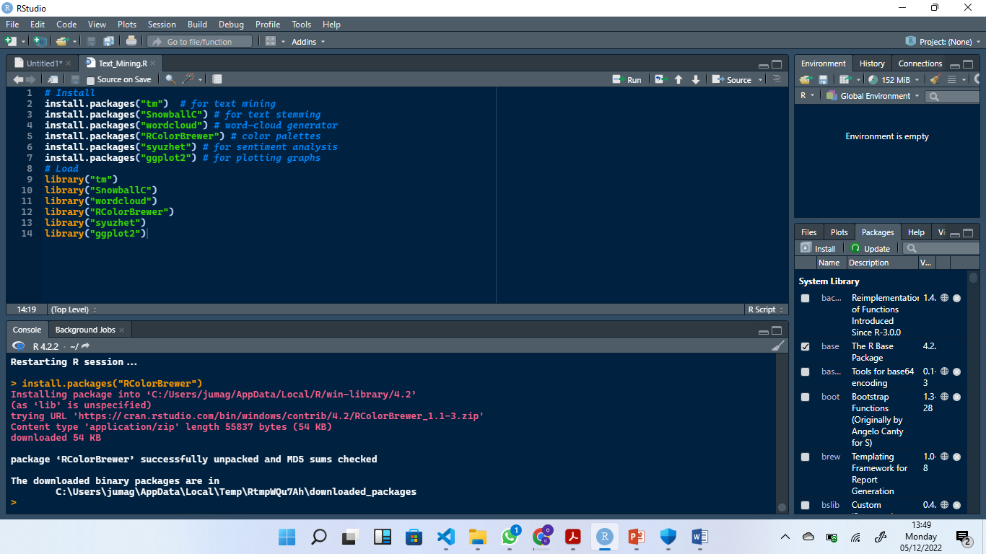
Installation of R packages
Run the following code to install and load the packages

Slide 7
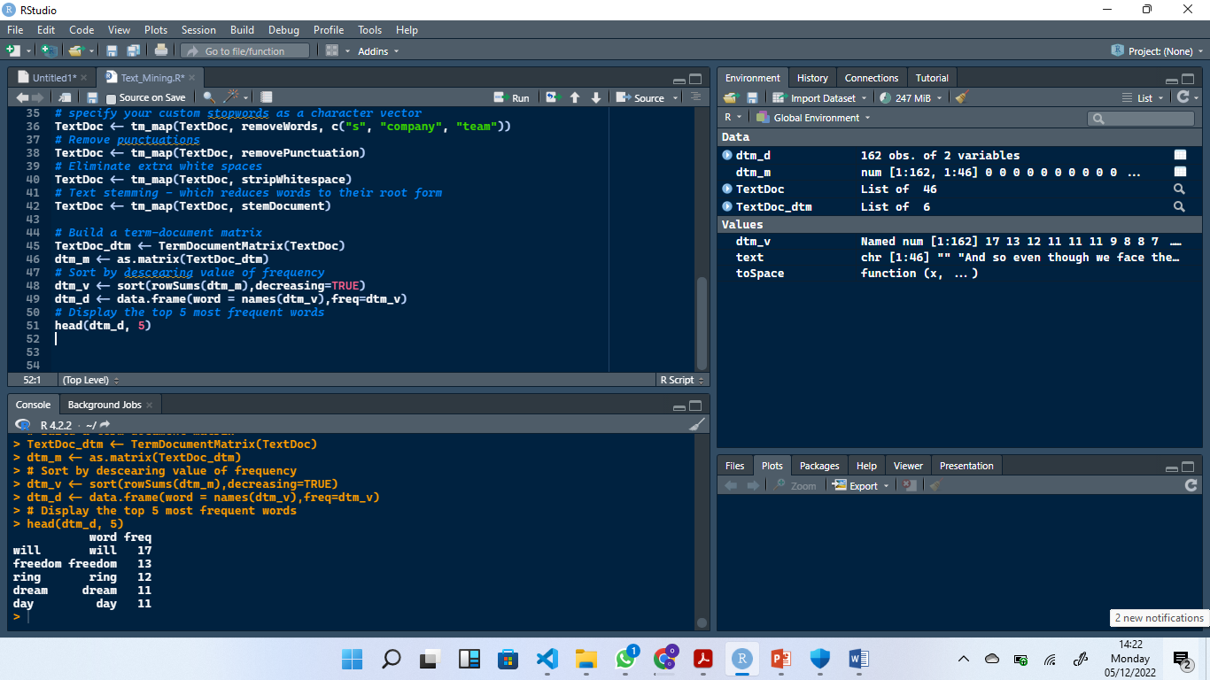
Showing use of R packages

Slide 8
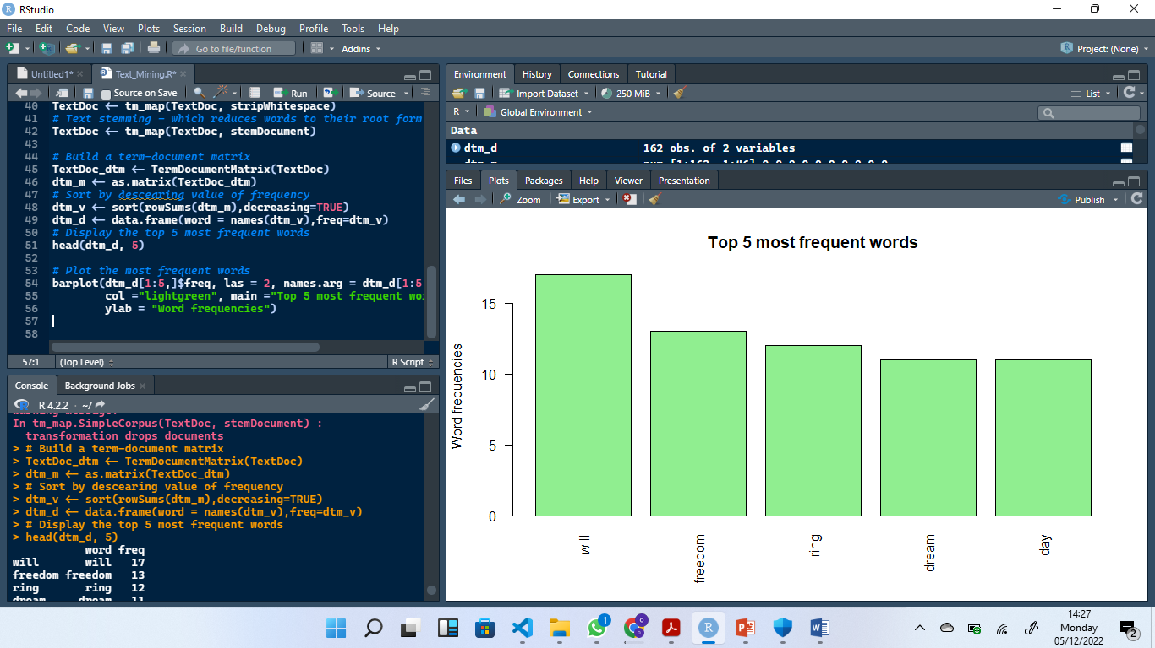
Top five most frequent words

Slide 9
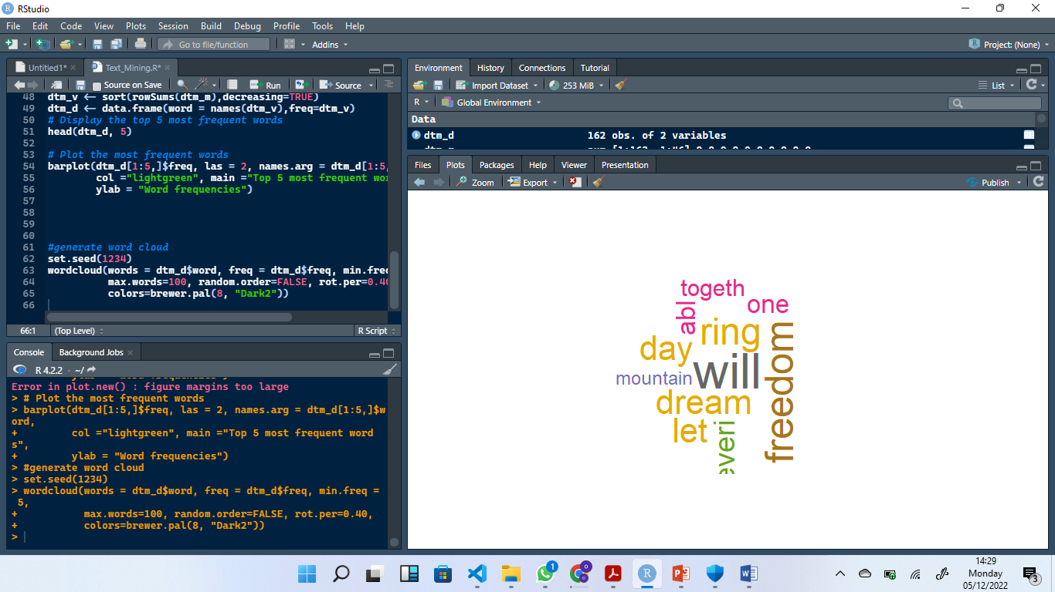
WordCloud

