Slide 1
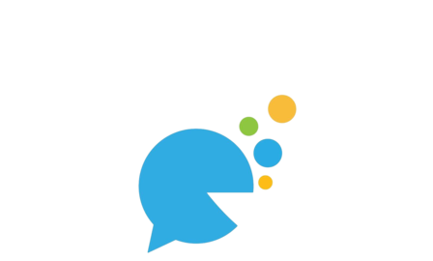
CHATTATIVE
Where words fly and messages never get lost!

Slide 2

Introduction
Chattative is a mobile chat application developed using Flutter, designed to provide users with an intuitive and real-time messaging experience. It enables seamless communication between users on Android platforms, featuring essential messaging tools like direct chats, notifications, and secure authentication. With its sleek and modern interface, Chattative is built to cater to users looking for a reliable chat solution.

Slide 3
Key Features:
User Authentication :
Secure login and registration using Firebase Authentication.
Email and password-based sign-in.
Real-Time Messaging:
Instant communication powered by Firebase Firestore.
Cross-Platform Support:
Runs on Android and iOS devices with a consistent user experience.
Custom User Interface :
Intuitive design with support for message bubbles and alignment based on sender/receiver.

Slide 4
Tools, Framework and Libraries:
Frontend:
Flutter: Single codebase for Android and iOS apps.
Backend:
Firebase Authentication: Secure user authentication.
Firebase Firestore: Real-time database for chat storage.
Firebase Storage: For multimedia messages.
Programming Language: Dart for the Flutter framework.
Version Control : GitHub for collaborative development.

Slide 5

Firebase Integration:
Firebase Core :
Enables initialization of Firebase services.
Firestore:
Storing messages in a structured format.
Listener streams for real-time updates.
Firebase Authentication:
Handling user sign-in and sign-up processes securely.
Future Enhancements:
Add support for push notifications via Firebase Cloud Messaging

Slide 6
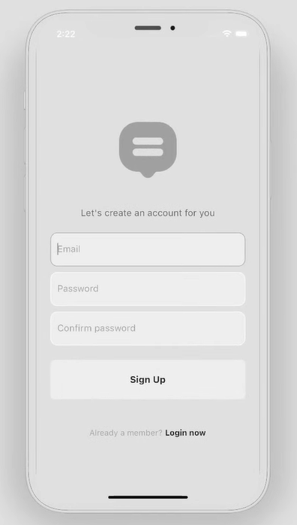
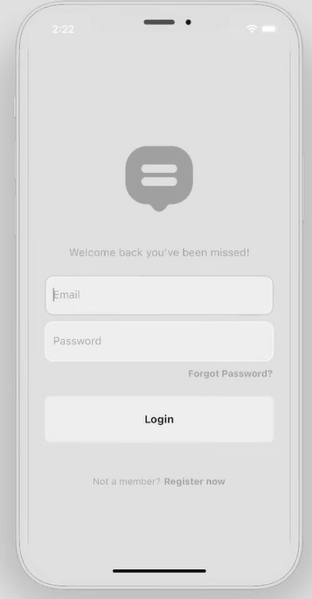
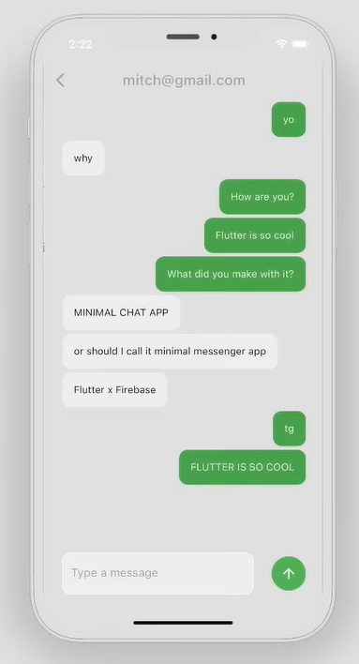

Slide 7
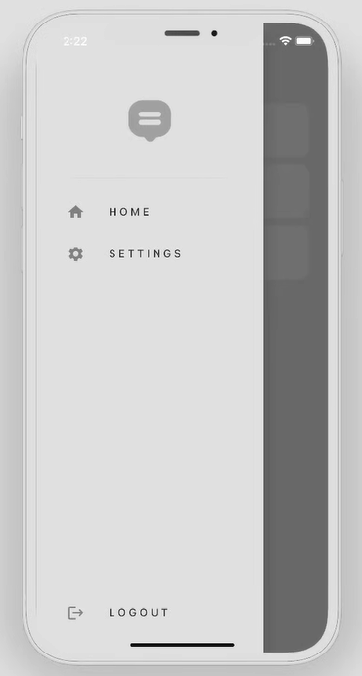
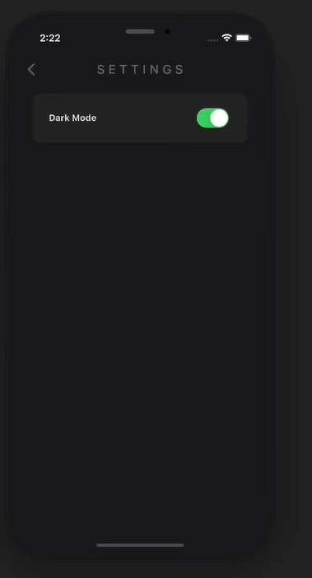
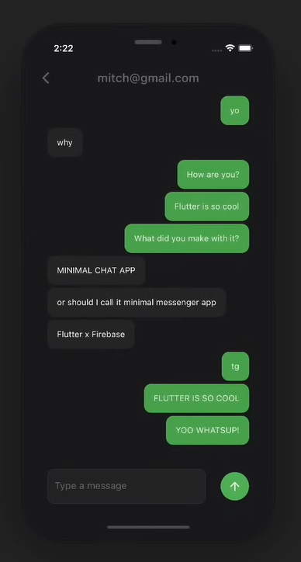

Slide 8
Challenges:
Initial Setup
Real-time messaging
UI/UX Design
Setting up Firebase with Flutter required integrating Firebase Authentication, Firestore, and Cloud Messaging. Configuring Firebase for both iOS and Android posed initial setup challenges, especially with setting up dependencies.
Ensuring real-time message updates and synchronization across multiple devices was a challenge, which was tackled using Firestore's real-time database and Flutter's stream listeners.
Developing an intuitive interface for a mobile chat app was key. Designing the chat screen and message layout (aligning messages based on the sender) was achieved using ListView and Container Widgets.

Slide 9
Potential Improvement
For this project, I wish to add the following features:
Adding voice and video calling features would make the app even more versatile.
More custom animations and design improvements, such as message bubble animations, could be added to enhance the user experience.
Enabling users to send files like PDFs or documents would increase the app's utility.

Slide 10
Thank You!!

