Slide 1
ACCEPTED
ADMISSIONS
ACCEPTED ADMISSIONS / SAT MASTERY SERIES
SAT PREP III
Information & Ideas
01 CENTRAL IDEAS & DETAILS
02 COMMAND OF EVIDENCE
SAT Reading & Writing • Digital SAT Reading & Writing
SAT PREP III
01 / 39

Slide 2
THE BIG PICTURE
ACCEPTED
ADMISSIONS
Where this lesson fits
SAT Reading & Writing focuses on four complementary skill areas.
01
Standard English Conventions
02
Expression of Ideas
03
Information & Ideas
THIS LESSON
04
Craft & Structure
SAT PREP III / INFORMATION & IDEAS
02

Slide 3
ACCEPTED
ADMISSIONS
REVIEW
Eoi Review
Recall the core skills before moving on.
01
SAT PREP III / INFORMATION & IDEAS
03

Slide 4
GENERAL STRATEGY
ACCEPTED
ADMISSIONS
A repeatable method for every question
01 Read the passage
Understand the topic and the author’s central point.
02 Predict an answer
Make a rough prediction before evaluating choices.
03 Eliminate distractors
Cross out answers that are clearly unsupported or off-topic.
04 Choose the best fit
Select the answer that fulfills the exact task.
05 Check if time allows
Revisit other choices only if it improves your confidence.
SAT PREP III / INFORMATION & IDEAS
04

Slide 5
SKILL FRAMEWORK
ACCEPTED
ADMISSIONS
Expression of Ideas: quick review
Transitions
Rhetorical Synthesis
Identify the logical relationship between two ideas.
Use relevant notes to achieve a stated writing goal.
SAT PREP III / INFORMATION & IDEAS
05

Slide 6
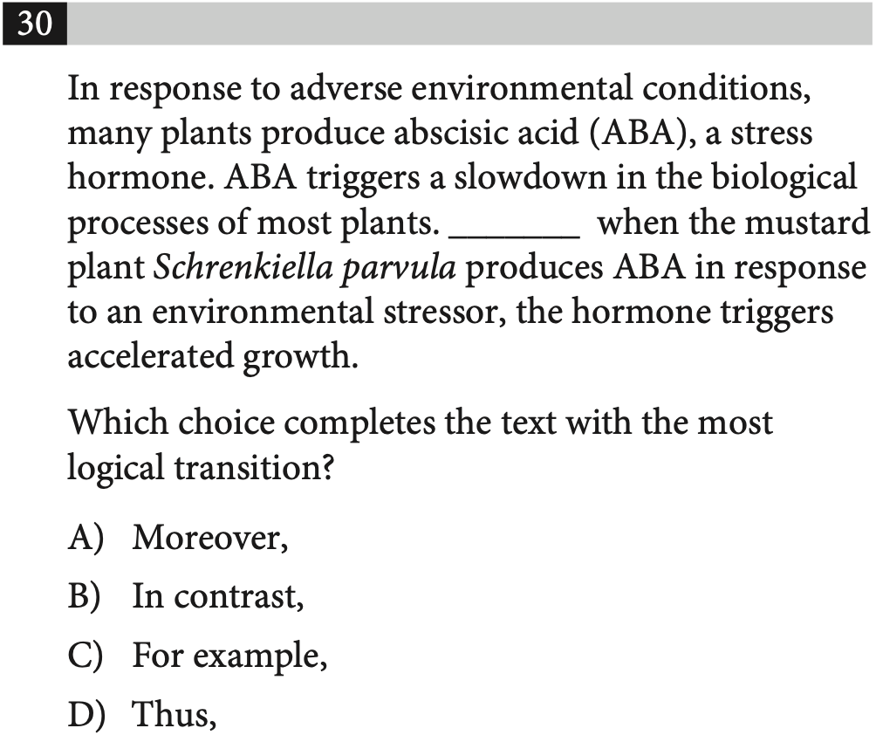
EXPRESSION OF IDEAS REVIEW
ACCEPTED
ADMISSIONS
PRACTICE 01
TRY IT FIRST
THINK ALOUD
Track The Logic
How do these ideas connect?
EXPLAIN YOUR REASONING
SAT PREP III / INFORMATION & IDEAS
06

Slide 7
EXPRESSION OF IDEAS REVIEW
ACCEPTED
ADMISSIONS
REVIEW 01
ANSWER CHECK
ANSWER REVIEW
Track The Logic
Use the stated writing goal or sentence relationship.
EXPLAIN YOUR REASONING
SAT PREP III / INFORMATION & IDEAS
07

Slide 8
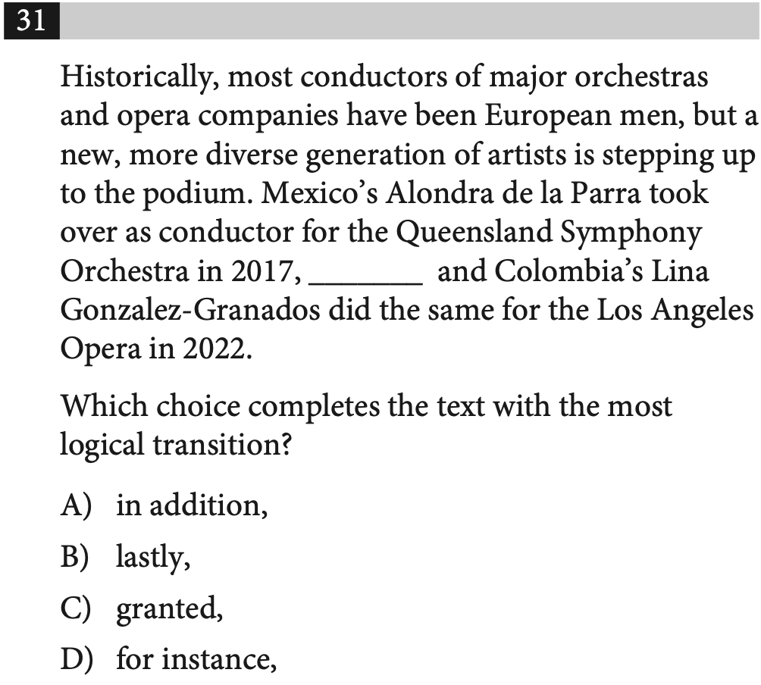
EXPRESSION OF IDEAS REVIEW
ACCEPTED
ADMISSIONS
PRACTICE 02
TRY IT FIRST
THINK ALOUD
Track The Logic
How do these ideas connect?
EXPLAIN YOUR REASONING
SAT PREP III / INFORMATION & IDEAS
08

Slide 9
EXPRESSION OF IDEAS REVIEW
ACCEPTED
ADMISSIONS
REVIEW 02
ANSWER CHECK
ANSWER REVIEW
Track The Logic
Use the stated writing goal or sentence relationship.
EXPLAIN YOUR REASONING
SAT PREP III / INFORMATION & IDEAS
09

Slide 10
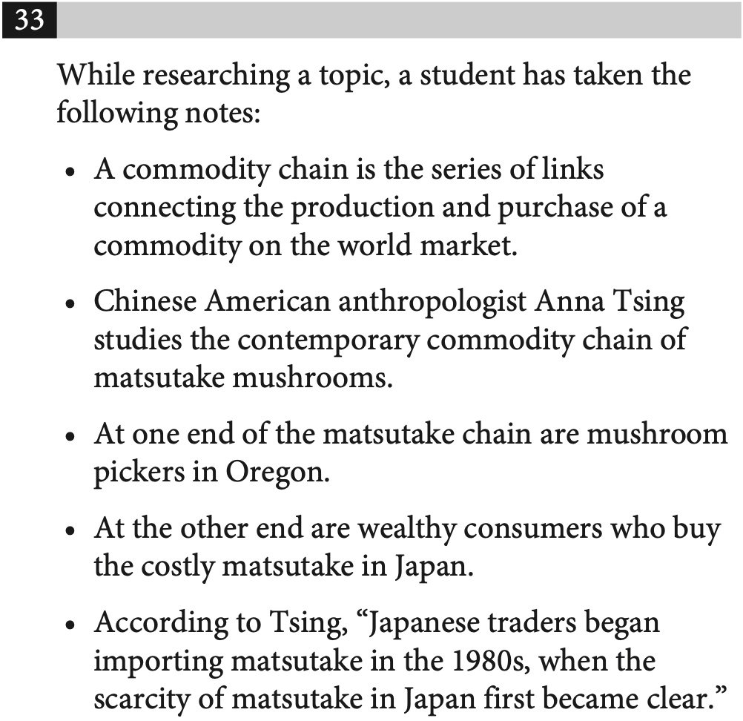
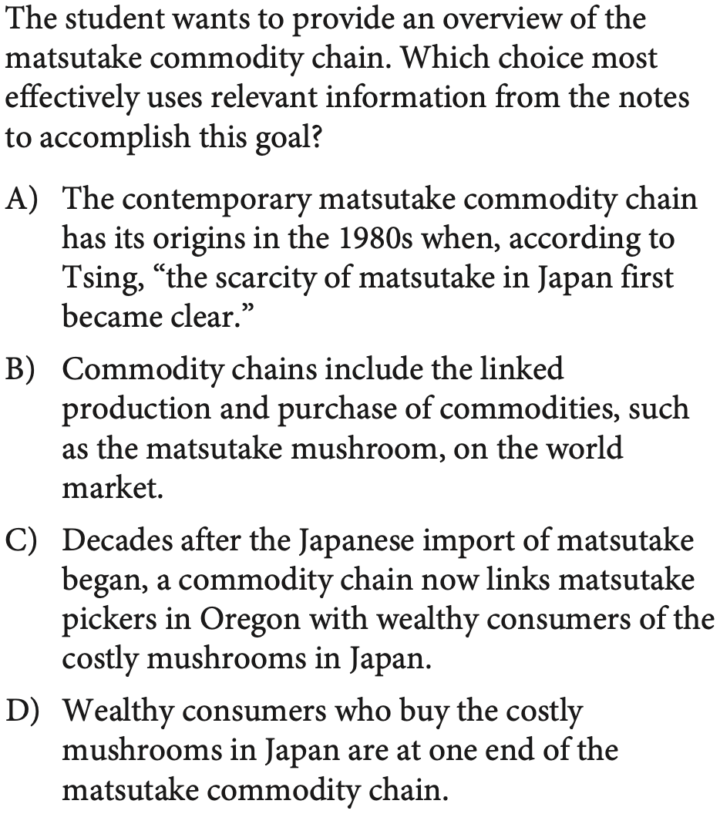
EXPRESSION OF IDEAS REVIEW
ACCEPTED
ADMISSIONS
PRACTICE 03
TRY IT FIRST
SAT PREP III / INFORMATION & IDEAS
10

Slide 11
EXPRESSION OF IDEAS REVIEW
ACCEPTED
ADMISSIONS
REVIEW 03
ANSWER CHECK
SAT PREP III / INFORMATION & IDEAS
11

Slide 12
SKILL FRAMEWORK
ACCEPTED
ADMISSIONS
Three ways the SAT tests ideas
Central Ideas & Details
Inferences
Command of Evidence
What does the text directly say?
What follows logically from what is stated?
Which information best supports the claim?
SAT PREP III / INFORMATION & IDEAS
12

Slide 13
SKILL FRAMEWORK
ACCEPTED
ADMISSIONS
Three question types, three tasks
Central Ideas & Details
Inferences
Command of Evidence
Find information in the text.
Draw logical conclusions from the text.
Evaluate evidence for the text.
SAT PREP III / INFORMATION & IDEAS
13

Slide 14
GENERAL STRATEGY
ACCEPTED
ADMISSIONS
A repeatable method for every question
01 Read the passage
Understand the topic and the author’s central point.
02 Predict an answer
Make a rough prediction before evaluating choices.
03 Eliminate distractors
Cross out answers that are clearly unsupported or off-topic.
04 Choose the best fit
Select the answer that fulfills the exact task.
05 Check if time allows
Revisit other choices only if it improves your confidence.
SAT PREP III / INFORMATION & IDEAS
14

Slide 15
ACCEPTED
ADMISSIONS
QUESTION TYPE
Central Ideas & Details
Understand the main idea, main purpose, and important details.
01
SAT PREP III / INFORMATION & IDEAS
15

Slide 16

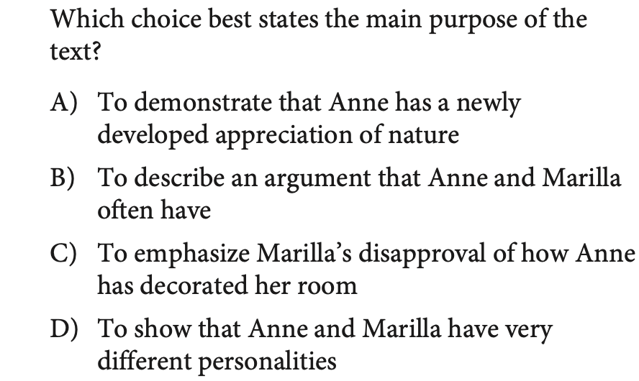
CENTRAL IDEAS & DETAILS
ACCEPTED
ADMISSIONS
PRACTICE 04
TRY IT FIRST
SAT PREP III / INFORMATION & IDEAS
16

Slide 17
CENTRAL IDEAS & DETAILS
ACCEPTED
ADMISSIONS
REVIEW 04
ANSWER CHECK
SAT PREP III / INFORMATION & IDEAS
17

Slide 18
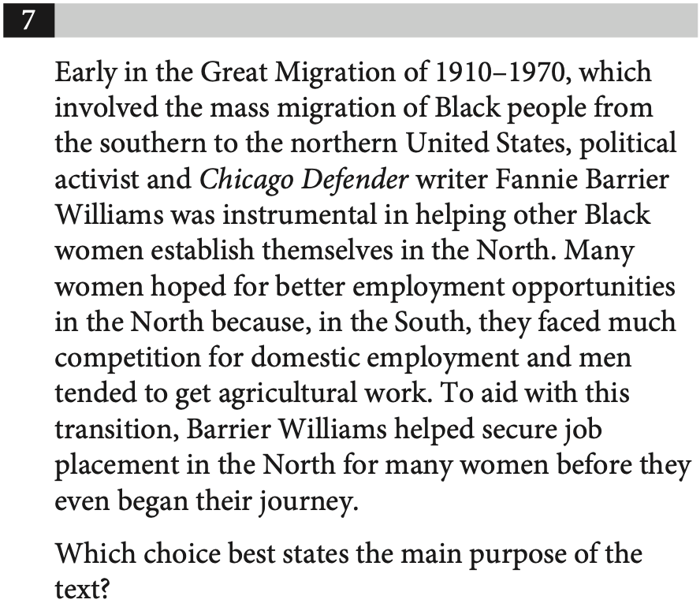
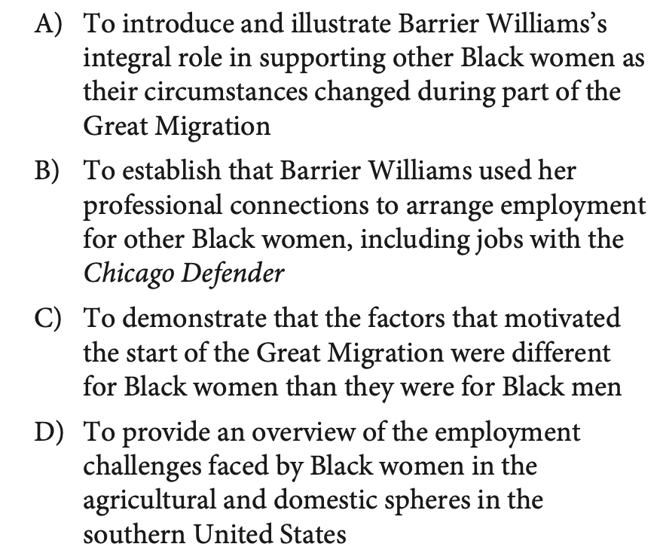
CENTRAL IDEAS & DETAILS
ACCEPTED
ADMISSIONS
PRACTICE 05
TRY IT FIRST
SAT PREP III / INFORMATION & IDEAS
18

Slide 19
CENTRAL IDEAS & DETAILS
ACCEPTED
ADMISSIONS
REVIEW 05
ANSWER CHECK
SAT PREP III / INFORMATION & IDEAS
19

Slide 20
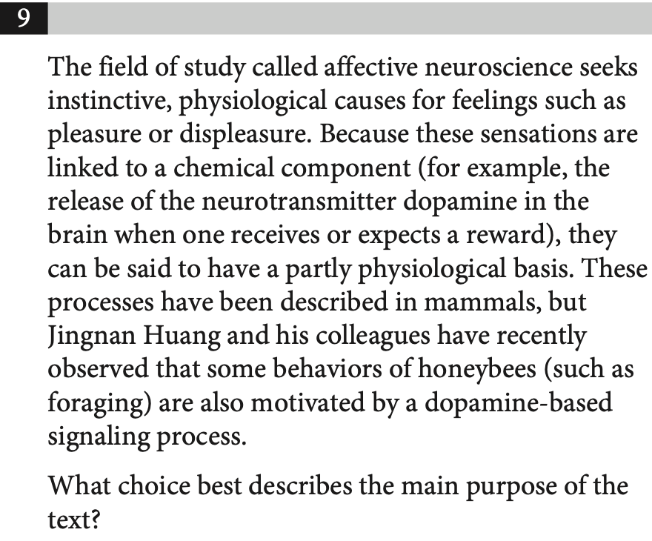
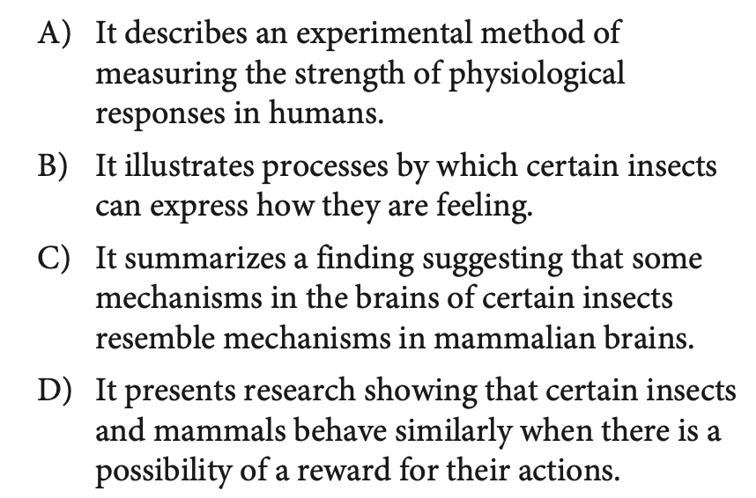
CENTRAL IDEAS & DETAILS
ACCEPTED
ADMISSIONS
PRACTICE 06
TRY IT FIRST
SAT PREP III / INFORMATION & IDEAS
20

Slide 21
CENTRAL IDEAS & DETAILS
ACCEPTED
ADMISSIONS
REVIEW 06
ANSWER CHECK
SAT PREP III / INFORMATION & IDEAS
21

Slide 22
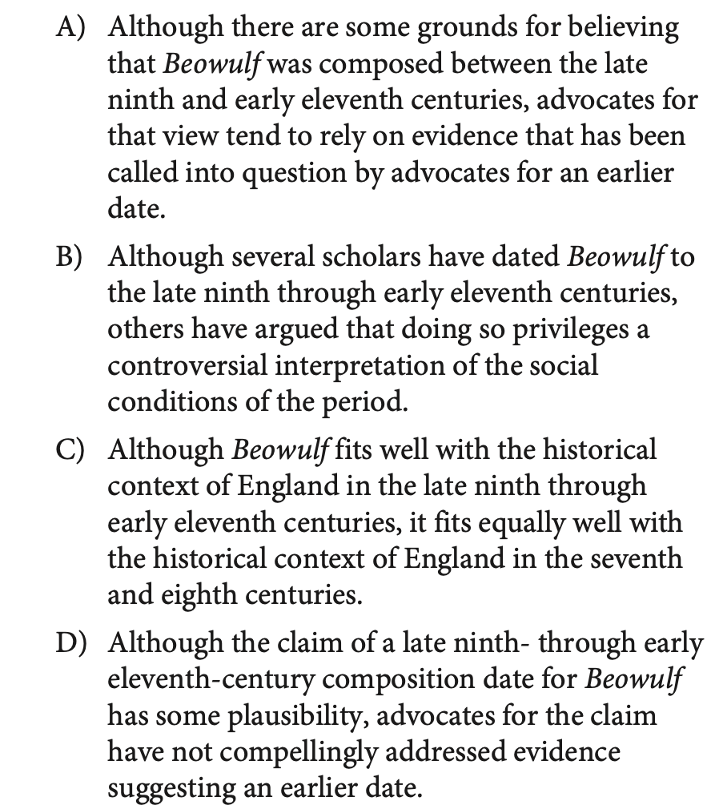
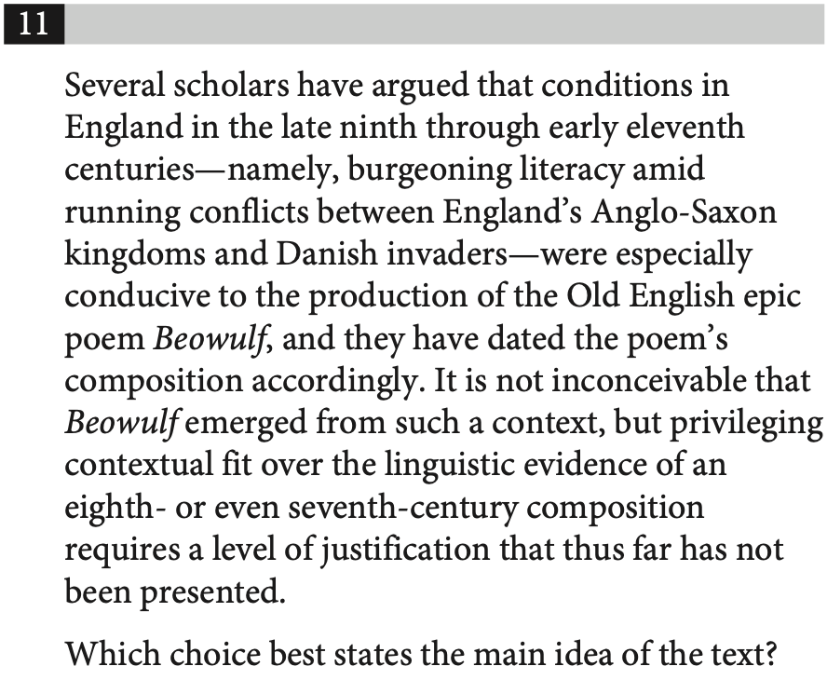
CENTRAL IDEAS & DETAILS
ACCEPTED
ADMISSIONS
PRACTICE 07
TRY IT FIRST
SAT PREP III / INFORMATION & IDEAS
22

Slide 23
CENTRAL IDEAS & DETAILS
ACCEPTED
ADMISSIONS
REVIEW 07
ANSWER CHECK
SAT PREP III / INFORMATION & IDEAS
23

Slide 24
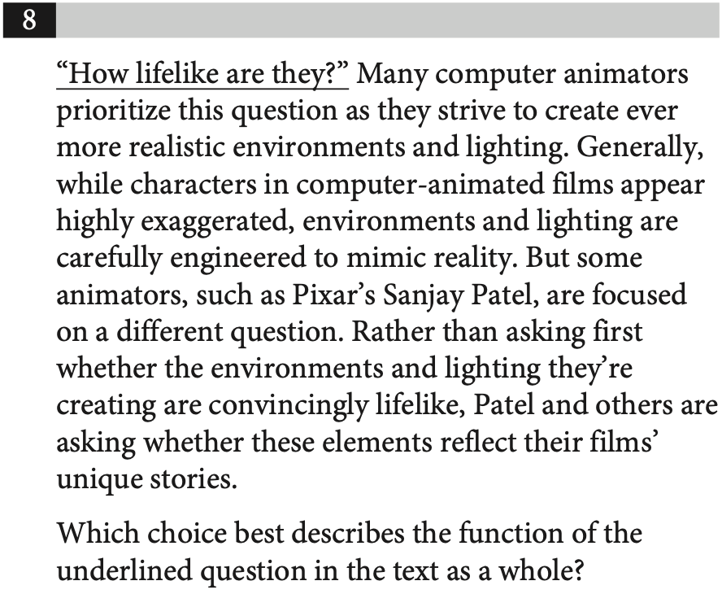
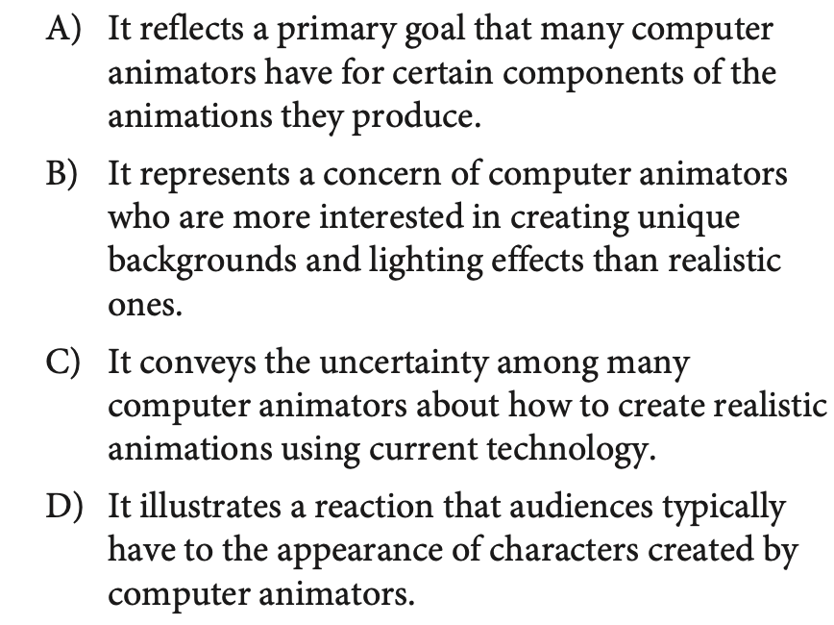
CENTRAL IDEAS & DETAILS
ACCEPTED
ADMISSIONS
PRACTICE 08
TRY IT FIRST
SAT PREP III / INFORMATION & IDEAS
24

Slide 25
CENTRAL IDEAS & DETAILS
ACCEPTED
ADMISSIONS
REVIEW 08
ANSWER CHECK
SAT PREP III / INFORMATION & IDEAS
25

Slide 26
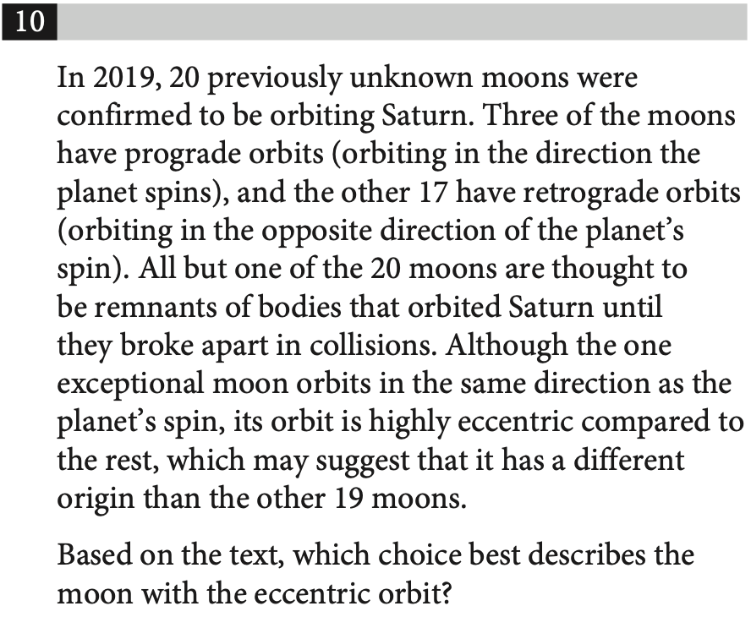
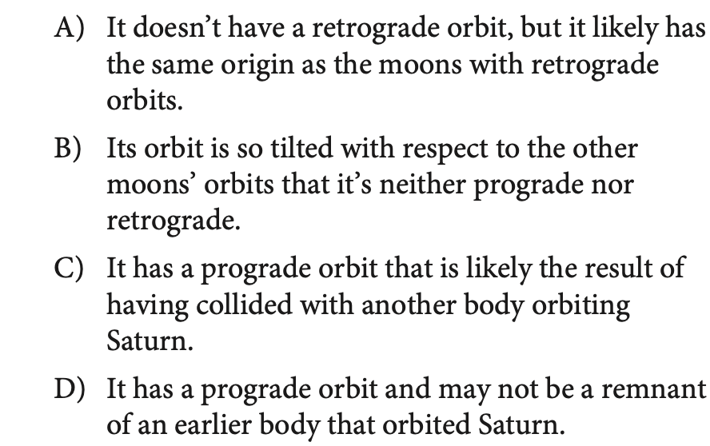
CENTRAL IDEAS & DETAILS
ACCEPTED
ADMISSIONS
PRACTICE 09
TRY IT FIRST
SAT PREP III / INFORMATION & IDEAS
26

Slide 27
CENTRAL IDEAS & DETAILS
ACCEPTED
ADMISSIONS
REVIEW 09
ANSWER CHECK
SAT PREP III / INFORMATION & IDEAS
27

Slide 28
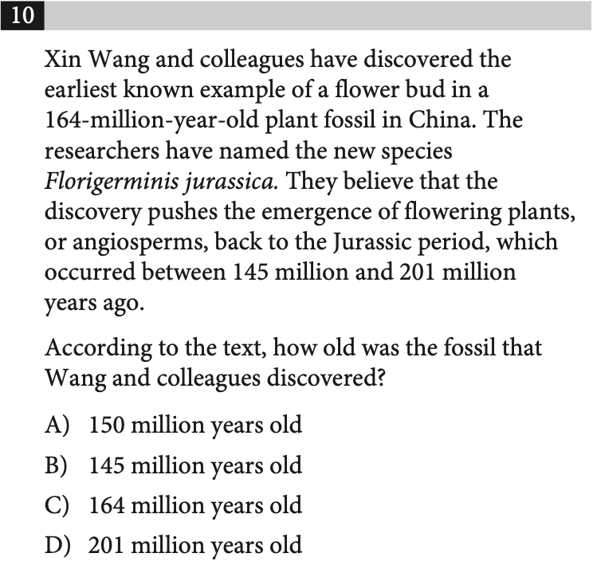
CENTRAL IDEAS & DETAILS
ACCEPTED
ADMISSIONS
PRACTICE 10
TRY IT FIRST
THINK ALOUD
Find The Main Point
What does the full passage emphasize?
EXPLAIN YOUR REASONING
SAT PREP III / INFORMATION & IDEAS
28

Slide 29
CENTRAL IDEAS & DETAILS
ACCEPTED
ADMISSIONS
REVIEW 10
ANSWER CHECK
ANSWER REVIEW
Find The Main Point
The best answer covers the whole passage—not an isolated detail.
EXPLAIN YOUR REASONING
SAT PREP III / INFORMATION & IDEAS
29

Slide 30
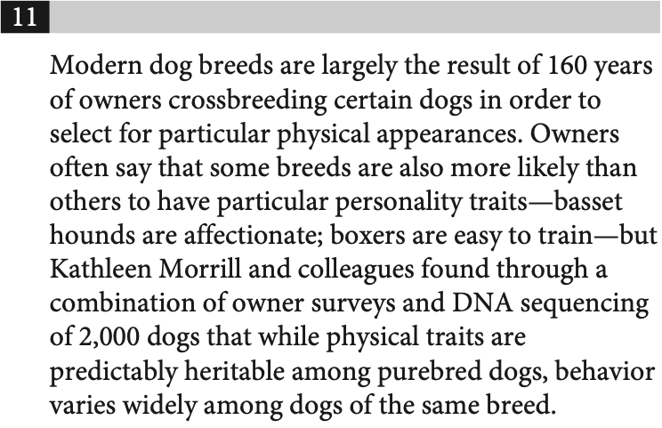
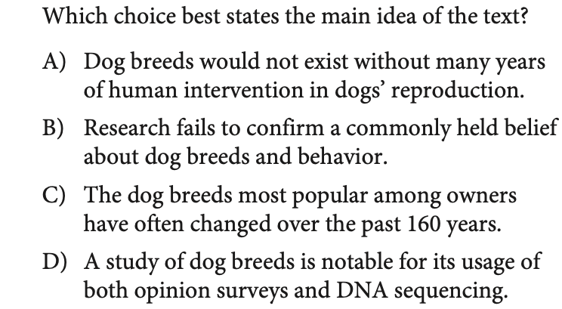
CENTRAL IDEAS & DETAILS
ACCEPTED
ADMISSIONS
PRACTICE 11
TRY IT FIRST
SAT PREP III / INFORMATION & IDEAS
30

Slide 31
CENTRAL IDEAS & DETAILS
ACCEPTED
ADMISSIONS
REVIEW 11
ANSWER CHECK
SAT PREP III / INFORMATION & IDEAS
31

Slide 32
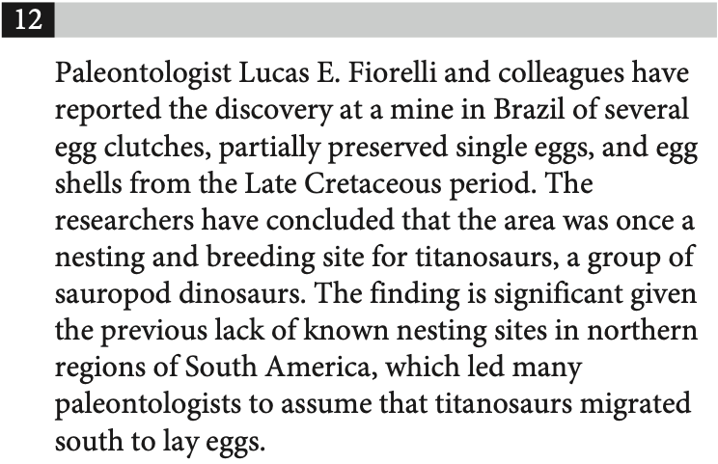
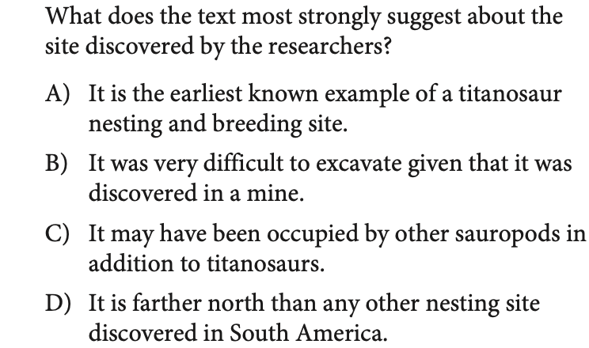
CENTRAL IDEAS & DETAILS
ACCEPTED
ADMISSIONS
PRACTICE 12
TRY IT FIRST
SAT PREP III / INFORMATION & IDEAS
32

Slide 33
CENTRAL IDEAS & DETAILS
ACCEPTED
ADMISSIONS
REVIEW 12
ANSWER CHECK
SAT PREP III / INFORMATION & IDEAS
33

Slide 34
ACCEPTED
ADMISSIONS
QUESTION TYPE
Inferences
Use only what the passage supports to complete the thought.
01
SAT PREP III / INFORMATION & IDEAS
34

Slide 35
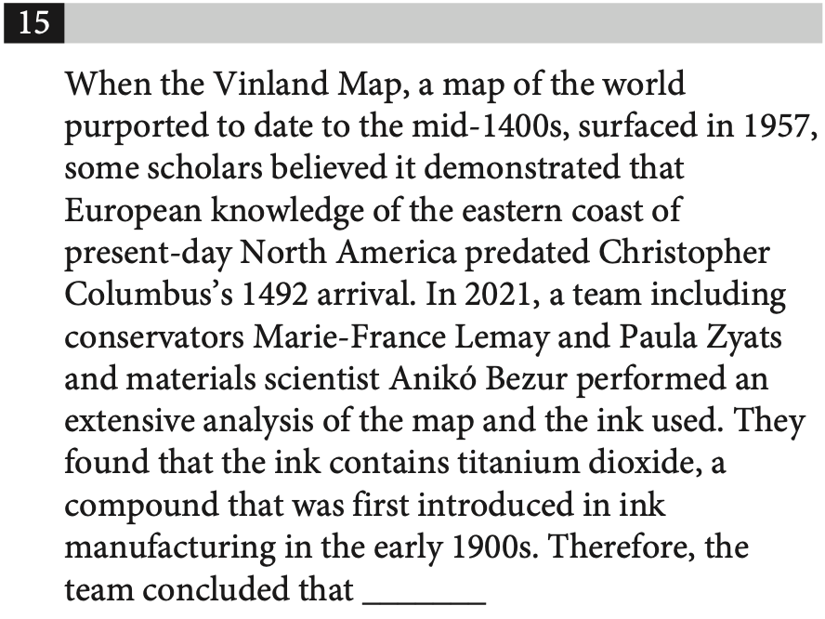
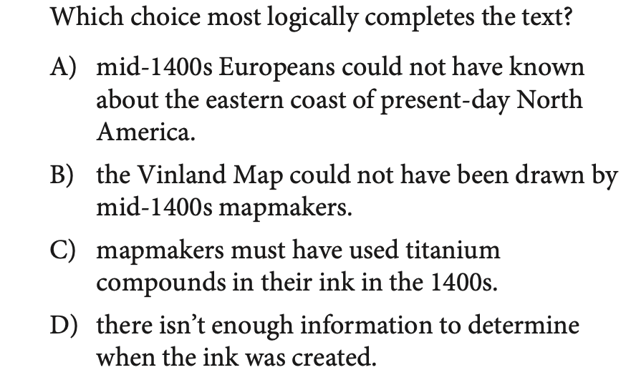
INFERENCES
ACCEPTED
ADMISSIONS
PRACTICE 13
TRY IT FIRST
SAT PREP III / INFORMATION & IDEAS
35

Slide 36
INFERENCES
ACCEPTED
ADMISSIONS
REVIEW 13
ANSWER CHECK
SAT PREP III / INFORMATION & IDEAS
36

Slide 37
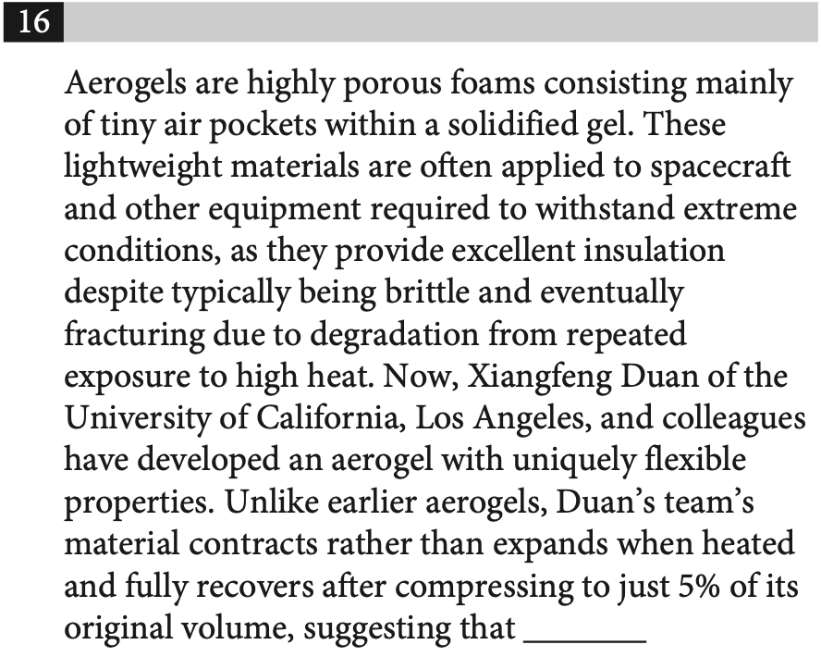
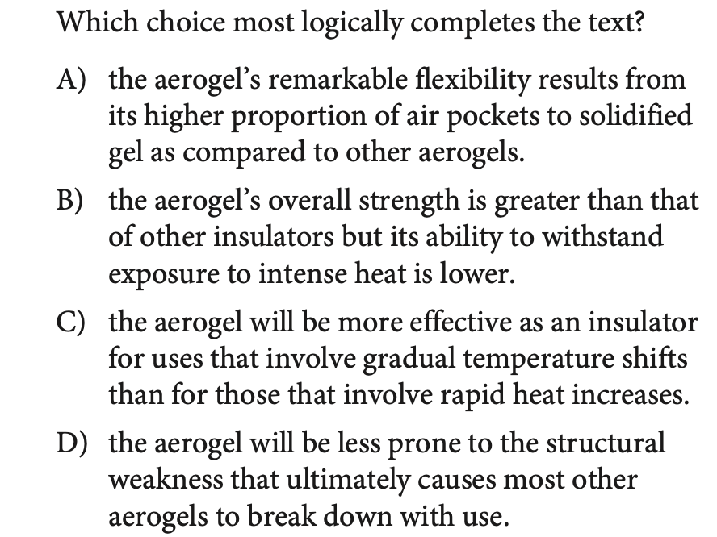
INFERENCES
ACCEPTED
ADMISSIONS
PRACTICE 14
TRY IT FIRST
SAT PREP III / INFORMATION & IDEAS
37

Slide 38
INFERENCES
ACCEPTED
ADMISSIONS
REVIEW 14
ANSWER CHECK
SAT PREP III / INFORMATION & IDEAS
38

Slide 39
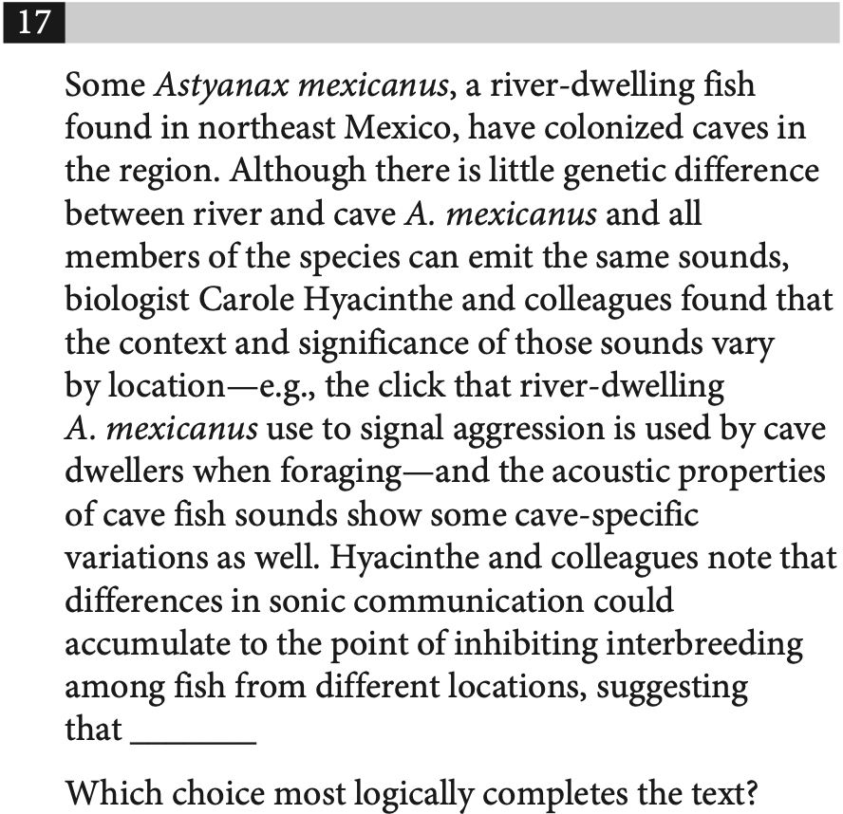
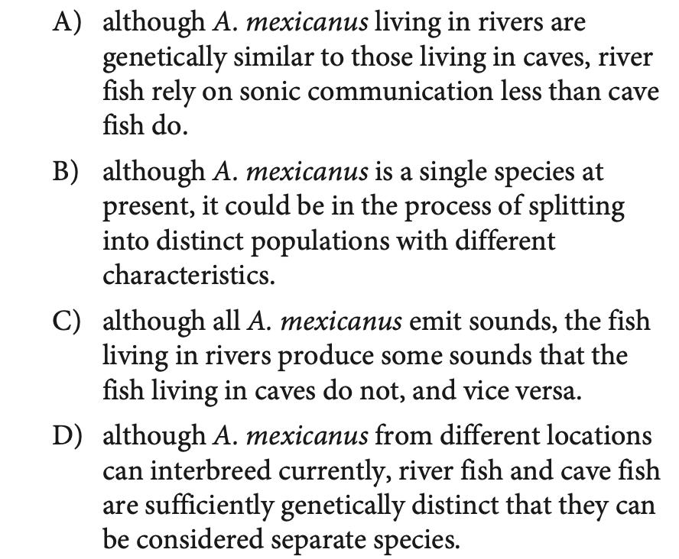
INFERENCES
ACCEPTED
ADMISSIONS
PRACTICE 15
TRY IT FIRST
SAT PREP III / INFORMATION & IDEAS
39

Slide 40
INFERENCES
ACCEPTED
ADMISSIONS
REVIEW 15
ANSWER CHECK
SAT PREP III / INFORMATION & IDEAS
40

Slide 41
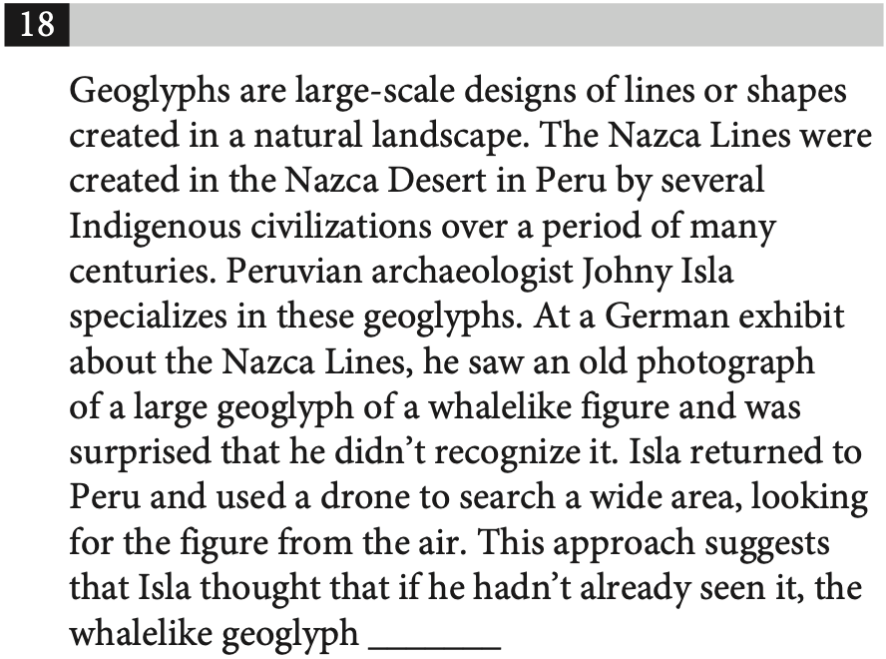
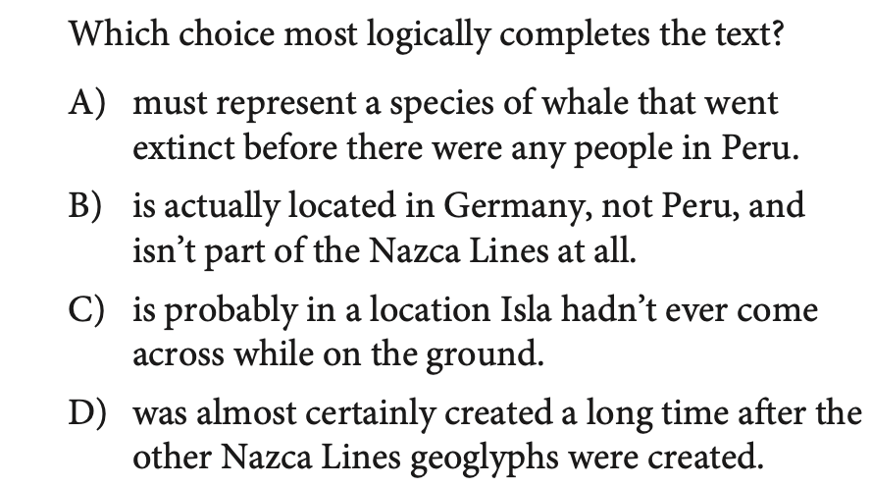
INFERENCES
ACCEPTED
ADMISSIONS
PRACTICE 16
TRY IT FIRST
SAT PREP III / INFORMATION & IDEAS
41

Slide 42
INFERENCES
ACCEPTED
ADMISSIONS
REVIEW 16
ANSWER CHECK
SAT PREP III / INFORMATION & IDEAS
42

Slide 43
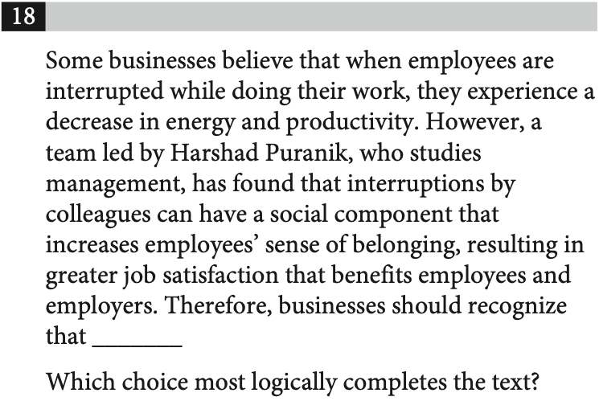
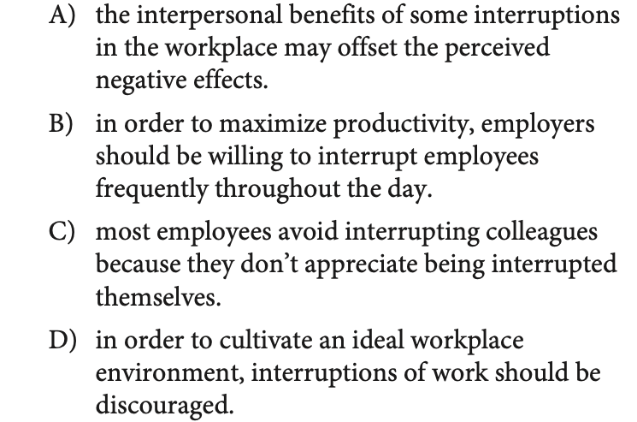
INFERENCES
ACCEPTED
ADMISSIONS
PRACTICE 17
TRY IT FIRST
SAT PREP III / INFORMATION & IDEAS
43

Slide 44
INFERENCES
ACCEPTED
ADMISSIONS
REVIEW 17
ANSWER CHECK
SAT PREP III / INFORMATION & IDEAS
44

Slide 45
SKILL FRAMEWORK
ACCEPTED
ADMISSIONS
Command of Evidence
Textual Evidence
Quantitative Evidence
Which finding or quotation supports or challenges the claim?
Which table or graph detail strengthens the conclusion?
SAT PREP III / INFORMATION & IDEAS
45

Slide 46
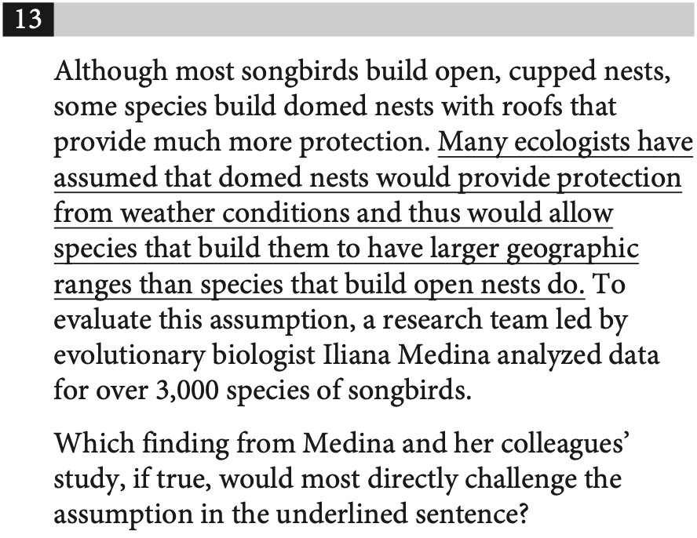
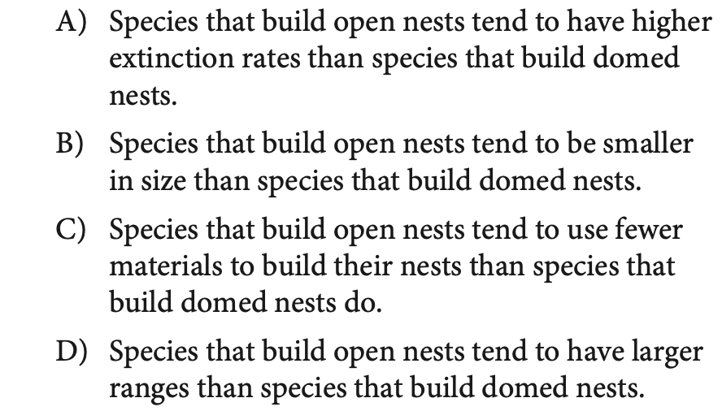
COMMAND OF EVIDENCE
ACCEPTED
ADMISSIONS
PRACTICE 18
TRY IT FIRST
SAT PREP III / INFORMATION & IDEAS
46

Slide 47
COMMAND OF EVIDENCE
ACCEPTED
ADMISSIONS
REVIEW 18
ANSWER CHECK
SAT PREP III / INFORMATION & IDEAS
47

Slide 48
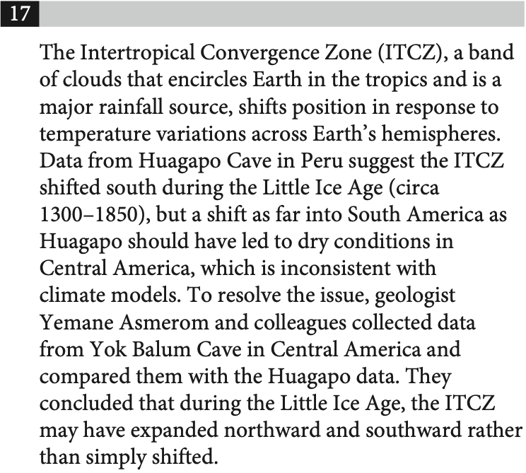
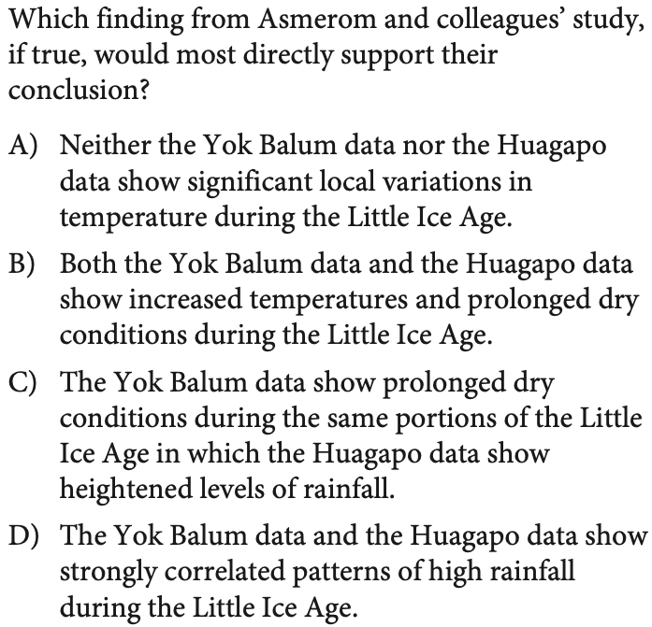
COMMAND OF EVIDENCE
ACCEPTED
ADMISSIONS
PRACTICE 19
TRY IT FIRST
SAT PREP III / INFORMATION & IDEAS
48

Slide 49
COMMAND OF EVIDENCE
ACCEPTED
ADMISSIONS
REVIEW 19
ANSWER CHECK
SAT PREP III / INFORMATION & IDEAS
49

Slide 50
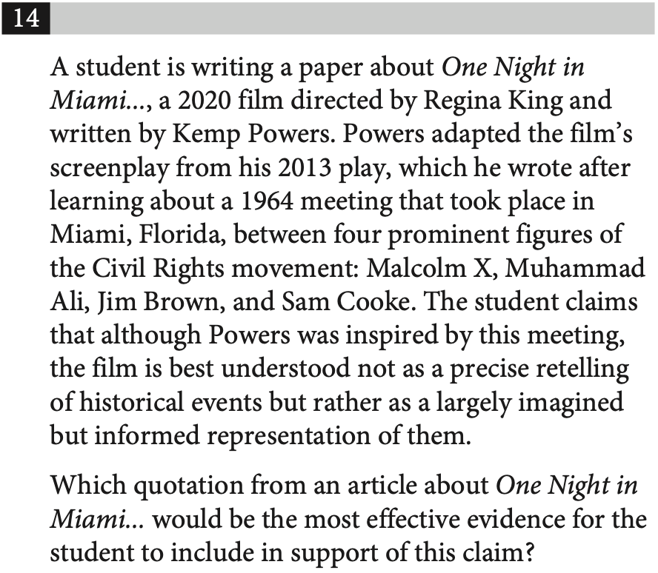
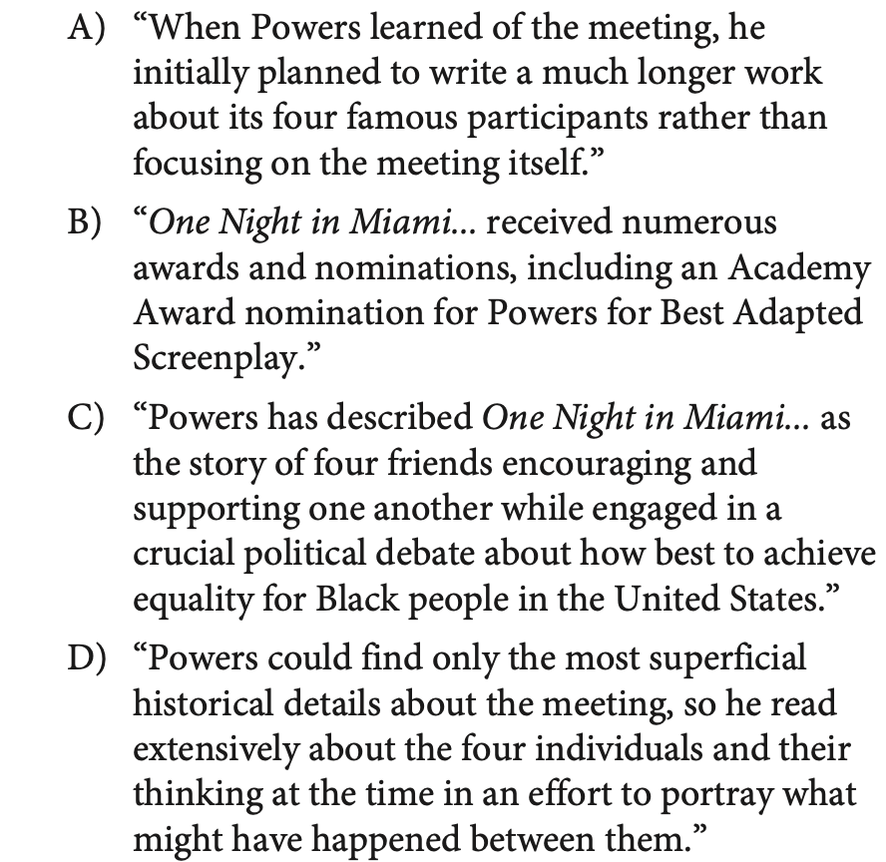
COMMAND OF EVIDENCE
ACCEPTED
ADMISSIONS
PRACTICE 20
TRY IT FIRST
SAT PREP III / INFORMATION & IDEAS
50

Slide 51
COMMAND OF EVIDENCE
ACCEPTED
ADMISSIONS
REVIEW 20
ANSWER CHECK
SAT PREP III / INFORMATION & IDEAS
51

Slide 52
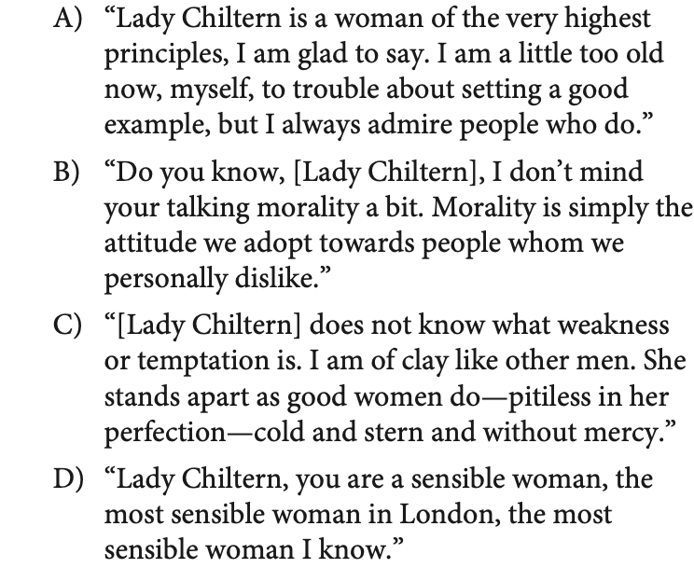
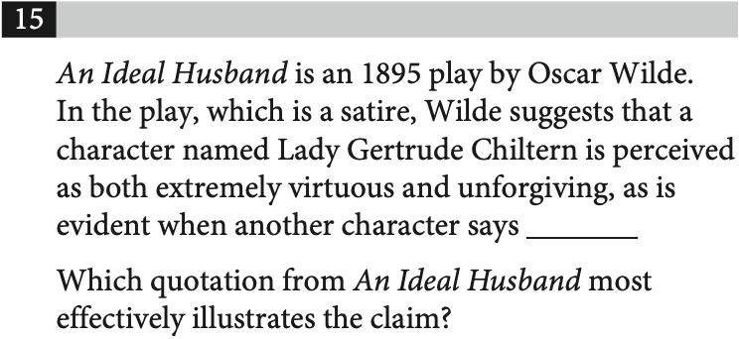
COMMAND OF EVIDENCE
ACCEPTED
ADMISSIONS
PRACTICE 21
TRY IT FIRST
SAT PREP III / INFORMATION & IDEAS
52

Slide 53
COMMAND OF EVIDENCE
ACCEPTED
ADMISSIONS
REVIEW 21
ANSWER CHECK
SAT PREP III / INFORMATION & IDEAS
53

Slide 54
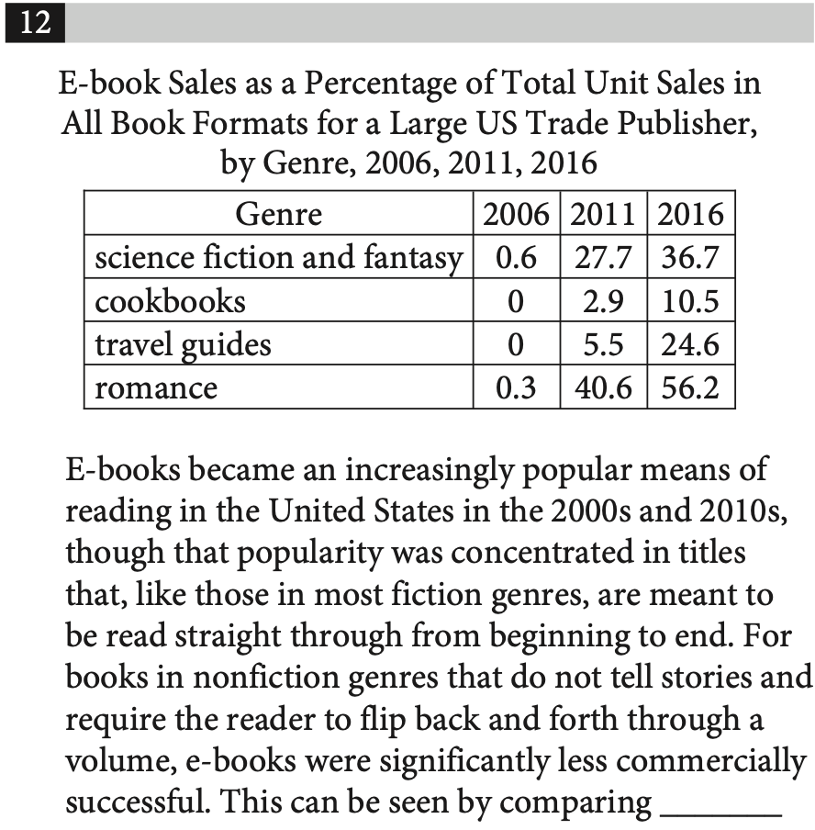
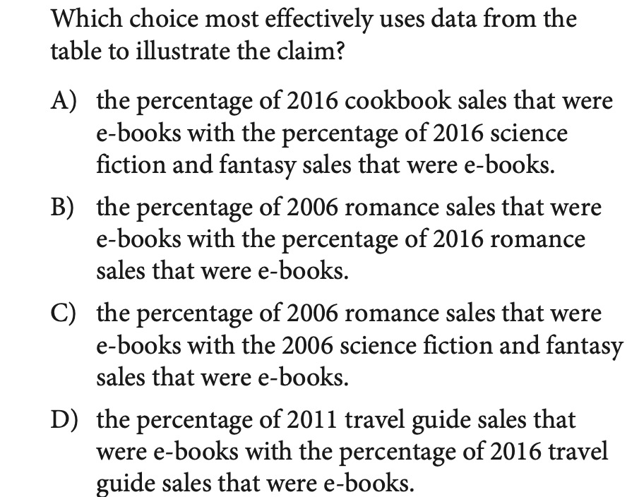
COMMAND OF EVIDENCE
ACCEPTED
ADMISSIONS
PRACTICE 22
TRY IT FIRST
SAT PREP III / INFORMATION & IDEAS
54

Slide 55
COMMAND OF EVIDENCE
ACCEPTED
ADMISSIONS
REVIEW 22
ANSWER CHECK
SAT PREP III / INFORMATION & IDEAS
55

Slide 56
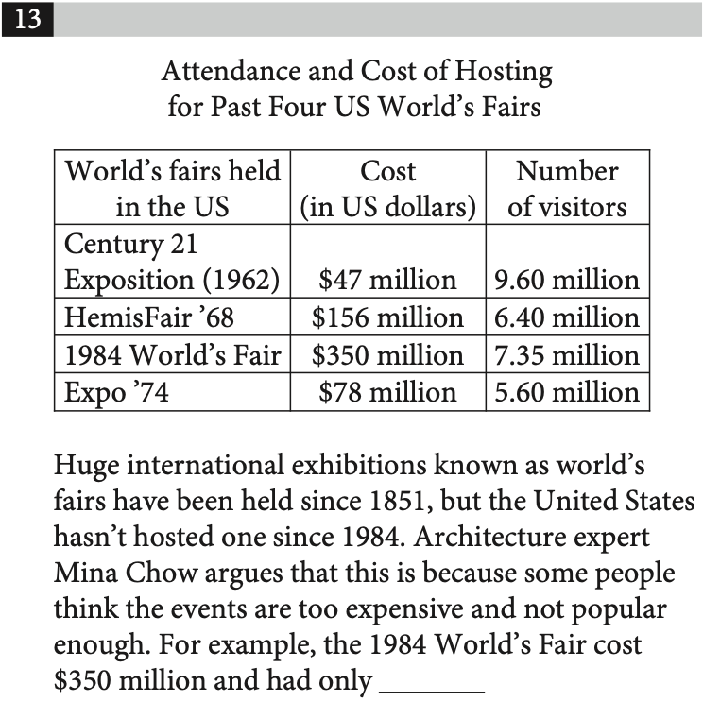
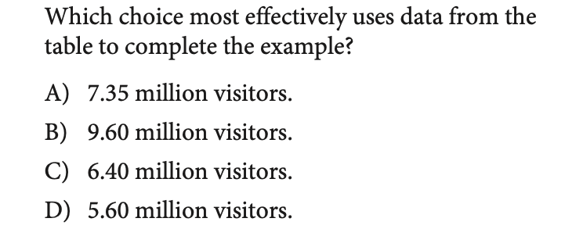
COMMAND OF EVIDENCE
ACCEPTED
ADMISSIONS
PRACTICE 23
TRY IT FIRST
SAT PREP III / INFORMATION & IDEAS
56

Slide 57
COMMAND OF EVIDENCE
ACCEPTED
ADMISSIONS
REVIEW 23
ANSWER CHECK
SAT PREP III / INFORMATION & IDEAS
57

Slide 58
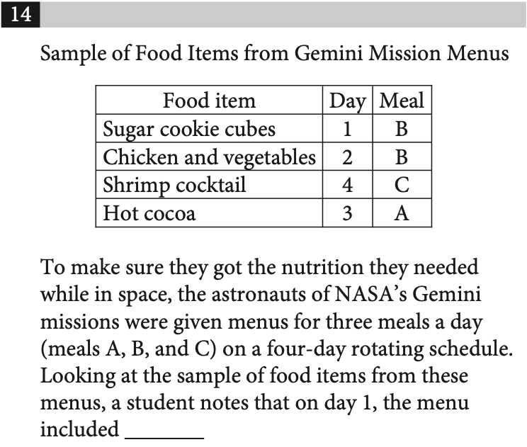
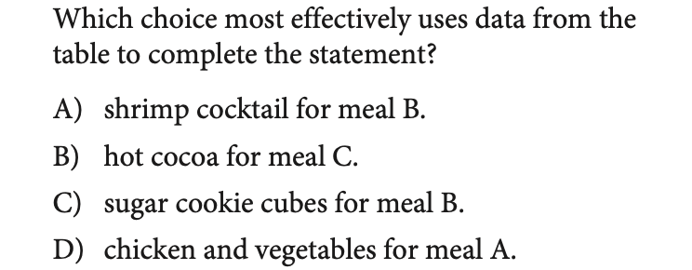
COMMAND OF EVIDENCE
ACCEPTED
ADMISSIONS
PRACTICE 24
TRY IT FIRST
SAT PREP III / INFORMATION & IDEAS
58

Slide 59
COMMAND OF EVIDENCE
ACCEPTED
ADMISSIONS
REVIEW 24
ANSWER CHECK
SAT PREP III / INFORMATION & IDEAS
59

Slide 60
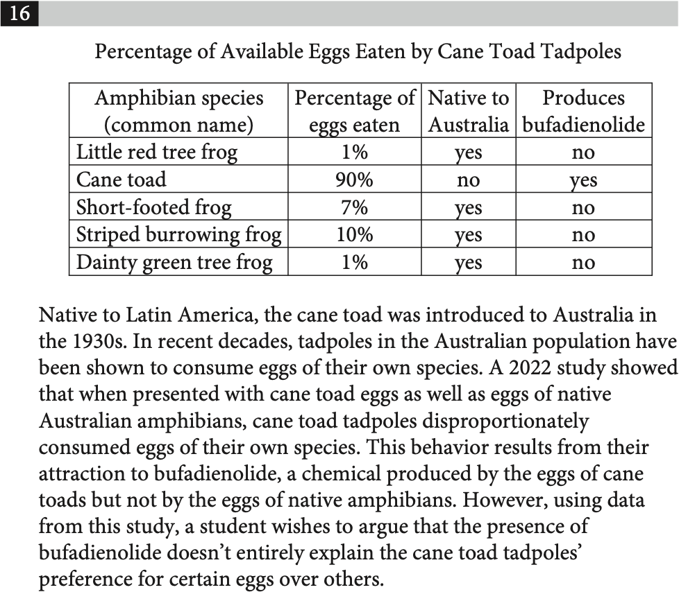
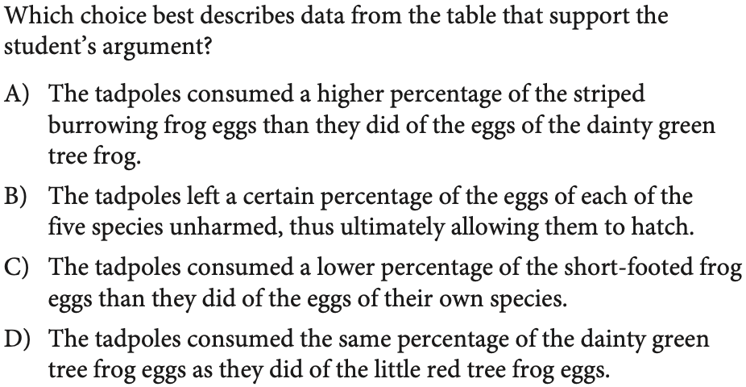
COMMAND OF EVIDENCE
ACCEPTED
ADMISSIONS
PRACTICE 25
TRY IT FIRST
SAT PREP III / INFORMATION & IDEAS
60

Slide 61
COMMAND OF EVIDENCE
ACCEPTED
ADMISSIONS
REVIEW 25
ANSWER CHECK
SAT PREP III / INFORMATION & IDEAS
61

Slide 62
ACCEPTED
ADMISSIONS
REVIEW & RETAIN
What will you remember
next time?
Explain one strategy that helped you reject a tempting wrong answer.
SAT PREP III / INFORMATION & IDEAS
62

